Slide 1
Transport Analysis
Intelligent Public Transport Analytics Platform
Digital Egypt Pioneers Initiative (DEPI)
AI & Data Science Track • Graduation Project
Notes:
Good morning. We present Transport Analysis — an end-to-end data and AI platform for public transport intelligence, developed under DEPI.

Slide 2
Our Team
Ahmed El-Gamal | Youssef Mustafa | Maryam Khaled
Mariam Tarek | Mostafa Fouad | Nada Ahmed
Transport Analysis | Digital Egypt Pioneers Initiative (DEPI)
Notes:
Our team collaborated across data engineering, analytics, BI, and project management roles to deliver every milestone.

Slide 3
Agenda
Problem Statement & Project Vision
Solution Architecture & Technology Stack
Data Pipeline: Ingestion → ETL → SQL Warehouse
Machine Learning & Predictive Analytics
Results, Insights & Live Dashboard Demo
Impact, Challenges & Future Work
Transport Analysis | Digital Egypt Pioneers Initiative (DEPI)
Notes:
We will walk from the business problem to the technical solution, show results, and demo the interactive dashboard.

Slide 4
Problem Statement
Why this project matters
Transport operators collect massive trip data but struggle to extract timely insights
Manual spreadsheets cannot scale to thousands of trips and multiple variables
Delays, revenue leakage, and peak-hour congestion need data-driven responses
Decision-makers need one trusted pipeline: clean data → analytics → predictions → dashboard
Transport Analysis | Digital Egypt Pioneers Initiative (DEPI)
Notes:
The core problem is turning raw transport CSV data into actionable intelligence at scale — not just storing numbers.

Slide 5
Project Objectives
Analyze large public transport datasets and extract meaningful patterns
Build a scalable batch ETL pipeline (Bronze → Silver → Gold)
Run SQL warehouse analytics for operational and strategic KPIs
Apply machine learning to predict fares, delays, and trip segments
Deliver an interactive dashboard for non-technical stakeholders
Transport Analysis | Digital Egypt Pioneers Initiative (DEPI)
Notes:
These objectives align directly with DEPI milestones: ingestion, development, deployment, automation, and presentation.

Slide 6
Solution Architecture
End-to-end data flow
CSV Ingestion
Batch ETL PySpark / Pandas
SQL Warehouse
Machine Learning
Streamlit Dashboard
Modular Python codebase — each stage runs independently or as one pipeline
Automated reports, metrics JSON, and Parquet layers for reproducibility
Transport Analysis | Digital Egypt Pioneers Initiative (DEPI)
Notes:
Data flows from raw CSV through ETL layers into SQL analytics and ML, ending in a live Streamlit dashboard.

Slide 7
Technology Stack
Data Processing | Python, Pandas, PySpark
Storage & ETL | CSV, Parquet, SQLite Warehouse
Analytics | SQL, scikit-learn
Visualization | Matplotlib, Seaborn, Plotly, Streamlit
Automation | Batch pipeline, JSON reports, scheduled re-runs
Transport Analysis | Digital Egypt Pioneers Initiative (DEPI)
Notes:
We used industry-standard tools — the same categories used in cloud warehouses and modern data teams.

Slide 8
Batch ETL Pipeline
Medallion architecture
Bronze
Raw transport_trips.csv
Silver
Cleaned + features (speed, revenue/km)
Gold
Daily summaries by vehicle, zone, date
Transport Analysis | Digital Egypt Pioneers Initiative (DEPI)
Notes:
Bronze keeps raw data, Silver adds engineered features, Gold delivers business-ready aggregates for executives.

Slide 9
SQL Warehouse Analytics
6 analytical queries on SQLite (simulating BigQuery / Snowflake / Redshift)
Revenue by vehicle type and average fare by zone
Delay rate by traffic level and weather impact
Peak-hour demand analysis for capacity planning
Outputs saved to sql/analytics_queries.sql and reports/sql_analytics.json
Transport Analysis | Digital Egypt Pioneers Initiative (DEPI)
Notes:
SQL answers the business questions stakeholders ask every day — revenue, delays, peaks, and zones.

Slide 10
Machine Learning Layer
Predictive intelligence
Fare Regression — predict trip fare from distance, vehicle, zone, traffic, weather
Performance: R² = 0.981, MAE = $1.91
Delay Classification — predict whether a trip will be delayed
Performance: Accuracy = 77.9%
Trip Segmentation (K-Means) — silhouette = 0.323
Transport Analysis | Digital Egypt Pioneers Initiative (DEPI)
Notes:
ML moves the project from descriptive analytics to predictive intelligence — forecasting fare and delay risk.

Slide 11
Key Results & KPIs
5,000
Trips Analyzed
$28.18
Avg Fare
30.7%
Delay Rate
Airport
Top Fare Zone
Taxi
Top Revenue Vehicle
Transport Analysis | Digital Egypt Pioneers Initiative (DEPI)
Notes:
These KPIs prove the pipeline works end-to-end on real-scale sample data with meaningful business metrics.

Slide 12
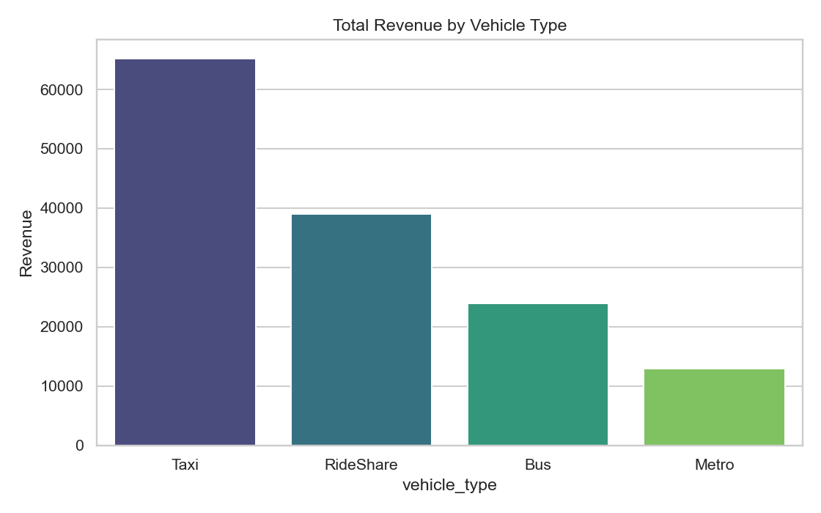
Revenue Analysis
Key Insight
Taxi generates the highest total revenue, making it critical for fare optimization.
Transport Analysis | Digital Egypt Pioneers Initiative (DEPI)
Notes:
Point out taxi bar height vs bus and metro — revenue vs volume trade-off.

Slide 13
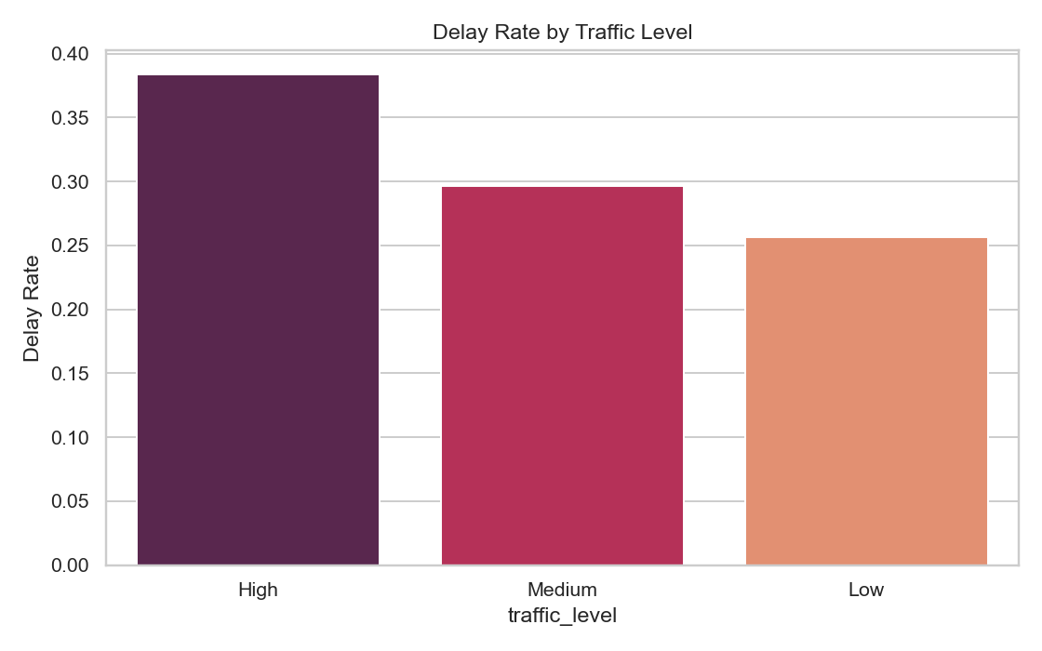
Operational Risk: Delays
Key Insight
High traffic shows the strongest delay rate — target congestion hotspots first.
Transport Analysis | Digital Egypt Pioneers Initiative (DEPI)
Notes:
Emphasize operations value — this supports staffing and routing decisions.

Slide 14
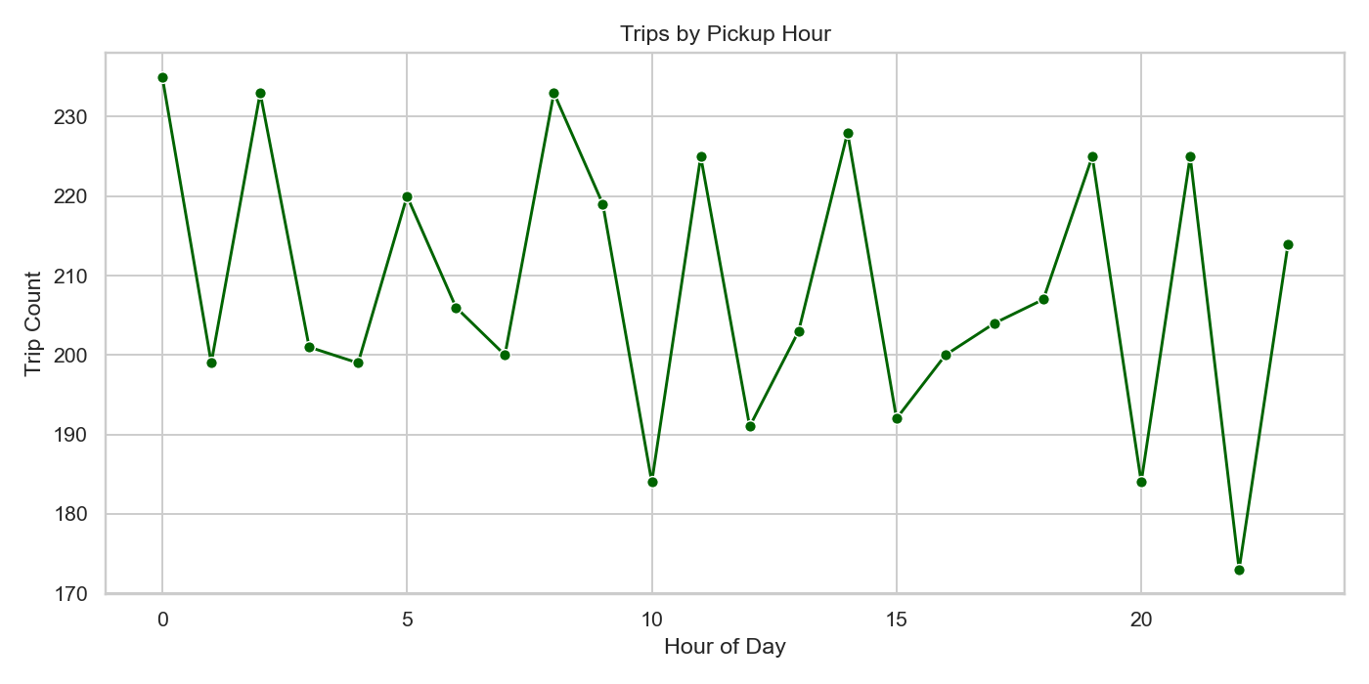
Demand Planning
Key Insight
Clear morning and evening peaks enable smarter fleet scheduling.
Transport Analysis | Digital Egypt Pioneers Initiative (DEPI)
Notes:
Connect to business: deploy more vehicles before peaks, reduce off-peak waste.

Slide 15
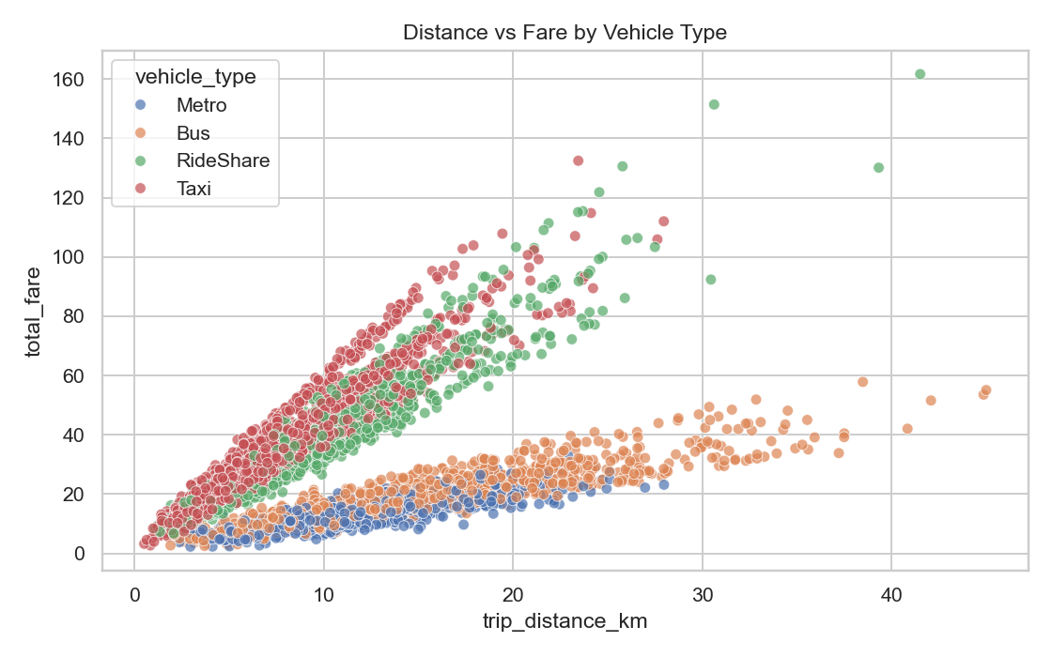
Fare Intelligence
Key Insight
Fare scales with distance but varies by vehicle type — supports dynamic pricing.
Transport Analysis | Digital Egypt Pioneers Initiative (DEPI)
Notes:
Show scatter clusters — different vehicle types, different economics.

Slide 16
Strategic Insights
Airport and downtown zones command premium fares — pricing strategy opportunity
Taxi leads total revenue; metro and bus serve volume and accessibility
High traffic increases delays to ~38% — prioritize congestion management
Peak hours (7–9 AM, 5–7 PM) show predictable demand surges
Weather (rain/fog) amplifies delay risk — useful for proactive scheduling
Transport Analysis | Digital Egypt Pioneers Initiative (DEPI)
Notes:
These insights are actionable — not just charts. They guide pricing, fleet allocation, and operations.

Slide 17
Interactive Dashboard Demo
Streamlit Web Application
Launch: py -m streamlit run dashboard.py
Live KPIs: trips, fare, distance, delay rate, revenue
Filters: vehicle, zone, traffic, weather, date range
Interactive Plotly charts update instantly
Trip-level drill-down table for validation
Transport Analysis | Digital Egypt Pioneers Initiative (DEPI)
Notes:
Live demo: open localhost:8501, filter by High traffic, show delay rate spike. This is the executive-facing layer.

Slide 18
Challenges & Solutions
Large dataset handling | PySpark ETL with Pandas fallback
Data quality issues | Automated cleaning in Silver layer
Stakeholder accessibility | Streamlit dashboard — no code required
Reproducibility | Single-command pipeline + versioned outputs
Transport Analysis | Digital Egypt Pioneers Initiative (DEPI)
Notes:
We designed for real-world constraints — environments without Java still run the full project.

Slide 19
Future Enhancements
Deploy to cloud warehouse (BigQuery / Snowflake) with scheduled batch jobs
Real-time streaming ingestion for live delay alerts
GPS route optimization and geospatial heatmaps
Mobile app for operators and executives
CI/CD automation and pipeline monitoring (MLOps)
Transport Analysis | Digital Egypt Pioneers Initiative (DEPI)
Notes:
This project is production-ready as a foundation — cloud deployment is the natural next step.

Slide 20
Thank You
Transport Analysis — From Data to Decisions
Questions & Live Demo
Notes:
Thank you for your time. We are ready for questions and a live dashboard demonstration.

