Slide 1
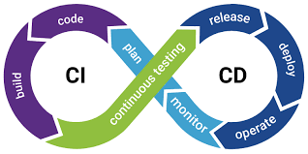
Continuous Integration/ Continuous delivery (CI/CD)
Presented By/
Ahmed Elgaml

Slide 2
Continuous Integration
The "CI" in CI/CD refers to continuous integration, which is an automation process for developers. Successful CI means new code changes to an app are regularly built, tested, and merged to a shared repository.
CI is a solution to the problem of having many developers who are working on an app in development at once that might conflict with each other.
CI gets the application features go faster to clients which will increase the revenue of the company.

Slide 3
continuous delivery
The "CD" in CI/CD refers to continuous delivery and/or continuous deployment, which are related concepts that sometimes get used interchangeably.
CD are about automating further stages of the pipeline, which means less human resources in the process (less cost), less errors due to human (Faster Delivery).

Slide 4
Why CI/CD
CI/CD can improve the consistency and quality of code where there will be less errors in the Applications.
CI/CD Improves flexibility and has the ability to ship new functionalities which will increase the revue by selling more.
CI/CD pipeline can streamline communication which will increase productivity of employees.
CI/CD can automate the process of software delivery where the process will require less resources and reduce cost.
CI/CD Helps you to achieve faster customer feedback where we will solve our problems faster.
CI/CD pipeline helps you to increase your product visibility.
CI/CD can make the software development lifecycle faster so satisfy the customer and increase selling.
A CD pipeline gives a rapid feedback loop starting from developer to client.
CI/CD Improves communications between organization employees which will increase productivity.

