Slide 1
Supervised By
Railway Reservation System
Dr. Maged Khafagy

Slide 2
Team Members
Muhammed
56305
Elsabahy
57658
Ahmed
56240
Amr
57474
Eslam
49962

Slide 3
AGENDA
1
2
3
4
5
Introduction
Motivations
Problem Definition
and Solution
Benefits & Drawback
Proposed System
6
7
8
9
10
Methodology
System Definition
Objective &Goals
Requirements
Related Works
11
System Analysis

Slide 4
Introduction
Overview

Slide 5
Motivations
Reduce Errors
Increase Security
Increase Productivity
Save Money
Increase Passenger Satisfaction

Slide 6
Solution
Problem Definition

Slide 7
Benefits Of Railway Reservation System
Easy to use
100%
Effective
100%
Reduce human errors
Efficient
Speed and more secured
100%
Time
Saving time
100%
Fast
Clear
More efficient
100%
Easy
More effective
100%

Slide 8
Drawbacks of
Railway Reservation System
Some of Railway Reservation Systems are very expensive

Slide 9
Proposed System
Stable
Fast
Secured
efficient

Slide 10
Methodology
1
Check Ticket Availability
2
Book Ticket
3
Fill Form
4
Pay Fare
6
5
Cancel Booking
Refund Money

Slide 11




Scenario
Website
Passenger
Confirm
Booking
Employee

Slide 12
System Definition
Web Host
Receiver Website
Sender Application
Sender website

Slide 13
GOALS AND OBJECTIVES

Slide 14




System Requirement(Software)
Photoshop
Android Studio
Sublime Text
ORACLE DATABASE

Slide 15


User Requirements
User Requirements

Slide 16
Related Works
Mobile Website For Railway Ticket Booking
London Train Station
Railway station Liverpool lime Street
IRCTC
ENR
LIV
Egypt Railway
China Train station

Slide 17
Software Life Cycle
Requirement gathering and analysis
Maintenance
Design
Deployment
Implementation
Testing

Slide 18
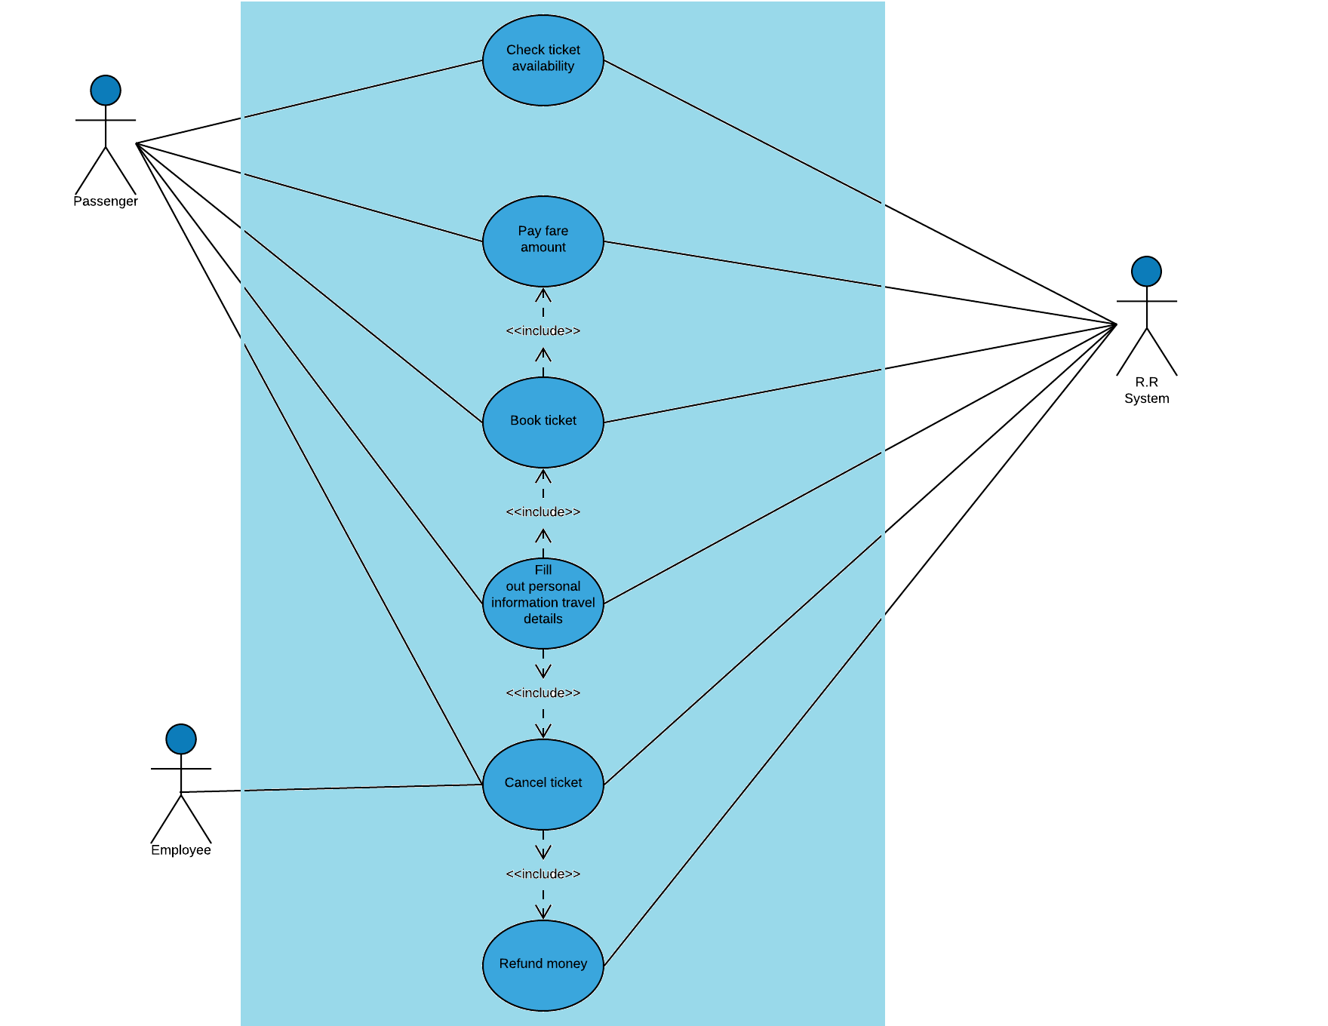
System Analyses
1- Usecase Diagram

Slide 19
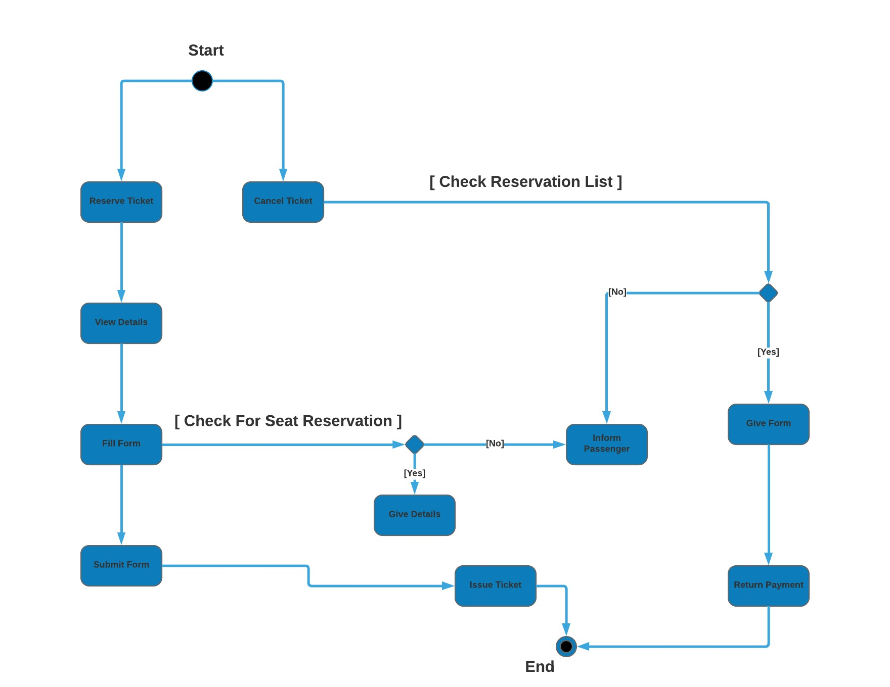
System Analyses
2- Activity Diagram

Slide 20
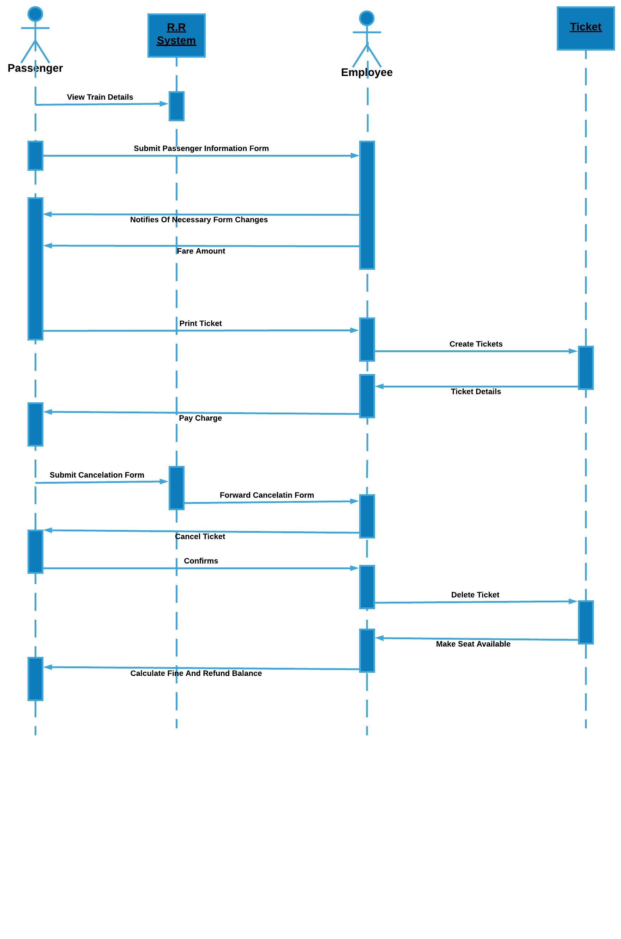
System Analyses
3- Sequence Diagram

Slide 21
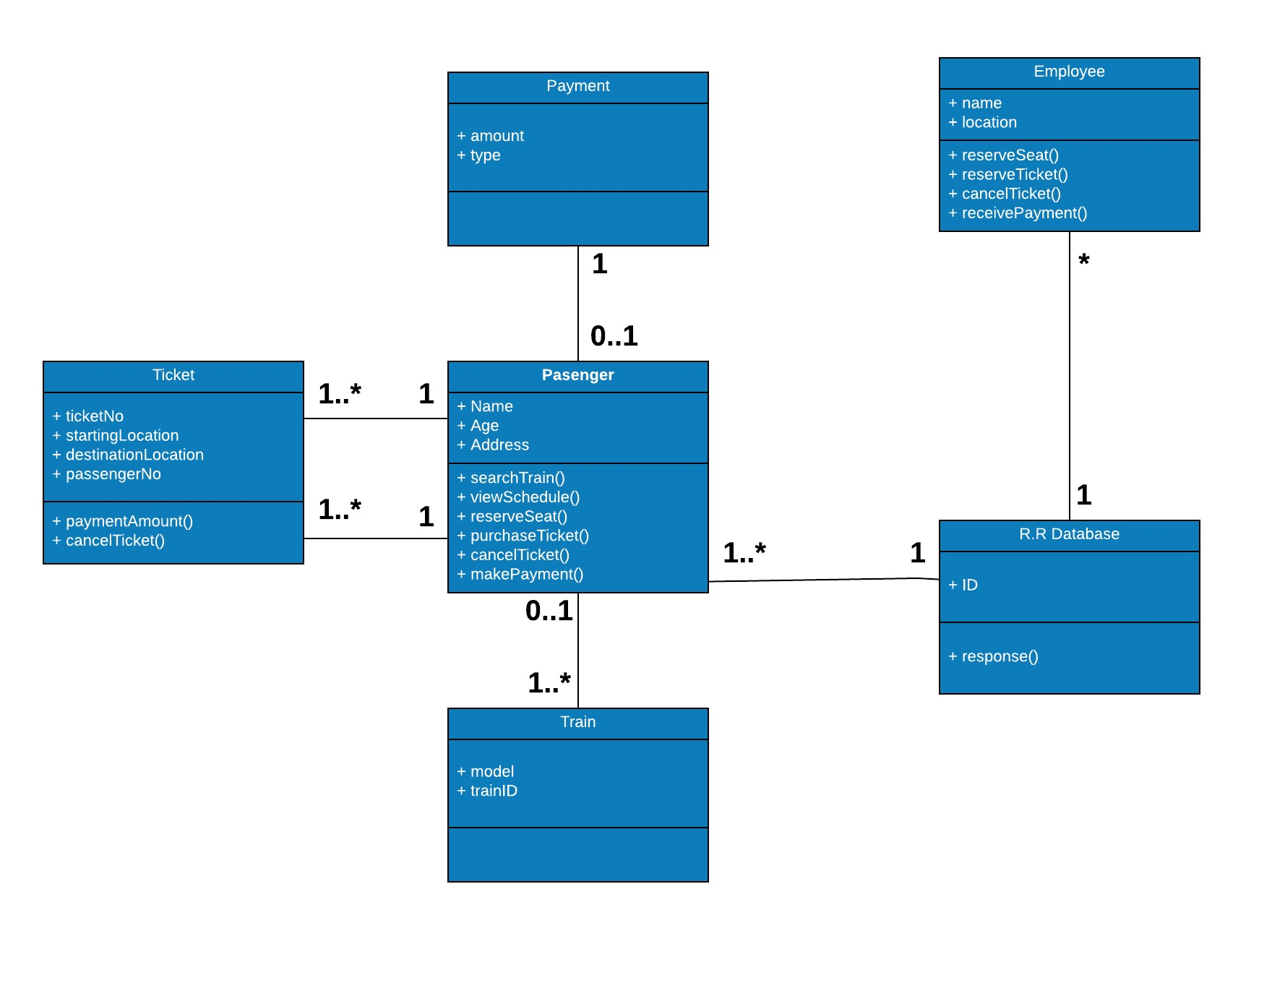
System Analyses
4- Class Diagram

Slide 22
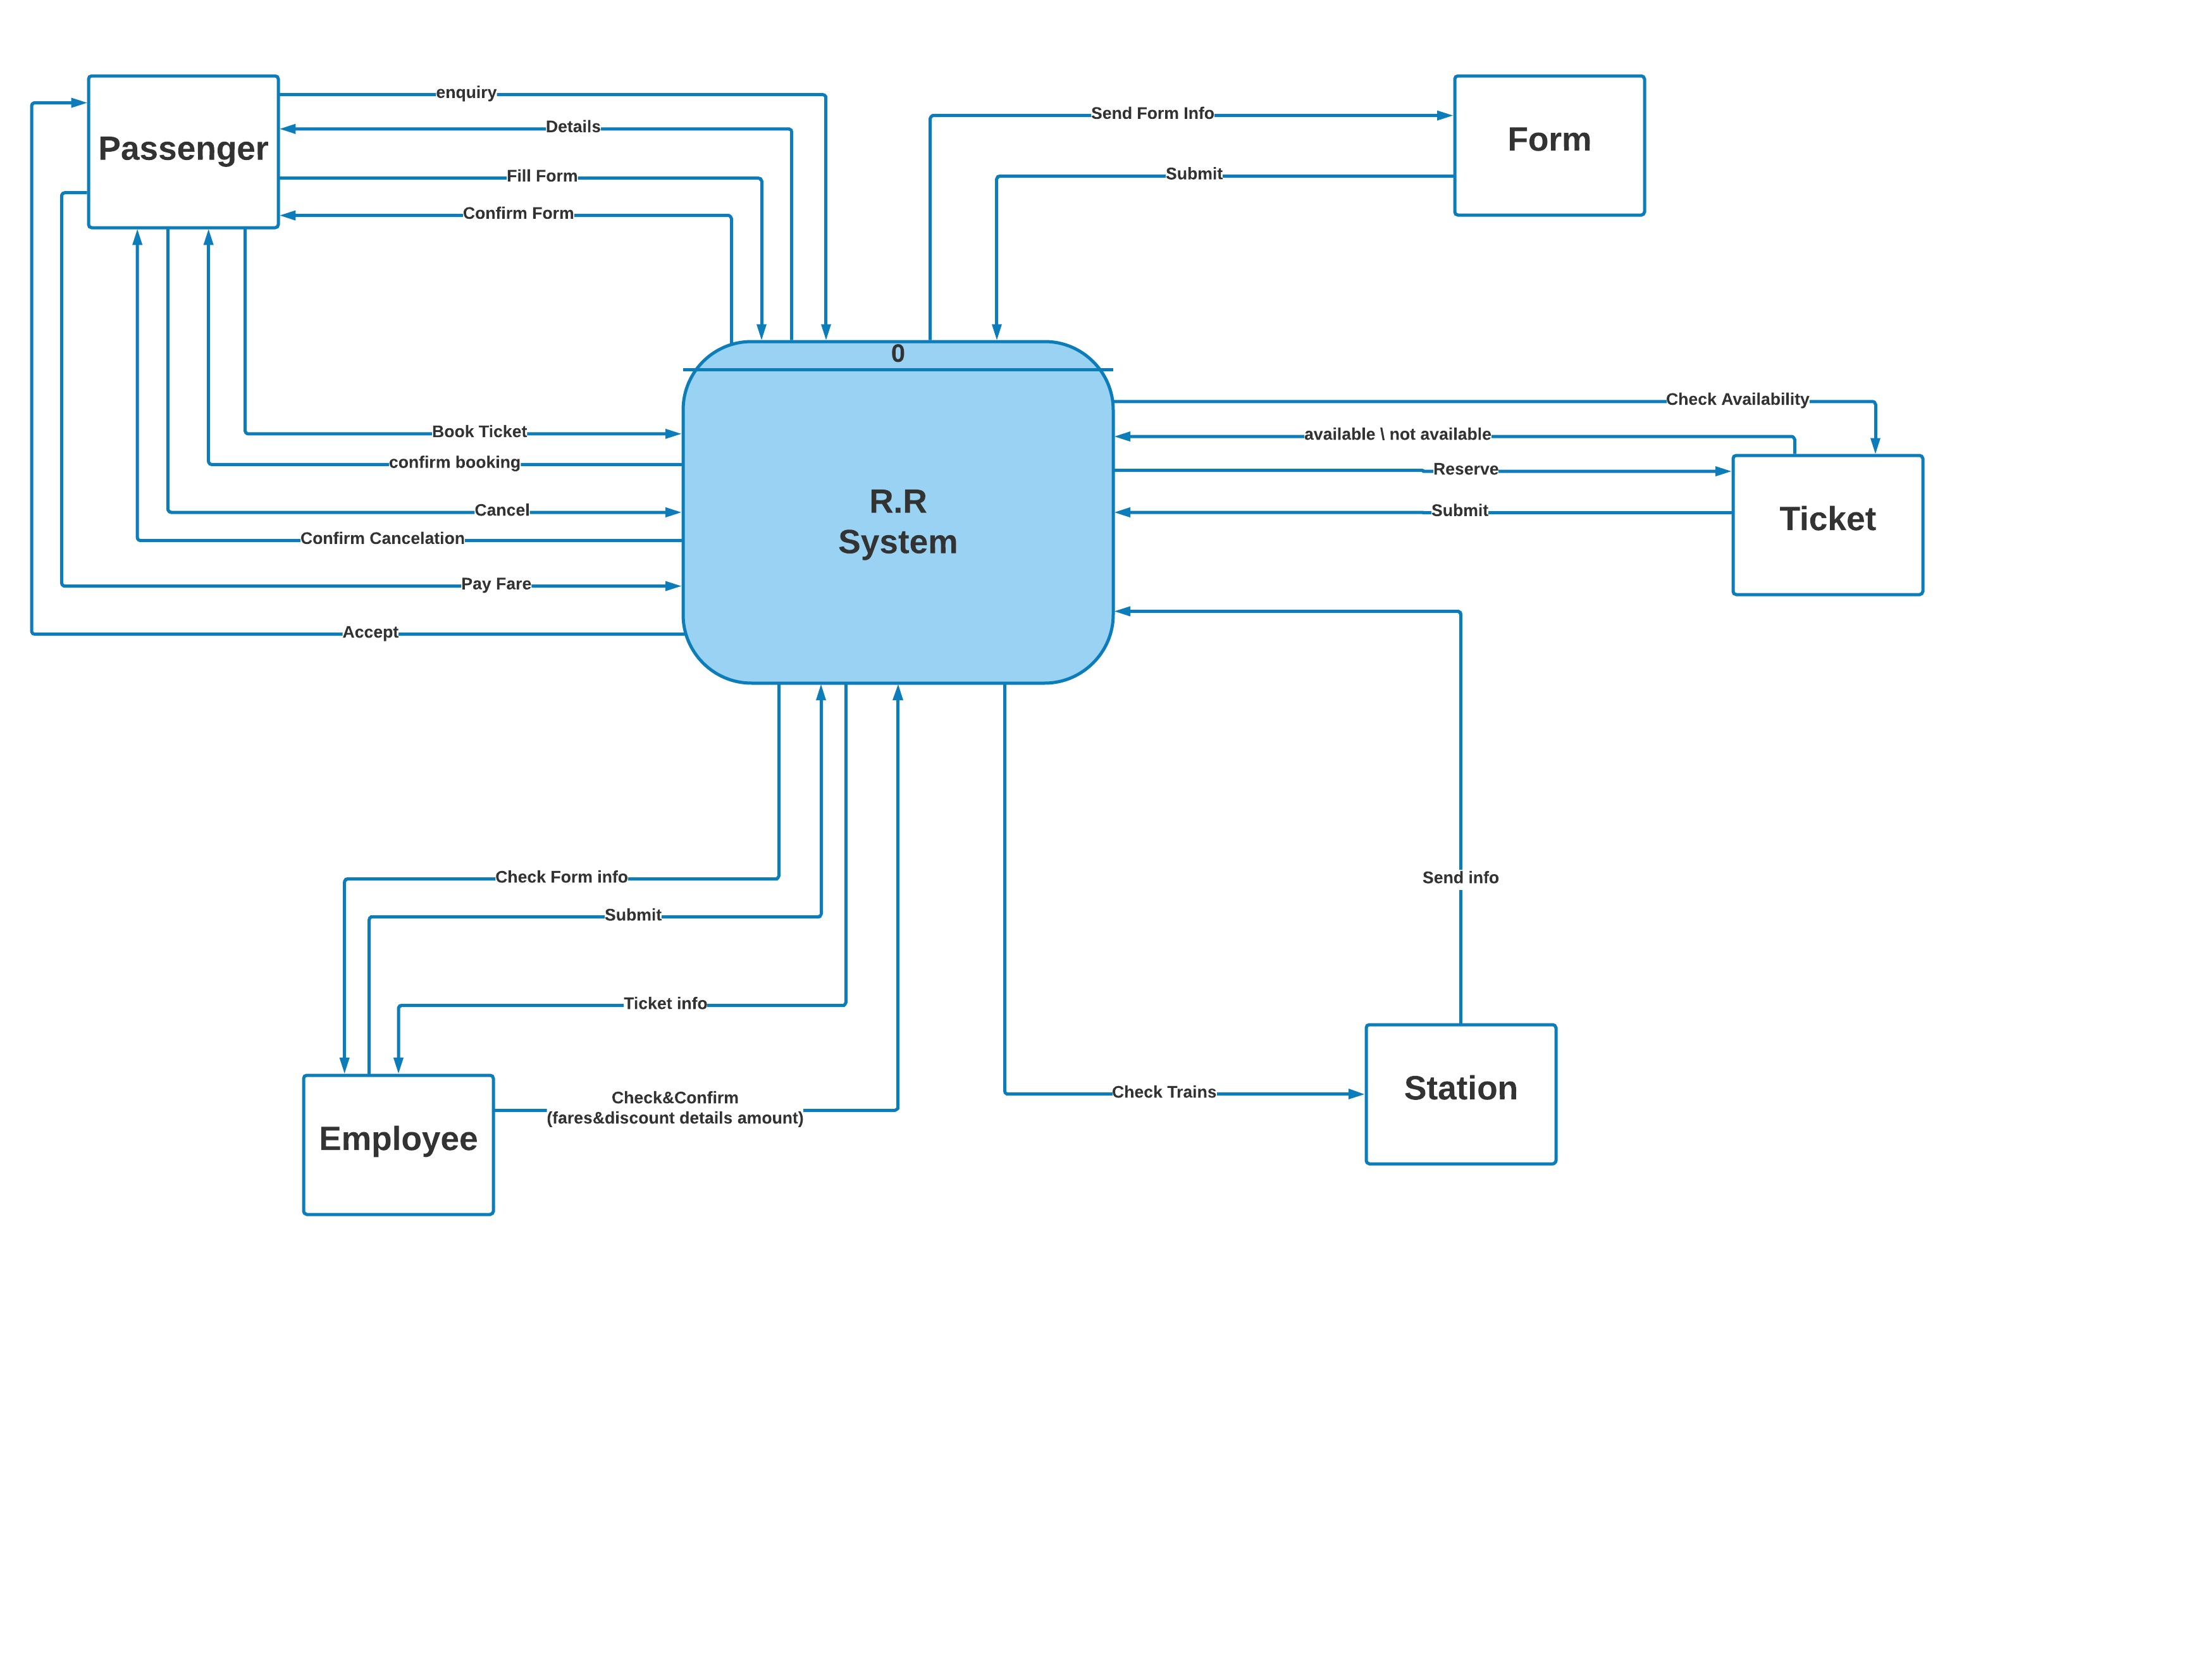
System Analyses
5- Dataflow Diagram
5.1 Context Diagram

Slide 23
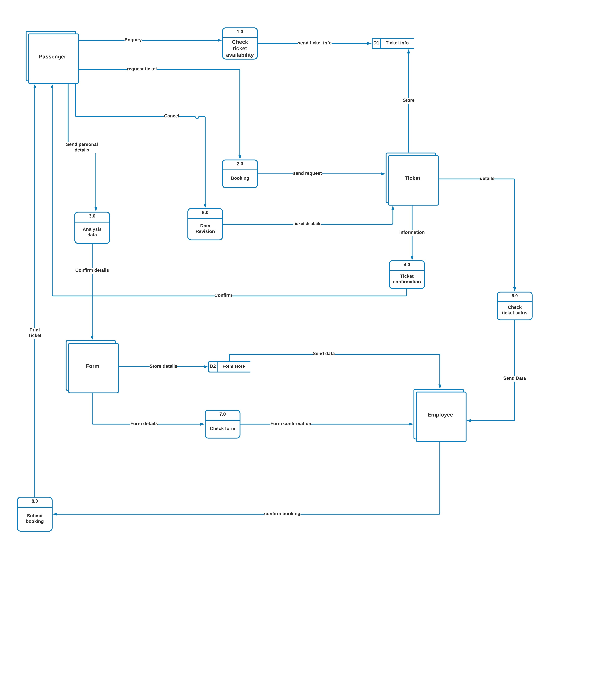
System Analyses
5- Dataflow Diagram
5.2 DFD Level 0

Slide 24
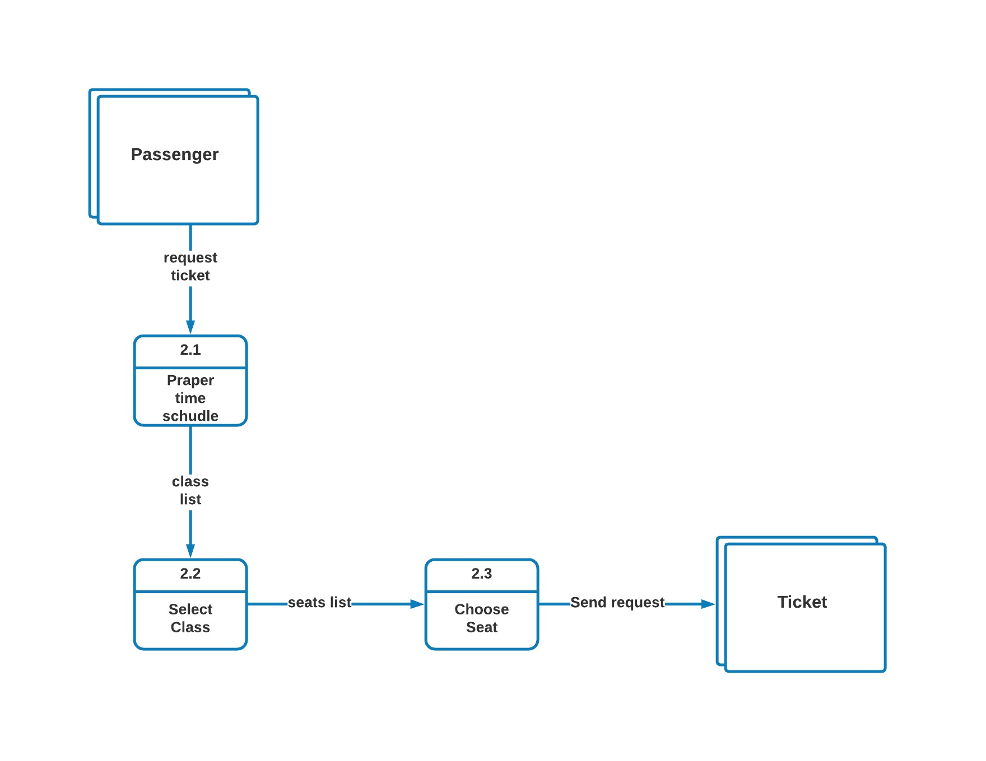
System Analyses
5- Dataflow Diagram
5.2 DFD Level (1 of 3)

Slide 25
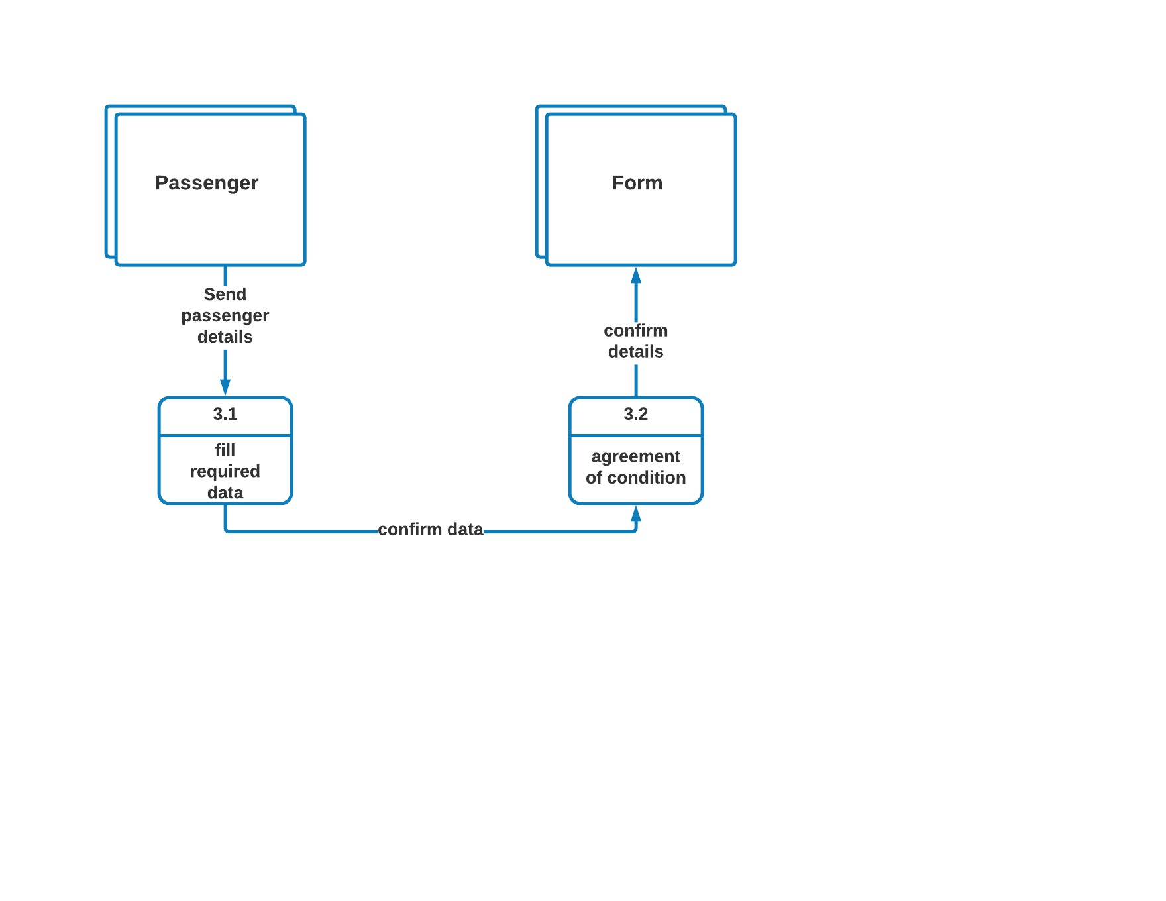
System Analyses
5- Dataflow Diagram
5.2 DFD Level (2 of 3)

Slide 26
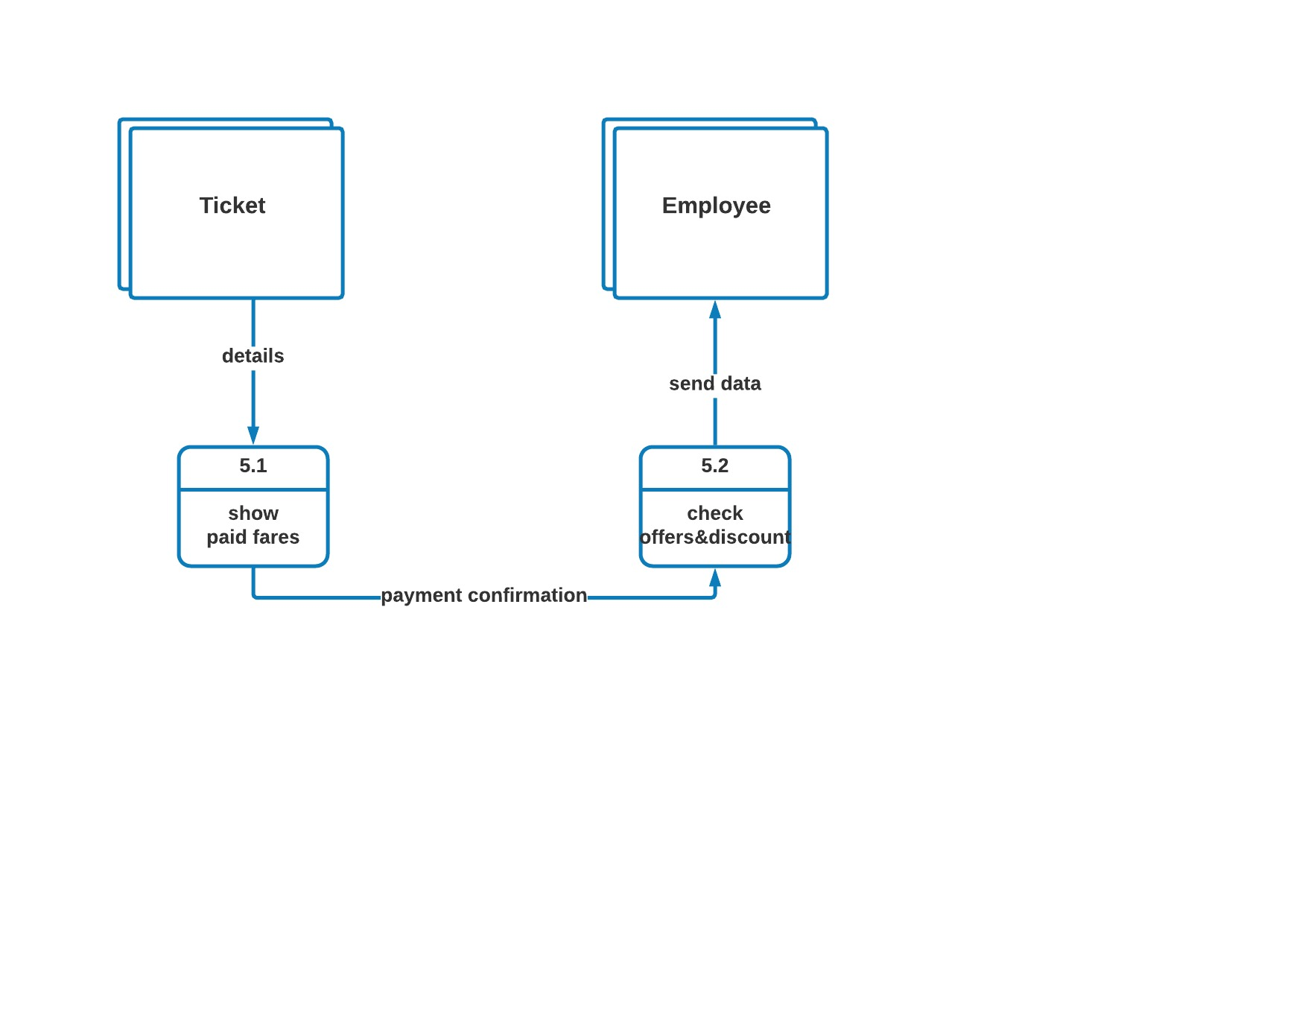
System Analyses
5- Dataflow Diagram
5.2 DFD Level (3 of 3)

