Slide 1

Data Analysis Superstore Project

Slide 2

Content
Introduction
Data Cleaning and Normalization
Questions and KPIs metrics
Create charts and visualizations
Creating Dashboard

Slide 3

Team members: Almoataz M. Gad | Abddelrahman Ali | Ahmed Adel |
Ahmed M. Elsafy

Slide 4
Introduction
In today’s competitive retail environment, data-driven decision-making is essential for optimizing sales performance and enhancing customer satisfaction. This project focuses on analyzing the sales data of a superstore to uncover key insights and trends that can drive strategic improvements. By leveraging tools such as Excel, SQL Server, and Tableau, we have examined various factors like product categories, customer demographics and sales performance. The goal is to identify patterns and opportunities that can inform decisions on inventory management, pricing strategies, and customer targeting to increase profitability and market reach.

Slide 5
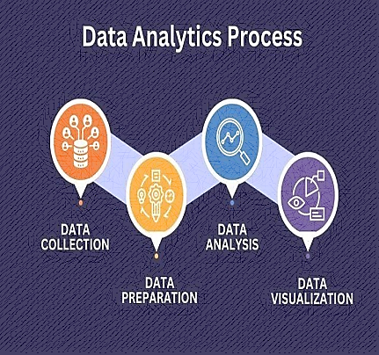
Introduction

Slide 6
Data Cleaning and Normalization
Data Cleaning is the first step in the project. And in my team’s opinion data cleaning process it the most important step.
Cleaned data is important to build high quality insights.
We used python programming language to achieve cleaned data.
We used python libraries like : Pandas ,Numpy and matplotlip.
Next screen show data cleaning process by python.

Slide 7
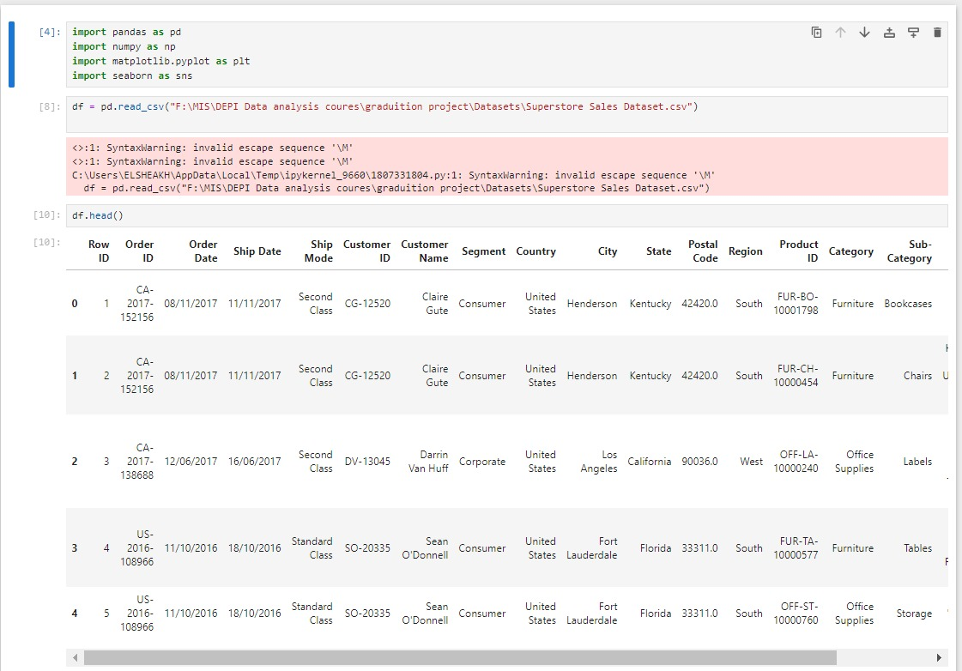
Data Cleaning and Normalization
Data cleaning step can be done by many tools, our team used python programming language. By using libraries like pandas and numpy as shown.

Slide 8
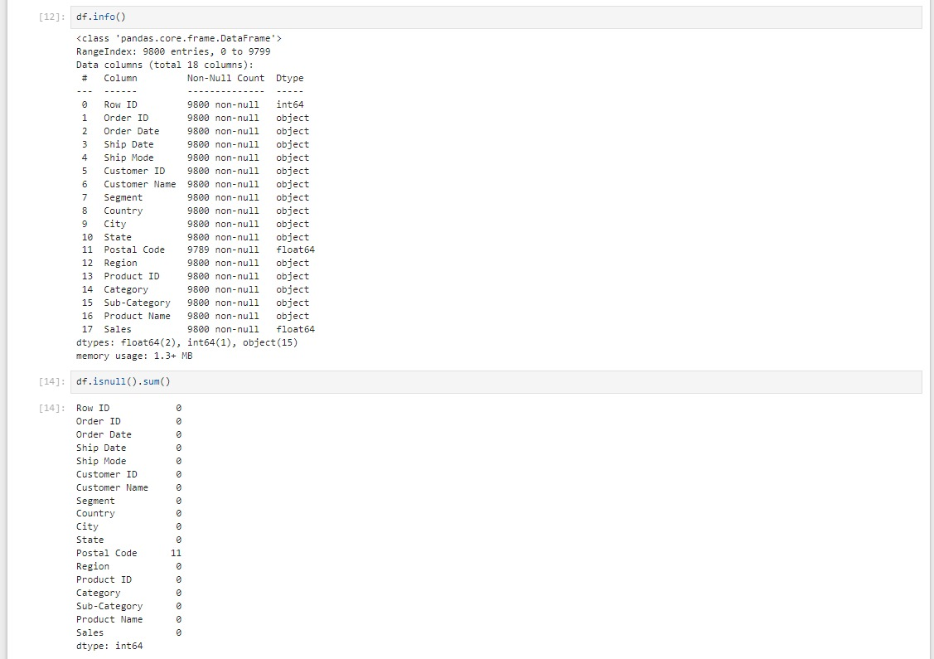
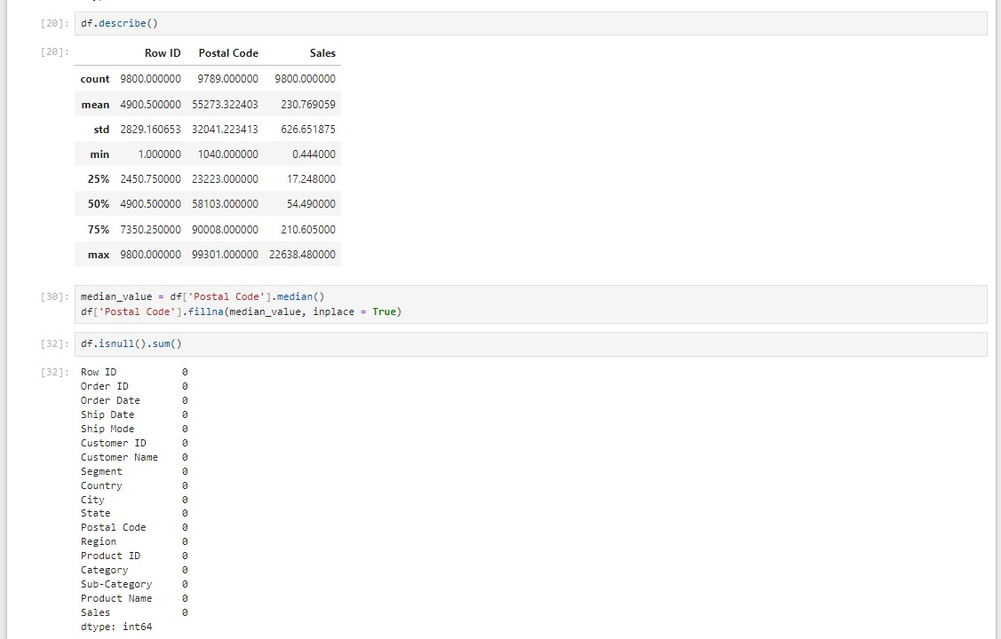
Data Cleaning and Normalization

Slide 9
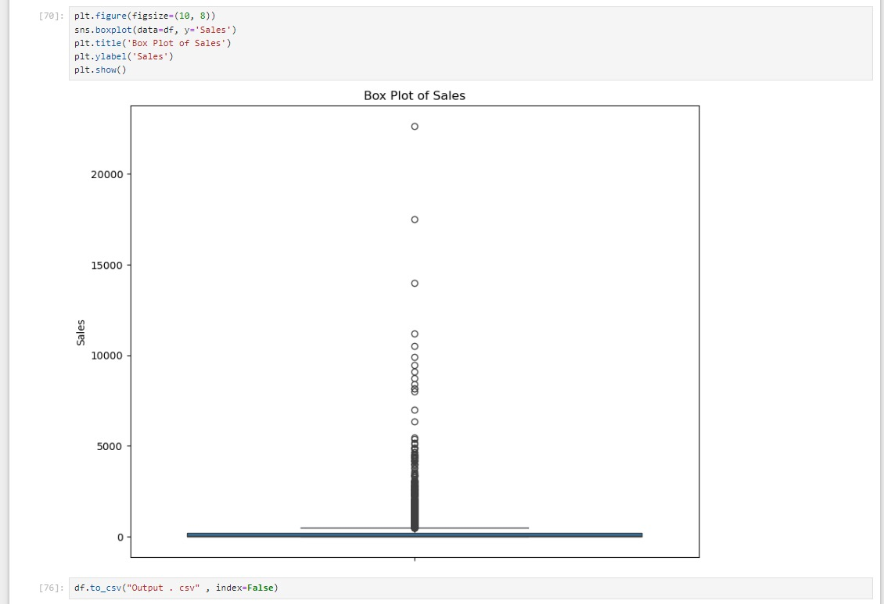
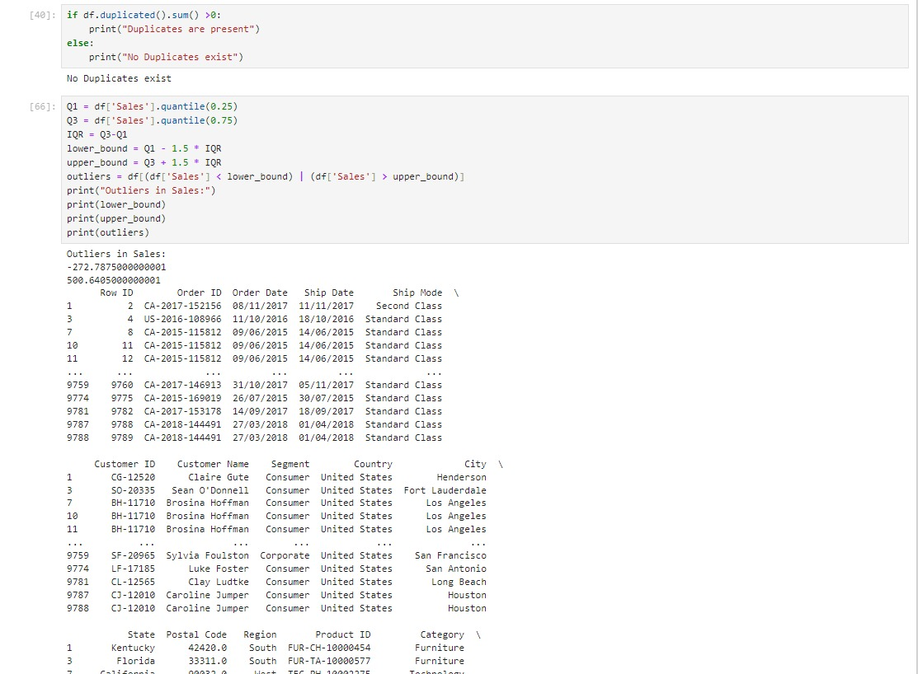
Data Cleaning and Normalization

Slide 10
Questions and KPIs metrics

Slide 11
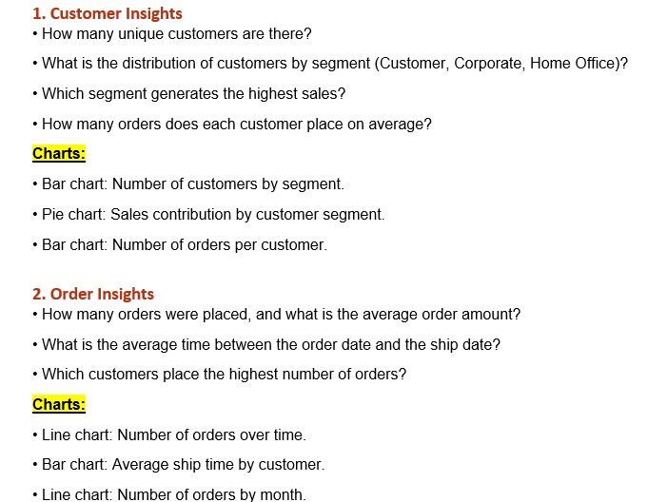
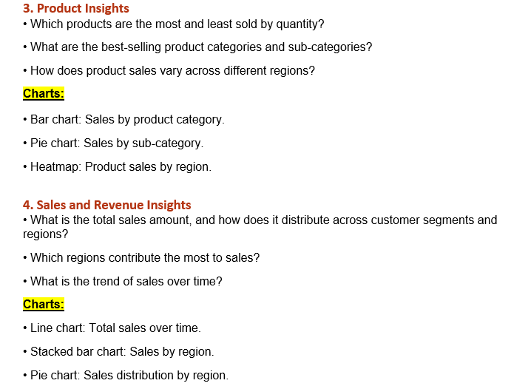
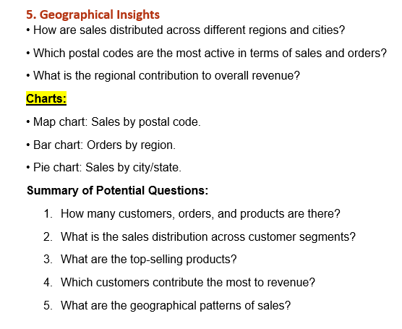
Questions and KPIs metrics

Slide 12
Create charts and visualizations

Slide 13
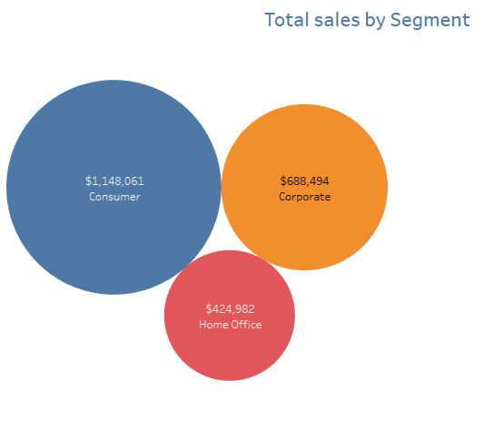
charts
In this Process our Team used tableau desktop.
Next, a few examples of charts
This chart shows amount of sales by Segment and it conclude that Consumer segment Is the most seller.

Slide 14
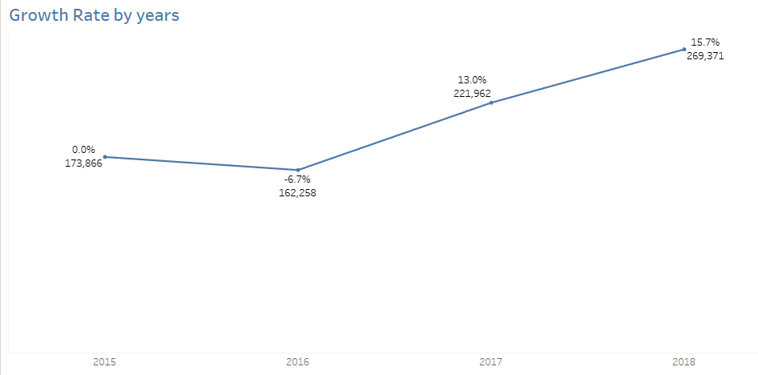
charts
The growth rate is one of the most important KPI that give us an idea about the performance of the store by years.

Slide 15
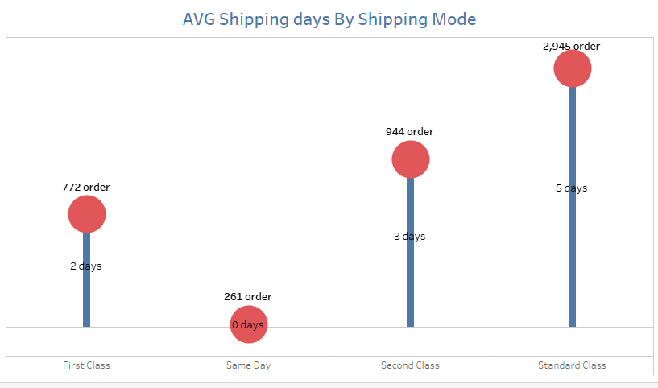
charts
Lollipop chart is amazing figure to show the relation between number of orders and shipping mode and average days top ship.

Slide 16
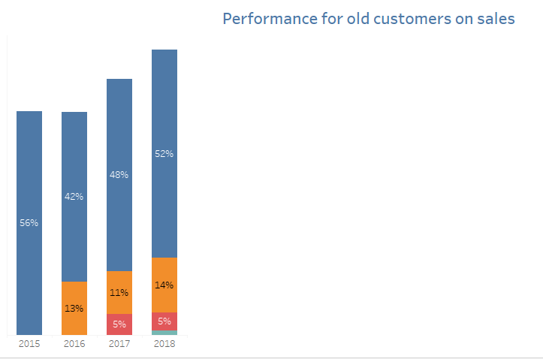
charts
This chart explains that old customers represented by blue color have the large scale in sales over years and represent the loyalty of the old customers

Slide 17
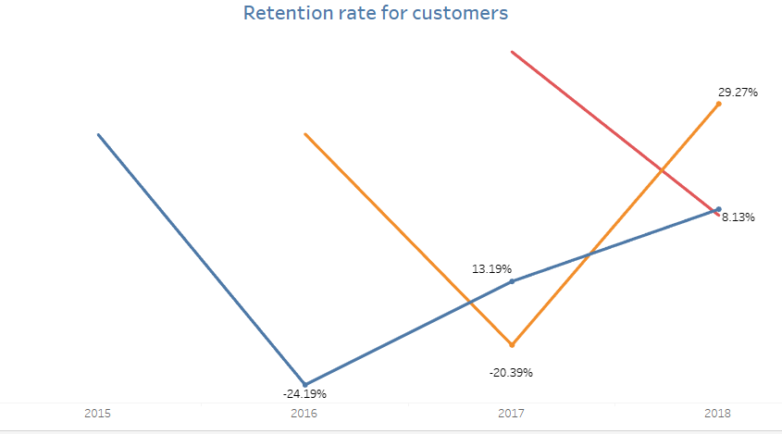
charts
Retention Rate also considering important metric to measure how satisfied the customers
If retention rate is high it means the same customers come again and make orders

Slide 18
Creating Dashboard

Slide 19
Creating Dashboard
The dashboard phase was divided into three reports.
Overview dashboard
Sales Report
Customer Performance

Slide 20
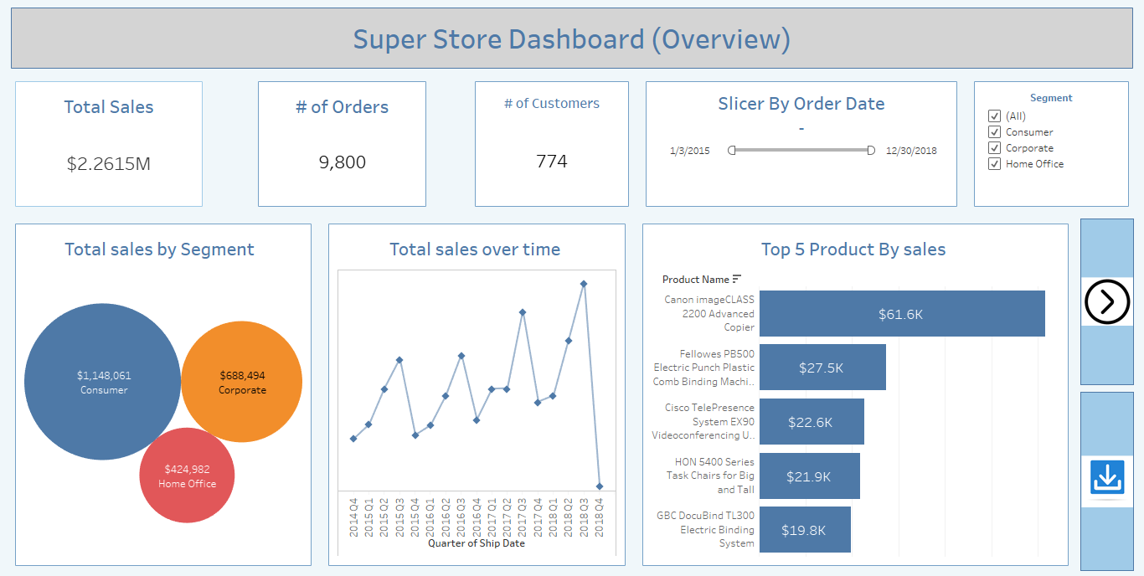
Creating Dashboard

Slide 21
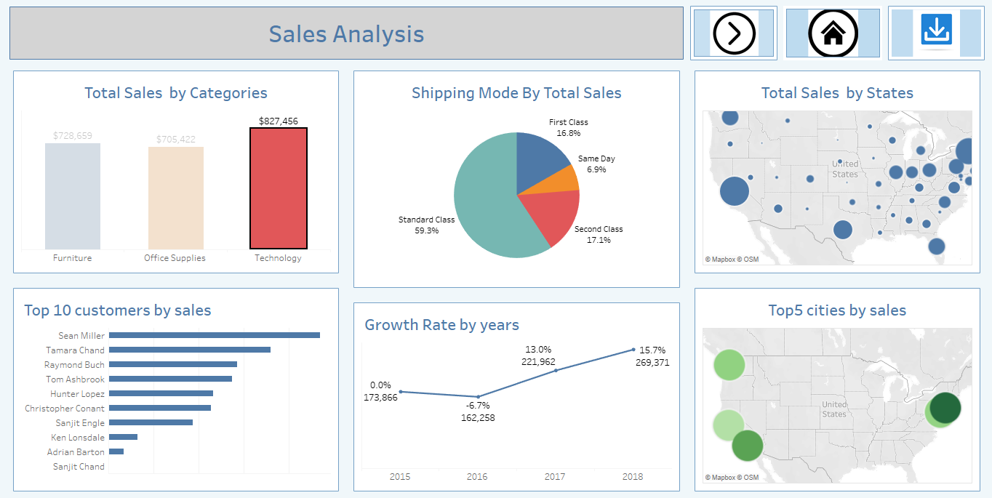
Creating Dashboard

Slide 22
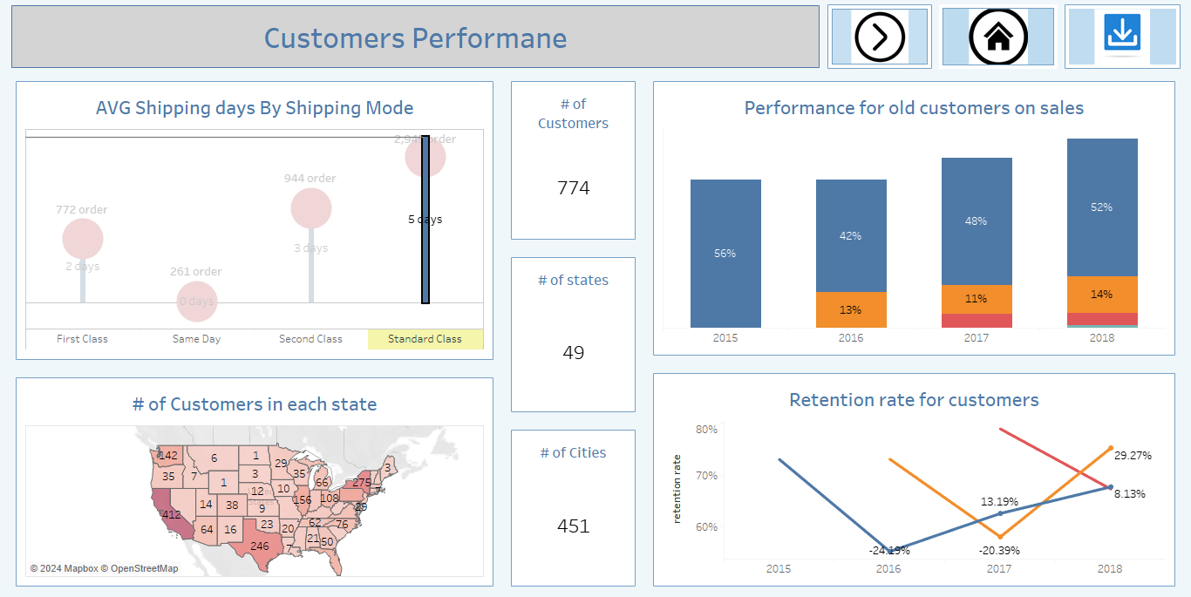
Creating Dashboard

Slide 23
Thank you

