Slide 1
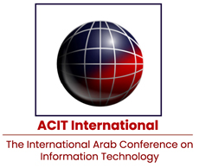



GHaLIB
A Multilingual Framework for Hope Speech Detection in Low-Resource Languages
Paper ID: 220
Conference: ACIT ’25
Authors(s)
Ahmed Abdullah (FAST-National University)
Haroon Mahmood (Al-Ain University)
Sana Fatima (FAST-National University)
Notes:
Good morning/afternoon everyone. My name is ________, and today I will present our work titled GHaLIB: A Multilingual Framework for Hope Speech Detection in Low-Resource Languages, developed for ACIT 2025.
I will briefly cover the motivation, dataset, methodology, model architecture, results, and key takeaways.”

Slide 2
Motivation & Problem
Hope speech is understudied, especially in low-resource languages.
Existing datasets/models focus mainly on English.
Similar wording between hope, sarcasm, and negativity causes misclassification.
Traditional ML misses contextual and cultural nuance.
Need a multilingual, context-aware framework.
GHaLIB
Notes:
Hope speech refers to expressions of encouragement, optimism, or positive expectation. Despite its importance, hope speech is understudied, especially in low-resource languages like Urdu.
Most existing datasets and models focus on English, leaving a gap for multilingual settings. Another challenge is that hope speech often resembles sarcasm or negativity, making it difficult for classical models to differentiate based on keywords alone.
This highlights the need for a multilingual, context-aware framework that can handle linguistic nuance and code-mixing.

Slide 3
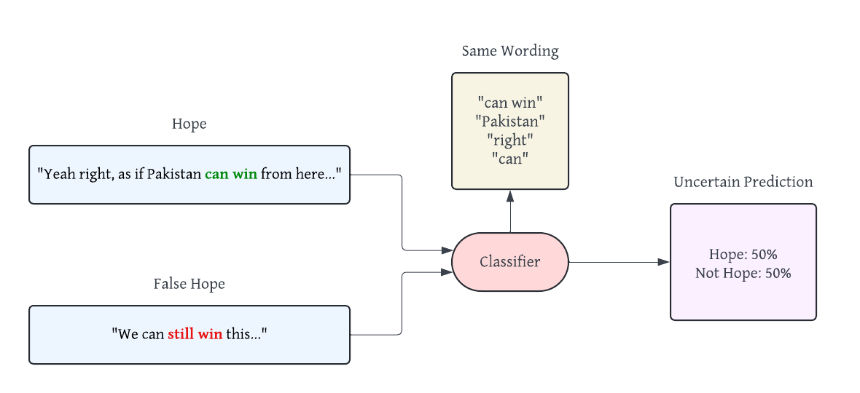
Motivation & Problem
GHaLIB
Notes:
As shown in this diagram, two sentences with very similar wording — such as ‘can win’ — can represent very different intentions: genuine hope or sarcasm.
Because the surface vocabulary is so similar, the classifier produces uncertain predictions. This visual emphasizes why deeper contextual modeling is needed rather than simple keyword-based approaches.

Slide 4
What is Hope Speech?
Category | Meaning | Example
Generalized Hope | Broad, non-specific optimism | “No matter how hard things are, they will get better with time.”
Realistic Hope | Achievable, effort-based optimism | “If I stay focused and keep working, I can pass the exam.”
Unrealistic Hope | Improbable or impossible expectation | “If I try hard enough, I’m sure I can jump high enough to reach the moon.”
Not Hope | No optimism / negative or neutral sentiment | “Nothing is going to improve, no matter what I do.”
GHaLIB
Notes:
Hope speech is categorized into four types:
Generalized Hope — broad optimism.
Realistic Hope — achievable, effort-based optimism.
Unrealistic Hope — impossible or highly improbable expectations.
Not Hope — neutral or negative statements showing no optimism.
These categories guide our labeling and classification tasks.

Slide 5
Gaps in Existing Research
Most studies focus on English, leaving low-resource languages underrepresented.
Existing datasets for hope speech are limited or small.
Lexicon-based and classical ML methods fail to capture context, sarcasm, and nuance.
Transformer models have been applied to hate/offensive speech, but rarely to hope speech.
Lack of multilingual frameworks that handle code-mixing and cultural variation.
GHaLIB
Notes:
Existing work is mainly English-centric. Datasets for hope speech are limited, especially for low-resource languages. Classical ML methods struggle with sarcasm and contextual nuance. Transformers have been applied mostly to hate speech—not hope speech. There is also no multilingual framework that handles code-mixing effectively.

Slide 6
Contributions of GHaLIB
Proposes a multilingual framework for hope-speech detection.
Incorporates language-specific encoders with a shared transformer backbone.
Achieves state-of-the-art results on PolyHope-M 2025 across four languages.
Demonstrates strong performance on low-resource languages like Urdu.
Provides publicly available code and resources for reproducibility.
GHaLIB
Notes:
“Our contributions are:
A multilingual framework for hope speech detection.
Integration of language-specific encoders with a shared transformer backbone.
State-of-the-art results on the PolyHope-M 2025 benchmark.
Strong performance in low-resource languages like Urdu.
Public release of code and resources for reproducibility.”

Slide 7
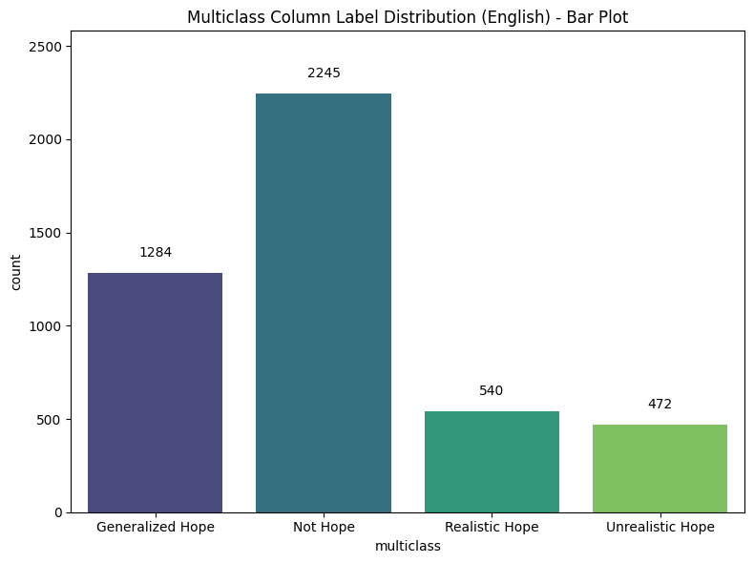
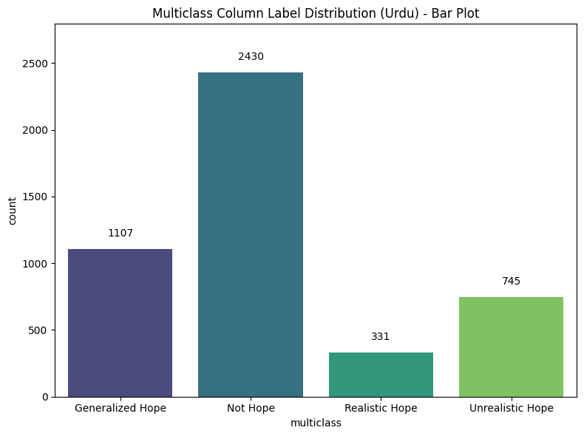
Dataset Overview
GHaLIB
Notes:
“These charts for English and Urdu show that the Not Hope category is the most common, which creates a class imbalance. The other categories—Generalized, Realistic, and Unrealistic Hope—are significantly smaller.
This imbalance influenced our decision to use weighted loss during training.”

Slide 8
Dataset Overview
Based on the PolyHope-M 2025 multilingual corpus.
Includes texts in Urdu, English, German, and Spanish.
Four labels: Generalized, Realistic, Unrealistic, Not Hope.
Class imbalance observed — Not Hope is the most frequent category.
Noticeable differences in text length and vocabulary across languages.
GHaLIB

Slide 9
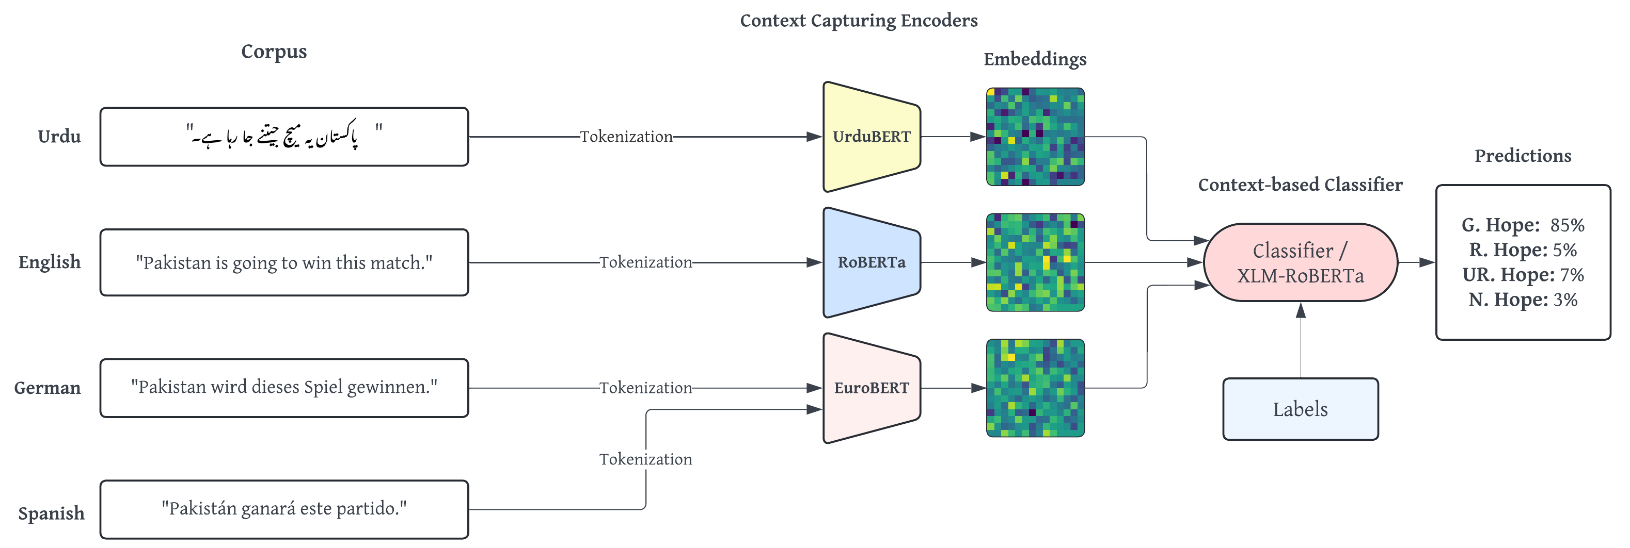
Methodology Overview
GHaLIB
Notes:
“This slide shows the full methodology pipeline.
Starting on the left, the input text first undergoes language detection. Based on the language, it is routed to the corresponding encoder — UrduBERT for Urdu, RoBERTa for English, and EuroBERT for German and Spanish.
As shown in the colored blocks in the middle, each encoder transforms the input into dense embeddings.
These embeddings are then fed into a context-based classifier powered by XLM-RoBERTa, which is our shared multilingual backbone.
The classifier then outputs label probabilities — such as Generalized Hope, Realistic Hope, Unrealistic Hope, or Not Hope — as displayed in the prediction box on the right.
This architecture allows us to blend language-specific understanding with multilingual generalization.”

Slide 10
Methodology Overview
Detects language and routes input to a language-specific encoder.
Uses XLM-RoBERTa as the shared multilingual backbone.
Text is normalized, tokenized, and padded/truncated to 128 tokens.
Combines encoder outputs for context-aware classification.
Handles imbalance using weighted loss during training.
GHaLIB

Slide 11
Model Training Setup
Used weighted cross-entropy to address class imbalance.
Optuna used for hyperparameter tuning (30 trials).
Trained on 2×16GB NVIDIA T4 GPUs.
Stratified 70/15/15 train–validation–test split.
Fixed seeds for reproducibility.
GHaLIB
Notes:
For training, we used weighted cross-entropy to counter class imbalance. We used Optuna for hyperparameter tuning across 30 trials. Training was performed using two 16-GB NVIDIA T4 GPUs. We maintained a 70/15/15 stratified split for train, validation, and test sets. Finally, we fixed all random seeds to ensure reproducibility.

Slide 12
Binary Classification Results
Language | Model (SOTA) | Accuracy | F1 Score | Ranking
Urdu | XLM-RoBERTa + UrduBERT | 95.0% | 95.0% | 1st
German | XLM-RoBERTa + EuroBERT | 87.1% | 87.4% | 2nd
English | XLM-RoBERTa (Base) | 86.3% | 86.3% | 2nd
Spanish | XLM-RoBERTa + EuroBERT | 85.0% | 85.0% | 1st
GHaLIB
Notes:
The model achieves:
95% F1 score in Urdu,
87.4% in German,
86.3% in English,
85% in Spanish.
These results confirm that the combination of language-specific encoders with XLM-RoBERTa performs strongly across diverse languages.

Slide 13
Multiclass Classification Results
Language | Model (SOTA) | Accuracy | F1 Score | Ranking
Urdu | RoBERTa Urdu (ADB/SVM/LGB) | 78.3% | 65.2% | 1st
English | XLM-RoBERTa (Base) | 77.2% | 71.0% | 2nd
Spanish | XLM-RoBERTa + EuroBERT | 75.3% | 68.5% | 3rd
German | XLM-RoBERTa + EuroBERT | 83.4% | 70.1% | 1st
GHaLIB
Notes:
Our best results are:
Urdu: 65.2% F1,
English: 71% F1,
Spanish: 68.5% F1,
German: 70.1% F1.
These scores remain competitive and in many cases state-of-the-art for hope speech classification.”

Slide 14
Key Observations
Language-specific encoders significantly boost performance for Urdu & German.
Multilingual transformers generalize well across all languages in binary tasks.
Multiclass classification is harder due to overlapping vocabulary and subtle distinctions.
English performs strongly because of richer pretraining resources.
Most errors arise from code-mixing and context ambiguity, not model weakness.
GHaLIB
Notes:
Our main observations are:
Language-specific encoders significantly improve performance in Urdu and German.
Multilingual transformers generalize well for binary tasks.
Multiclass tasks are harder due to overlapping vocabulary.
English benefits from richer pretraining resources.
Most errors stem from code-mixing and ambiguous context.

Slide 15
Conclusion
GHaLIB provides a robust multilingual framework for hope-speech detection.
Achieves state-of-the-art performance across four languages.
Shows strong results even in low-resource settings like Urdu.
Demonstrates the value of combining language-specific encoders with XLM-RoBERTa.
Establishes a solid foundation for future multilingual NLP research.
GHaLIB
Notes:
In conclusion, GHaLIB provides a robust multilingual framework for hope speech detection, achieving state-of-the-art results across four languages.
Combining language-specific encoders with XLM-RoBERTa proves highly effective, especially for low-resource languages.

Slide 16
Future Work
Extend framework to more low-resource languages (e.g., Punjabi, Sindhi, Seraiki).
Explore domain-specific pretraining and parameter-efficient fine-tuning.
Improve handling of code-mixing and contextual ambiguity.
GHaLIB
Notes:
For future work, we aim to extend this framework to additional low-resource languages such as Punjabi, Sindhi, and Seraiki. We also plan to explore domain-specific pretraining and more efficient fine-tuning strategies. Finally, improving our system’s ability to handle code-mixing and context ambiguity will remain an important research direction.

Slide 17
Q&A
GHaLIB
Notes:
Thank you for your attention. I will now be happy to take any questions.

