Slide 1

غالب
Generating Hope and Linguistic Irony in Banter
PolyHope-M (Multilingual Hope Speech Classification) at RANLP 2025 @Bulgaria

Slide 2
غالب
Presenter(s)
Noman Jaffar (FAST-NU)
Ahmed Abdullah (MMSL, JKU)
Abdullah Ibrahim (FAST-NU)
Date
April 13th, 2025

Slide 3
غالب
Preface
- Problem Statement
Literature Review/Previous Works
Methodology
Results
Conclusion
Future Works

Slide 4
غالب
Problem Statement

Slide 5
غالب
Problem Statement
- Urdu as a Low-Resource Language
- Lack of Standardized NLP Tools
- Overlapping Vocabulary in Hope vs. Neutral/Negative Speech
- Linguistic Irony and Sarcasm Complexity
- Code-Mixing and Dialectal Variations in Social Media Texts

Slide 6
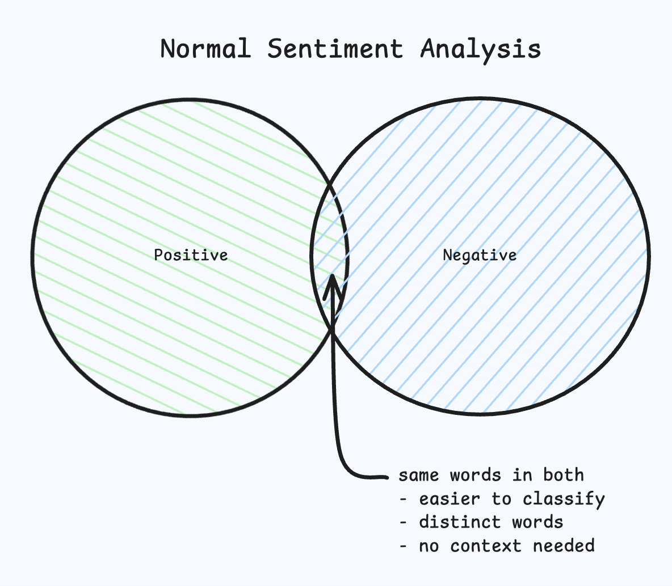
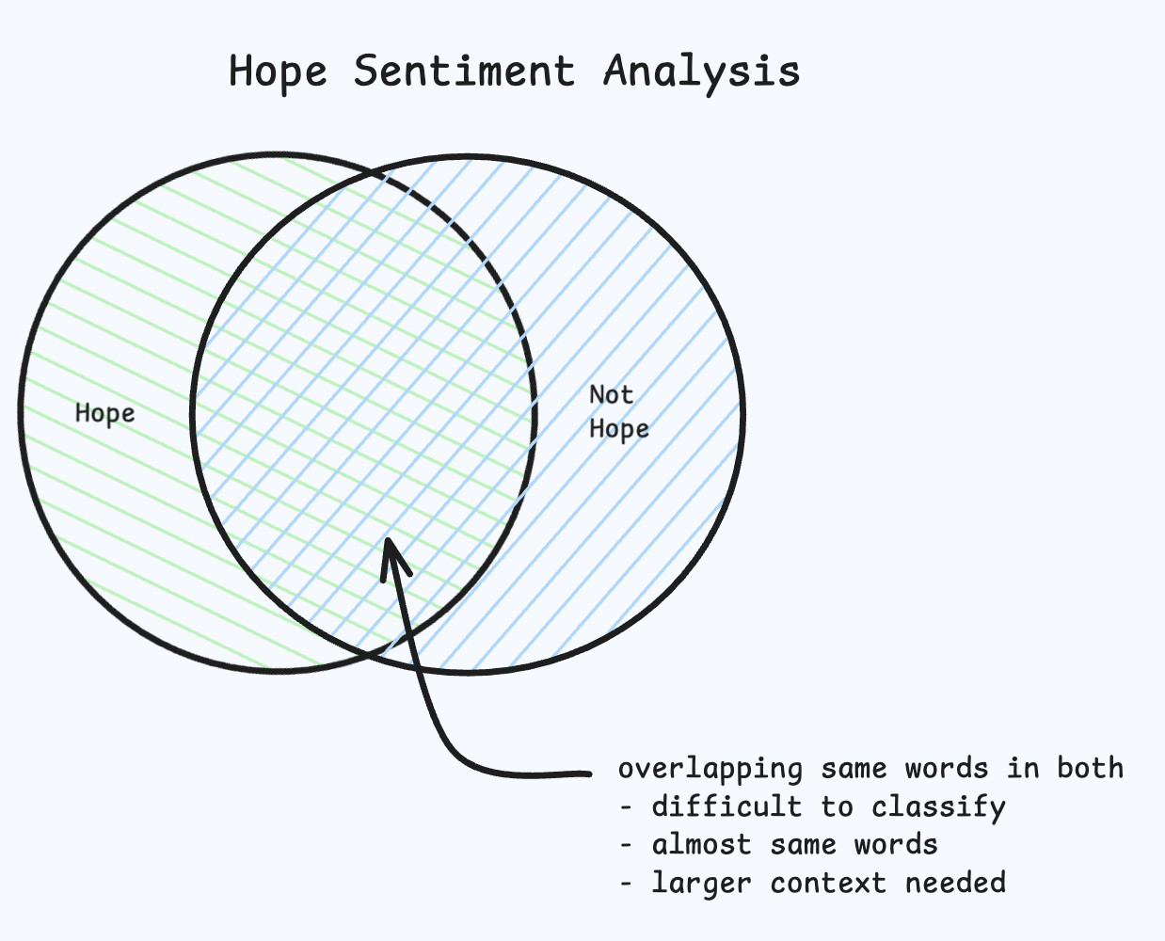
غالب
Overlapping Words

Slide 7
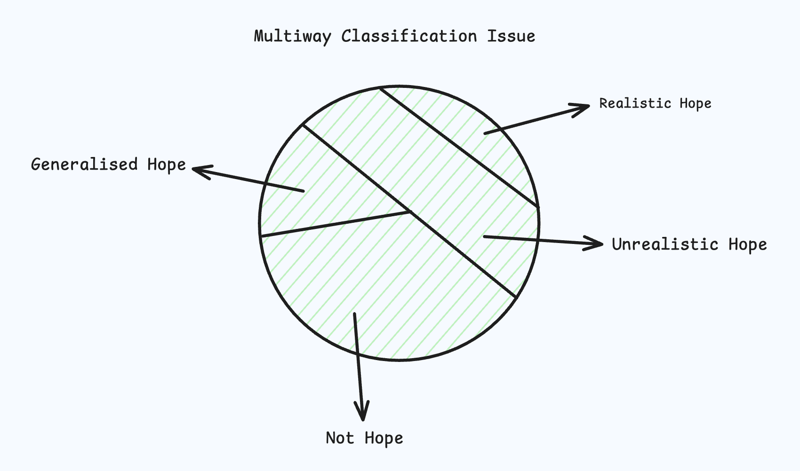
غالب
Multiway Classification

Slide 8
غالب
Context Problem
- Pakistan 152/0 (19 ov): Pakistan is about to lose. → Unrealistic Hope (clearly sarcastic, detached from reality)
- Pakistan 113/7 (19 ov): Pakistan is about to lose. → Realistic Hope (acknowledging a tough spot but not giving up yet)
- Pakistan 45/6 (8 ov): Pakistan is about to lose. → Not Hope (pessimistic, defeatist)
- Pakistan 199/2 (18 ov): Pakistan is about to lose. → Generalized Hope (used jokingly, but overall mood is still confident)

Slide 9
غالب
Previous Works
Limited Research in Urdu: There is a notable lack of studies focusing on hope speech detection in Urdu.

Slide 10
غالب
Previous Works
Dave et al. (2021): Utilized TF-IDF character n-grams combined with MuRIL embeddings for code-mixed text classification.
Hossain et al. (2021): Employed a combination of machine learning and deep learning models, including SVM and CNN-BiLSTM, for multilingual hope speech detection.
Mahajan et al. (2021): Fine-tuned RoBERTa and XLM-RoBERTa models for hope speech detection in English, Tamil, and Malayalam.
Khanna et al. (2022): Implemented a contextualized BERT model with an attention mechanism for social media text classification.
Butt et al. (2024, primary paper): Applied transformers for Urdu text classification, particularly focusing on detecting hope speech.

Slide 11
غالب
Methodology

Slide 12
غالب
Methodology
URLs Remove
##USER## Remove
Not Addition Text Cleaning
No Stop Words Removal

Slide 13
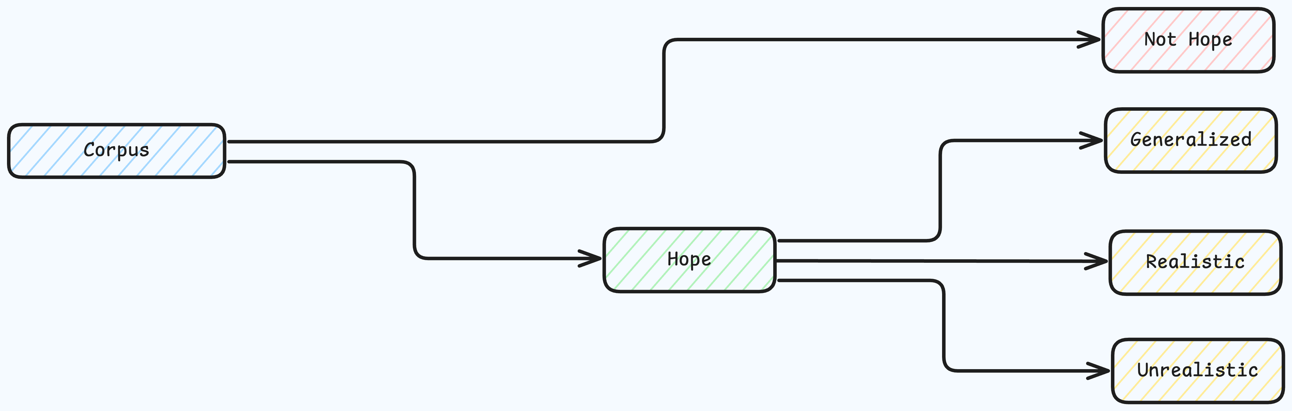
غالب
Methodology
Finetuned RoBERTa for English Classification
Finetuned UrduRoBERTa from UrduHack for Urdu Classification
Finetuned EuroBERT for Spanish – German Classification
Two-way classification for Hope (Generalized, Realistic, Unrealistic) and Not Hope

Slide 14
غالب
Results
F1 Score will be the base metric, that is used as judgement in competition as well

Slide 15
غالب
Results
Author | Language | Classification | F1-Score | Our F1-Score
 | Urdu | Binary |  | 94.5%
 | Urdu | Multiway |  | 65.3%
 | English | Binary |  | 86.3%
 | English | Multiway |  | 71.2%
 | Spanish | Binary |  | 84.5%
 | Spanish | Multiway |  | 68.6%
 | German | Binary |  | 87.2%
 | German | Multiway |  | 70.13%

Slide 16
غالب
Results
Language | Classification | Position of Leaderboard
Urdu | Binary | 2nd
Urdu | Multiway | 1st
English | Binary | 2nd
English | Multiway | 2nd
Spanish | Binary | 1st
Spanish | Multiway | 3rd
German | Binary | 2nd
German | Multiway | 1st

Slide 17
غالب
Future Works

Slide 18
غالب
Future Works
- Finer emotion labels (e.g., sarcasm, optimism)
- Support for Roman Urdu & code-mixed text
- Context-aware modelling (e.g., score-based)
- Cross-lingual extension (Pashto, Balochi)

Slide 19
غالب
https://github.com/ahmedembeddedxx/GHaLIB

