Slide 1
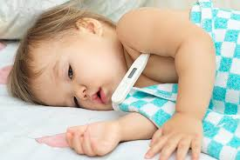
Fever
Preparation:Shahd Moaffaq Enaya
INSTRUCTOR: zaina abo al haija
Subject:pediatric
College: Alrawdah University college

Slide 2
Objective and outline:
Definition of fever
Pathophysiology
Causes of fever
How to take a child temperature
Grades of fever
Treatment of fever
Nursing care plan

Slide 3
Background:
Feverish illness in children:
is the most common reason for children to be taken to the doctor.
is a cause of concern for parents and carers.
Fever occurs in response to infection, injury, or inflammation and has many causes.
can be a result of a simple self-limiting infection or a life-threatening disorder.

Slide 4
DEFINITION OF FEVER :
fever is A fever is a body temperature that is higher than normal. A normal temperature can vary from person to person, . A fever is not a disease. It is usually a sign that your body is trying to fight an illness or infection.

Slide 5
Pathophysiology:
The mechanism of fever appears to be a defensive reaction by the body against infectious disease. When bacteria or viruses invade the body and cause tissue injury, one of the immune system’s responses is to produce pyrogens. These chemicals are carried by the blood to the brain, where they disturb the functioning of the hypothalamus, the part of the brain that regulates body temperature. The pyrogens inhibit heat-sensing neurons and excite cold-sensing ones, and the altering of these temperature sensors deceives the hypothalamus into thinking the body is cooler than it actually is. In response the hypothalamus raises the body’s temperature above the normal range, thereby causing a fever. The above-normal temperatures are thought to help defend against microbial invasion because they stimulate the motion, activity, and multiplication of white blood cells and increase the production of antibodies. At the same time, elevated heat levels may directly kill or inhibit the growth of some bacteria and viruses that can tolerate only a narrow temperature range.

Slide 6
Causes of fever:
Common causes of fever in children:
Fever is a symptom of the disease, not the disease itself. Children get a fever when they fight their immune system.

Slide 7
Common causes of fever in children include:
Colds
Ear infections
Respiratory infections, such as respiratory syncytial virus (RSV), or croup
flu
Pneumonia
roseola
Viral throat infections
Children can also develop a fever after skin injury. This usually means that there is an infection.

Slide 8
HOW TO TAKE A CHILD’S TEMPERATURE
A child's temperature can be taken:
from the rectum, ear, mouth, forehead, or armpit
It can be taken with a Mercury thermometer or digital thermometer.

Slide 9
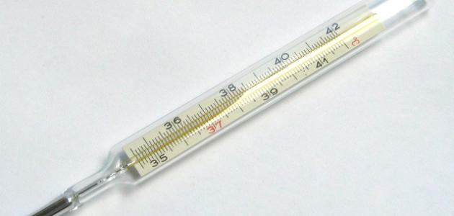
Glass thermometers
need to be shaken before use to make sure the temperature they show is below the normal body temperature (98.6° F, or about 37° C). Then they must be left in place for 2 to 3 minutes.
Digital thermometers are easier to use and give much quicker readings (and usually give a signal when they are ready).
Glass thermometers containing mercury are no longer recommended because they can break and expose people to mercury.

Slide 10
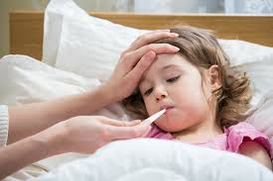
Oral temperatures:
are taken by placing a glass or digital thermometer under the child's tongue. Oral temperatures provide reliable readings but are difficult to take in young children. Young children have difficulty keeping their mouth gently closed around the thermometer, which is necessary for an accurate reading. The age at which oral temperatures can be reliably taken varies from child to child but is typically after age 4.

Slide 11
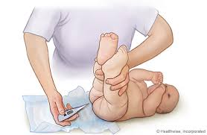
Rectal temperatures
are most accurate. That is, they come closest to the child's true internal body temperature. For a rectal temperature, the bulb of the thermometer should be coated with a lubricant. Then the thermometer is gently inserted about 1/2 to 1 inch (about 1 1/4 to 2 1/2 centimeters) into the rectum while the child is lying face down. The child should be kept from moving.

Slide 12
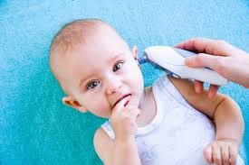
Ear temperatures
are taken with a digital device that measures infrared radiation from the eardrum. Ear thermometers are unreliable in infants under 3 months old. For an ear temperature, the thermometer probe is placed around the opening of the ear so that a seal is formed, then the start button is pressed. A digital readout provides the temperature.

Slide 13
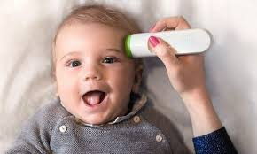
Forehead (temporal artery) temperatures
are taken with a digital device that measures infrared radiation from an artery in the forehead (the temporal artery). For a forehead temperature, the head of the thermometer is moved lightly across the forehead from hairline to hairline while pressing the scan button. A digital readout provides the temperature. Forehead temperatures are not as accurate as rectal temperatures, particularly in infants under 3 months old.

Slide 14
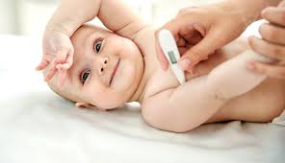
• Armpit temperatures
are taken by placing a glass or digital thermometer in the child's armpit, directly on the skin. Doctors rarely use this method because it is less accurate than others (readings are usually too low and vary greatly). However, if caretakers are uncomfortable taking a rectal temperature and do not have a device to measure ear or forehead temperature, measuring armpit temperature may be better than not measuring temperature at all.

Slide 15
Grades of Fever
A fever may be classified as:
mild (or 'low grade') if it's between 37.8°C and 38.5°C; or
high (or 'high-grade') above 38.5°C.
very high: body temperatures in excess of 41°C,

Slide 16
What Are the Symptoms of Fever in Children?
Signs and symptoms of a fever may be obvious or subtle. The younger the child, the more subtle the symptoms.
Infants may:
be irritable
be fussy
be lethargic
feel warm or hot
not feed normally,
Cry

Slide 17
Treatment :
If a doctor diagnoses a bacterial infection, the child will be started on antibiotics.
Urinary tract infections, ear infections, throat infections, sinus infections, skin infections, gastrointestinal infections, and pneumonia may be treated with antibiotics at home.
The child may receive oral antibiotics, injection, or both.

Slide 18
Drugs to lower fever:
Typically, the following drugs are used:
• Acetaminophen, given by mouth or by suppository
• Ibuprofen, given by mouth
• Rarely, acetaminophen or ibuprofen is given to prevent a fever, as when infants have been vaccinated.
• Aspirin is no longer used for lowering fever in children because it can interact with certain viral infections (such as influenza or chickenpox) and cause a serious disorder called Reye syndrome

Slide 19
Nursing care plan :
Assessment
Nursing diagnosis
Planning and goal
Nursing intervention
Evaluation

Slide 20
Assessment :
obtain history.
obtain past, present, childhood, familial, socioeconomic, environmental history.
Assess /monitor vital signs every four hourly.
conduct physical and systemic examination.( Check skin texture, signs for dehydration, fatigue levels,
Send sample for blood investigation (for underlying infection, assessing fluid and electrolyte levels).

Slide 21
Nursing diagnosis:
Fever related to inflammatory process/ hypermetabolic state as evidenced by an increase in body temperature, warm skin and tachycardia
Fluid volume deficit related to failure of regulatory mechanism
Interrupted breastfeeding related to neonate’s present illness as evidenced by separation of mother to infant

Slide 22
Planning and goal :
Patient will still maintain normal core temperature as evidenced by normal vital signs and normal laboratory results.
Patient will be able to maintain fluid volume at a functional level as evidenced by individually adequate urinary output with normal specific gravity, stable vital signs, moist mucous membranes, good skin turgor and prompt capillary refill and resolution of edema.
The mother shall still be able to identify and demonstrate techniques to sustain lactation and identify techniques on how to provide the newborn with breast milk.

Slide 23
Nursing intervention :
Monitor neonate’s condition.
Monitor vital signs
Note for the causative factors that contribute to fluid volume deficit
Assess mother’s perception and knowledge about breastfeeding and extent of instruction that has been given

Slide 24
Evaluation :
normal core temperature
Patient able to maintain fluid volume at a functional level
stable vital signs

Slide 25
Reference
https://www.slideshare.net/azadhaleem/fever-in-children-for-medical-students
https://www.medicalnewstoday.com/articles/324660.php

Slide 26


