Slide 1



Supply Chain
• Data Analysis AST1_DAT1_G1E
• DEPI Graduation Project
• Under Supervision of Eng/Mohamed Ahmed

Slide 2

Team Members
Ahmed Essam Eldin
Ahmed Mohamed Osman
Shimaa Mohamed
Ayaa Hassan
Eman Abdelhaliem

Slide 3
Agenda
Objective
Get data
Data exploration and cleaning using SQL
Listing the KPIs using SQL
Data exploration and cleaning using Python
Listing the KPIs using Python
Dashboard design using Power BI

Slide 4
Objective

Slide 5
Objective
The primary objective of this analysis was to:
Clean and preprocess the dataset to handle missing or inconsistent data.
Calculate key performance indicators (KPIs) to measure the efficiency of the supply chain, financial performance, and customer satisfaction.
Provide actionable insights based on the KPIs to guide strategic business decisions.

Slide 6
Get Data

Slide 7

Get data
We get the data from Kaggle https://www.kaggle.com/datasets/shashwatwork/dataco-smart-supply-chain-for-big-data-analysis
We created a new database and set it up for data analysis using SQL

Slide 8
Data exploration and cleaning using SQL

Slide 9
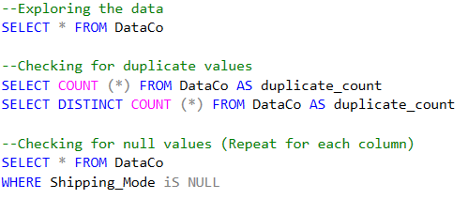
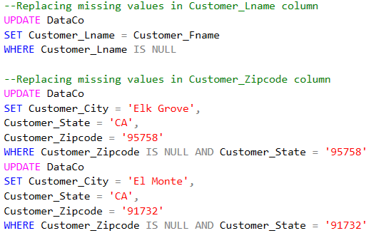
Data exploration and cleaning using SQL

Slide 10
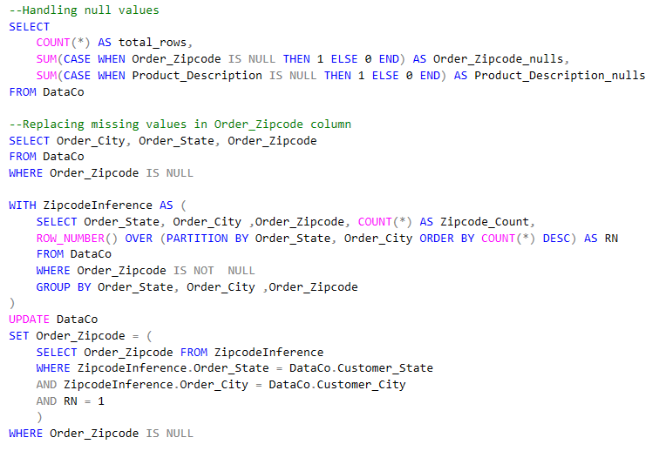
Data exploration and cleaning using SQL

Slide 11
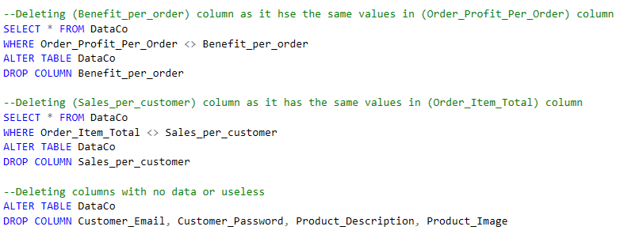
Data exploration and cleaning using SQL

Slide 12
Listing the KPIs using SQL

Slide 13
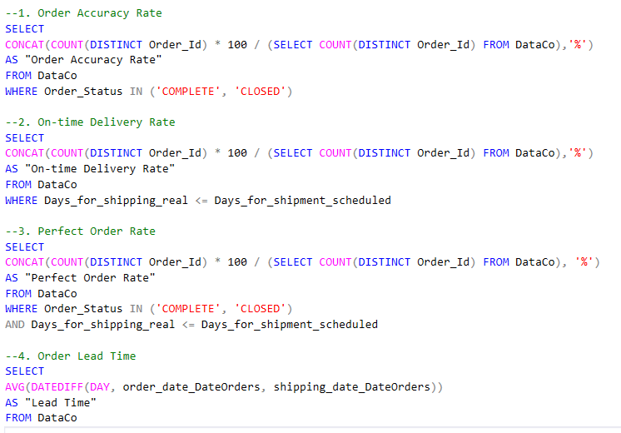
Listing the KPIs using SQL

Slide 14
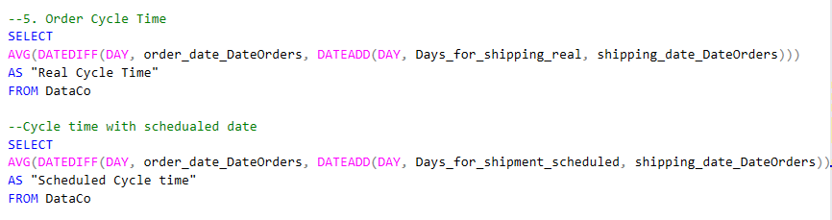
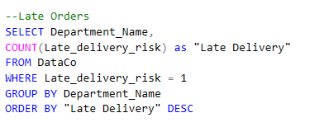
Listing the KPIs using SQL

Slide 15
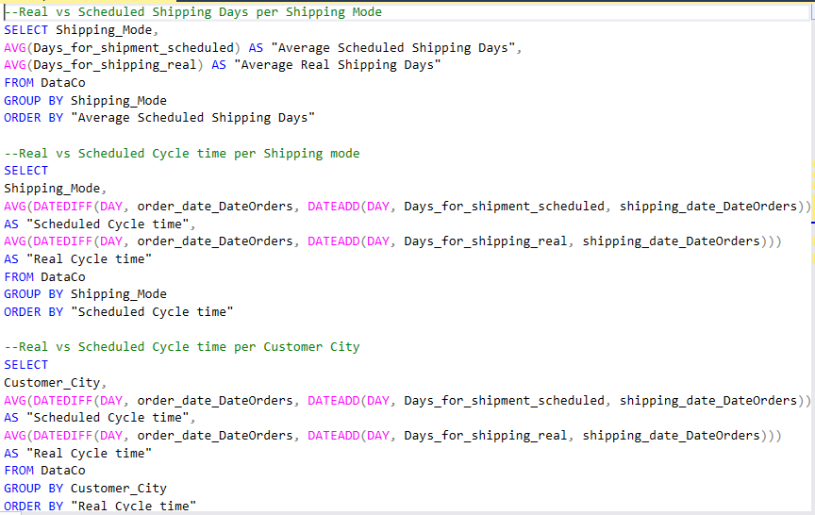
Listing the KPIs using SQL

Slide 16
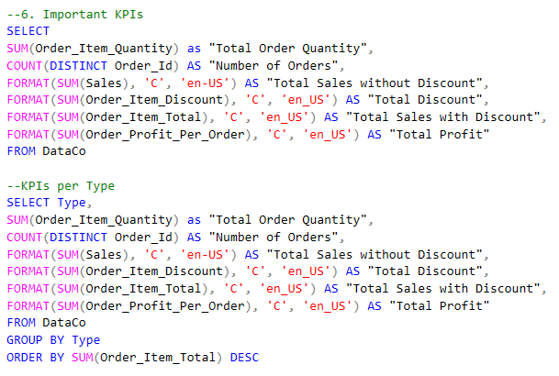
Listing the KPIs using SQL

Slide 17
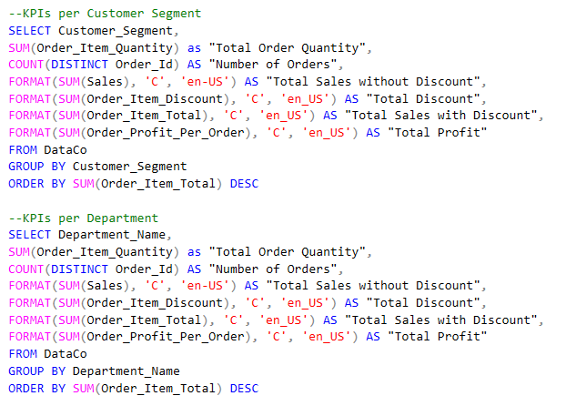
Listing the KPIs using SQL

Slide 18
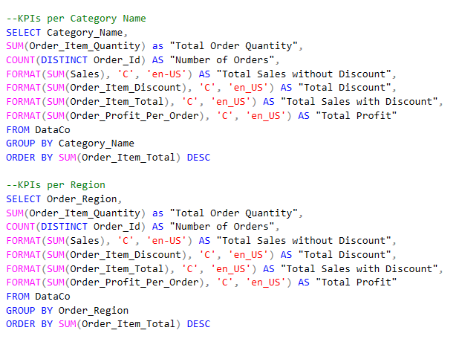
Listing the KPIs using SQL

Slide 19
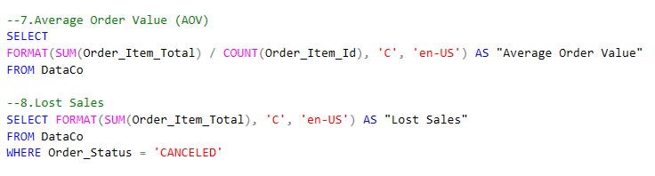
Listing the KPIs using SQL

Slide 20
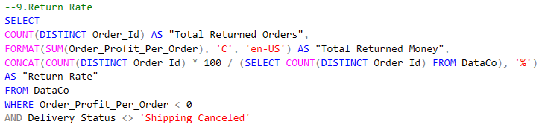
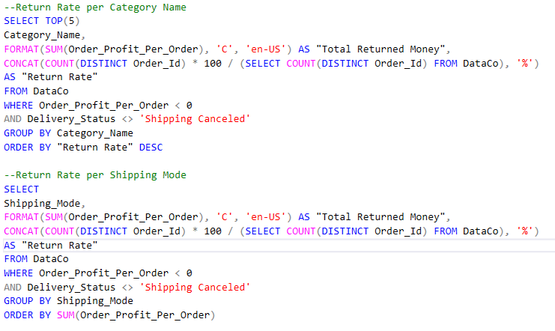
Listing the KPIs using SQL

Slide 21
Dashboard design using Power BI

Slide 22
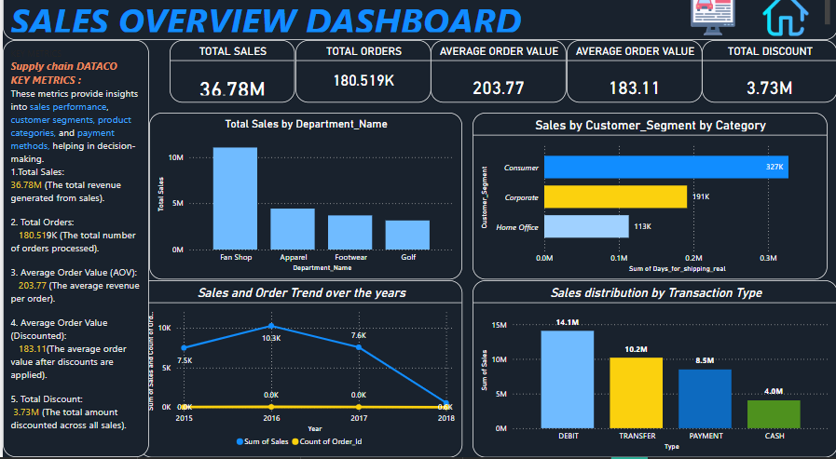
Dashboard design using Power BI

Slide 23
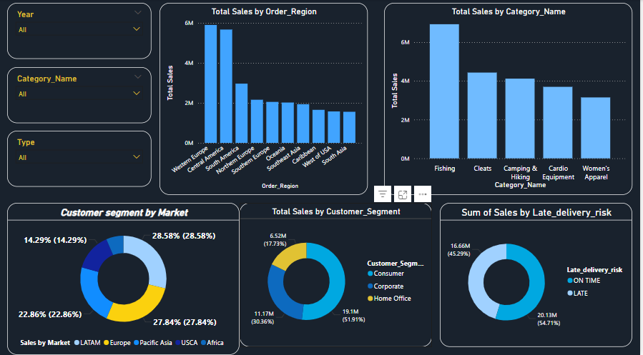
Dashboard design using Power BI

Slide 24
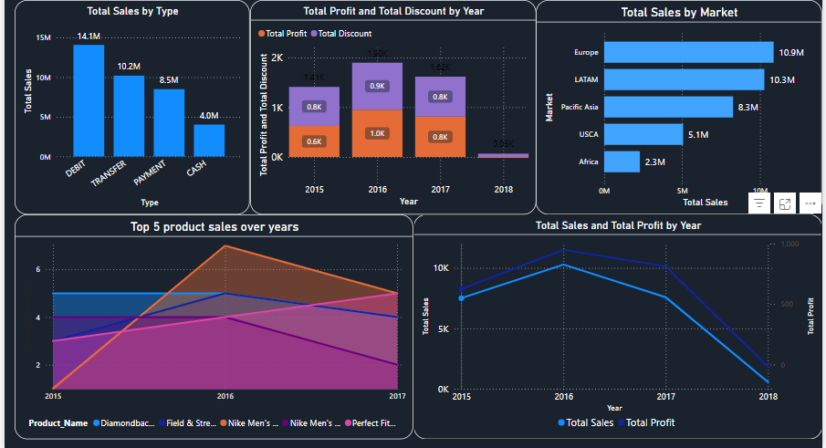
Dashboard design using Power BI

Slide 25
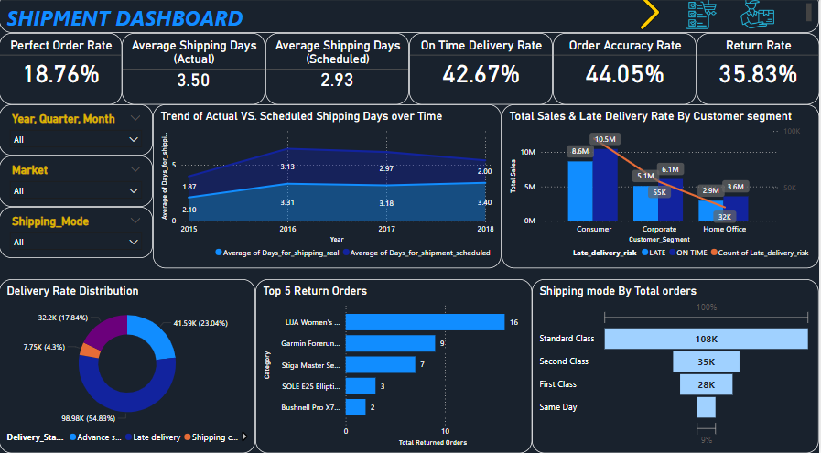
Dashboard design using Power BI

Slide 26
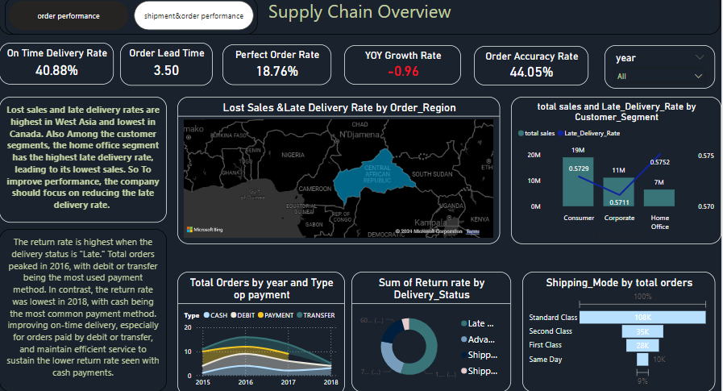
Dashboard design using Power BI

Slide 27
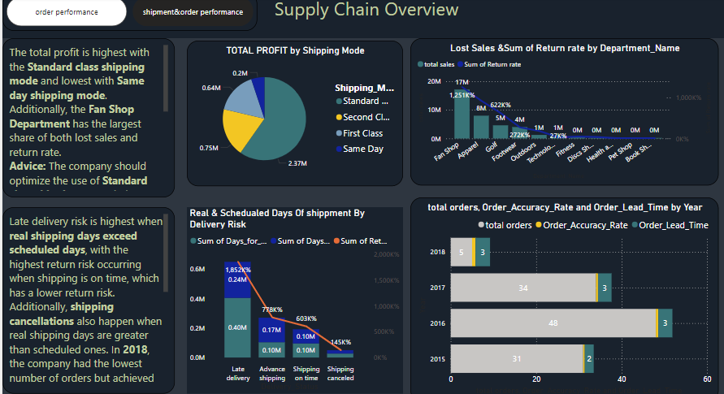
Dashboard design using Power BI

Slide 28
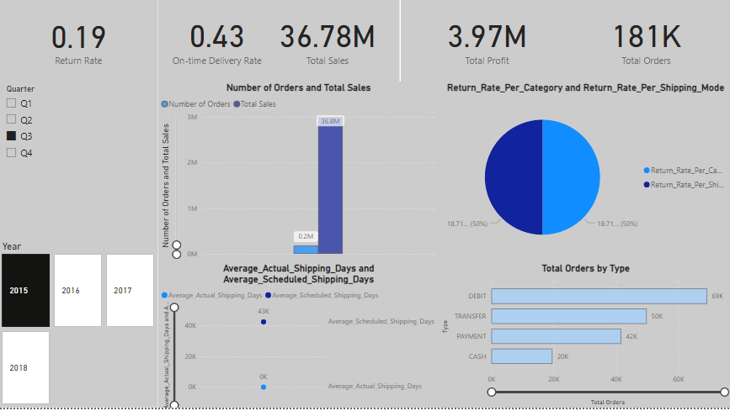
Dashboard design using Power BI

Slide 29
Data exploration and cleaning using Python

Slide 30
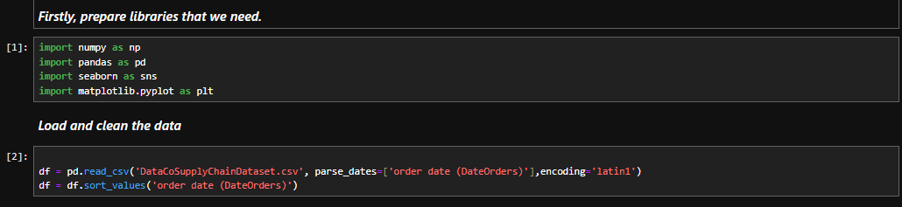
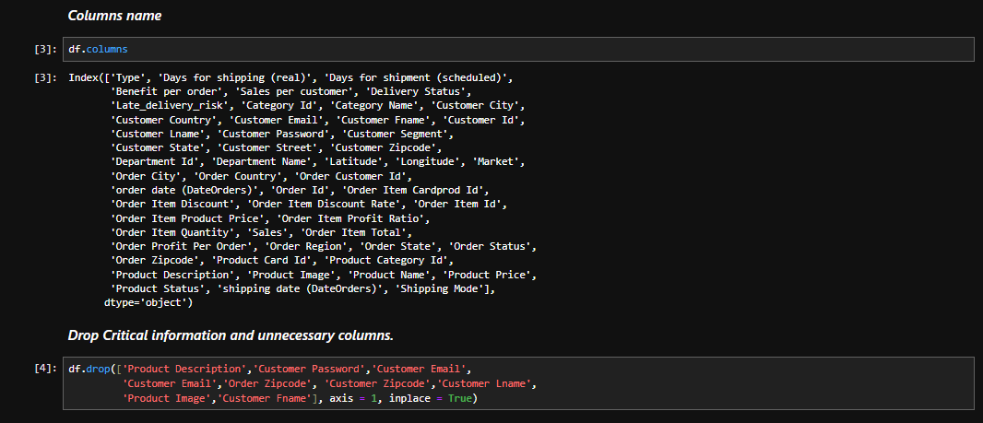
Data exploration and cleaning using Python

Slide 31
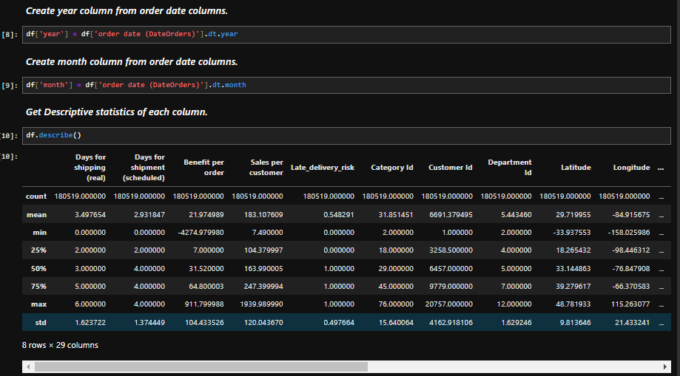
Data exploration and cleaning using Python

Slide 32
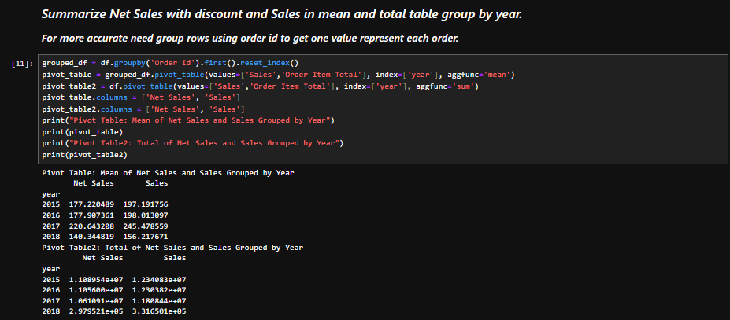
Data exploration and cleaning using Python

Slide 33
Measuring Performance
using Python

Slide 34
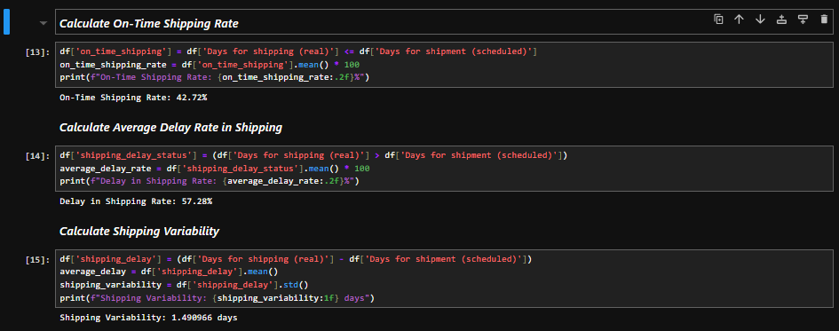
Listing Measuring Performance
using Python

Slide 35
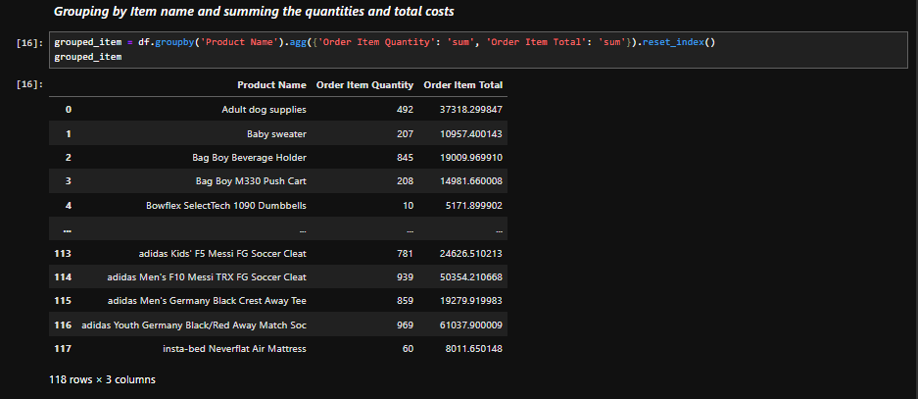
Listing Measuring Performance
using Python

Slide 36
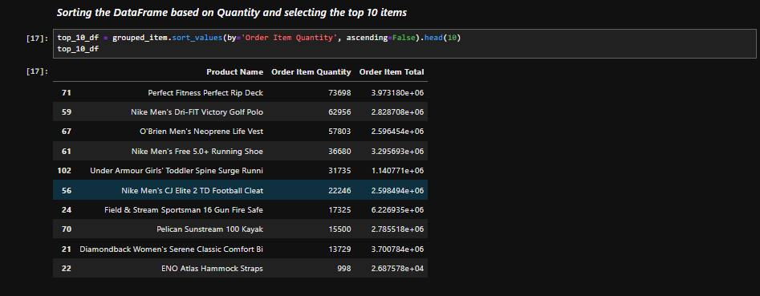
Listing Measuring Performance
using Python

Slide 37
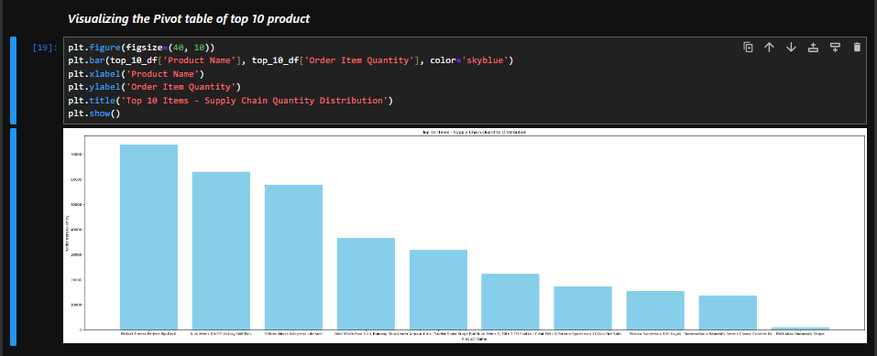
Listing Measuring Performance
using Python

Slide 38
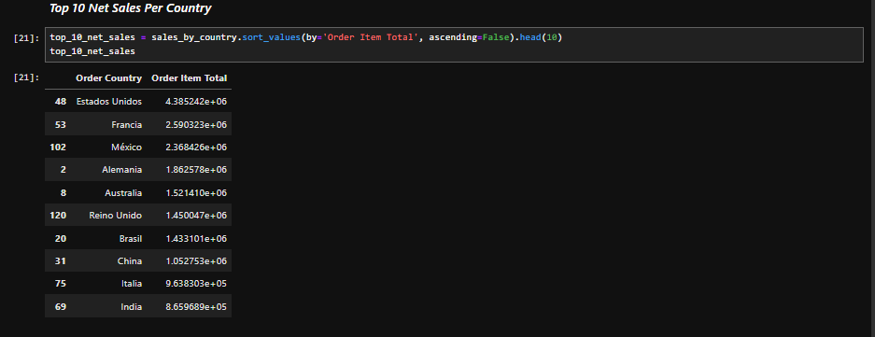
Listing Measuring Performance
using Python

Slide 39
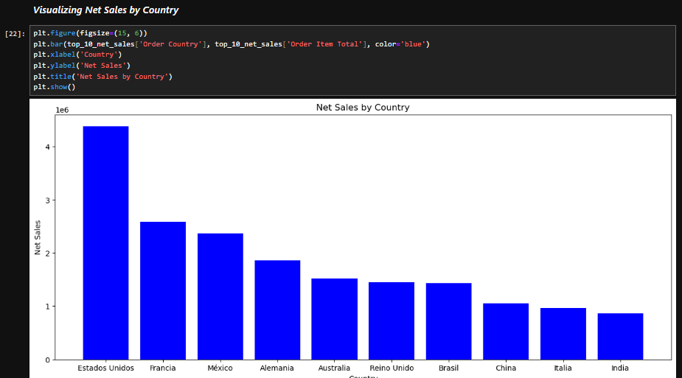
Listing Measuring Performance
using Python

Slide 40
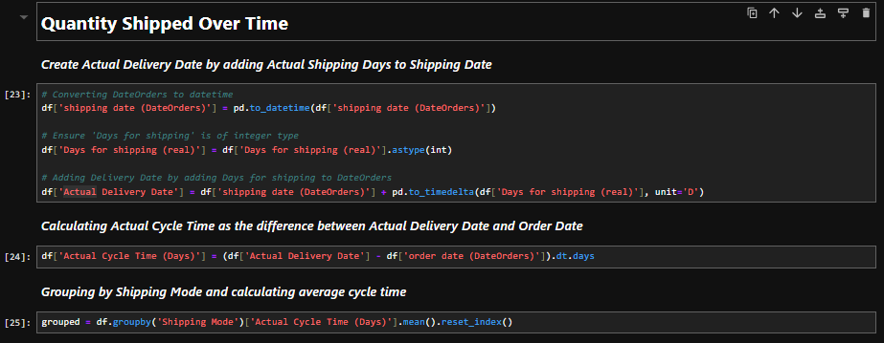
Listing Measuring Performance
using Python

Slide 41
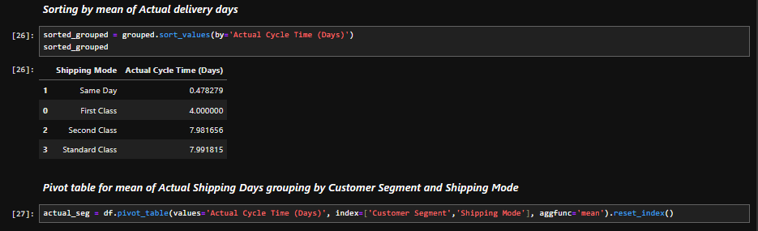
Listing Measuring Performance
using Python

Slide 42
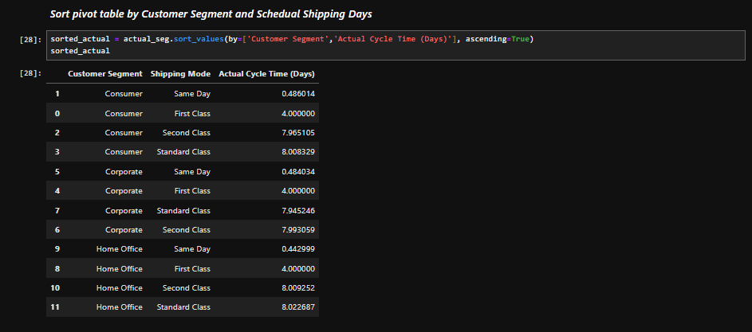
Listing Measuring Performance
using Python

Slide 43
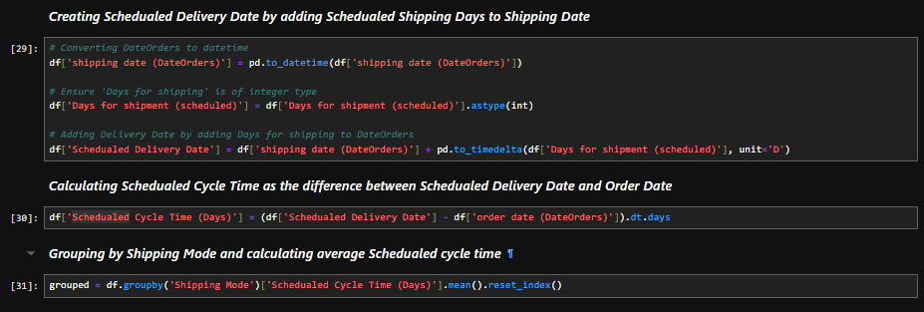
Listing Measuring Performance
using Python

Slide 44
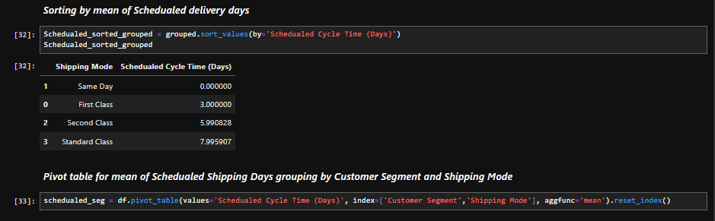
Listing Measuring Performance
using Python

Slide 45
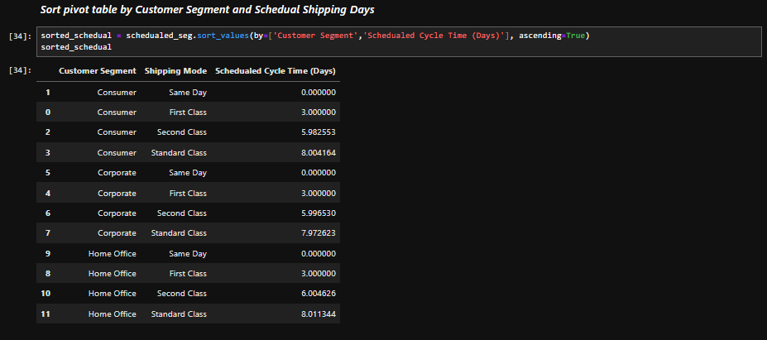
Listing Measuring Performance
using Python

Slide 46
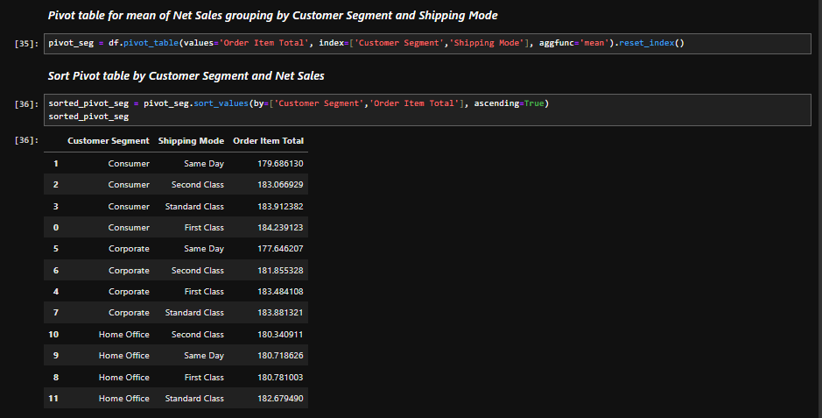
Listing Measuring Performance
using Python

Slide 47

Thank you!

