Slide 1

TECHNICAL ARCHITECTURE REVIEW
Online Parking
Lot System
A RESTful API built with SOLID OOP principles, EF Core, MySQL, and JWT Security
Ahmed Essam
Software Engineer
June 29, 2026

Slide 2
Project Objectives & Scope
5
BUSINESS CHALLENGE & OBJECTIVES
A parking lot management firm requires a secure and automated backend API to control a multi-floor parking lot facility. The system must allocate spots automatically, calculate fees dynamically based on configured strategies, and keep track of active spots to prevent state inconsistencies.
Entities Modelled
Lot, Floor, Spot, Vehicle, Ticket.
4
01
Check-In & Spot Allocation — Matches spot size to vehicle. Reserves spot and starts active ticket.
OOP Concepts
Inheritance, Polymorphism, Encapsulation, Strategy.
02
Active Stay & Live Tracking — Locks spot status in database. Real-time listing displays active park logs.
1
03
Billing Strategy Computation — Resolves pricing strategies (Hourly, Daily, Flat) based on ticket config.
Clean API
Asynchronous endpoints, validations, JWT validation.
04
Exit & Spot Release — Sets fee, updates ticket state to closed, and releases the spot for future bookings.

Slide 3
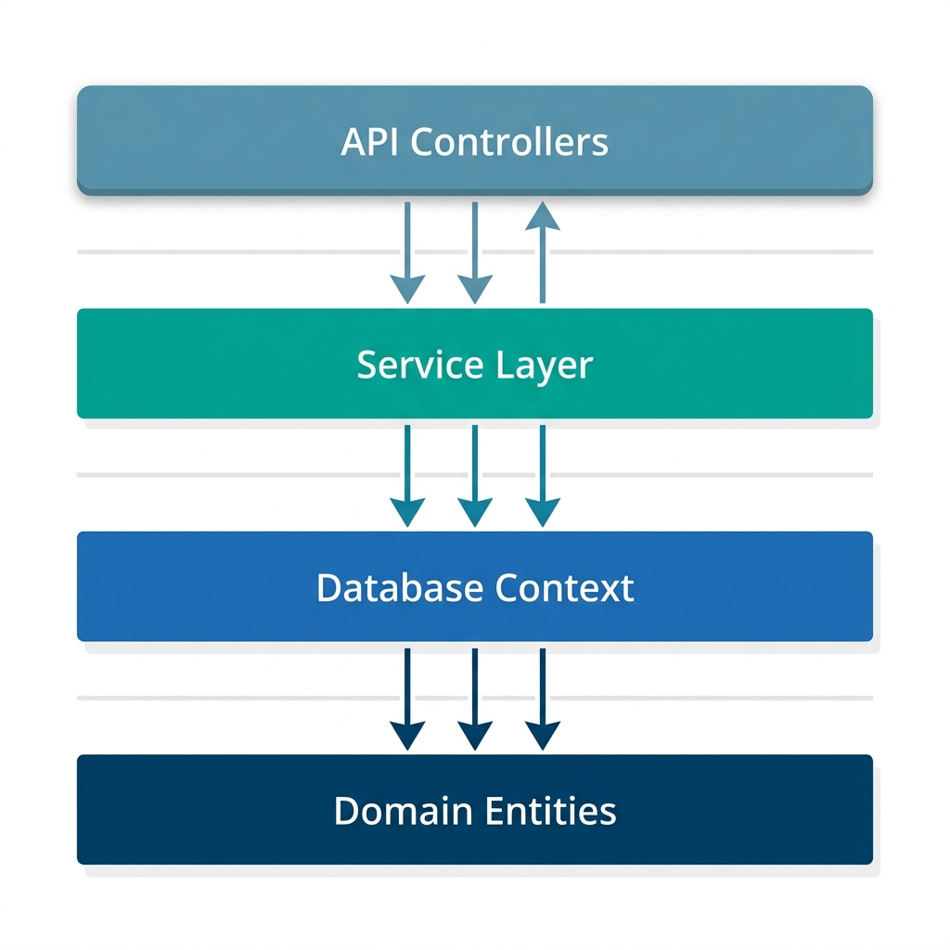
Layered System Architecture
ParkingLotSystem.API/
├── Controllers/ // Controller routers
├── DTOs/ // Data contracts
│ ├── Requests/ // Request validators
│ └── Responses/ // Output mapping DTOs
├── Domain/ // Domain rules (Pure C#)
│ ├── Entities/ // Core models (Vehicle, Spot)
│ └── Enums/ // Domain definitions
├── FeeStrategies/ // Strategy definitions
├── Interfaces/ // DI abstractions
├── Mappers/ // Domain-DTO static mappers
├── Middleware/ // Exception handling & logging
├── Data/ // AppDbContext & Migrations
└── Services/ // Core async operations

Slide 4
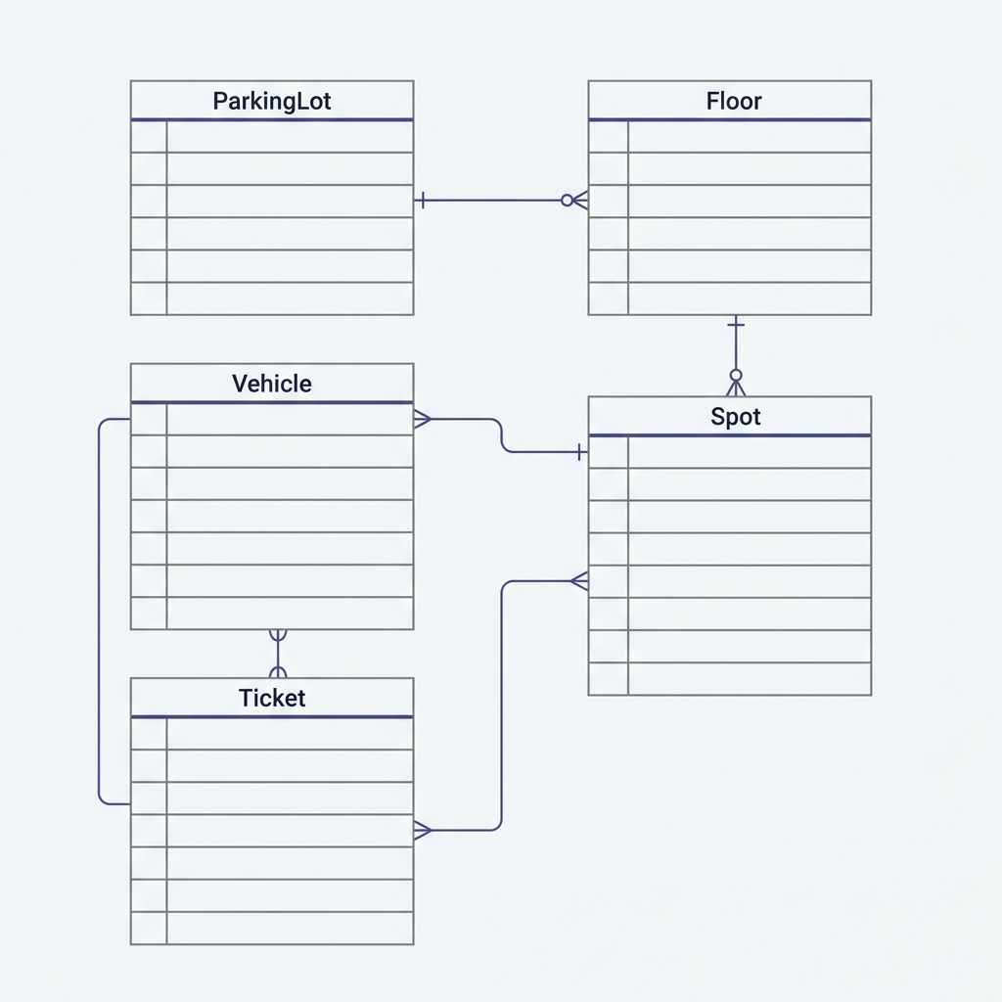
Domain Entities & Relationship Schema
PERSISTENT DATA STRUCTURES
▪ ParkingLot
Attributes: Id (PK), Name, Address
▪ Floor
Attributes: Id (PK), Number, ParkingLotId (FK)
▪ ParkingSpot
Attributes: Id (PK), SpotNum, IsOccupied, FloorId (FK)
▪ Vehicle
Attributes: Id (PK), LicensePlate, Type (Enum)
▪ ParkingTicket
Attributes: Id (PK), EntryTime, ExitTime, Fee, IsActive, VehicleId (FK), SpotId (FK), FeeType
Data Mapping: Navigation boundaries are eager-loaded via EF Core .Include() expressions in repository services.

Slide 5
OOP — Vehicle Inheritance Hierarchy
INHERITANCE STRUCTURING
public enum VehicleType { Motorcycle, Car, Truck }
We model vehicle categories (Motorcycle, Car, Truck) using a single inheritance chain. Instantiating the base class is blocked directly by declaring it abstract.
public abstract class Vehicle
{
public int Id { get; set; }
public string LicensePlate { get; set; } = string.Empty;
▪ Motorcycle Subclass
public VehicleType Type { get; protected set; }
}
Constructor sets VehicleType = Motorcycle
public class Motorcycle : Vehicle
▪ Car Subclass
{
Constructor sets VehicleType = Car
public Motorcycle() => Type = VehicleType.Motorcycle;
}
▪ Truck Subclass
public class Car : Vehicle
Constructor sets VehicleType = Truck
{
public Car() => Type = VehicleType.Car;
}
TPH Database Mapping: Transformed by EF Core into a single database table containing a string Discriminator column.

Slide 6
OOP — Polymorphic Spot Checks
SPOT COMPATIBILITY MATRIX
public abstract class ParkingSpot
Spot Class | Motorcycle | Car | Truck
CompactSpot | ✔ Fits | ✘ No | ✘ No
LargeSpot | ✔ Fits | ✔ Fits | ✔ Fits
Handicapped | ✔ Fits | ✔ Fits | ✘ No
{
public int Id { get; set; }
public int SpotNumber { get; set; }
public bool IsOccupied { get; protected set; }
public abstract bool CanFitVehicle(Vehicle v);
}
public class CompactSpot : ParkingSpot
Polymorphic Resolution Strategy:
{
public override bool CanFitVehicle(Vehicle v)
The base class ParkingSpot exposes an abstract method CanFitVehicle(). Subclasses implement the validation rules. This isolates the spot constraints inside each respective model, eliminating validation branches in controllers.
=> v.Type == VehicleType.Motorcycle;
}
public class HandicappedSpot : ParkingSpot
{
public override bool CanFitVehicle(Vehicle v)
=> v.Type == VehicleType.Motorcycle ||
v.Type == VehicleType.Car;
}

Slide 7
OOP — State Encapsulation and Safeguards
UNSAFE DOMAIN (NO ENCAPSULATION)
SAFE DOMAIN (ENCAPSULATED STATE)
// Properties can be changed directly from outside:
public abstract class ParkingSpot
spot.IsOccupied = true;
{
public bool IsOccupied { get; private set; }
// Threat: Double bookings can occur without safety check.
public int SpotNumber { get; set; }
public void Occupy()
{
if (IsOccupied)
External controllers are directly muting domain state. Business validations (e.g. check if spot is free before booking) are left to controllers, causing logic duplication.
throw new SpotAlreadyOccupiedException(SpotNumber);
IsOccupied = true;
}
public void Free()
{
if (!IsOccupied)
throw new SpotAlreadyFreeException(SpotNumber);
IsOccupied = false;
}
}

Slide 8
OOP — Billing Strategy & Factory Pattern
OPEN-CLOSED PRINCIPLE COMPLIANCE
public interface IFeeCalculator
We implement fee rules (Hourly, Daily, Flat) through an interface IFeeCalculator. The factory resolves calculators dynamically. Adding billing strategies requires zero modification to exit service logic.
{
decimal Calculate(DateTime inTime, DateTime outTime);
}
public class HourlyFeeCalculator : IFeeCalculator
{
public decimal Calculate(DateTime i, DateTime o)
▪ Hourly Strategy
=> (decimal)
Rs 50 / hour (rounded up)
Math.Ceiling((o - i).TotalHours) * 50.0m;
}
▪ Daily Strategy
Rs 500 / day (rounded up)
public class FeeCalculatorFactory
{
▪ Flat Strategy
private readonly Dictionary<FeeType, IFeeCalculator> _calcs;
Rs 200 flat fee regardless of stay
public IFeeCalculator GetCalculator(FeeType t)
=> _calcs[t];
}

Slide 9
Workflow Sequence: Park Vehicle
01
Incoming Validations
DTO request arrives containing LicensePlate, VehicleType, and FeeType. Model checks enforce properties.
02
Vehicle Fetch / Register
Query DB for existing vehicle. Reuses existing entity or creates a new subclass based on input.
03
Polymorphic Spot Allocation
Service runs a query on floor spots to resolve a match where Spot.CanFitVehicle(v) returns true.
04
Encapsulated Booking & Save
Invokes spot.Occupy() (safeguarding against double booking) and records active ParkingTicket. Transaction committed.
05
DTO Output Return
Map persistent ticket entities to a ParkingTicketResponse contract. Return HTTP 201 Created.

Slide 10
Workflow Sequence: Exit Vehicle
01
Eager Load Ticket
Query active ticket by Id. Uses eager loading (.Include) to fetch associated Vehicle and Spot objects.
02
State Validations
Verify ticket is open. If ticket is already closed, throw custom exception returning RFC 7807 problem details.
03
Dynamic Strategy Computation
Pass Ticket.FeeType to FeeCalculatorFactory. Resolve calculator and compute fee.
04
Release & Save State
Invoke spot.Free() inside ParkingSpot class. Sets Ticket ExitTime/Fee, mark IsActive = false, save changes.
05
Return API Response
Output closed ticket transaction details mapped to Response DTO. Yield HTTP 200 OK.

Slide 11
REST API Endpoints & Routes
HTTP Method | API Route Path | Authentication | Success | Action Description
POST | /api/parking/park | Required (JWT) | 201 Created | Park vehicle. Allocate spot & issue ticket.
PUT | /api/parking/exit/{ticketId} | Required (JWT) | 200 OK | Process exit, calculate fee & free spot.
GET | /api/parking/active | Public Route | 200 OK | Fetch a list of active vehicles parked.
GET | /api/parking/ticket/{ticketId} | Public Route | 200 OK | Retrieve a specific ticket log by ID.
POST | /api/auth/login | Public Route | 200 OK | Authorize username & return JWT payload.

Slide 12
Database Configuration & Data Seeding
TPH MODEL CONFIGURATION
DEFAULT INSTANTIATED SEED DATA
A migration configuration seeds database tables automatically on startup. This allows testing without manual record entry:
// EF Core Table-Per-Hierarchy (TPH)
protected override void OnModelCreating(
ModelBuilder modelBuilder)
{
01. ParkingLot Entity
modelBuilder.Entity<Vehicle>()
.HasDiscriminator<string>("Discriminator")
Downtown Hub Parking Lot.
.HasValue<Motorcycle>("Motorcycle")
.HasValue<Car>("Car")
.HasValue<Truck>("Truck");
02. Level Floors
modelBuilder.Entity<ParkingSpot>()
Instantiates Floor 1 and Floor 2.
.HasDiscriminator<string>("Discriminator")
.HasValue<CompactSpot>("CompactSpot")
.HasValue<LargeSpot>("LargeSpot")
.HasValue<HandicappedSpot>("Handicapped");
03. Strategic Spot Allocations
}
Seeds 10 spots distributed across floors:
▪ 3 CompactSpots (Motorcycles)
▪ 4 LargeSpots (All Vehicles)
▪ 3 HandicappedSpots (Cars and Motorcycles)

Slide 13
HTTP Request Middleware Pipeline
01
Global Exception Handler
Outermost layer. Intercepts exceptions, resolving domain validations to map custom RFC 7807 ProblemDetails.
02
Request Logger Middleware
Logs request verb, path, and incoming execution context. On output, logs status code and duration (ms).
03
Authentication Middleware
Extracts Bearer tokens from incoming Authorization headers. Decodes claims and updates HttpContext.
04
Authorization Middleware
Evaluates endpoints metadata. Rejects claims mismatch with 401 Unauthorized or 403 Forbidden.
05
Controller Routing
Endpoints map to matching actions. Accesses injected Services via DI to complete the request.

Slide 14
API Security & JWT Configurations
JWT CONFIGURATION (APPSETTINGS.JSON)
ACCESS POLICY BOUNDARIES
{
POST /api/parking/park
"JwtSettings": {
🔒 Authorized (JWT Signature Required)
"SecretKey": "SuperSecretSecureKeyWith32Chars+",
"Issuer": "ParkingLotSystem",
"Audience": "ParkingLotUsers",
PUT /api/parking/exit/{id}
"ExpiryMinutes": 60
🔒 Authorized (JWT Signature Required)
}
}
GET /api/parking/active
🔓 Open Access (Public Endpoint)
GET /api/parking/ticket/{id}
Authentication Scheme: Wire up Bearer token verification in Program.cs. Claims extract identity parameters directly to protect sensitive API boundaries.
🔓 Open Access (Public Endpoint)
POST /api/auth/login
🔓 Open Access (Public Endpoint)

Slide 15
Requirements & Verification Matrix
SESSION 1: OOP & DOMAIN
SESSION 2: MIDDLEWARE
SESSION 3: CONTRACTS
SESSION 4: DATABASE & AUTH
✔ Abstract Base Vehicles
✔ Async Service Interface
✔ Request/Response DTOs
✔ MySQL Schema via Pomelo
✔ Abstract Base Spots
✔ Custom Exception Mapping
✔ Static Entity Mapper
✔ EF Core 5-DbSet Context
✔ IFeeCalculator Strategy
✔ Request Log Pipeline
✔ DI Scoped Registry
✔ Startup Auto-Migrations
✔ LINQ Query Allocations
✔ RFC 7807 Global Errors
✔ Model Validations
✔ Bearer Token Verification
Validation Status: All 16 criteria resolved. Unit and integration flows verified via local execution.

Slide 16
Verification playbook: Live Swagger Demo
SWAGGER ENDPOINT PLAYBOOK
Open Swagger interface: /swagger/index.html to execute verification steps
01
Authenticate User ➔ Send POST request to /api/auth/login. Submit default payload: (admin / admin123). Copy returned JWT token.
02
Bearer Setup ➔ Click Swagger 'Authorize' button. Paste Bearer token directly into authorization header.
03
Register Parking ➔ POST to /api/parking/park. Input license, vehicle type, strategy. System creates ticket, return HTTP 201.
04
Audit Logs ➔ Call GET /api/parking/active. Validate that designated spot has IsOccupied state toggled to true.
05
Exit Validation ➔ Send PUT to /api/parking/exit/{ticketId}. Check billing computation, spot transitions back to free state.
Ahmed Essam · Technical Evaluation Final Project · June 29, 2026

