Slide 1
Jamra: one fair fire record from two satellites, with live early warning
Challenge: Harmonization of MODIS and VIIRS Hot Spots
Team Astro Byte
Shahd Farraj · Ahmed Etkaidek · Aya Salman
Ahmad Akhras · Tala Yousef
Local event by NOVA · NASA Space Apps Challenge 2026
Raw record (orange): 4.0× more hotspots after 2012 in Greece.
Harmonized (navy): 0.7×. The fake rise disappears.
Yearly hotspots in Greece, 2003–2025. Data: NASA FIRMS. Analysis: Jamra.
Team Astro Byte · NASA Space Apps Challenge 2026 · Harmonization of MODIS and VIIRS Hot Spots
1
Notes:
Speaker: Shahd Farraj
Hello, we are Team Astro Byte and this is Jamra, which means ember in Arabic. Satellites have watched fires for more than twenty years, but the record is split between an older sensor, MODIS, and a sharper one, VIIRS. On this chart the orange line is what you get if you simply join them: in Greece the number of hotspots jumps about 4.0 times after 2012. The dark line is our harmonized record: the fake jump is gone, and the real disasters, like 2007, 2021 and 2023, stand out. In the next minutes we show how we built it, how well it works, and how it warns people live.

Slide 2
Joining MODIS and VIIRS raw creates a fake rise in fires after 2012, and the old satellites are retiring
Who we serve
6.2×
E
Emergency managers & early warning
F
Firefighting teams
more hotspots seen by VIIRS than MODIS for the same fires
VIIRS S-NPP ÷ MODIS Aqua, all hotspots, 8 countries, calibration years 2012–2025
L
Land & forest managers
S
Scientists & researchers
Also benefit: village councils, municipalities, farmers (via local authorities)
MODIS (2000–) is near end of life; NASA stopped S-NPP VIIRS data on 2 Nov 2026.
Data: NASA FIRMS (MODIS C6.1 Aqua, VIIRS 375 m S-NPP / NOAA-20), standard processing 2003–2025. Analysis: Jamra.
Team Astro Byte · NASA Space Apps Challenge 2026 · Harmonization of MODIS and VIIRS Hot Spots
2
Notes:
Speaker: Shahd Farraj
Here is the problem in one number. For the same fires, VIIRS records about 6.2 times more hotspots than MODIS, because its pixels are 375 metres wide instead of one kilometre. So anyone who joins the two records raw sees fires suddenly multiply after 2012: about 4.0 times in Greece and 3.5 times in Portugal. That misleads the people who plan with fire history: emergency managers and early-warning teams, firefighting teams, land and forest managers, and scientists. Through them, village councils, municipalities and farmers benefit too. And it is urgent: MODIS is near the end of its life, and NASA stopped the S-NPP VIIRS data stream on 2 November 2026, so a fair, continuous record is needed now.

Slide 3
Two eyes in the sky: MODIS 1 km since 2000, VIIRS 375 m since 2012, same afternoon orbit for Aqua and S-NPP, so we can compare them fairly
Same 1 km × 1 km patch of ground
Who watched when
MODIS Terra (~10:30)
MODIS Aqua (~13:30)
VIIRS S-NPP (~13:30)
stopped 2 Nov 2026
VIIRS NOAA-20
MODIS: 1 pixel (1 km)
VIIRS: ~7 pixels (375 m)
pixel geometry, not a count
VIIRS NOAA-21
Smaller pixels catch smaller fires, so VIIRS counts more hotspots.
overlap: our calibration lab
2000
2006
2012
2018
2024
Calibration years: 13 stable overlap years (2012–2025 without 2021).
Data: NASA FIRMS (MODIS C6.1 Aqua, VIIRS 375 m S-NPP / NOAA-20), standard processing 2003–2025. Analysis: Jamra.
Team Astro Byte · NASA Space Apps Challenge 2026 · Harmonization of MODIS and VIIRS Hot Spots
3
Notes:
Speaker: Ahmed Etkaidek
Let me introduce the two eyes. MODIS flies on Terra and Aqua and has watched since 2000 with pixels about one kilometre wide. VIIRS, since 2012, sees 375 metre pixels, so about seven VIIRS pixels fit in one MODIS pixel and small fires are caught. Aqua and S-NPP cross the equator at about 1:30 in the afternoon and night, so they look at the same fires at the same hour: a fair pair for calibration. All data come from NASA FIRMS: standard yearly archives for history and the FIRMS API for live data. We checked the VIIRS to MODIS ratio year by year and used 13 stable overlap years; 2021 was an outlier and was left out. Since S-NPP stopped, live data come from NOAA-20, the same instrument, converted with a measured factor of 0.97.

Slide 4
We harmonize per area and per month, then compare each month with its usual, and watch live
1 Overlap years
2 Conversion factor
3 Compare with usual
Count VIIRS and MODIS hotspots in the same country and month, 2012–2025.
k = (V + λ·k_country) / (M + λ)
Few fires → lean on the country.
Each month vs the same month in other years: median, 25–75%, percentile.
Chosen by cross-validation: M3 (ratio per country and month (shrinkage)), out of six models.
NASA FIRMS archive
Monthly rebuild
NASA FIRMS API
Early-warning check
Jamra web app
yearly files
harmonize + baselines
every 3 hours
month-to-date vs past
calendar · alerts · CSV
Data: NASA FIRMS (MODIS C6.1 Aqua, VIIRS 375 m S-NPP / NOAA-20), standard processing 2003–2025. Analysis: Jamra.
Team Astro Byte · NASA Space Apps Challenge 2026 · Harmonization of MODIS and VIIRS Hot Spots
4
Notes:
Speaker: Aya Salman
Our method has three steps. First, in the overlap years we count, for each country and calendar month, how many VIIRS hotspots appear per MODIS hotspot. Second, we turn that into a conversion factor with shrinkage: when a month or a small drawn area has few fires, the factor leans on the broader country value, so noise does not explode. For any area a user draws, Jamra computes that area's own factor and shows its uncertainty. Third, every month is compared with the same month in other years: the median, the middle half, and a percentile rank. We compared six models with leave-one-year-out cross-validation and chose M3, the simplest within five percent of the best. Behind it, the archive rebuilds monthly from NASA FIRMS, and the live job pulls the FIRMS API every three hours.

Slide 5
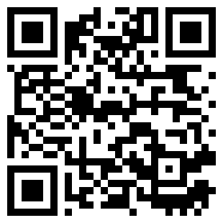
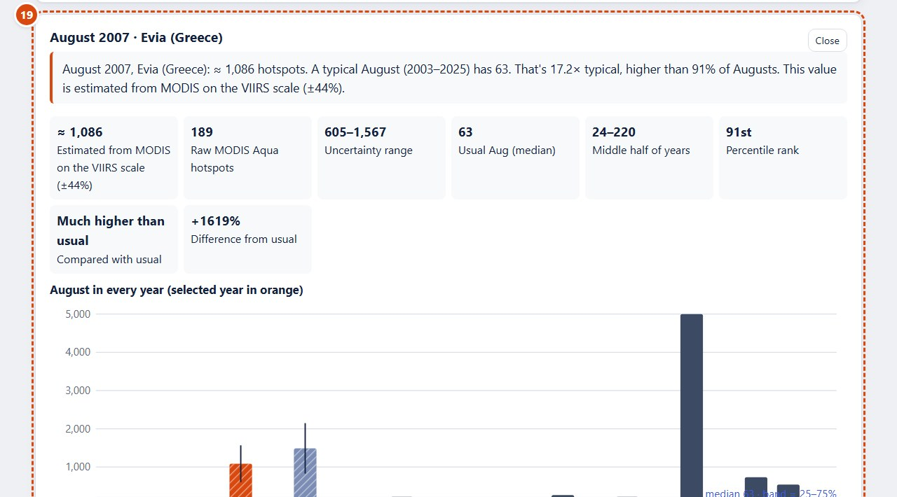
Pick any area, see its burning calendar, and know which values are observed and which are estimated
J
F
M
A
M
J
J
A
S
O
N
D
August 2007, Evia: ≈ 1,086 hotspots
17.2× a typical August (usual 63)
Estimated from MODIS on the VIIRS scale, ±44%
2003
2005
2007
2009
2011
2013
Try it live
ahmedetk.github.io/jamra/
2015
2017
2019
• 8 pages: Calendar, Alerts, Live Data, Validation…
• Presets, countries, polygon, circle, lat/lon
• Observed vs estimated, with ±
• Alerts every 3 h from NASA FIRMS
• CSV, PNG and one-page summary
2021
2023
2025
Evia (Greece), hotspots per month 2003–2025, VIIRS-equivalent, log colour scale. Rows before 2012 are estimated from MODIS.
The Jamra web app (installable on phones).
Data: NASA FIRMS (MODIS C6.1 Aqua, VIIRS 375 m S-NPP / NOAA-20), standard processing 2003–2025. Analysis: Jamra.
Team Astro Byte · NASA Space Apps Challenge 2026 · Harmonization of MODIS and VIIRS Hot Spots
5
Notes:
Speaker: Ahmad Akhras
Live demo, six steps. 1) Home (https://ahmedetk.github.io/jamra/?area=greece&hero=raw): the raw yearly chart for Greece jumps after 2012. 2) Press Harmonized: the fake jump disappears. 3) Press 'Try the Evia 2007 example' (https://ahmedetk.github.io/jamra/calendar/?area=evia&from=2003&to=2025&month=2007-08&mode=abs&detail=1): the Calendar opens on Evia, August 2007, with the details open. 4) The bars compare August in every year: about 1,086 hotspots, 17.2 times a typical August of 63. 5) Point at the label: this value is estimated from MODIS on the VIIRS scale, plus or minus 44 percent (range 605 to 1,567); raw MODIS saw only 189. 6) End on the Validation page (https://ahmedetk.github.io/jamra/validation/): on held-out years the monthly error drops from 87 to 40 percent. Extra if time: Alerts (https://ahmedetk.github.io/jamra/alerts/) and Live Data (https://ahmedetk.github.io/jamra/live/?area=greece). If Wi-Fi fails, the app works offline from cache; backup screenshots are in AstroByte_Backup.pptx.

Slide 6
Does it work? On held-out years, monthly error drops from 87% to 40% and 82 of 121 high-fire months are caught
87% → 40%
typical monthly error on test years, raw → harmonized
82 of 121
high-fire months caught · 37 false alarms (raw MODIS: 5)
44%
error in small fire areas (55% in 239 1° areas) · local factor adopted
Honest limits
• Hotspots are not fires or burned area; clouds hide fires.
• Small areas: few hotspots → wider error (shown as ±).
• FRP was not more stable than counts, so we use counts.
Model chosen on development years 2012–2020; scored on test years 2022, 2023, 2024, 2025. Country-months with ≥10 VIIRS hotspots.
Data: NASA FIRMS (MODIS C6.1 Aqua, VIIRS 375 m S-NPP / NOAA-20), standard processing 2003–2025. Analysis: Jamra.
Team Astro Byte · NASA Space Apps Challenge 2026 · Harmonization of MODIS and VIIRS Hot Spots
6
Notes:
Speaker: Aya Salman
Does it work? We built the model only on 2012 to 2020 and kept 2022 to 2025 hidden as a final test. On those test years, raw MODIS is off by 87 percent on a typical country-month; harmonized, 40 percent, and 16 percent on a yearly total. For early warning, real VIIRS had 121 higher-than-usual months: we caught 82, with 37 false alarms; raw MODIS caught only 5. Small areas are harder: typical error 44 percent in the fire areas and 55 percent in 239 one-degree areas. The local factor beat the country factor on the test years, by a small margin, so we adopted it. Limits: hotspots are not fires or burned area, clouds hide fires, and FRP was not more stable than counts in our test, so we use counts.

Slide 7
Impact and next steps: a fair 23-year fire calendar for any area, live warnings today, more regions tomorrow
Shahd Farraj
Ahmed Etkaidek
Aya Salman
Problem & users · slides 1–2
NASA data & live system · slide 3
Science: method & validation · slides 4, 6
Ahmad Akhras
Tala Yousef
Calendar & live demo · slide 5
UX, impact & next steps · slide 7
Shared: idea and method, testing with real users, pitch rehearsal.
Scan to try Jamra
ahmedetk.github.io/jamra/
Next steps
More regions
Arabic interface
Telegram + SMS
Terra + Aqua
global coarse grid
right-to-left
alerts
26% vs 31% error, to 2001
Data: NASA FIRMS (LANCE / ESDIS). We acknowledge the use of data from NASA's Fire Information for Resource Management System (FIRMS). NASA does not endorse this project.
SI disclosure: we used an SI coding assistant (Claude Code by Anthropic) to write the code for the pipeline, website, live system and slides, following our design and decisions. The team chose the method, checked results against NASA FIRMS data and verified every reference.
Team Astro Byte · NASA Space Apps Challenge 2026 · Harmonization of MODIS and VIIRS Hot Spots
7
Notes:
Speaker: Tala Yousef
Jamra gives emergency teams one fair record from 2003 to today, for any area they draw, with a live early-warning check every three hours and open CSV downloads. It runs on free infrastructure and NASA open data, and it installs on a phone. Next, we want more regions, an Arabic interface, Telegram and SMS alerts, and to test Terra plus Aqua, which showed a lower cross-validated error (26 versus 31 percent) and could extend the record to 2001. Each of us owned one part, shown here; together we chose the idea and the method, tested the site with real users, and rehearsed this pitch. We used an SI coding assistant to write the code, following our design; we checked the numbers against NASA FIRMS. Thank you, scan the code and try Jamra yourself.

