Slide 1
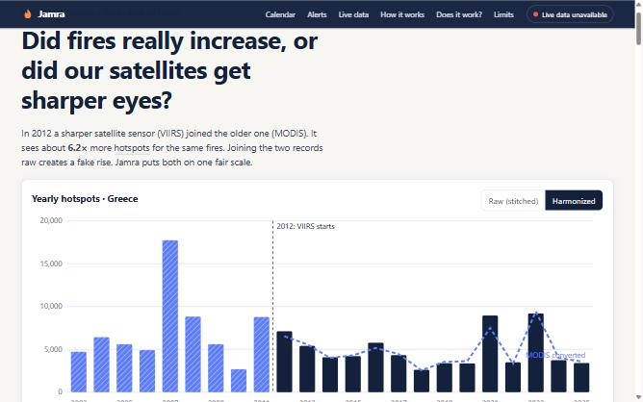
Backup (not part of the 7-slide submission): app

