Slide 1
Controlling Car with hand motion

Slide 2

Group:Alex 25
Ahmed Ezz
Ahmed abdelhak
Ahmed Ehab
Mail:
Ezz81800@gmail.com
mailto:ahmadbatto3@gmail.com
mailto:habdelhaqe@mail.com

Slide 3
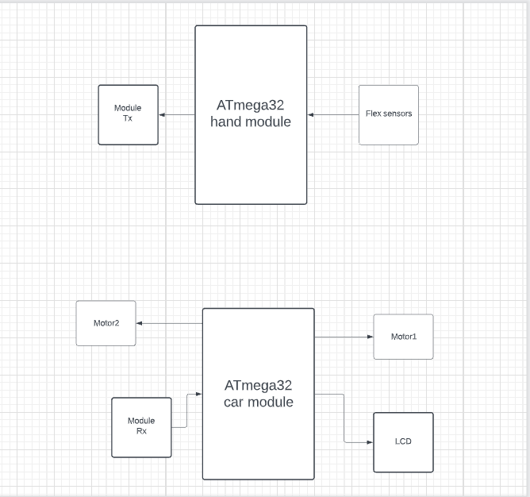

Slide 4
GitHub Link

