Slide 1
SENIOR HCI PROJECT · 2025–2026
Wasla.
Your Smart Subscription Hub
مركز اشتراكاتك الذكي — تتبع، أدر، ووفر
6 Members · 1 Supervisor
Umm Al-Qura University
Flutter · Firebase
WCAG 2.1 AA / AAA
Wasla · Senior HCI Project · 2025–2026
01 / 18

Slide 2
OVERVIEW · نظرة عامة
One hub. Every subscription. Zero surprise charges.
Wasla is a smart bilingual subscription manager for Saudi Arabia and the GCC — designed to fix the fragmented way people track recurring payments across streaming, software, gym, education, and family services.
PROBLEM
GOAL
SOLUTION
OUTCOME
Subscriptions are scattered across emails, apps, and bank statements. Users lose track and pay for what they don’t use.
Centralise every recurring payment, surface the real monthly / yearly cost, and alert users before each renewal.
A Flutter + Firebase mobile app with native RTL Arabic, deterministic AI chatbot, and guided cancellation.
Validated with 221 survey participants and 5 think-aloud users. WCAG AAA contrast. 6–8 weeks to ship.
Wasla · Senior HCI Project · 2025–2026
02 / 18

Slide 3
01 · PROBLEM · المشكلة
Subscriptions are bleeding Saudi wallets — silently.
Validated with 221 survey participants across Saudi Arabia. 50.7% experienced at least one unexpected charge.
96.9%
50.7%
76%
84%
Want renewal reminders
Hit by surprise charges
Forget active subscriptions
Want Arabic first
لم يكن لديهم تطبيق يقدم تذكيرات قبل التجديد.
تعرضوا لرسوم غير متوقعة على الأقل مرة واحدة.
ينسون اشتراكات نشطة ويدفعون بدون استخدام.
يطلبون تطبيقاً عربياً أصيلاً بواجهة RTL.
Wasla · Senior HCI Project · 2025–2026
03 / 18

Slide 4
02 · SOLUTION · الحل
A 4-pillar ecosystem, designed for the GCC.
One hub. Four orbiters. End-to-end control over every subscription in your life.
TRACK
كل اشتراك في مكان
Live renewal calendar + customisable reminders.
WASLA HUB
ANALYSE
لوحة إنفاق ذكية
Monthly / yearly spending with insights.
Smart Add · Analytics · Renewal Alerts · Smart Offers · Cancel Guides · AI Assistant · Multi-Channel · Favourites
ASSIST
مساعد عربي فوري
Deterministic Arabic chatbot.
CANCEL
إلغاء ميسر
Step-by-step cancellation for any provider.
Wasla · Senior HCI Project · 2025–2026
04 / 18

Slide 5
03 · FEATURES · المزايا
Eight capabilities, one super-app.
Each feature is backed by survey data, think-aloud tests, and a clean design system.
Smart Add
Analytics
Renewal Alerts
Smart Offers
إضافة ذكية
تحليلات
تنبيهات
عروض ذكية
Auto-categorise + price intelligence
Monthly / yearly spending toggle
3-day default, customisable per sub
Personalised deals on top cats
Cancel Guide
AI Assistant
Favourites
Multi-Channel
دليل الإلغاء
مساعد ذكي
المفضلة
دعم متعدد
Step-by-step in-app
Deterministic Arabic chatbot
Pin important subs for quick access
WhatsApp · Email · Phone
Wasla · Senior HCI Project · 2025–2026
05 / 18

Slide 6
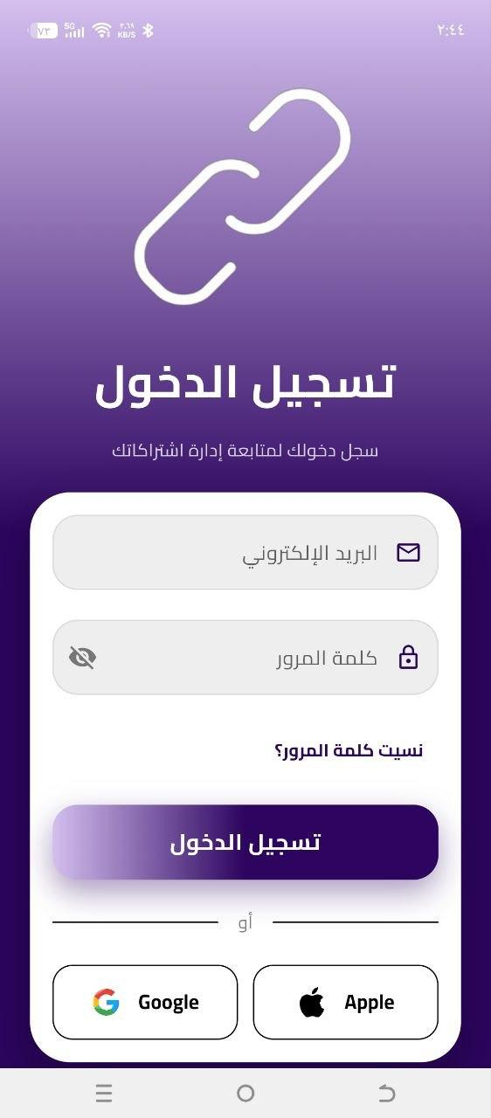
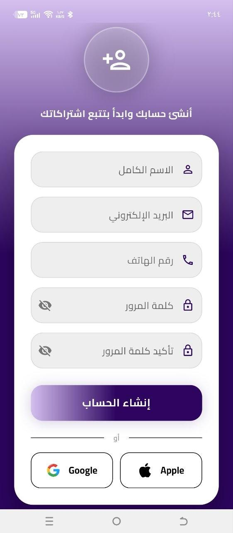
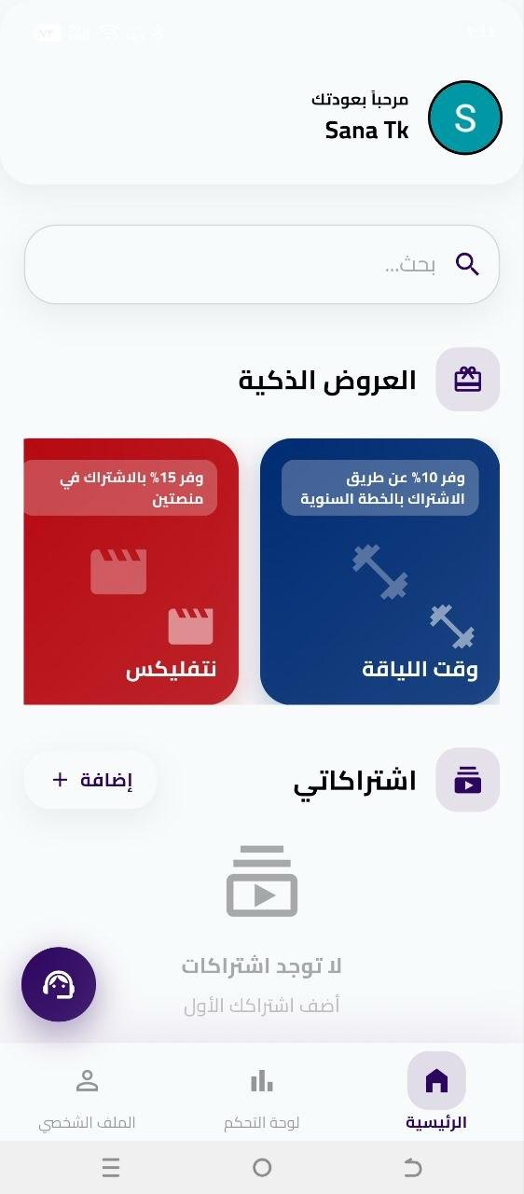
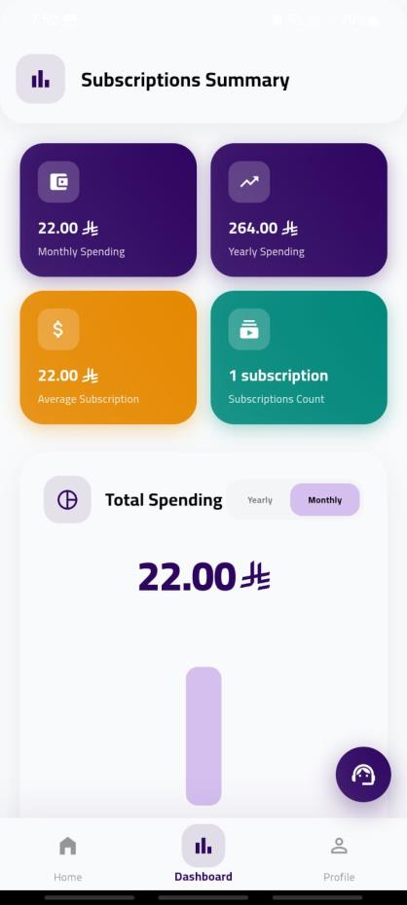
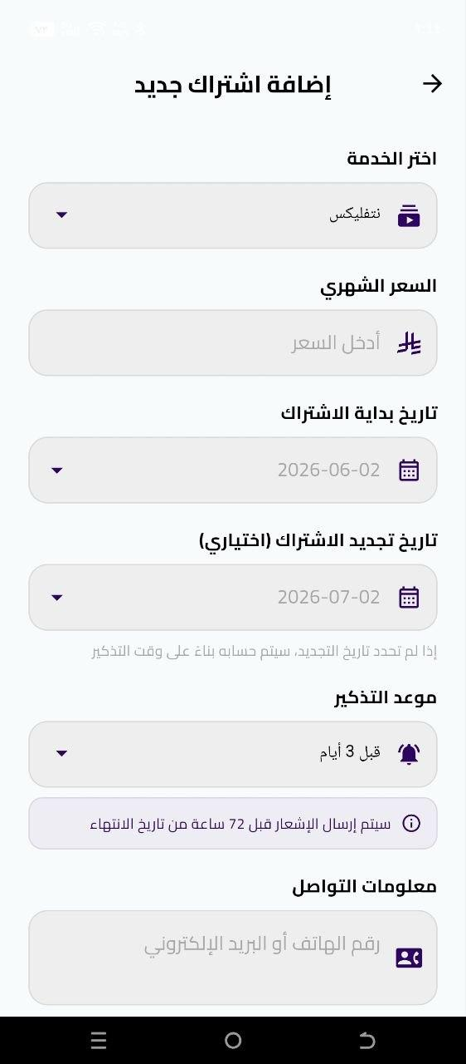
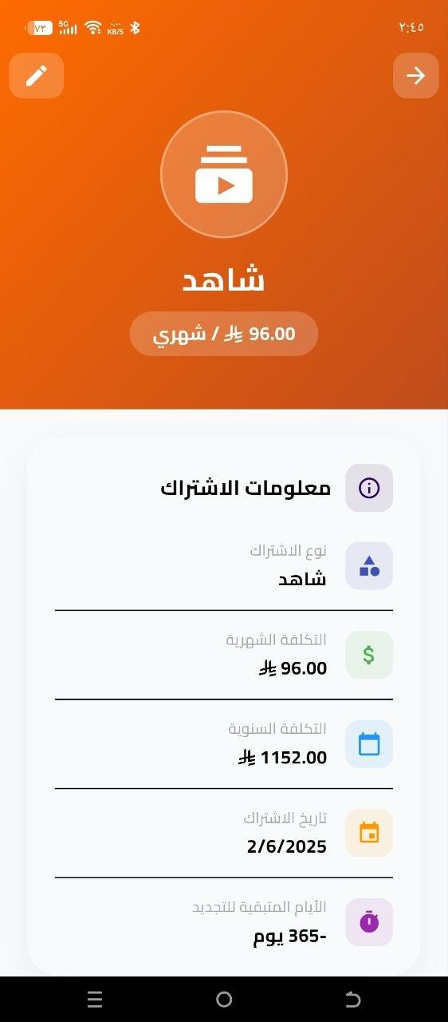
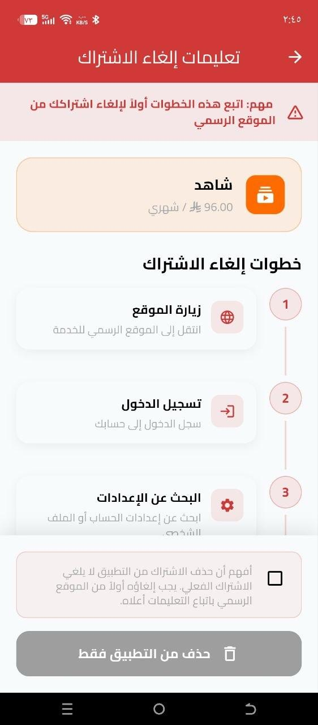
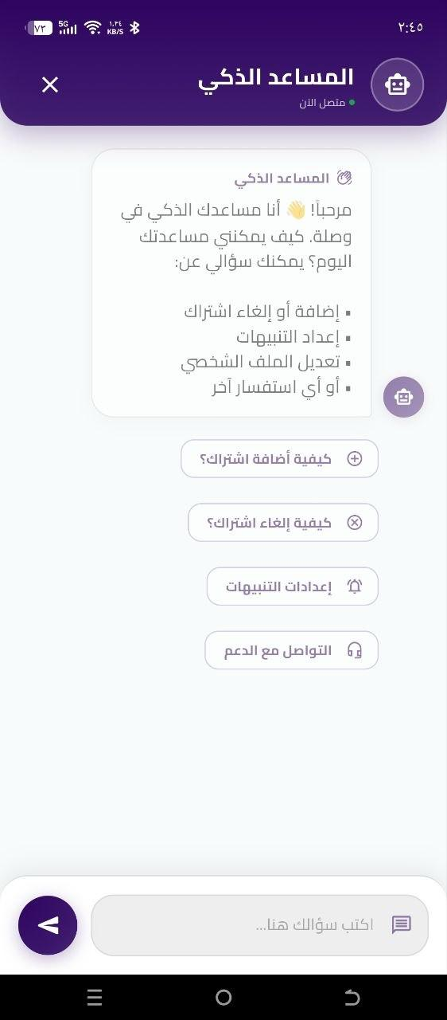
04 · SCREENS · الشاشات
Eight high-fidelity screens, validated in Arabic.
Built in Flutter · Material 3 · with native RTL support. Dashboard colors match the design system shipped in the actual app.
Login
Signup
Home
Dashboard
Add
Details
Cancel
Chatbot
Wasla · Senior HCI Project · 2025–2026
06 / 18

Slide 7
05 · ARCHITECTURE · المعمارية
Clean Dart + Firebase. Three actors, one model.
The Subscription model is the heart. The Dashboard widget reads it. The Chatbot service answers questions about it. Real code on the left.
1 Three actors, one model
lib/models/subscription_model.dart
// Real Subscription model from waslaa app
import 'package:cloud_firestore/cloud_firestore.dart';
import 'package:flutter/material.dart';
class Subscription {
final String id, userId, name;
final String? customName;
final double price;
final DateTime renewalDate;
final DateTime? expiryDate;
final String iconColor;
final String? notes, reminder, contactInfo;
late Color _cachedColor;
Subscription({
required this.id,
required this.userId,
required this.name,
required this.price,
required this.renewalDate,
required this.iconColor,
}) { _cachedColor = Color(int.parse(iconColor)); }
Color get color => _cachedColor;
String get displayName {
if (name == 'اشتراك مخصص') return customName!;
return name;
}
The Subscription model is the single source of truth. Each actor has a focused responsibility around it.
U
User Actor
A
Admin Actor
S
System Actor
PRIMARY
OPERATOR
BACKGROUND
→
Manage subs (CRUD)
→
Manage advertisements
→
Monitor renewal dates
→
View analytics
→
Manage offers
→
Generate notifications
→
Receive reminders
→
Send push notifications
→
Process spending analytics
→
Talk to AI assistant
→
View system analytics
→
Store preferences locally
→
Customise settings
→
Re-render all screens in new theme
→
View offers & cancel guides
→
Search & contact support
Wasla · Senior HCI Project · 2025–2026
07 / 18

Slide 8
06 · RESEARCH METHODOLOGY · منهجية البحث
Mixed-methods research, two GPs, 226 participants.
A multi-stage user-centred design process that informs every design decision in Wasla.
1
Literature & Market Review
221
5
2
Analysed 12 popular subscription apps to identify feature gaps in the GCC market.
2
Quantitative Survey · 221 participants
Online questionnaire targeting young adults (18–35) in Saudi Arabia.
Survey participants
Think-aloud users
Graded projects
3
Qualitative Interviews · 5 users
Semi-structured interviews to deepen survey findings and uncover pain points.
12
AAA
4
4
Think-Aloud Usability Test · 5 users
Conducted during GP1 and GP2 to validate prototypes and the final system.
Competitor apps
WCAG 2.1 contrast
Roadmap phases
5
Accessibility & Visual Audit
WCAG 2.1 AA / AAA contrast verified at 19.41:1, 15.42:1, 12.57:1, 11.56:1.
Wasla · Senior HCI Project · 2025–2026
08 / 18

Slide 9
07 · TESTING METHOD · طريقة الاختبار
Think-Aloud usability testing, twice.
A formative usability test with 5 participants during both GP1 and GP2.
1
Add a new subscription
Test Setup
From launch, through category selection, to saving.
2
Edit an existing subscription
✓
Test name: Usability test for Wasla
Modify reminder settings, price, or notes.
✓
Test type: Usability, Think-Aloud Protocol
3
Delete a subscription
✓
Sample size: 5 users per round (GP1 + GP2)
Including the confirmation flow and feedback.
✓
Environment: Mobile (Android), touch-based
4
Manually add a custom subscription
✓
Prerequisites: Logged in, internet, ≥1 sub, notifications
Including contact info and notes fields.
✓
Data captured: time-on-task, errors, verbal protocol
5
Display the control panel
✓
Iteration cycle: find issues → fix → re-test → ship
Open the dashboard and inspect monthly / yearly view.
Wasla · Senior HCI Project · 2025–2026
09 / 18

Slide 10
08 · TESTING RESULTS · نتائج الاختبار
GP1 → GP2: measurable improvement on every aspect.
A side-by-side comparison of GP1 (prototype) versus GP2 (final system).
Aspect
GP1 Prototype
GP2 System
Improvement
Status
Add Subscription
Add button small & unclear, up to 55s to complete.
Most users added subs successfully. "لقيت زر الإضافة بسرعة".
Improved button visibility.
Pass
User Interface
Small fonts, unclear layout, unnecessary dashboard elements.
Dashboard appreciated — clear and organized.
Better UI organization.
Pass
Reminder Editing
Feature not available in GP1 testing.
Most users successfully edited reminders.
Added reminder editing.
Pass
Delete / Cancel
Process simple, but no direct unsubscribe links.
Most users deleted subs successfully.
Improved deletion flow.
Pass
Subscription Info
Some users confused about expiry & renewal.
Dashboard clearly shows monthly & yearly expenses.
Improved clarity of tracking.
Pass
Custom Subscription
Feature not available in GP1 prototype.
Users could manually add custom subscriptions.
More flexible management.
Pass
All 6 aspects passed
Minor follow-ups
Visual polish
Zero blocking issues, no critical errors.
Fewer confirmations, clearer custom-sub labels.
One user requested a colour & UI refresh.
Wasla · Senior HCI Project · 2025–2026
10 / 18

Slide 11
09 · COMPARISON · المقارنة
Wasla closes every meaningful gap.
Benchmarked against the three most popular subscription managers in global app stores.
BillBot · Subby · Bobby
Wasla · وصلة
Most popular subscription apps
Built for Saudi Arabia & the GCC
Arabic language support
✗
Arabic language support
✓
Smart personalised offers
✗
Smart personalised offers
✓
Cancellation guidance
PART
Cancellation guidance
✓
Spending analytics
PART
Spending analytics
✓
Personalized settings
PART
Personalized settings
✓
AI chatbot assistant
✗
AI chatbot assistant
✓
Dark / Light mode
✗
Dark / Light mode
✓
Font size customisation
✗
Font size customisation
✓
Multi-channel support
✗
Multi-channel support
✓
Native RTL interface
✗
Native RTL interface
✓
Wasla · Senior HCI Project · 2025–2026
11 / 18

Slide 12
10 · USER FLOW · رحلة المستخدم
From sign-up to saved money, in 5 steps.
A linear, predictable flow that 5 think-aloud users completed without guidance during GP2.
01
02
03
04
05
Register / Login
Add Subscription
View Dashboard
Get Reminders
Manage & Save
Email + password, Google or Apple sign-in.
Category, price, dates, reminder settings.
Monthly / yearly spending with toggle.
Notified 3 days before each renewal.
Edit, cancel, smart offers, chatbot.
Wasla · Senior HCI Project · 2025–2026
12 / 18

Slide 13
11 · TECH STACK · التقنيات
A modern, accessible foundation.
Cross-platform Flutter client, Firebase backend, deterministic AI, Material Design 3.
◆
Flutter / Dart
◆
Material 3
◆
Firebase
◆
FCM
iOS + Android from one codebase
Custom Wasla tokens
Auth · Firestore · Functions
Push notifications
◆
Deterministic AI
◆
Figma
◆
Provider / BLoC
◆
Cloud Functions
Curated Arabic responses
High-fidelity prototypes
State management
Reminder scheduling
Wasla · Senior HCI Project · 2025–2026
13 / 18

Slide 14
12 · ROADMAP · خارطة الطريق
From prototype to a smarter future.
GP1 and GP2 are validated and shipped. Phase 3 unlocks the platform for personal finance.
GP1 · COMPLETED
GP2 · COMPLETED
P3 · FUTURE
P4 · FUTURE
Core CRUD + Dashboard
AI + Offers + Cancellation
Bank Integration
Advanced AI + Marketplace
Add / edit / delete subscriptions, basic dashboard, reminder, login flow.
Deterministic Arabic chatbot, smart offers, step-by-step cancel.
Connect bank and payment platforms, auto-discover subscriptions.
Spending predictions, marketplace, family sharing.
Wasla · Senior HCI Project · 2025–2026
14 / 18

Slide 15
13 · IMPACT · الأثر
Designed around real users, real data.
A research-driven HCI project — every design decision is backed by a survey, interview, or test.
221
96.9%
50.7%
19.41:1
Survey Participants
Want Reminders
Hit by Surprise
WCAG Pass
Young adults & professionals across Saudi Arabia.
And didn’t have them in any existing app.
Experienced at least one unexpected charge.
Contrast ratio verified AA & AAA.
Wasla · Senior HCI Project · 2025–2026
15 / 18

Slide 16
14 · TEAM · الفريق
The people behind Wasla.
Six future HCI specialists from Umm Al-Qura University, guided by Dr. Reem Saleh Alshaikh.
G
K
E
M
K
S
Ghadi Shaker Mutair Al-Fadhli
Kholoud Sultan Atiq Al-Otaibi
Elaf Ahmad Abdulsttar Almaymani
Maryam Zainalabidin Fatani
Khadijah Ahmed Azab
Suha Abdulrahman Turkistani
Team Lead · قائدة الفريق
UI/UX Designer · Researcher
Backend Developer
Quality Assurance · Testing
Documentation · Content
AI / Chatbot Developer
Frontend
UI/UX
Backend
QA
Docs
AI
444000760
444005515
443008696
444006766
444001406
444006390
SUPERVISOR · المشرف
Dr. Reem Saleh Alshaikh · د. ريم الشيخ
College of Computing · Umm Al-Qura University · كلية الحاسبات
Wasla · Senior HCI Project · 2025–2026
16 / 18

Slide 17
15 · DOCUMENTATION · التوثيق
Full technical documentation, publicly available.
A complete technical reference at /docs — design system, file tree, code samples, deployment, accessibility.
Design System
File Tree
Code Samples
12 brand tokens, light & dark variants, typography, spacing, motion, elevation.
lib/models, lib/services, lib/providers, lib/screens, assets — annotated.
Subscription model, SpendingChart, ChatbotService intent matcher, AuthService.
Architecture
Accessibility
Deployment
Three actors, Firebase integration, FCM reminders, Cloud Functions.
WCAG 2.1 AAA contrast ratios, font scaling, dark mode, RTL audit, screen reader.
Vercel-ready static site, GitHub Actions CI, security headers, clean URLs.
Wasla · Senior HCI Project · 2025–2026
17 / 18

Slide 18
END · النهاية
Thank You.
شكراً لكم
testuser@gmail.com
123A321
Supervisor: Dr. Reem Saleh Alshaikh
Flutter · Firebase · Dart
Umm Al-Qura University · College of Computing
Presented by the Wasla team · 2025–2026
Wasla · Senior HCI Project · 2025–2026
18 / 18

