Slide 1
slsh:~$ Simple Linux Shell
Presented By
Istiaq Ahmed Fahad
Roll: 1204
Supervised By
Dr. Kazi Muheymin-Us-Sakib

Slide 2
01
Project Overview
02
Motivation
TABLE OF CONTENTS
04
Working Progress & Future Target
03
How It Works
05
Tools & Technologies
06
Challenges

Slide 3
01
Project Overview

Slide 4
I will recreate a simple Linux Shell (Bash) that includes the basic shell operations namely:
Executing simple shell commands (will implement a few of them due to time limitation)
Command name customization (aliasing)
Tentative command suggestion,
Text & background color customization
Command auto-completion.

Slide 5
02
Motivation

Slide 6
Rather than working on Windows, I want to try something different. Therefore I decided to implement my project in Ubuntu to learn more about different operating systems.
Another reason for selecting this project is to minutely observe how the system process, I/O redirection, pipelines work, and to know how the shell has been implemented using C. Ultimately, I want to reinforce my knowledge about system-level programming by building the shell from scratch.

Slide 7
03
How It Works

Slide 8
Basic Shell Operation
Breaks the input into words and operators and Parse the tokens into simple commands
Execute the parsed command through exec system calls.
1
2
3
4
5
Reading Input from user’s terminal
Performs shell expansions and any necessary redirections
Optionally waits for the command to complete and collects its exit status

Slide 9
Tentative Command Suggestion
Customizing Text & Background Color
Command Auto Completion
In case of entering wrong commands, we’ll suggest the closest available commands. We’ll use the BK-Tree data structure to store the closest commands that are based upon Levenshtein Distance (Edit Distance) and will perform Inorder traversal of that tree to find the closest command as a suggestion. In addition, we’ll also implement KMP String Matching Algorithm to find the matched substring of given commands in order to find the executable file.
Our shell will also enable the user customize the text color as well as the background color using the ANSI Escape Codes.
This is an extended version of the command suggestion feature. In that case, we’ll execute a particular command that’s frequency is the highest among the suggested commands.

Slide 10
04
Working Progress & Future Target

Slide 11
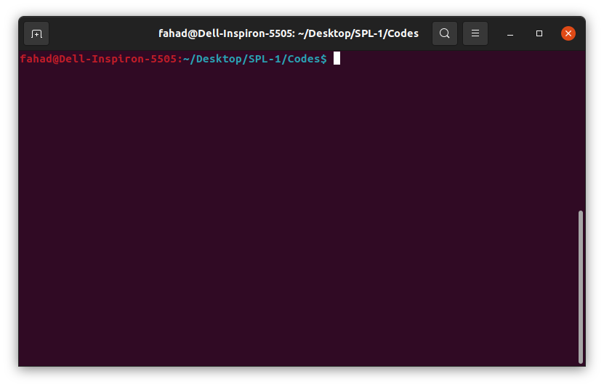
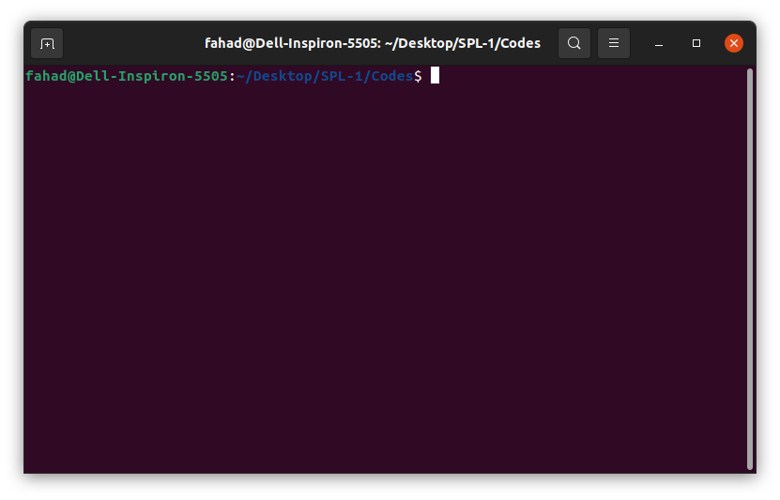
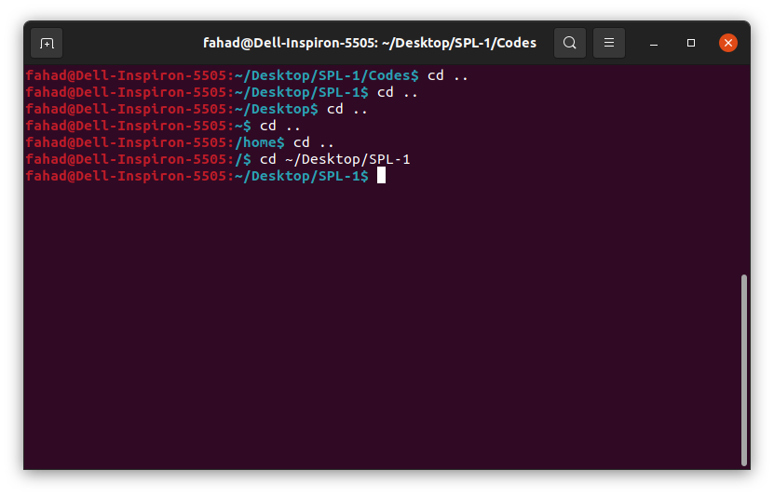
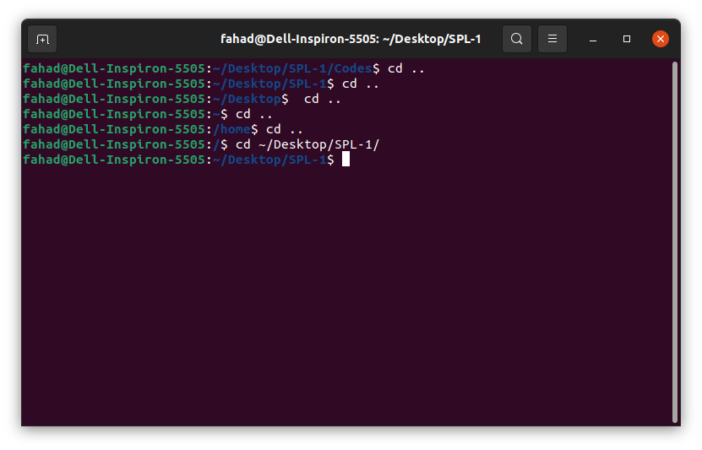
Progress so far
Reading user’s input from terminal through system prompt
slsh
bash
Implemented tilde expansion (~)
slsh
bash

Slide 12
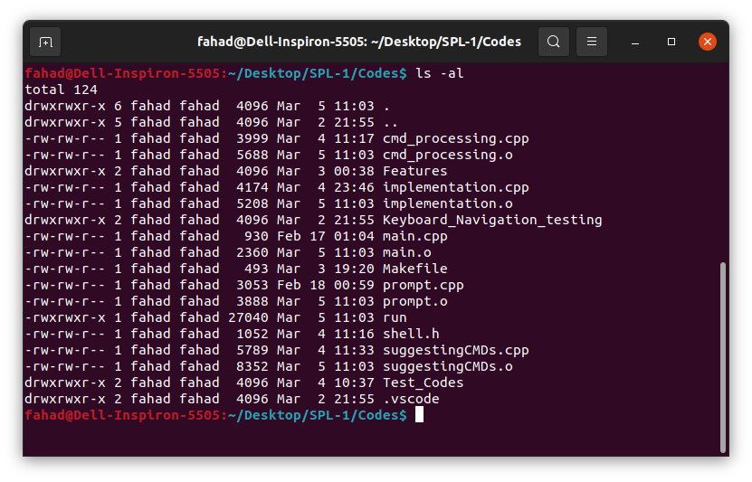
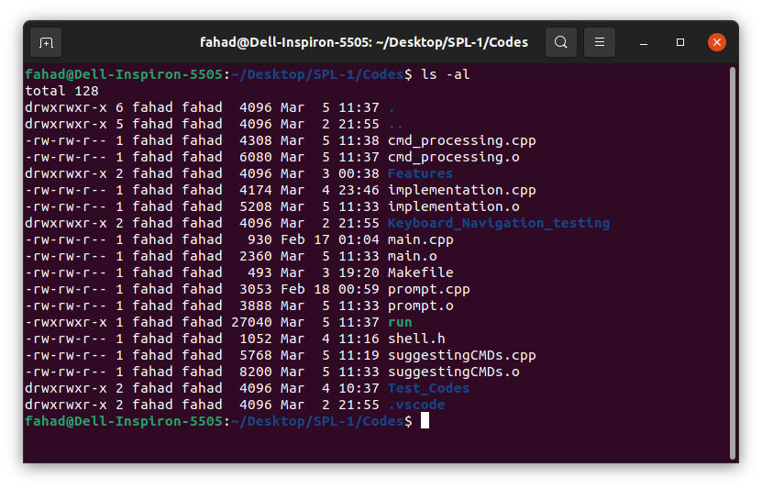
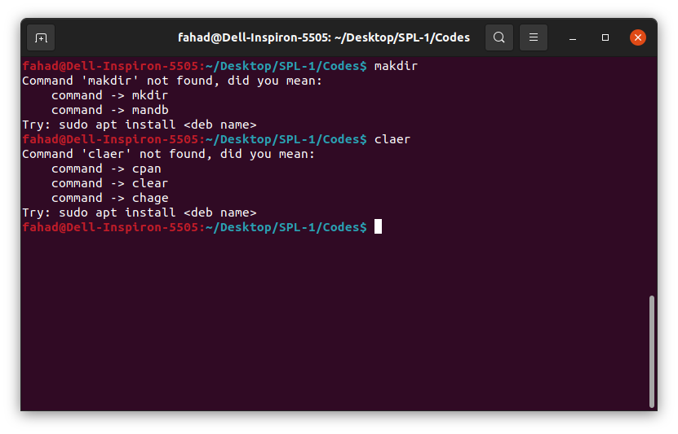
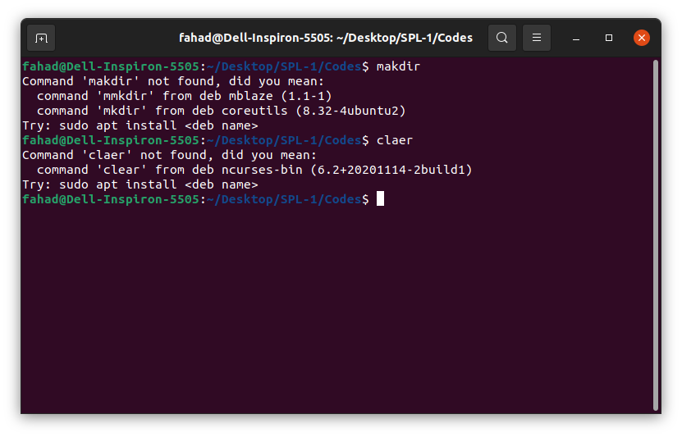
Progress so far
Parsing (delimited only by space) and Executing simple external commands.
slsh
bash
Suggesting tentative commands against wrong user input.
slsh
bash

Slide 13
Future Target
Parsing and Tokenizing complex commands (eg. ls -al | wc *.cpp -l)
Implementing some common builtin & external commands (history, apropos, alias etc.)
Customizing text and background colors.
Command auto-completion.

Slide 14
05
Tools & Technologies

Slide 15
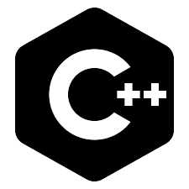

Coding Language
Operating System
C++
Linux (Ubuntu)

Slide 16
06
Challenges

Slide 17
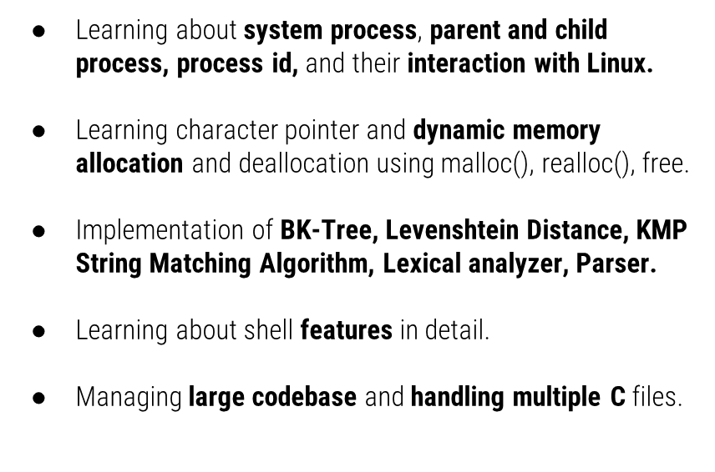

Slide 18
THANK YOU
Github: https://github.com/ahmedfahad04/SPL-1

