Slide 1


Slide 2
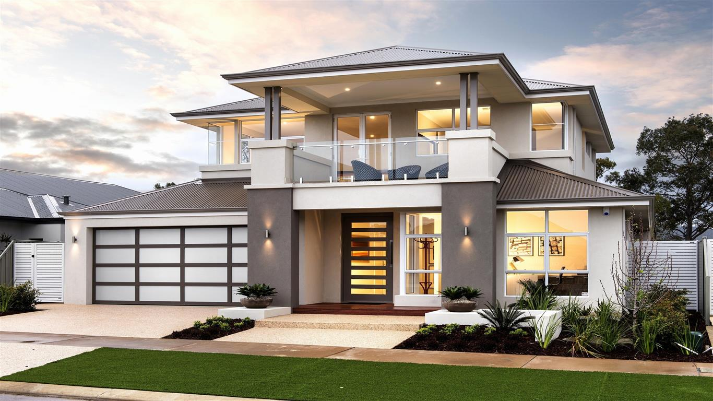
Rent It Out
All a Landlord and a tenant need is a Metamask wallet

Slide 3
Previous solutions to it

Slide 4


Slide 5

How we will help to solve
the problem

Slide 6
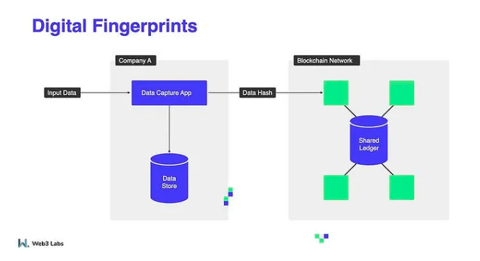

Slide 7
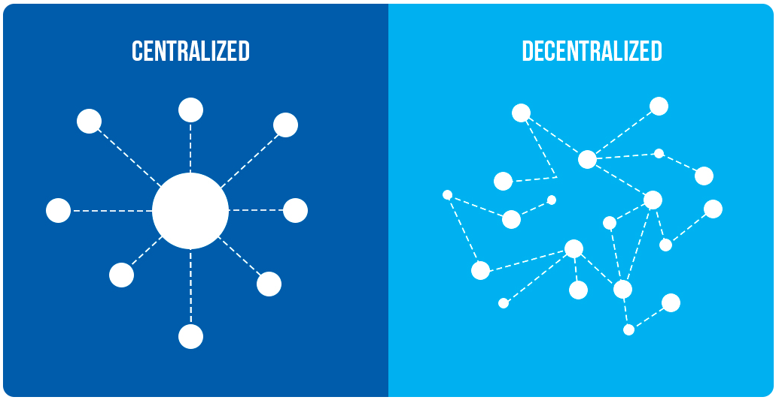
Stamp
Transaction
Monthly Transactions

Slide 8
Time Line:
The Project will be completed in 4 to 5 weeks.

Slide 9
Thank You For Your Time
And Patience

