Slide 1

LinkedIn Jobs
Unlocking Insights in Job Trends and Opportunities

Slide 2
Mavericks Members
Ahmed Gamal Logain Emad Ahmed Ragab Hager Wael Saleh Mohamed
Supervised by:
Ahmed Abdellatif

Slide 3
“Unlocking insights in the job market is not just about finding opportunities—it’s about understanding where the future is heading.”

Slide 4
Table of contents
1
2
3
5
4
6
Remote Work Allowance
Top Job Locations
Work Type Overview
Most Popular Job Postings
Top Paid Jobs
Overview of Job Benefits
7
8
9
Top Required Skills
Data Job Skillset
Companies by Industry
10
11
12
Company Size Distribution
Top Companies by Followers
Top Company Specialties

Slide 5
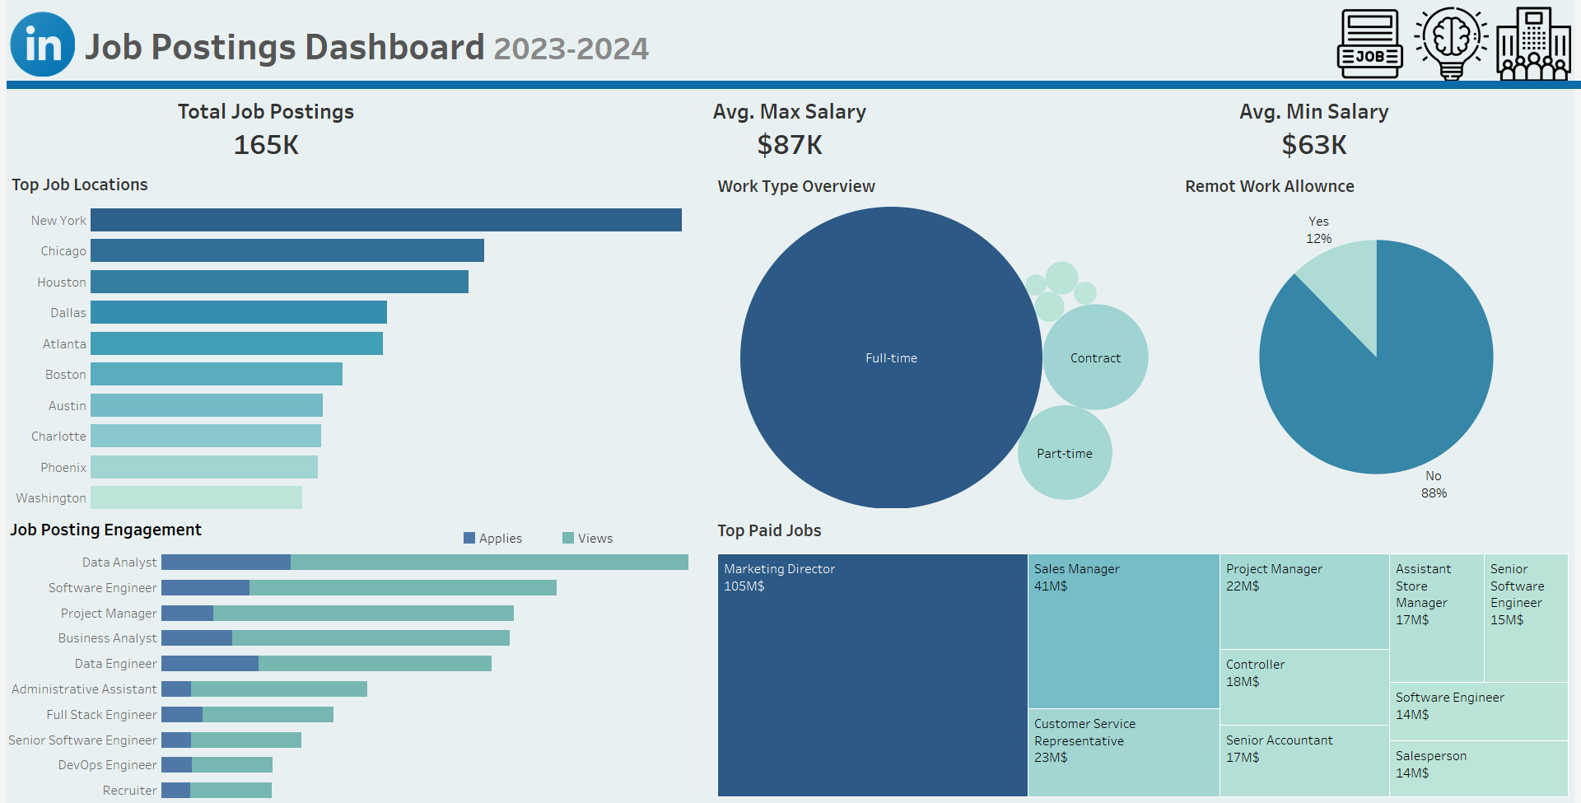

Slide 6
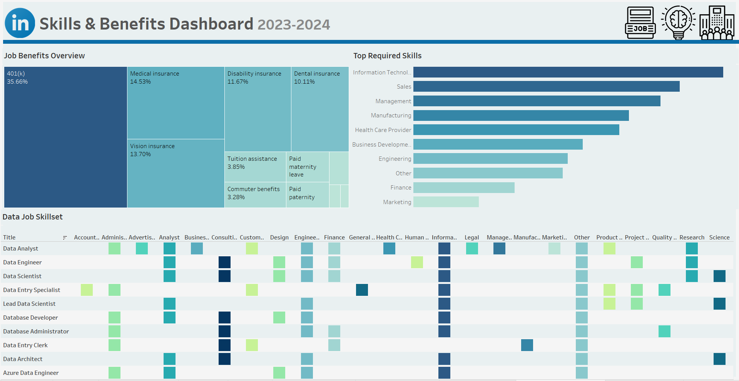

Slide 7
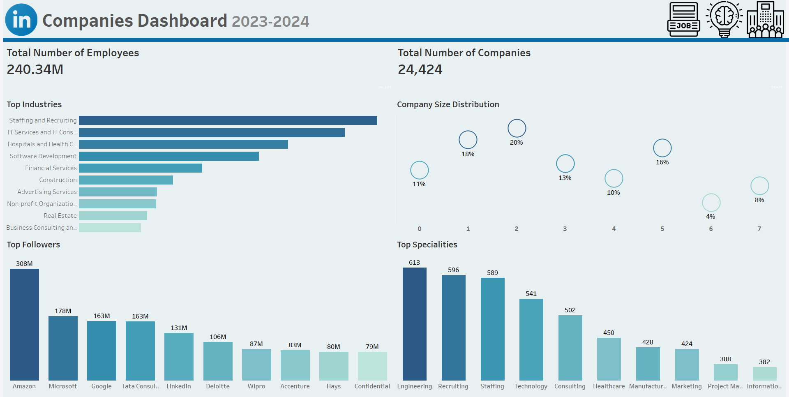

Slide 8
Top Job Locations
01
Identifying Key Locations for Career Opportunities

Slide 9
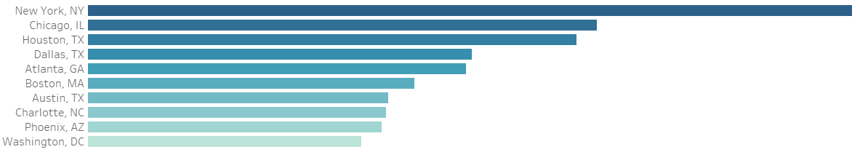

Top Job Locations
Overview of Popular Job Locations:
Highlights job seekers' focus in 2023
Leading Location: New York City
Renowned for diverse job market and abundant opportunities
Following Locations: Chicago and Houston
Both offer robust job prospects
Key Insights:
Understanding geographic trends is essential for job seekers
Valuable insights for those considering relocation
Indicates where demand for talent is highest

Slide 10
Work Type Overview
02
Insights into Full-Time, Contract, and Part-Time Employment Trends

Slide 11
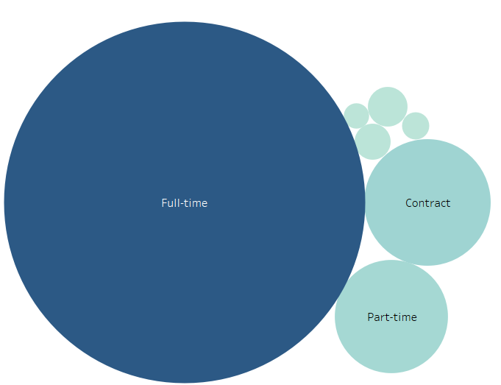

Work Type Overview
Overview of Work Types:
Bubble chart visualization of work type distribution in the job market
Key Findings:
Most Prevalent: Full-time work
Followed by:
Contract work
Part-time work
Key Insights:
Highlights the distribution of different work types
Larger bubbles indicate more common work types
Provides a visual representation of the relative prevalence of work types

Slide 12
Remote Work Allowance
03
Understanding Trends in Remote Work Allowances Among Employers

Slide 13

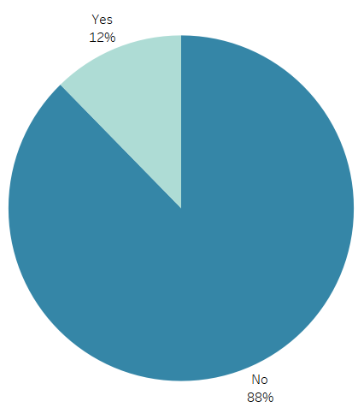
Remote Work Allowance
Overview of Remote Work Allowances:
88% of jobs offer remote work allowances
12% do not offer remote work allowances
Key Insights:
Strong preference for remote work flexibility among employers
Significant trend reflecting employee expectations
Purpose of the Chart:
Visual representation of the prevalence of remote work allowances
Provides valuable insights for job seekers prioritizing flexibility

Slide 14
04
Most Popular Job Postings
A Look at In-Demand Roles on LinkedIn in 2023

Slide 15
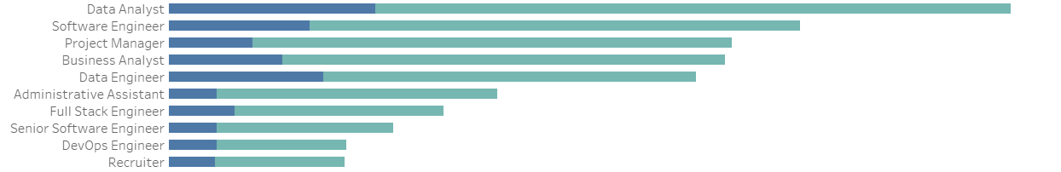

Most PopularJob Posting
in
Overview of Popular Job Postings:
Highlights demand for various roles in the job market
Leading Position: Data Analysts
Most sought-after role, reflecting reliance on data-driven decision-making
Following Positions:
Software Engineers: High demand for technology and development expertise
Marketing Assistants: Crucial in supporting marketing initiatives
Key Insights:
Provides a clear overview of popular job titles
Valuable resource for job seekers
Helps align skills with current market trends

Slide 16
05
Top Paid Jobs
Insights into High-Earning Career Opportunities

Slide 17
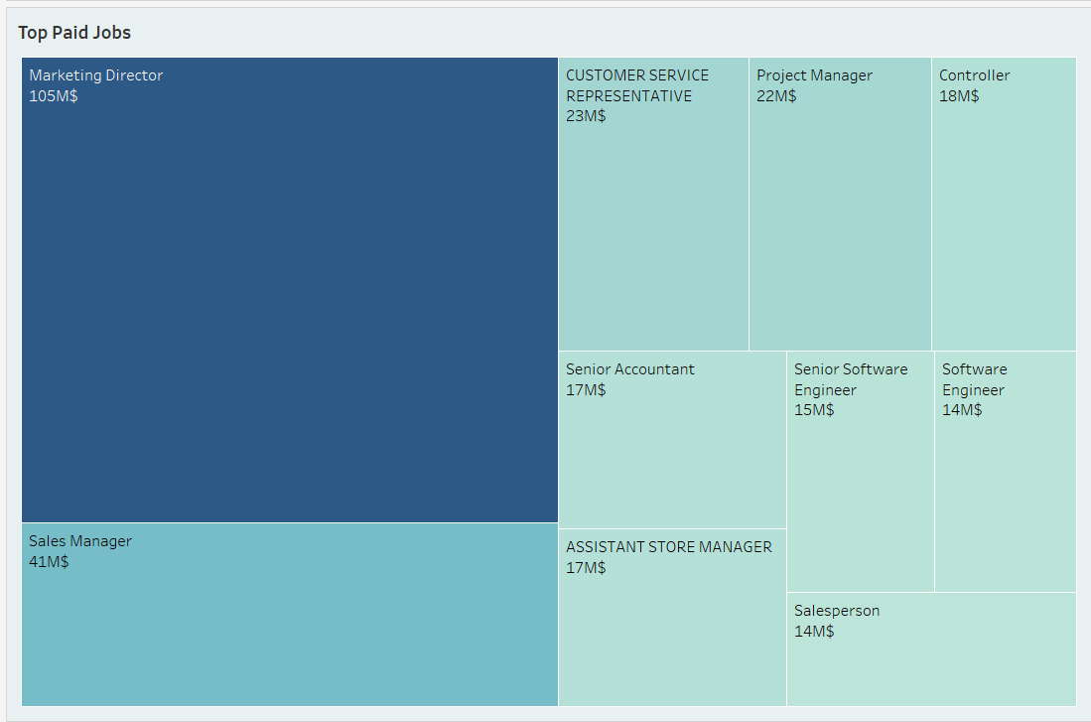

Top Paid Jobs
Overview of Highest-Paying Job Titles:
Treemap visualization showcases job titles on LinkedIn
Provides essential insights for career seekers
Key Findings:
Largest Rectangle: Marketing Directors
Command the highest average salary among roles
Other lucrative positions include:
Customer Service Representatives
Project Managers
Key Insights:
Data-driven visualization serves as a valuable resource
Helps individuals explore potential career paths and salary expectations

Slide 18
06
Overview of Job Benefits
Insights into the Most Common Employee Benefits

Slide 19

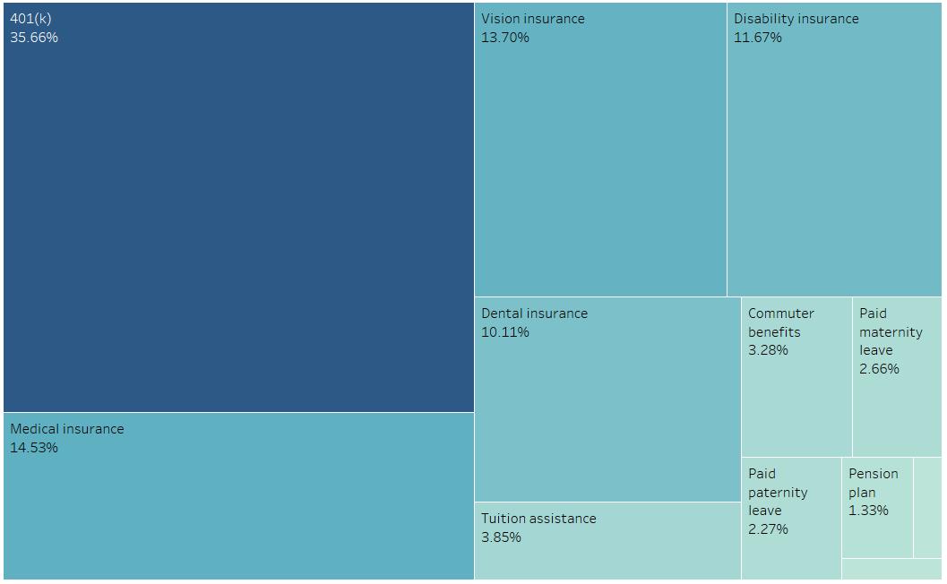
Overview of Job Benefits
Overview of Job Benefits:
Treemap visualization of job benefits among companies
Key Findings:
Most Common Benefit: 401(k) Plans
Followed by:
Medical insurance
Vision insurance
Disability insurance
Key Insights:
Highlights the importance of healthcare benefits for employees
Provides a clear visual representation of the distribution of job benefits

Slide 20
Top Required Skills
07
Insights into the Most In-Demand Skills Across Industries

Slide 21

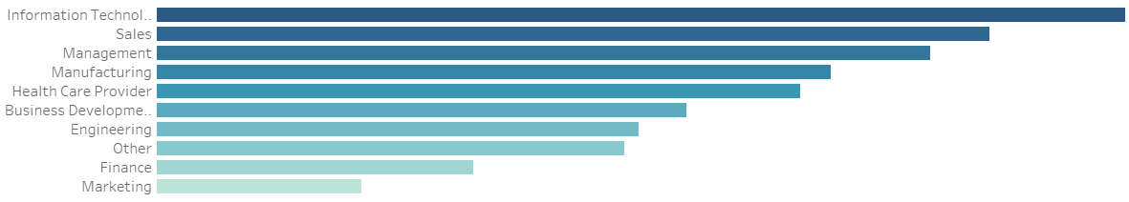
Top Required Skills
Overview of Required Skills:
Bar chart displays the most in-demand skills in the job market
Key Findings:
Most In-Demand Skill: Information Technology skills
Followed by:
Business Development
Marketing
Key Insights:
Highlights the importance of technical and business skills
Provides a clear visual representation of sought-after skills among employers

Slide 22
08
Data Job Skillset
Insights into In-Demand Skills for Data Analysts, Engineers, and Scientists

Slide 23

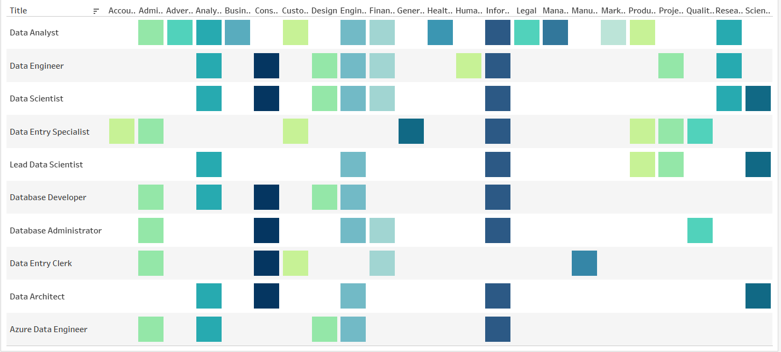
Data Job Skillset
Overview of Job Skills:
Treemap visualization of in-demand skills in the job market
Key Findings:
Most Sought-After Skill: Data Analyst
Followed by:
Data Engineer, Data Scientist
Key Insights:
Highlights the growing demand for data-related skills
Provides a clear visual representation of the most in-demand skills for data-focused roles

Slide 24
09
Companies by Industry
Insights into Industry Prevalence in the Job Market

Slide 25
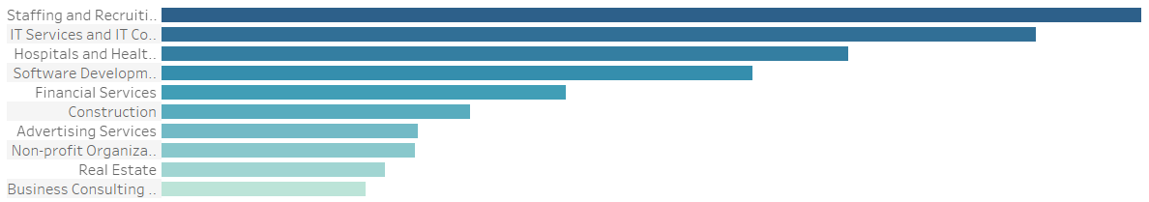

Companies by Industry
Overview of Companies by Industry:
Bar chart visualization of companies across various industries
Key Findings:
Industry with the Highest Number of Companies: Staffing and Recruiting
Followed by:
IT Services
Key Insights:
Highlights representthe prevalence of certain industries in the job market
Provides a clear visual ation of the distribution of companies by industry

Slide 26
10
Company Size Distribution
Insights into the Distribution of Companies by Size Category

Slide 27
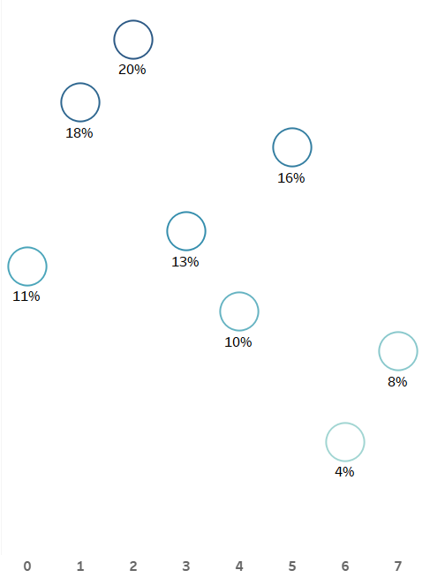

Company Size Distribution
Overview of Company Size Distribution:
Bubble Chart Visualization of Companies by Size Category
Key Findings:
Most Prevalent: Companies in size category 0, with 20% of the total
Second Largest: Size category 1, accounting for 18%
Least Prevalent: Companies in size category 6, making up only 4%
Key Insights:
Concentration at the smaller end, with categories 0 and 1 making up 38% of all companies
Low representation of large-sized companies in categories 6 and 7
The chart effectively visualizes the distribution with circle size reflecting the number of companies
Color gradients provide additional clarity by distinguishing between size categories

Slide 28
Top Companies by Followers
11
Examining the Most Popular Companies Among LinkedIn Users

Slide 29
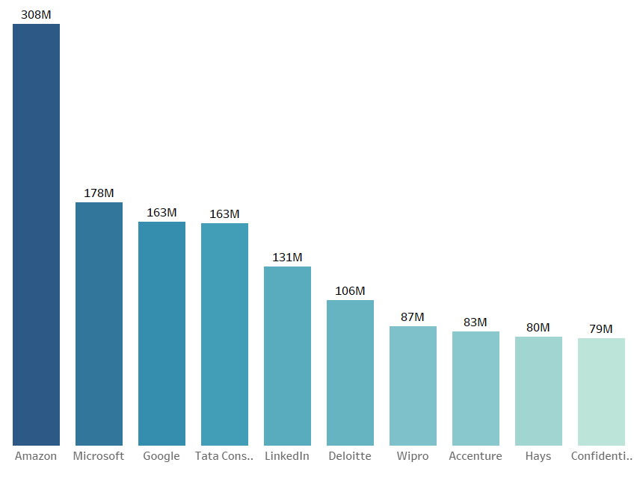

Top Companies by Followers
Overview of Top Companies by Followers:
Bar chart visualization of companies based on follower count on LinkedIn
Key Findings:
Most Followed Company: Accenture
Followed by:
Amazon
Microsoft
Key Insights:
Highlights the most popular companies among LinkedIn users
Provides a clear visual representation of top companies by follower count

Slide 30
12
Top Company Specialties
Insights into the Most Common Company Specializations

Slide 31

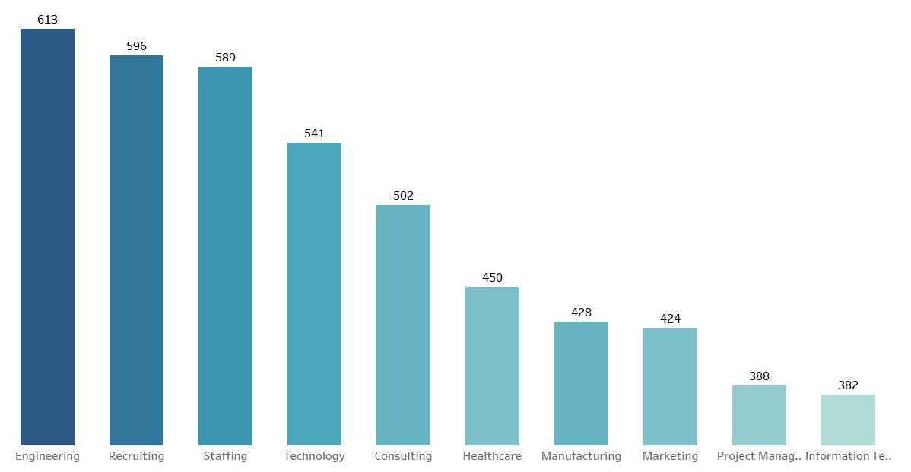
Top Company Specialties
Overview of Top Company Specialties:
Bar chart visualization of company specialties
Key Findings:
Most Common Specialty: Engineering
Followed by:
Recruiting
Staffing
Key Insights:
Highlights the prevalence of certain specializations within the company landscape
Provides a clear visual representation of the distribution of company specialties

Slide 32


KPIs
165K
87K$
Total Job Posting
Avg. Max Salary
61K$
63K$
Avg. Med Salary
Avg. Min Salary
240.34M
24,424
Total No. Employees
Total No. Companies

Slide 33

Thanks Any Question?

