Slide 1
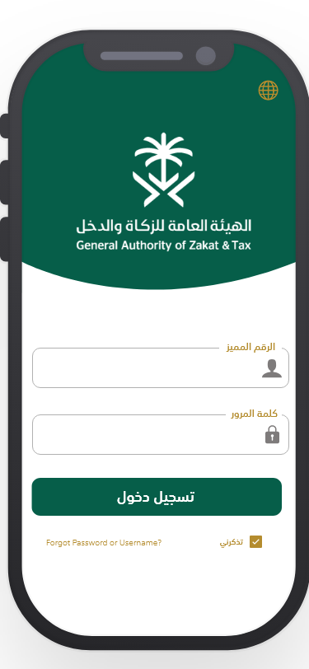
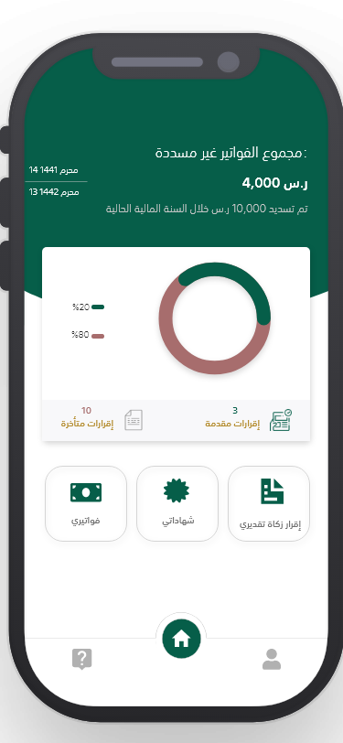
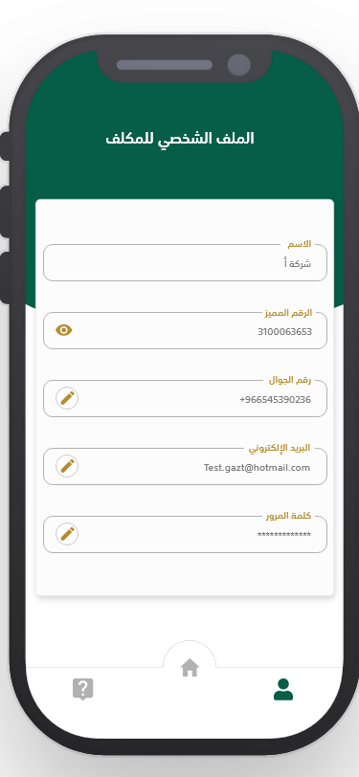
GAZT E-Service App - existing design
Rendering of the green curve takes a considerable time
Lot of white space and vertical spaces in controls
Dashboard is not extendible
Footer will overlap the additional tiles
Services like FORM 12 has many fields and will be cumbersome & introduce scroll vertically
40-50% of the space is kind of wasted
App visuals is not branded as a GAZT app
Not in sync with the guidelines
Login
Dashboard
Profile

Slide 2
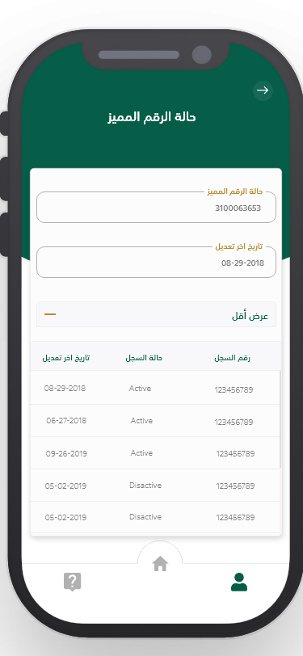
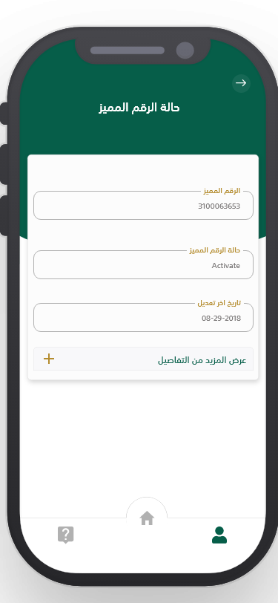
GAZT E-Service App - existing design – AR mode
TIN Status
TIN Status Expanded

Slide 3
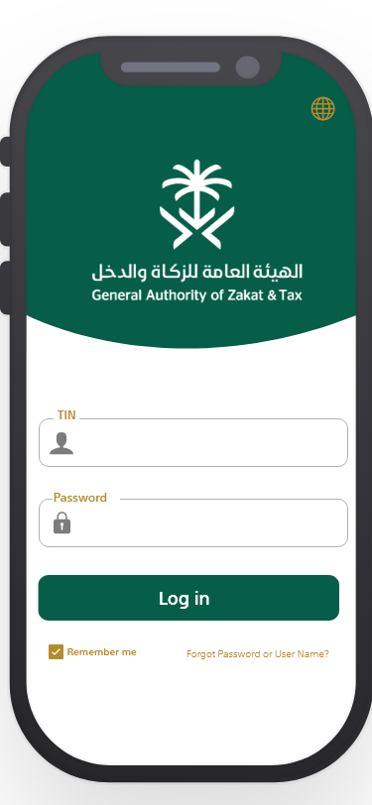
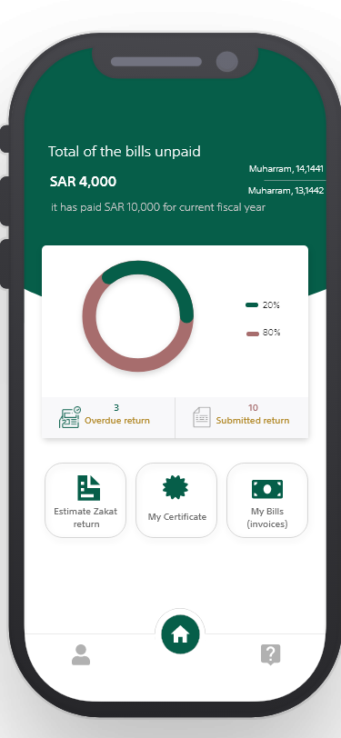
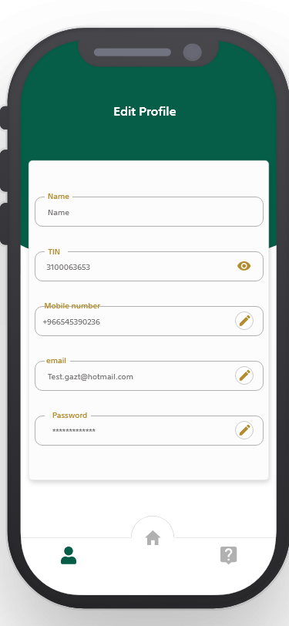
GAZT E-Service App - existing design – EN mode
Login
Dashboard
Profile

Slide 4
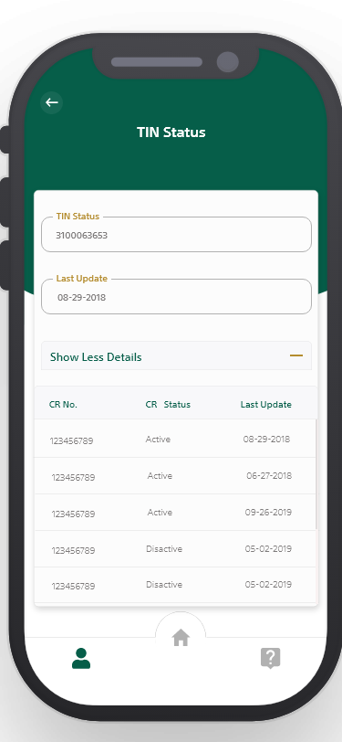
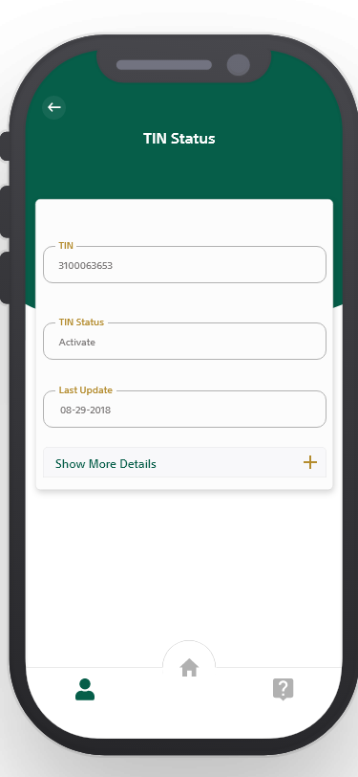
GAZT E-Service App - existing design – EN mode
TIN Status expanded
TIN Status

Slide 5


GAZT E-Service App design
It’s not about the beauty always – its about the purpose of the mobile app
What matters is user eXperience - usability & application performance
Timely screen rendering is the key
The app should be modular and easy to enable / disable the feature
GAZT eService's App is mostly a form based application
Hence, maximum space utilisation is the key
The user should get seamless experience between web portal and the mobile app
The iconography and fonts and overall theme must match the GAZT branding guidelines

Slide 6
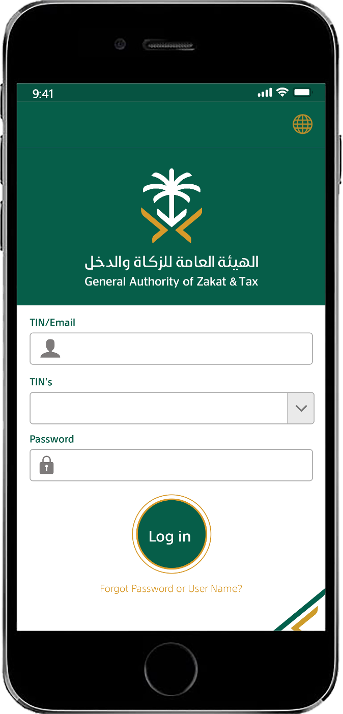
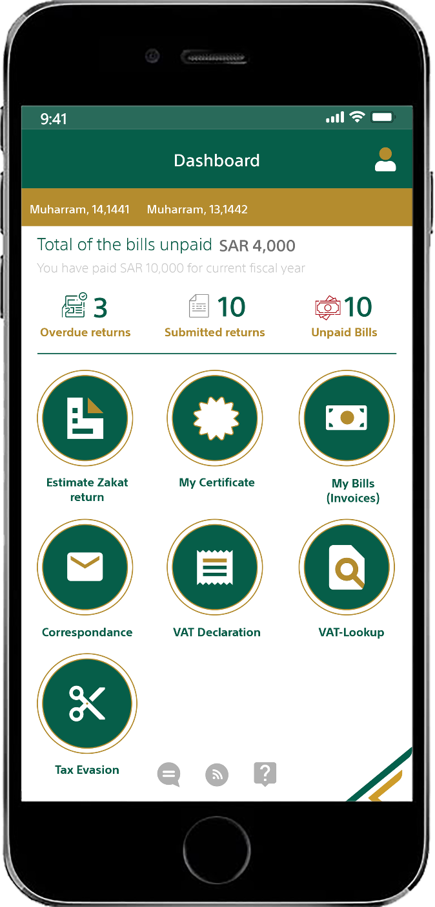
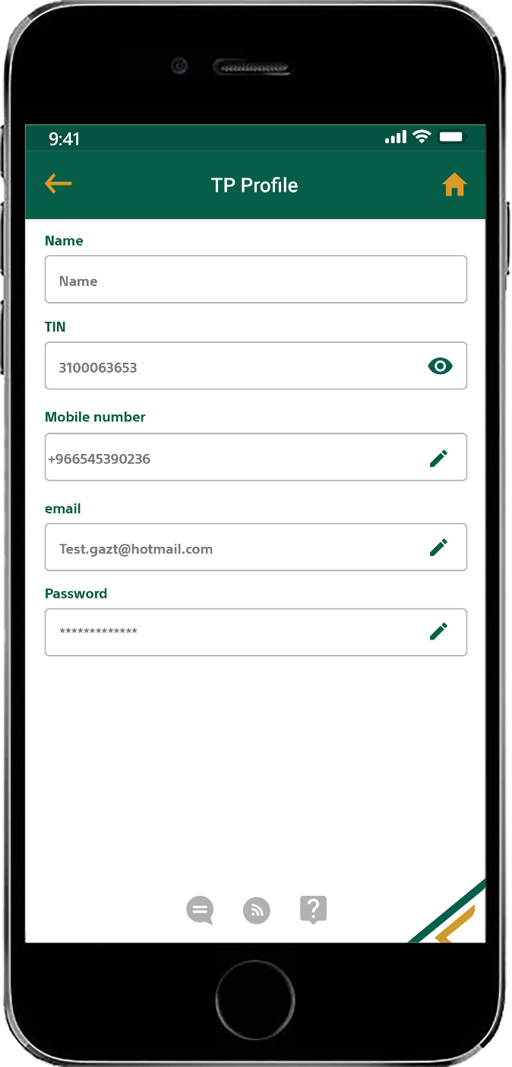
GAZT E-Service App design - proposed – EN mode
Proposed Login
Proposed Dashboard
Proposed Profile

Slide 7
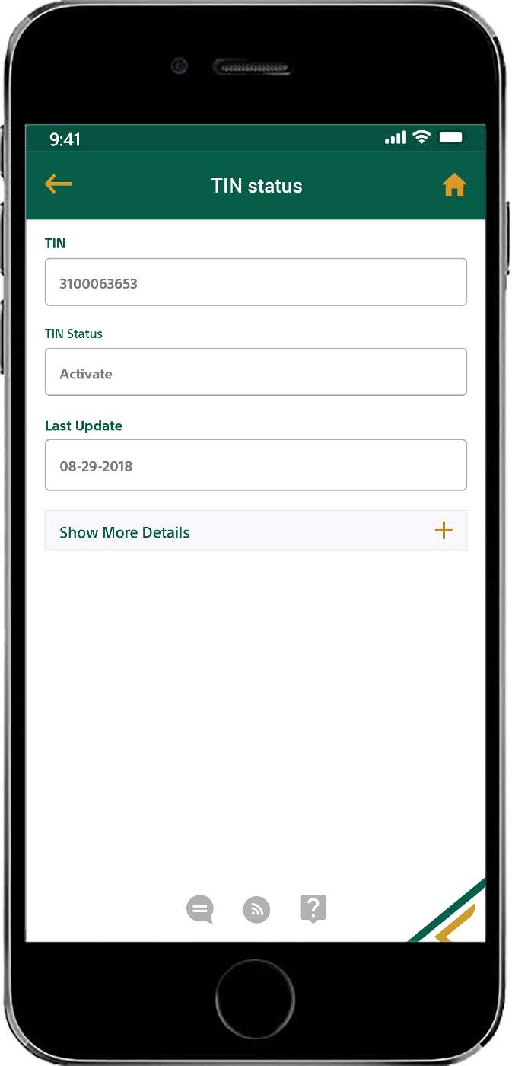
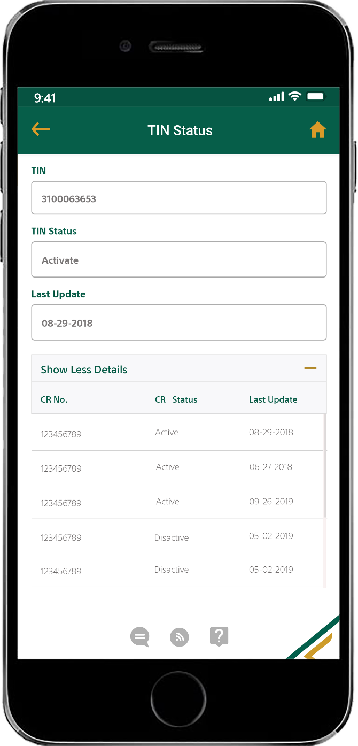
GAZT E-Service App design - proposed - EN mode
Proposed TIN Status
Proposed TIN Status Expanded

Slide 8
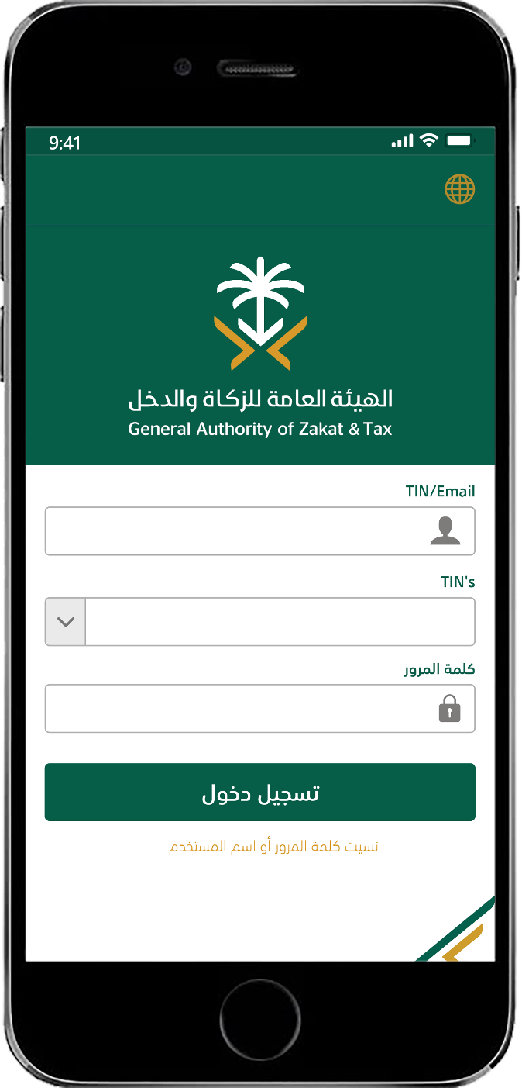
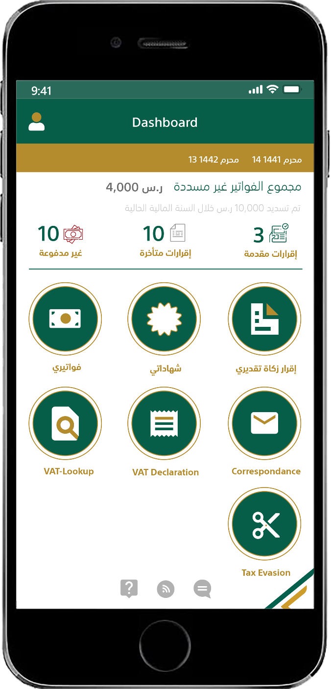
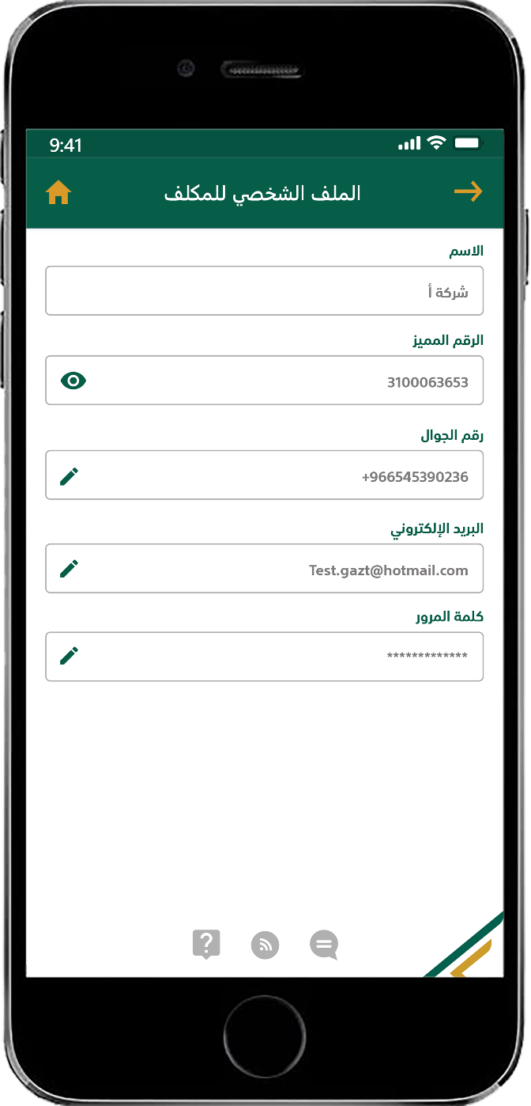
GAZT E-Service App design - proposed – AR mode
Proposed Login
Proposed Dashboard
Proposed Profile

Slide 9
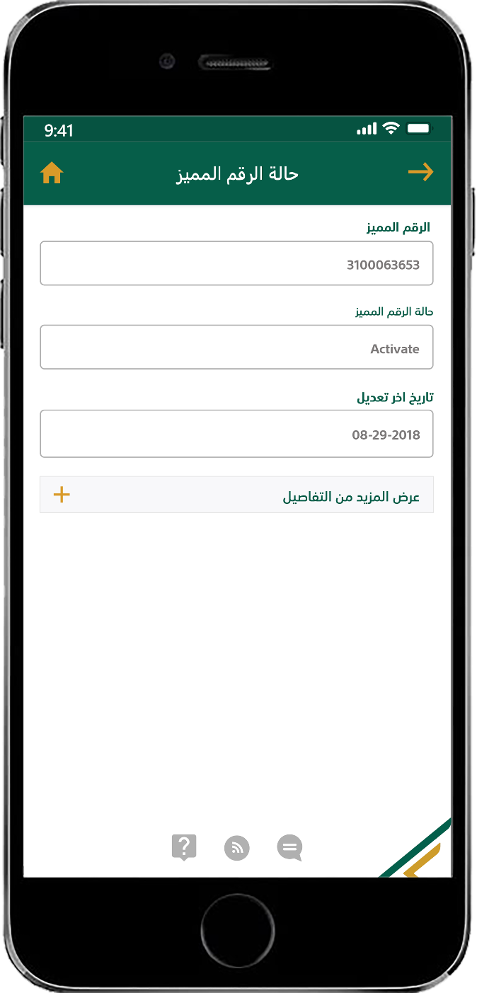
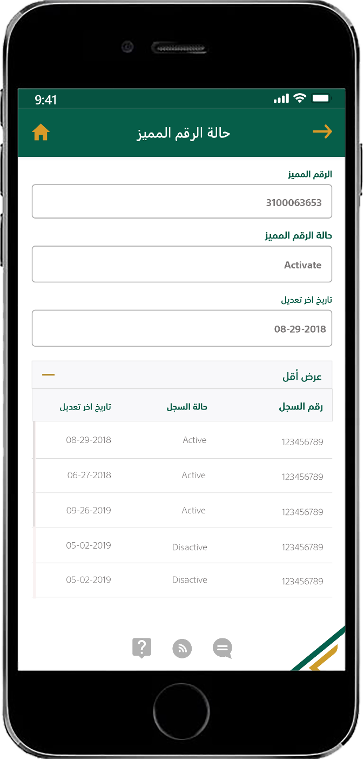
GAZT E-Service App design - proposed AR mode
Proposed TIN Status
Proposed TIN Status Expanded

Slide 10
GAZT E-Service App design – proposed & existing design comparison
Proposed Dashboard
Proposed Profile
Existing Dashboard
Existing Profile

