Slide 1

Netflix Data Analysis

Slide 2

Read Netflix data using pandas
Show insights in data
Data contain 8809 row and 11 column

Slide 3

Insights about Netflix data
The United States has the largest content directory.
India dominates in both movies and TV shows.
The year 2018 stands out as the biggest year for movie and TV show releases.
The highest achieved content rating is TV-MA.
Data Quality
The dataset contains some empty values.

Slide 4
Import Libraries
Pandas is primarily used for organizing data into rows and columns, making it easy to clean, analyze, and manipulate data.
Numpy is an open-source Python library that facilitates efficient numerical operations on large quantities of data.
Matplotlib used to visualize data.

Slide 5
Netflix type is
Movie 6132
TV Show 2677
Netflix rating is
TV-MA 3208
TV-14 2160
TV-PG 863
R 799
PG-13 490
TV-Y7 334
TV-Y 307
PG 287
TV-G 220
NR 80
G 41
TV-Y7-FV 6
NC-17 3
UR 3
74 min 1
84 min 1
66 min 1
A 1
Netflix director top four is
Rajiv Chilaka 19
RaÃºl Campos, Jan Suter 18
Marcus Raboy 16
Suhas Kadav 16

Slide 6

Visualization using Matplotlib

Slide 7
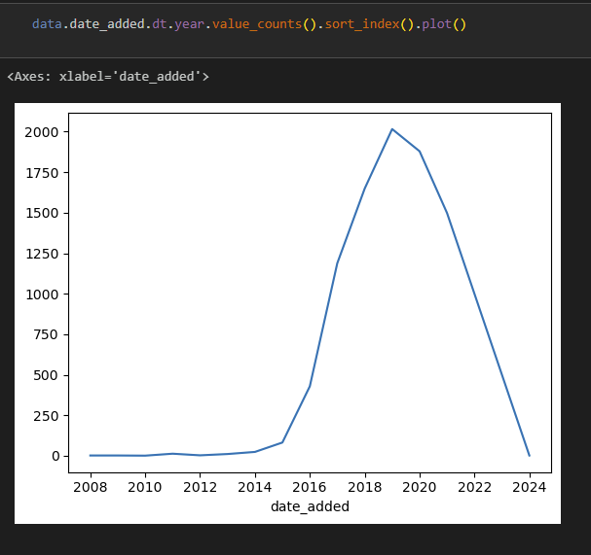
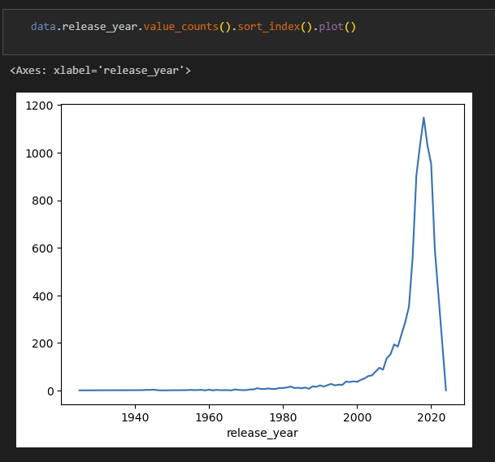

Slide 8
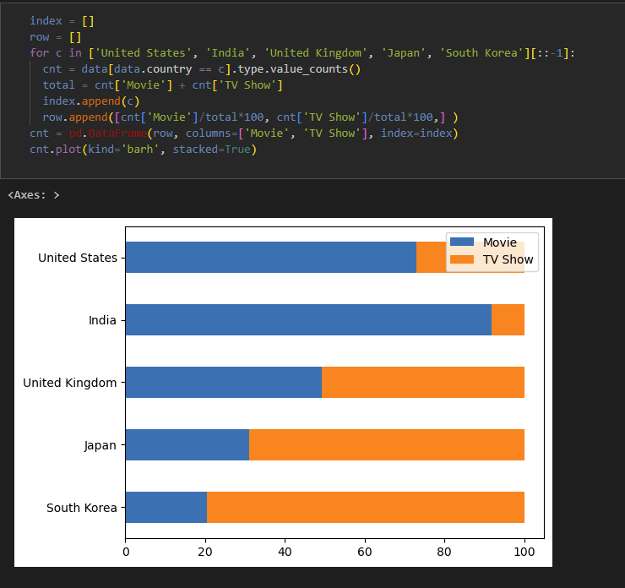
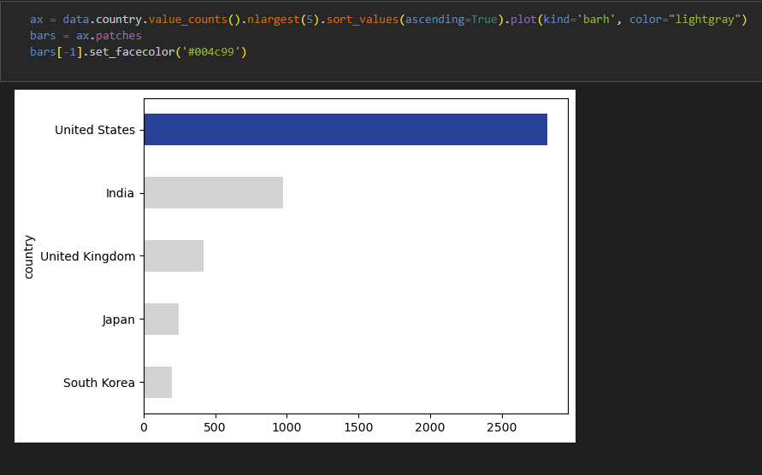

Slide 9
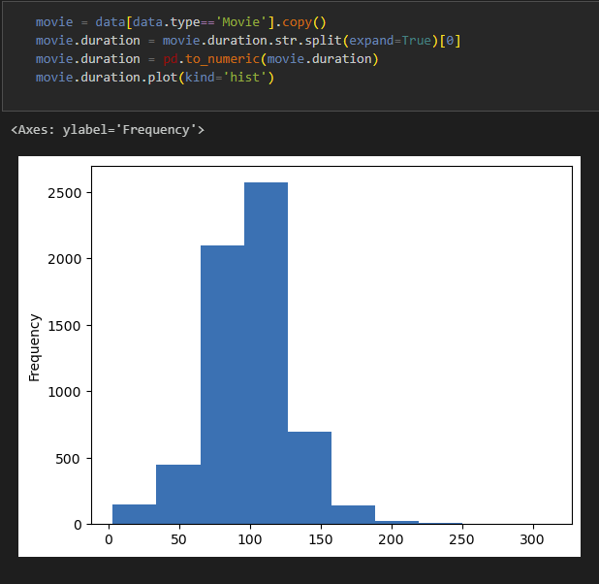
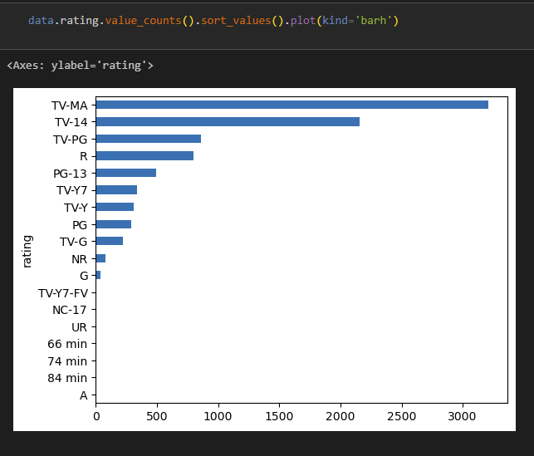

Slide 10
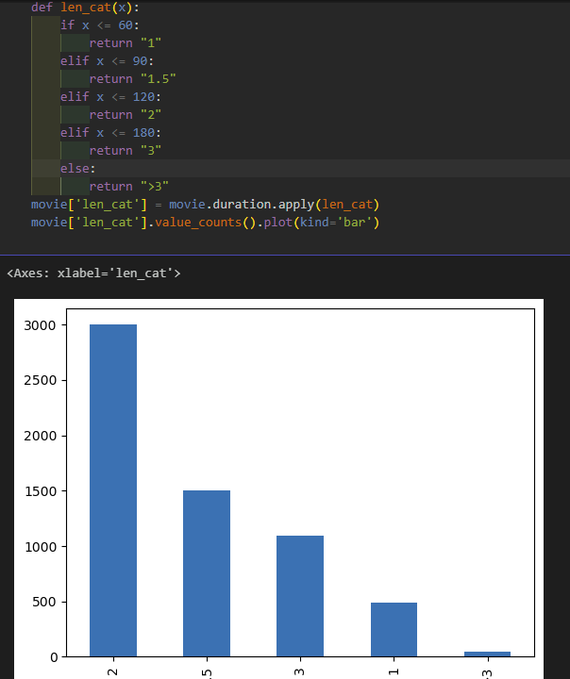

Slide 11
Visualization using PowerBi

Slide 12


Microsoft Power BI

Slide 13

Thank You
Github: https://github.com/ahmedgamal23
Report Link in power bi: Netflix Data Analysis Visualization - Power BI
LinkedIn: https://www.linkedin.com/in/ahmed-gamal-667a061a3/

