Slide 1
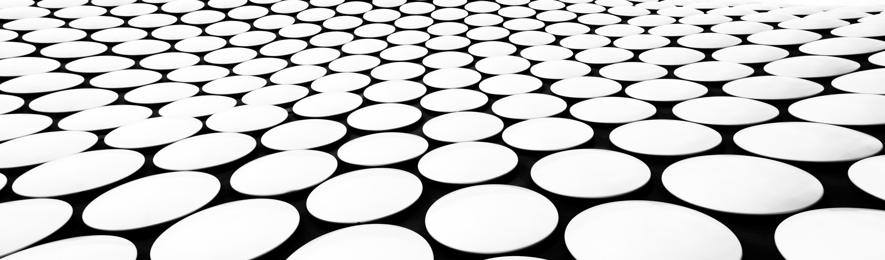
Welcome to group 32

Slide 2
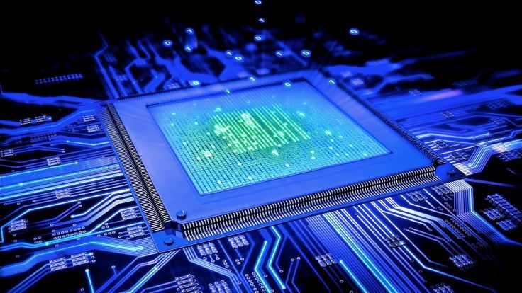
The best processor in the market right now:
You own the power between your hands , 4.9GHz turbo mode and 3.6GHz standard clock speed.

Slide 3
Supported functions :
Add two registers data
Add register data and constant number
store register data in the memory
Load data from the memory to register
Make the DMA send data to the memory
make the DMA copy part of the memory to another address in the memory (choose the number of words need to copy)
Display data on output device
Take input and store it in the memory

Slide 4
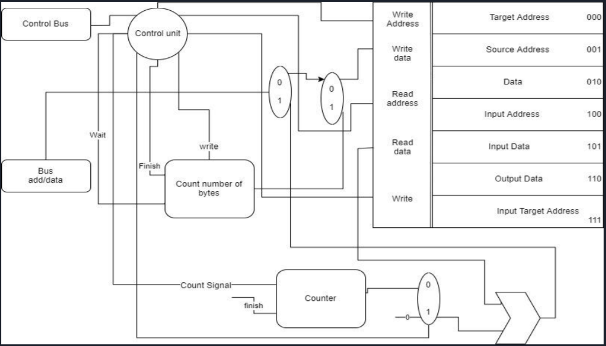
Dma design :
The DMA is Responsible for sending and receiving data from processor to memory , from memory to memory OR from I/O devices to memory . Under supervision of the processor

Slide 5
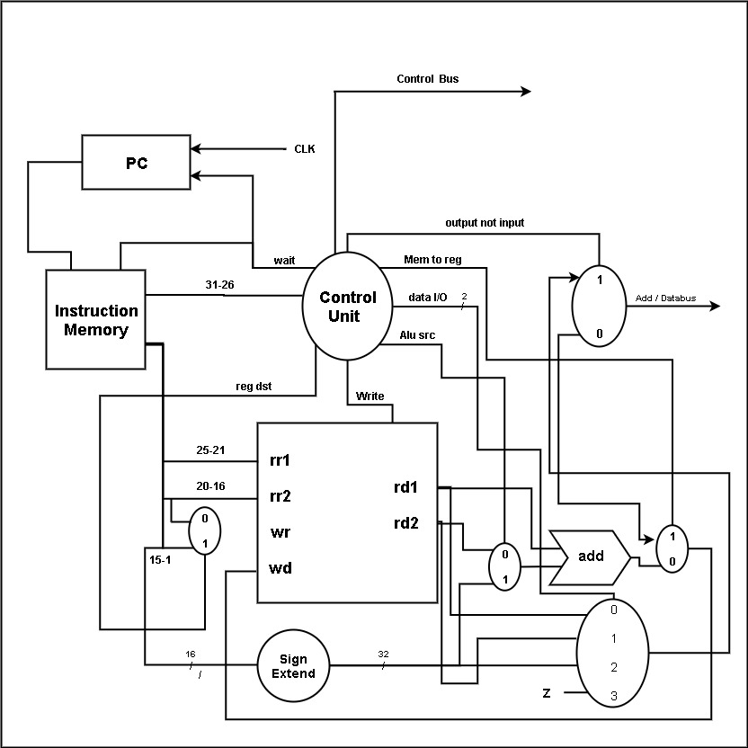
Processor design :
Processor is responsible for making Digital operations , sending instructions to the DMA to work and it could also use the memory directly without using DMA .

Slide 6
Instructions use :
Add : use to add two registers
Addi: use to add register and 16bit constant
Lw: use to get data from memory to a register (processor)
Sw: use to send data from a register to memory (processor)
Send: use to send data from a register to memory(DMA)
Copy: use to copy part of the memory to another part of the memory(DMA)
Sw $ra : use to display on the output device

Slide 7
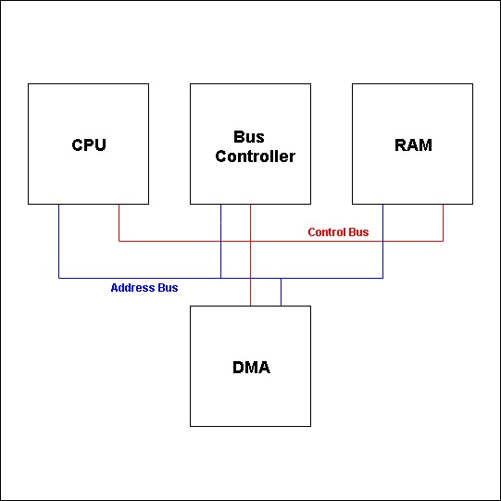
The full circuit design :

Slide 8
The design :
We use :
32-bit data bus to send and receive data and addresses
32_bit control bus to send and receive control signals
A bus controller to organize the control signals and the data traffic between modules
Static random-access memory as the main memory to ensure speed

Slide 9
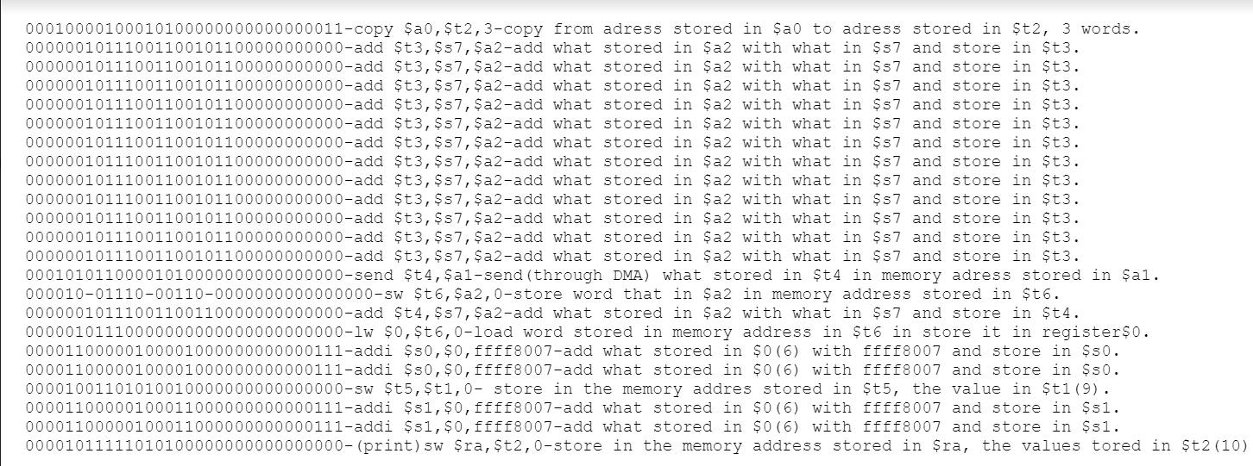
Test case:

Slide 10
Contributions :
Ahmed Gamal : designing , DMA & modules Composition
Omar Hany : designing , processor & modules Composition
Eslam Asfour : designing & processor
Ahmed Khaled : DMA , slides
Dalia ayman : bus controller unit
Alaa Mohamed : bus controller unit
Rasha Mahmoud : memory, testing
Doaa yehia : memory , test cases
Sara rafat : bus buffers ,test cases

Slide 11
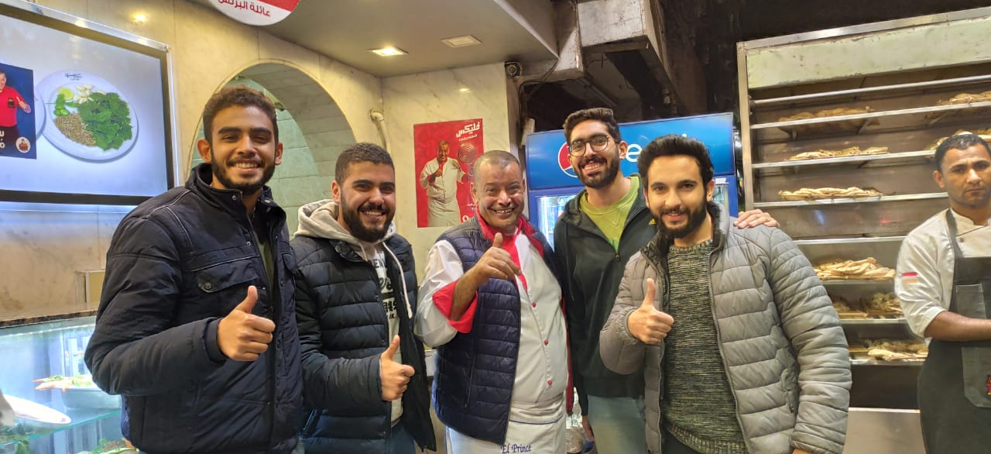
Thank you

