Slide 1











The journey of order in Italian Restaurant

Slide 2
Group
seif eldeen abd elfatah
Ahmed Emad
Ahmed Gamal
Asmaa Shokri Gouda

Slide 3

scenario
1. Network Setup:
- There are two VPCs:
- VPC 1: This contains a Public Subnet with an EC2 instance that collects web application traffic it express to order management.
- VPC 2: This has a Private Subnet with another EC2 instance dedicated to processing and storing traffic data in an RDS database express to prepare management.
- Both VPCs are connected through a VPC Peering Connection.
2. Traffic Collection and Storage:
- In VPC 1, the EC2 instance in the public subnet captures traffic data from the web application.
- This EC2 instance then uploads the collected traffic data to Amazon S3, which is located in the same region as VPC 1.
3. Data Processing with Lambda and SQS:
- Amazon S3 acts as the source for an AWS Lambda function. When new data is uploaded, it triggers the Lambda function.
- The Lambda function retrieves the data from the S3 bucket and sends it to an Amazon SQS queue.
- The SQS queue is set up to be accessed by the EC2 instance located in VPC 2's private subnet.
4. Traffic Data Handling in VPC 2:
- Through the VPC Peering Connection, the EC2 instance in VPC 2’s private subnet receives the traffic data from the SQS queue.
- This EC2 instance then processes the data and sends it to an RDS instance for storage, which is located on the same private subnet within VPC 2.
5. Final Storage:
- The RDS database in VPC 2 securely stores the traffic data, where it can be accessed and analyzed later and there are three levels in security on (subnet ) and (instance) and (data Monitoring)

Slide 4
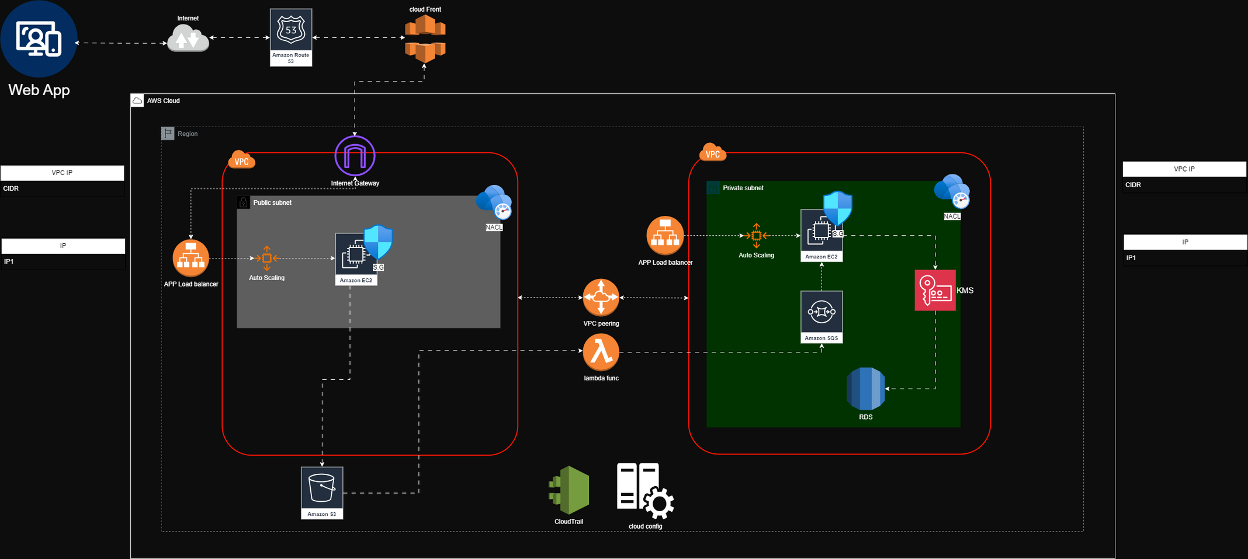
design

Slide 5
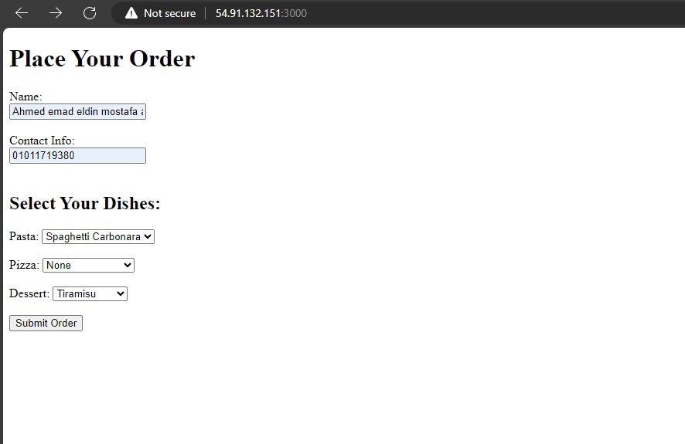
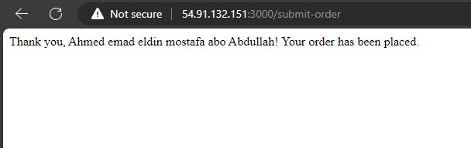
WEb APP

Slide 6

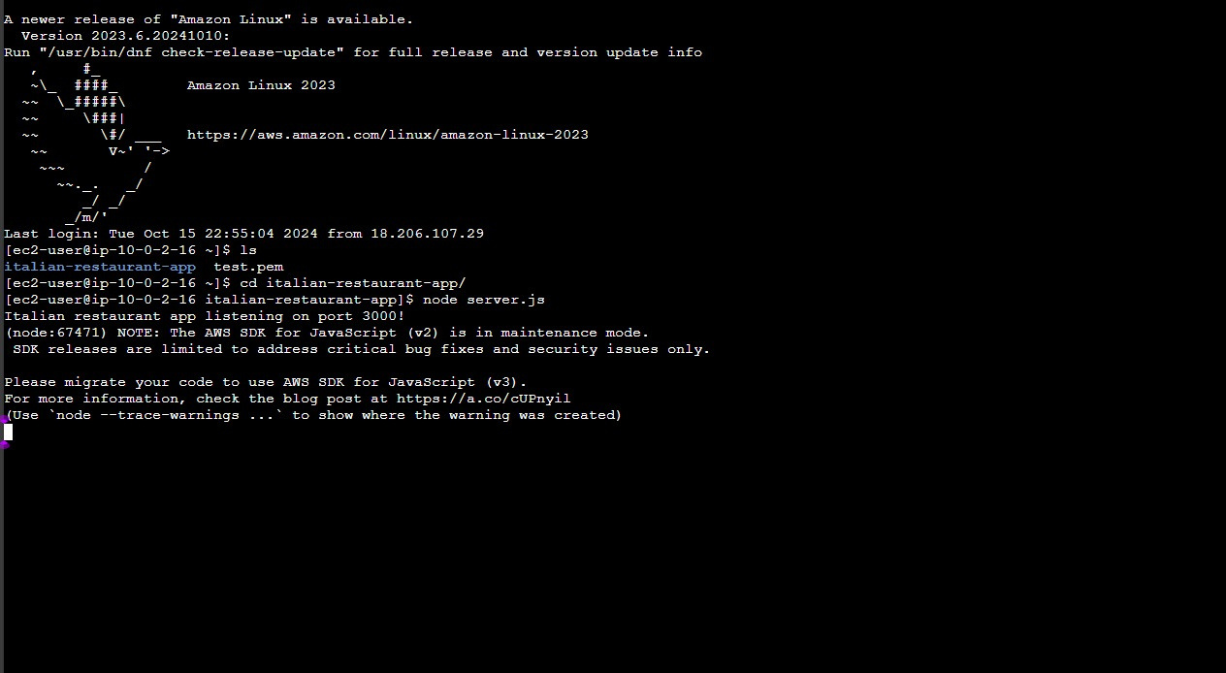
Running the APP in EC2

Slide 7

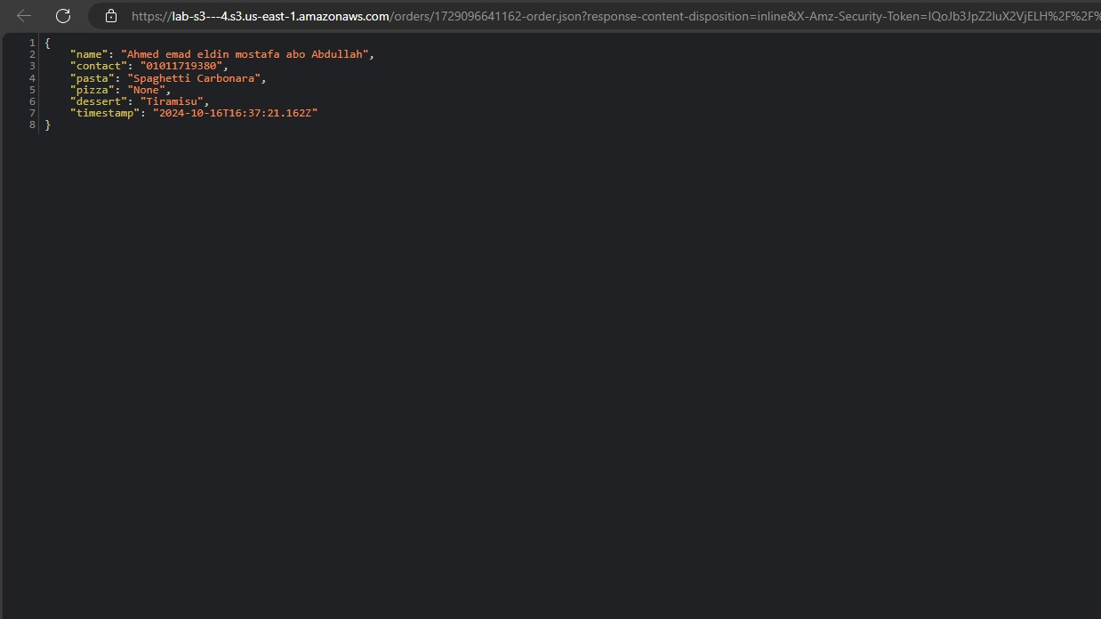
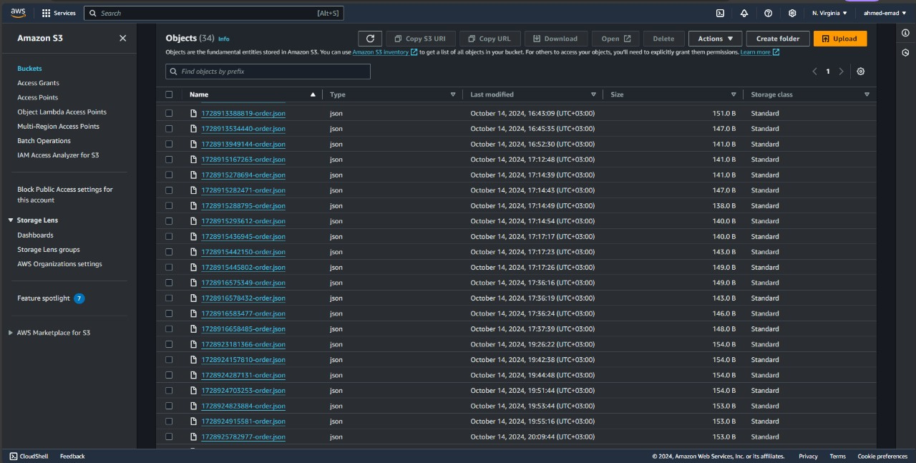

order in s3

Slide 8
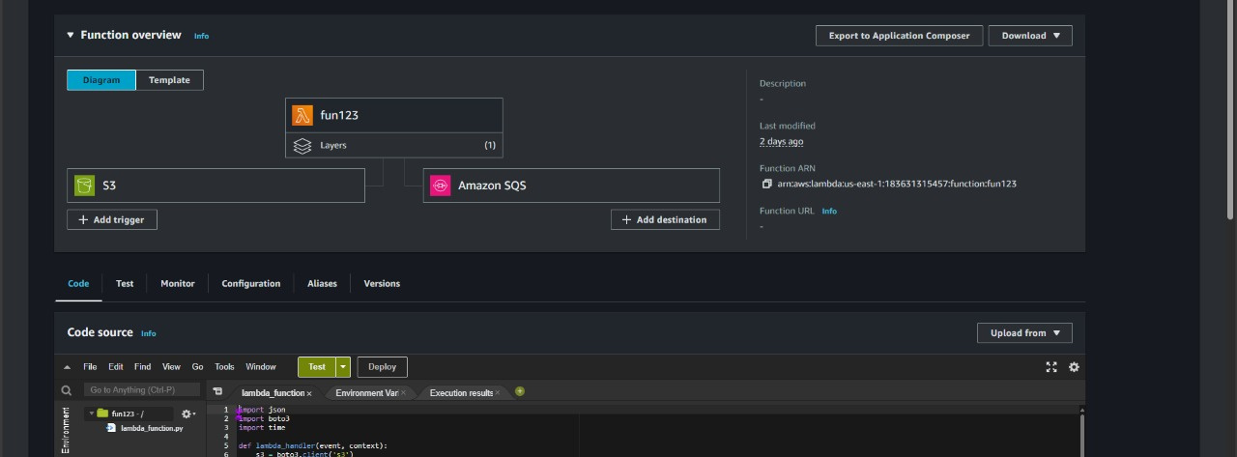
lambda function

Slide 9
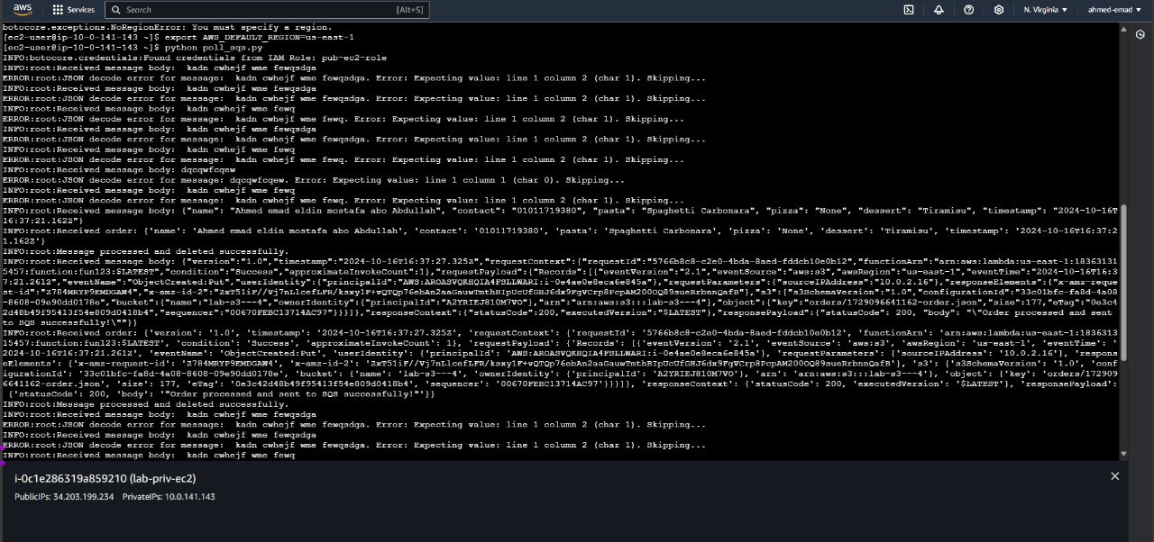
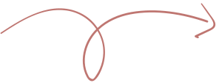
order in lambda to SQS
order details in web app

Slide 10
the final place for order in RDS
This EC2 instance then processes the data and sends it to an RDS instance for storage, which is located on the same private subnet within VPC 2.
The Italian restaurant's order management system uses AWS KMS to encrypt sensitive customer and order data stored in RDS, ensuring data security at rest.

Slide 11
thank you!

