Slide 1
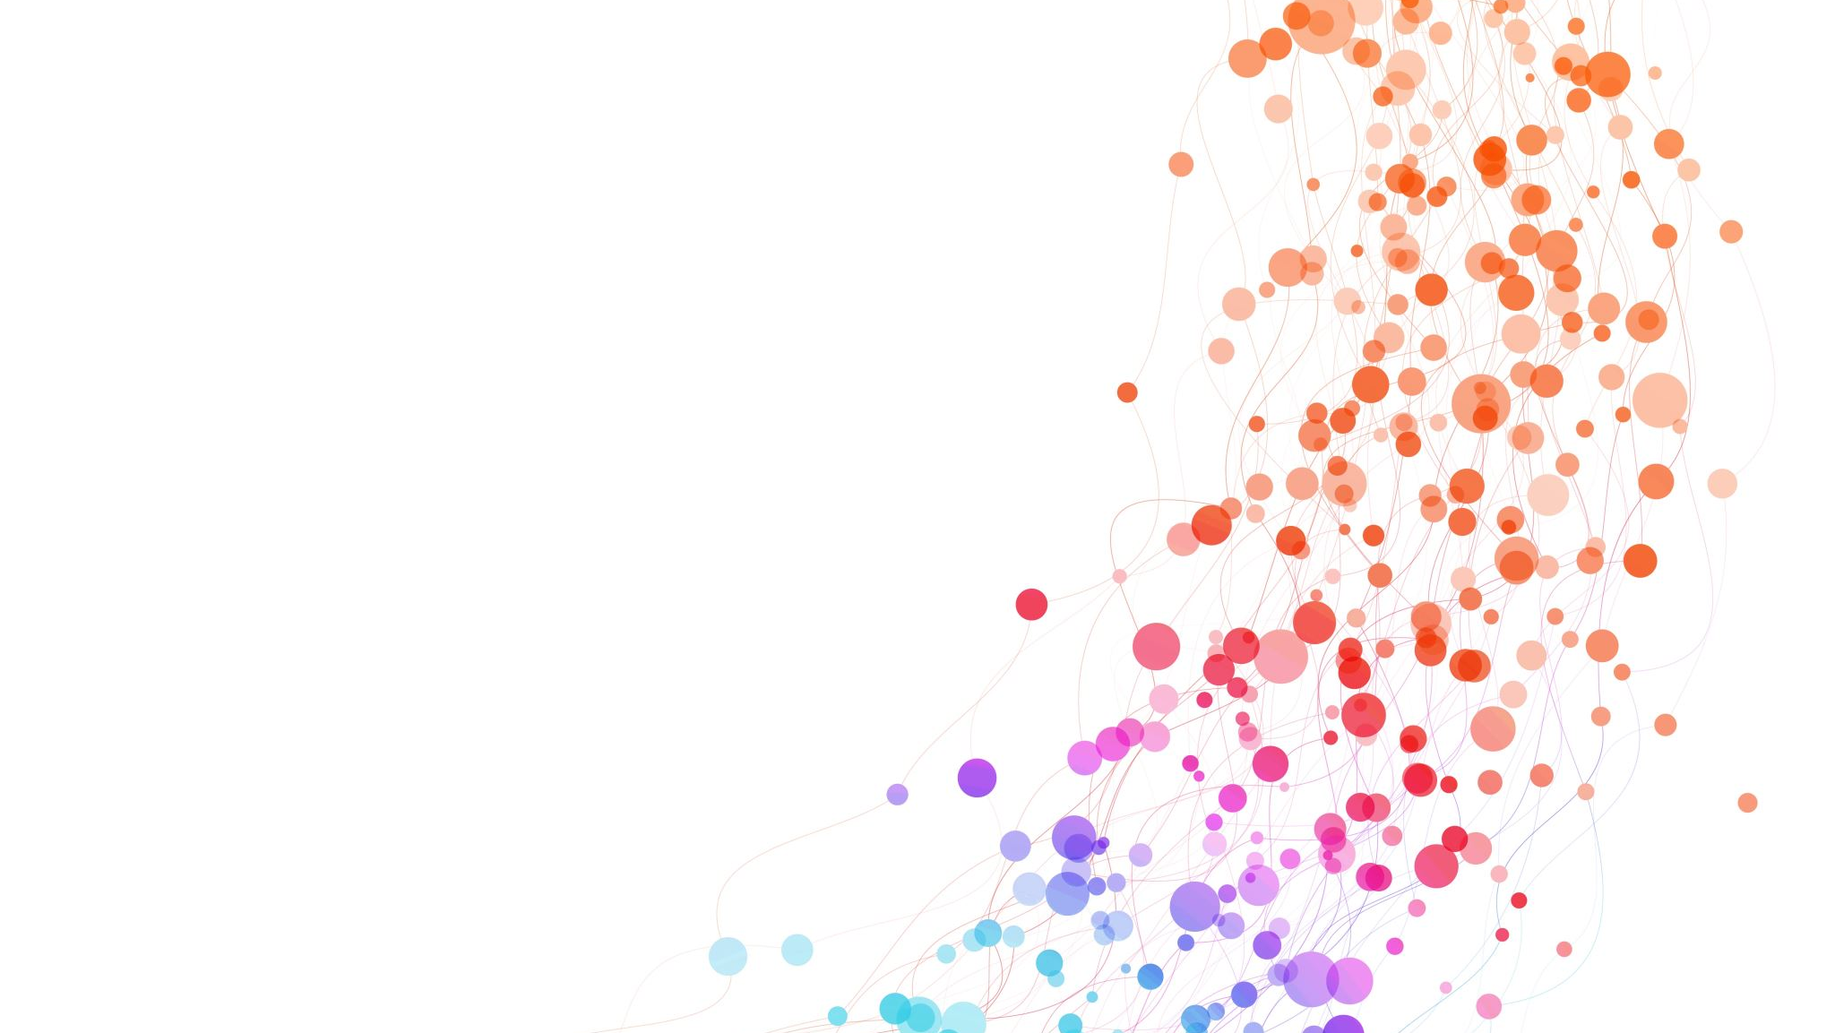
Root Cause Analysis
Profit Drop Investigation (2016 vs 2017)

Slide 2


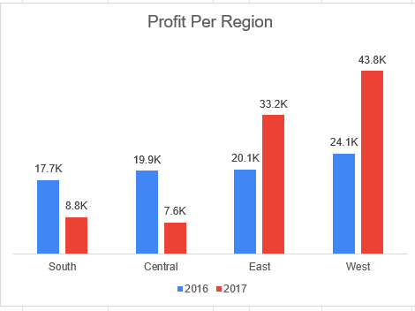
Problem Definition
Profits Dropped from 2016 To 2017 in Central Region by 62% and South Region By 50% .

Slide 3
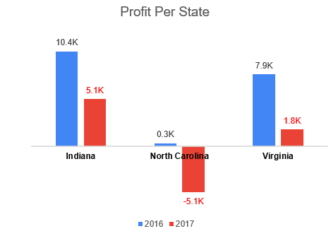
Where The Drop Happened in the Central and South Region?
Top 3 States | 2016 | 2017
Virginia | 7.9K | 1.8K
Indiana | 10.4K | 5.1K
North Carolina | 0.3K | -5.1K

Slide 4
Where The Drop Happened in the Central and South Region?
Top 3 States | 2016 | 2017 | Growth Rate
Virginia | 7.9K | 1.8K | -77%
Indiana | 10.4K | 5.1K | -51%
North Carolina | 0.3K | -5.1K | -2051%

Slide 5
Where The Drop Happened in the Central and South Region?
Top 3 States | 2016 | 2017 | Growth Rate | Profit Difference
Virginia | 7.9K | 1.8K | -77% | -6.05K
Indiana | 10.4K | 5.1K | -51% | -5.25K
North Carolina | 0.3K | -5.1K | -2051% | -5.35K

Slide 6
Where The Drop Happened in the Central and South Region?
City | 2016 | 2017 | Growth rate | Profit Difference
Lafayette | 8.8K | 0.2K | -98% | -8.56K
Burlington | -0.2K | -5.7K | -2755% | -5.50K

Slide 7

What Categories Dropped in Central and South Region?
Category | 2016 | 2017 | Growth rate | Profit Difference
Furniture | 2.89K | -1.87K | -164% | -4.76K
Office Supplies | 11.72K | 5.87K | -50% | -5.85K
Technology | 22.99K | 12.40K | -46% | -10.59K

Slide 8
What Tech Sub-Category Dropped in Central and South Region?
Machines shifted from +4.37K profit to -3.24K, representing the largest deterioration within the Technology category.
Sub-Category | 2016 | 2017 | Growth rate
Copiers | 9.27K | 3.4K | -63%
Machines | 4.37K | -3.4K | -174%

Slide 9
Canon imageCLASS 2200 Was the Biggest Contributor to the Profit Drop
The Canon imageCLASS 2200 Advanced Copier experienced a complete sales loss in 2017, resulting in an estimated decline of approximately $8.4K, making it the largest product contributor to the overall profit drop.
Product Id | 2016 | 2017 | Growth rate | Profit Difference
TEC-CO-10004722 | 8.40K | 0 | -100% | -8.4k
TEC-MA-10001127 | 2.80K | 0 | -100% | -2.8 k
TEC-MA-10000010 | 1.46K | 0 | -100% | -1.4 k
TEC-CO-10001943 | 0.75K | 107.99 | -86% | -0.6 k
TEC-MA-10004458 | 0.19K | 0 | -100% | -0.2 k
Product ID: TEC-CO-10004722 Product Name: Canon imageCLASS 2200 Advanced Copier

Slide 10
Who Caused Dropped in Central and South Region?
Segmant | 2016 | 2017 | Growth rate | Profit Difference
Consumer | 15.91K | 10.30K | -35% | -5.62K
Corporate | 16.54K | 2.41K | -85% | -14.13K
Home Office | 5.15K | 3.69K | -28% | -1.45K

Slide 11
Profit Decline Accelerated During Q4 2017
From October to December the Profit is Dropped in Central and south Region with 28.3K Dollar.

Slide 12
One $17.5K Order in 2016 Inflated the Baseline — Without It, Indiana Shows Growth, Not Decline
On October 2, 2016, Corporate client Tamara Chand placed a single order for a Canon copier ($17.5K sales, $8.4K profit) in Lafayette, Indiana — then made zero purchases in 2017
Metric | Value
Her order's share of Indiana's entire 2016 Copiers profit | 91%
Her order's share of the Corporate segment's total 2016→2017 loss | 59%
Indiana's growth rate excluding this one order | +159% (vs. -51% actual)
Her repeat orders in 2017 | 0
A single, non-recurring transaction created an artificially high 2016 baseline. Once removed, Indiana's underlying trend is positive growth, not decline.

Slide 13
Conclusion & Recommendations
Profit dropped 62% in Central and 50% in South (2016→2017) — driven primarily by a single outlier transaction in the Corporate segment (see Why), not a broad market decline.
Four Actions to Address the Root Cause and Prevent Recurrence
Re-engage the client — Reach out to Tamara Chand and similar high-value Corporate accounts who placed large one-time orders and didn't return; a single reorder could reverse a meaningful share of the Corporate segment's loss.
Flag single-order concentration risk — Build a standard check that identifies when one transaction represents >20% of a segment/category's profit, so future YoY comparisons aren't distorted by outlier orders.
Investigate Furniture separately — Furniture turned from )+$2.9K( to )-$1.9K (profit, unrelated to the Tamara Chand order; this needs its own root cause analysis (likely pricing/discount-driven, not a single-client issue).
Re-run the regional comparison excluding outlier orders — Before reporting "Central/South regions declined," recalculate growth rates with one-time large transactions excluded, to separate real trend from noise.

