Slide 1
SR
INTELLIGENT STUDENT
Project scope
Academic Progress Monitoring
& Early Risk Prediction
EDA & feature engineering
Leakage-safe preprocessing
LR · SVM · Random Forest
OULAD · Day-28 Early Warning · Explainable ML · Support Recommendations
5-fold group-aware CV + tuning
Calibration + risk bands
SHAP + recommendations + demo
FINAL PROJECT PRESENTATION
Prepared by: Project Team

Slide 2
1 · Problem & Project Question
Can we identify future academic risk early enough to support the student?
Prediction task
Why this is stronger than “predict the final grade”
At Risk vs Not At Risk
Early intervention before the final outcome is known.
Combines engagement, assessment progress, and study context.
Produces calibrated probability and relative risk bands.
Explains model behavior and recommends support actions.
Designed for human review — not automatic punishment or exclusion.
At Risk
Fail / Withdrawn
Not At Risk
Pass / Distinction
Prediction point
Day 28
Only information available through Day 28 is allowed to enter the model.

Slide 3
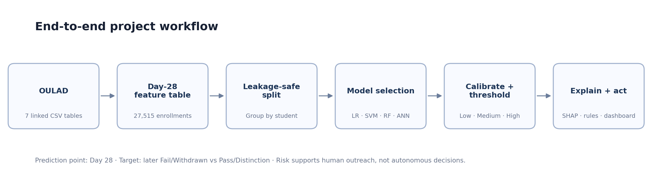
2 · Why OULAD?
A temporal learning-analytics dataset that supports real early-warning design.
ENGINEERED ROWS
STUDENTS
FEATURES
RISK PREVALENCE
PREDICTION POINT
27,515
24,826
61
44.11%
Day 28
eligible enrollments
unique students
incl. audit/target fields
overall engineered table
fixed observation boundary
What OULAD adds
Daily VLE activity over time
Assessment dates and student scores
Registration and prior-attempt context
Linked student-course presentations
Enough scale for grouped CV and tuning
Dataset reference: Kuzilek, Hlosta & Zdrahal (2017), Scientific Data 4:170171 · doi:10.1038/sdata.2017.171

Slide 4
3 · Leakage-Aware Experimental Design
The model sees the past — never the future.
Allowed by Day 28
Blocked / audit-only
Group-aware split
VLE clicks & active days
Week 1 → Week 4 activity
Recent engagement
Assessments due/submitted by Day 28
Early scores available by Day 28
Background/course context
final_result → target only
id_student → joins / grouping only
date_unregistration → cohort eligibility only
Any VLE activity after Day 28
Any assessment outcome after Day 28
DEVELOPMENT
HOLDOUT
22,011
5,504
rows
rows
DEV STUDENTS
HOLDOUT STUDENTS
19,851
4,975
unique
unique
Student overlap = 0
Methodology note: earlier iterative development viewed holdout diagnostics, so strict external validation still requires a future cohort / external dataset.

Slide 5
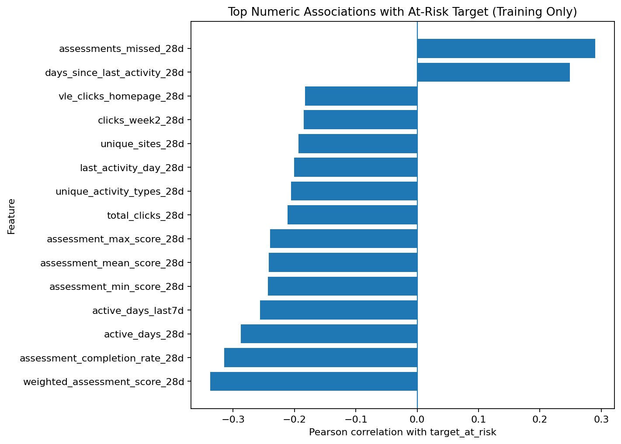
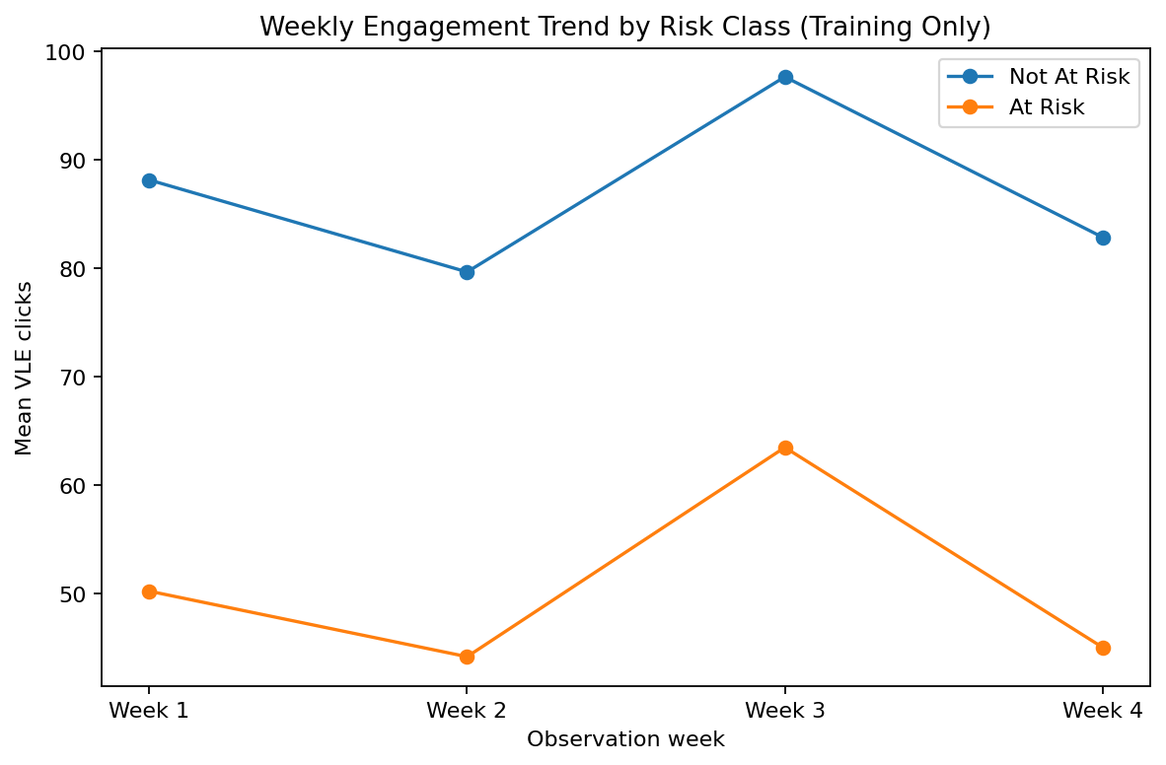
4 · EDA: What Signals Appear Early?
Target-facing analysis is restricted to development data.
Key descriptive signals
Early assessment score & completion
Missed assessments
Active days / recent activity
Inactivity duration
Four-week engagement pattern

Slide 6
5 · Feature Engineering
One student-course row becomes a Day-28 snapshot of progress and context.
Background
History
VLE totals
age · education · region · IMD · disability
previous attempts · studied credits · registration
clicks · active days · resource/activity counts
Weekly progress
Recent engagement
Assessments
Week 1–4 clicks · slope · direction
last 7 days · days since activity
scores · weighted score · completion · missed
Result: a reproducible 61-column engineered table with an explicit prediction-time boundary.

Slide 7
6 · Preprocessing Pipeline
Same transformations during training and inference.
Numeric
Categorical
Identity
Pipeline
Median imputation
Most-frequent imputation
Drop id_student
Fit inside CV
standardize for LR / SVM
one-hot encoding
retain only for grouping
avoid test-distribution leakage
Random Forest does not require numeric scaling; Logistic Regression and SVM do.
Unknown categorical values are ignored safely by the inference encoder.

Slide 8
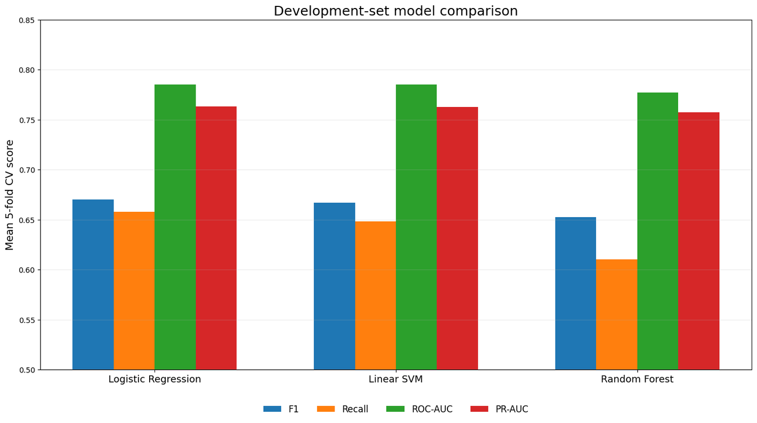
7 · 5-Fold Group-Aware Model Comparison
Selection uses development CV — not the locked evaluation metrics.
Winner
Logistic Regression
CV F1
CV RECALL
0.670
0.658
mean
mean
ROC-AUC
PR-AUC
0.785
0.763
mean
mean
Simple ≠ weak. On this structured tabular problem, the interpretable linear model generalized best in the selected comparison.

Slide 9
8 · Tuning, Calibration & Risk Bands
The output is a calibrated support probability — not just a hard class.
Selected hyperparameters
Relative modeled risk bands
C = 0.05
class_weight = balanced
LOW
MEDIUM
HIGH
p < 0.2509
0.2509 – 0.3197
p ≥ 0.3197
Calibration
Logistic calibrator fitted on group-aware out-of-fold development scores.
Low ≠ guaranteed success · High ≠ guaranteed failure. These bands prioritize human-reviewed support.

Slide 10
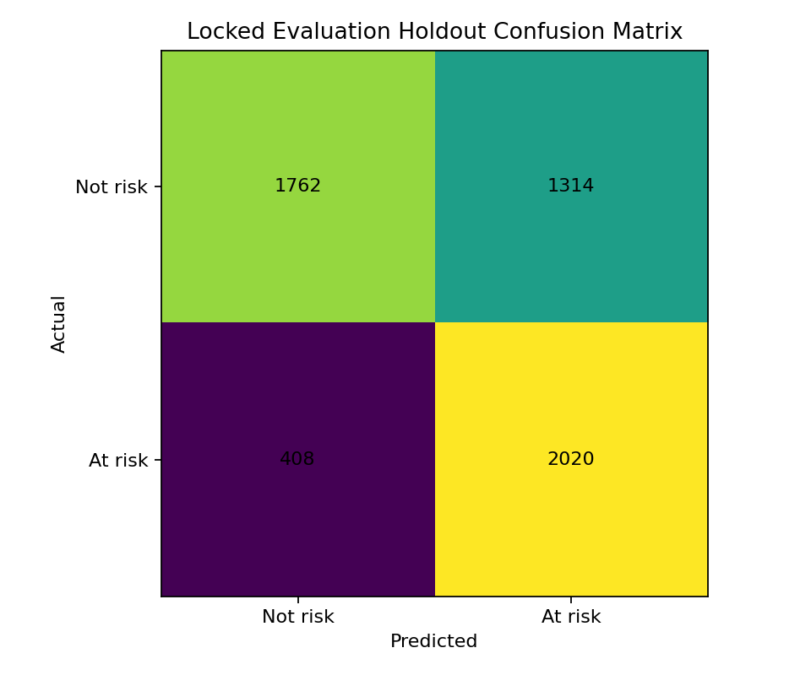
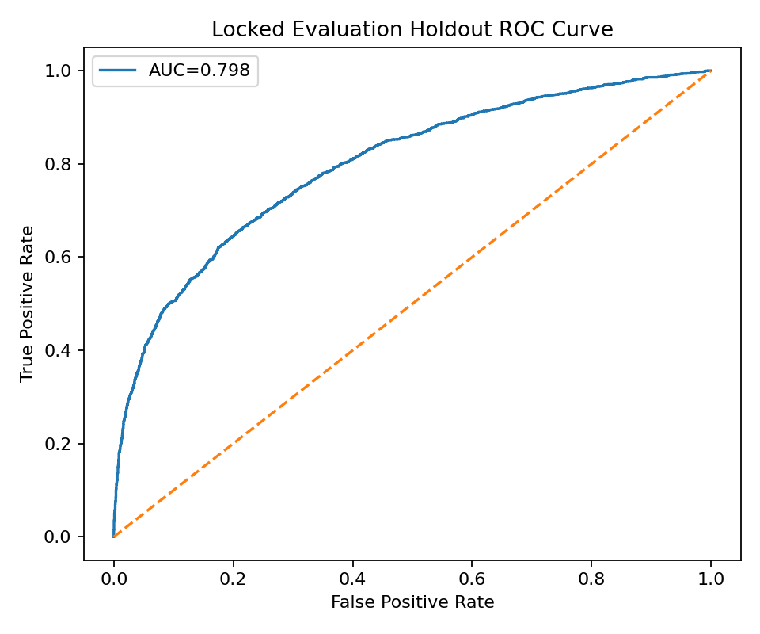
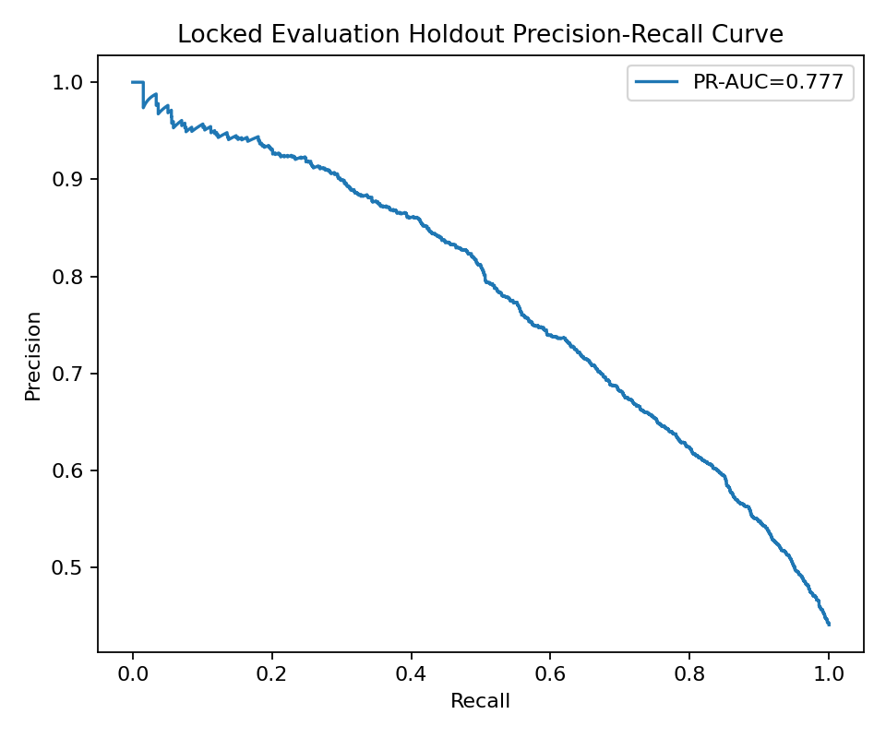
9 · Locked Evaluation Holdout Performance
The operating threshold favors recall so fewer at-risk students are missed.
ACCURACY
PRECISION
RECALL
F1
ROC-AUC
PR-AUC
68.7%
60.6%
83.2%
70.1%
0.798
0.777
overall
alert purity
at-risk detected
balance
ranking
PR ranking

Slide 11
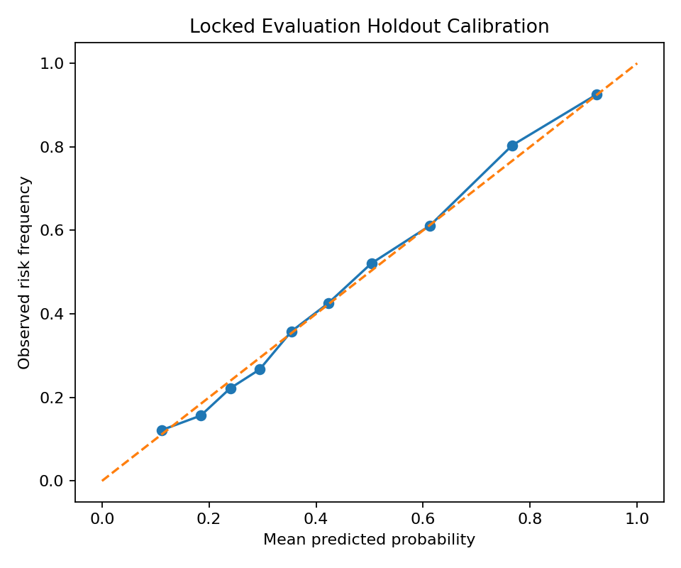
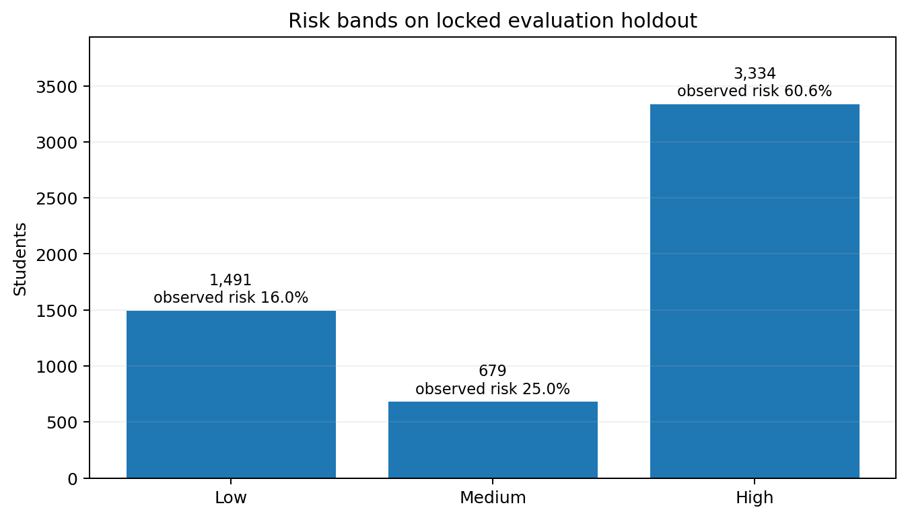
10 · Calibration & Risk Distribution
Do the probability bands behave sensibly?
Observed outcome rate rises clearly across Low → Medium → High bands.
Brier = 0.179 · ECE ≈ 0.015

Slide 12
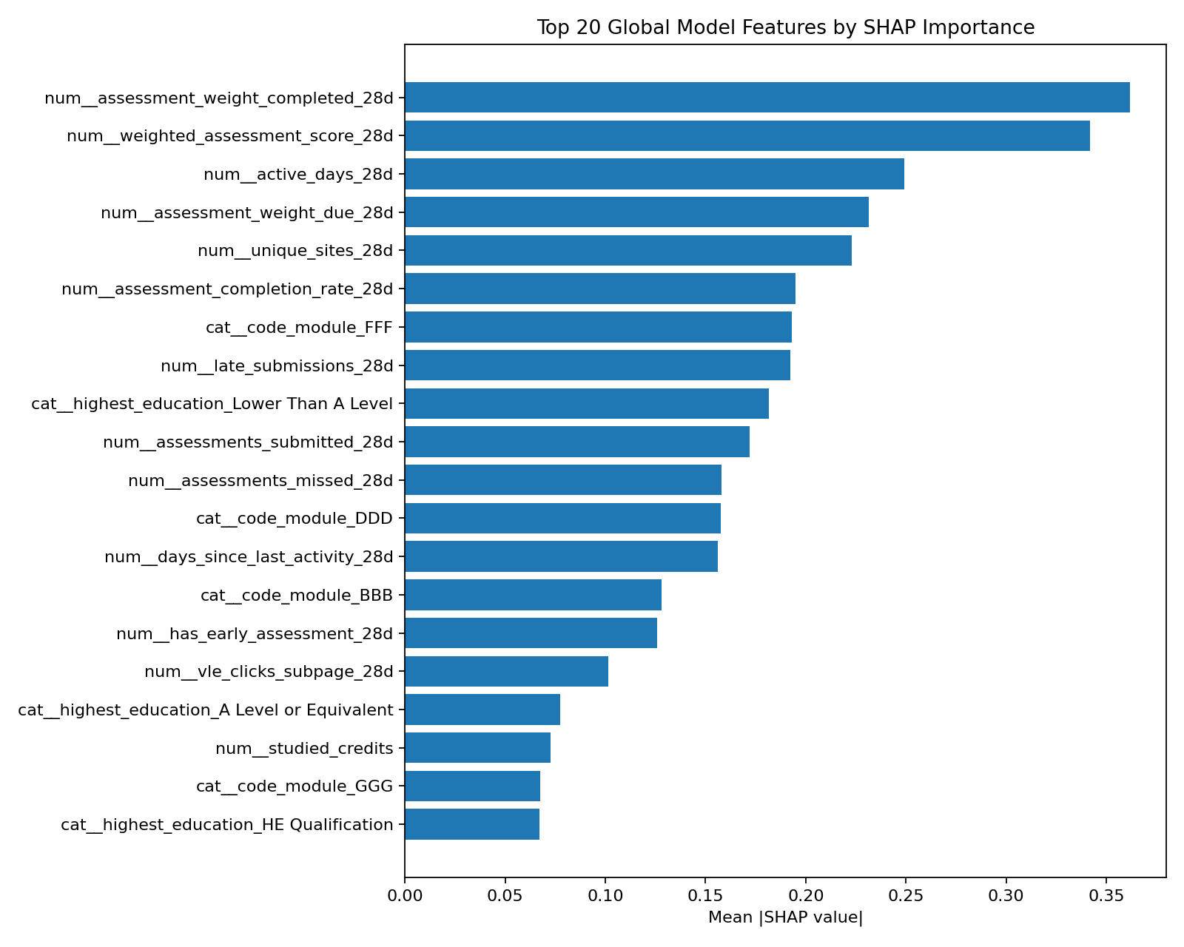
11 · Explainability: SHAP + Coefficients
Explain model behavior — do not claim causality.
How we interpret explanations
Global mean |SHAP| → importance magnitude only.
Local signed SHAP → raises or lowers one student prediction.
Logistic coefficients → transformed-feature model direction.
None of these establish causal effects.
Explain prediction ≠ explain the student

Slide 13
12 · Recommendation Engine
Translate actionable warning signals into supportive next steps.
Missed assessment
Catch-up plan for overdue work
Low early score
Targeted academic review
Recent inactivity
Supportive re-engagement check-in
Low recent engagement
Short regular study schedule
Declining activity
Identify barriers + recovery plan
Previous attempts
Consider structured tutoring support
Sensitive demographic attributes are deliberately excluded from recommendation rules.

Slide 14
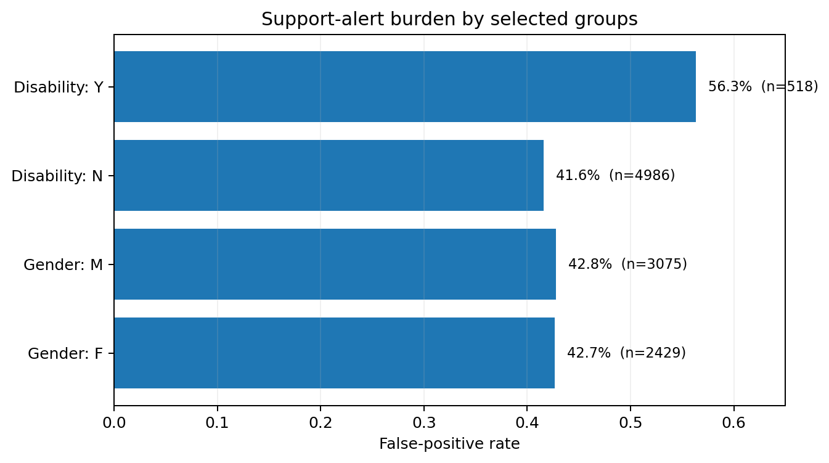
13 · Responsible AI & Deep-Learning Extension
Performance is only one part of a defensible project.
Fairness / support audit
ANN extension
Development-only 3-fold group-aware MLP
F1
RECALL
ROC-AUC
0.636
0.593
0.760
CV
CV
CV
The neural network did not outperform Logistic Regression. That is a valid scientific result on structured tabular data.
Sensitive-feature ablation (development CV)
All features: F1 0.670 · ROC-AUC 0.785
No sensitive demographics: F1 0.659 · ROC-AUC 0.774
Optional Keras script: Dense + BatchNorm + Dropout + Adam + BCE + EarlyStopping with group-aware development validation.

Slide 15
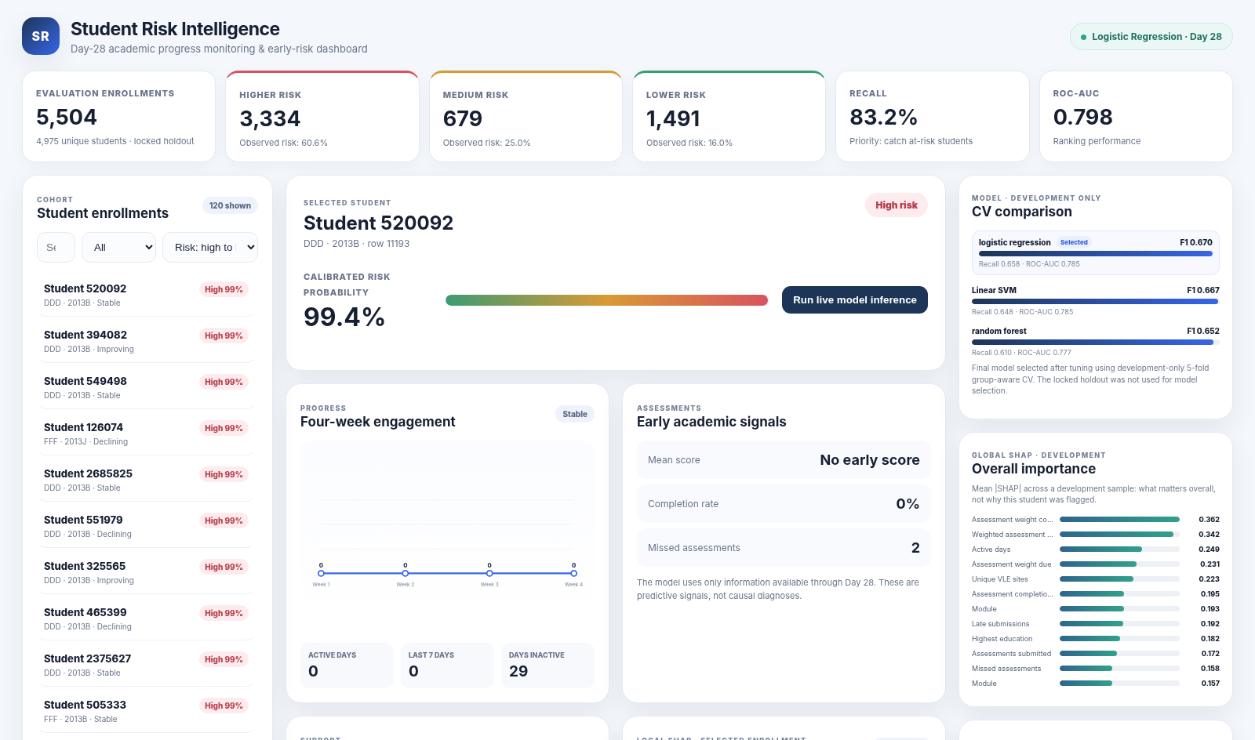
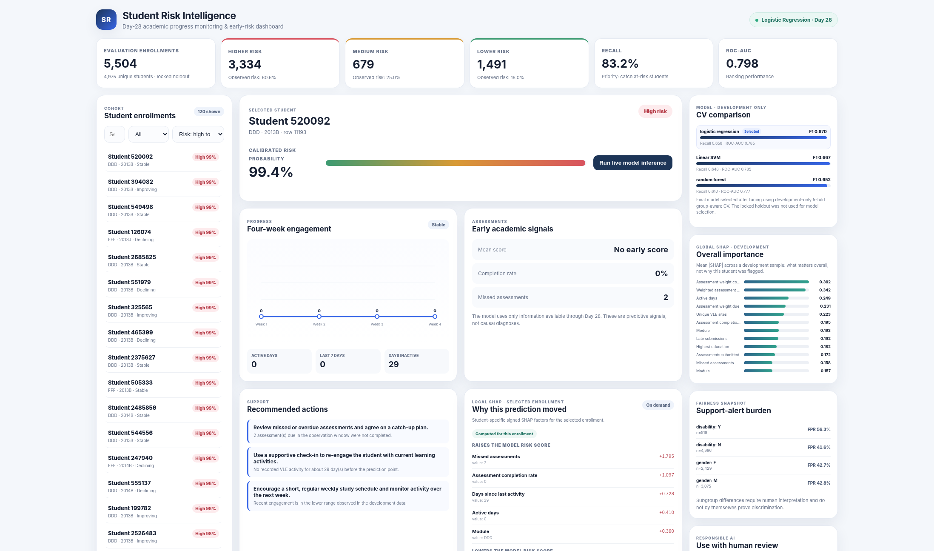
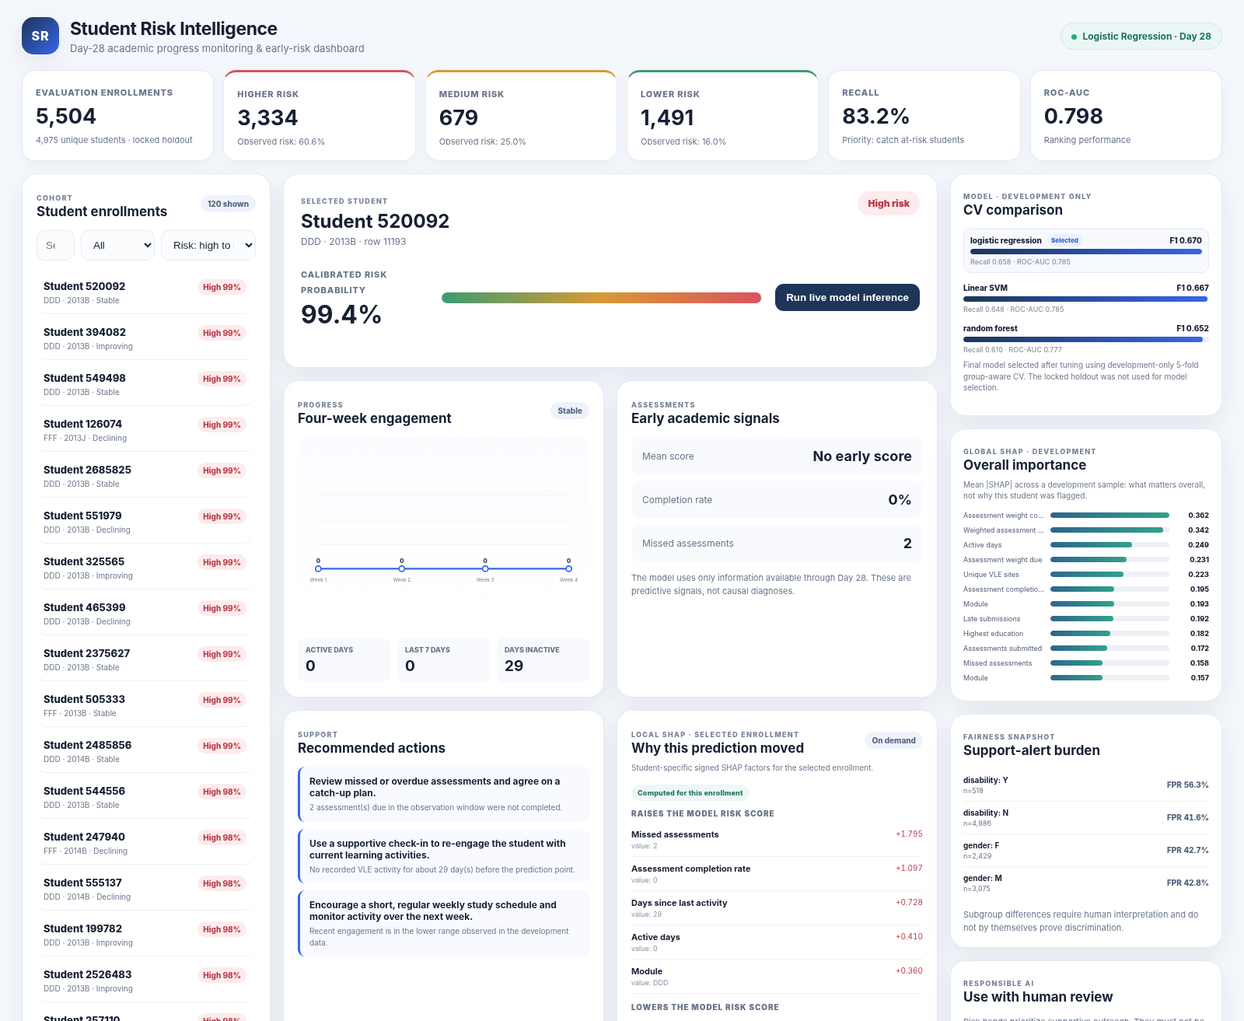
14 · Demo Dashboard & Deployment
From trained model to an explainable, human-readable workflow.
Demo capabilities
Search / filter students by risk band
Week 1–4 engagement chart
Early assessment signals
Calibrated probability + risk band
Support recommendations
On-demand local SHAP for selected enrollment
Global importance + CV comparison
Live inference using saved bundle
Run locally on Windows CMD: py demo\app.py

Slide 16
15 · Conclusion & Future Work
A complete early-warning ML pipeline — with clear boundaries on what it can claim.
What we completed
Next research steps
Temporal Day-28 target design
Full EDA + feature engineering
Leakage-safe grouped validation
LR / SVM / RF + ANN extension
Calibration + risk thresholds
SHAP + recommendations
Fairness/support audit
Reproducible inference + dashboard
Future-cohort / external validation
Multiple prediction points → risk trajectory
Sequential LSTM / GRU on raw temporal events
Intervention-impact evaluation
Operational capacity-aware thresholds
Key takeaway
The strongest contribution is the disciplined workflow: time boundary, leakage control, grouped validation, calibration, explainability, fairness, and human-reviewed intervention.

