Slide 1
DEPI GRADUATION PROJECT
1 Problem
AdaptiveEdu
2 Student journey
Telegram study bot for 1st Secondary.
Register → choose subject → AI lesson PDF
→ submit Excel quiz → Pass / Fail by email.
3 3 Sheets
4 n8n steps
5 Live canvas
6 Demo emails
n8n · Gemini · 3 Google Sheets · Gmail · Drive
7 Pass / Fail
https://t.me/AdaptiveEdubot
8 Deliverables
https://github.com/ahmedhamedali82/AdaptiveEdu
1

Slide 2
WHY THIS PROJECT
Problem and solution
Problem
Solution — AdaptiveEdu
One class. One pace. One book.
A student who fails still moves on.
A teacher cannot follow every student by hand.
We need: finish this lesson before the next one — with proof.
A live Telegram bot.
1) Student sends ID (ST005).
2) Chooses a subject code.
3) Gemini builds the next lesson as PDF + 10 MCQs.
4) Student uploads Excel answers.
5) Score saved. Email: Pass or Fail.
Bot: t.me/AdaptiveEdubot
https://github.com/ahmedhamedali82/AdaptiveEdu
2

Slide 3
STUDENT JOURNEY
Eight clear steps (demo path)
1
2
3
4
Open bot
Send ID
Pick subject
Get lesson
t.me/AdaptiveEdubot
ST005
Send 4 = Philosophy
PDF + quiz by email
5
6
7
8
Study
Answer file
Upload Excel
Result email
Download PDF link
ST005_4_1.xlsx
On Telegram
Pass (>6) or Fail
https://github.com/ahmedhamedali82/AdaptiveEdu
3

Slide 4
DATA
Three Google Sheets the bot uses
1 Students_Data
2 Lessons_Data
3 student_progress
Who is the student?
student_id
student_name
telegram_chat_id
email
status (waiting flag)
First login saves chat ID.
What can we teach?
Tab subject:
1–8 subject codes
Tab Lessons_Data:
lesson_code + lesson_name
per subject
Next lesson = first not passed.
History log.
student + subject + lesson
date, grade, succeed
FILE_NAME
ANS_1 … ANS_10
Append / update each attempt.
https://github.com/ahmedhamedali82/AdaptiveEdu
4

Slide 5
SHEET LINKS
Open these in the live demo
Students_Data
https://docs.google.com/spreadsheets/d/1m8rzYDXa7817vFFcd1bqszegV0orMgxA8AyyOEyYl1s
Lessons_Data (subject + lessons)
https://docs.google.com/spreadsheets/d/1FUfTrazMkwUSOi1NzrC9D4FKqGhTUJ1KPdb-lLCUyY0
student_progress
https://docs.google.com/spreadsheets/d/18C6AQaF5evsGaI4upz1vxbCgnE8jhxJfVfQS3-R5KPk
https://github.com/ahmedhamedali82/AdaptiveEdu
5

Slide 6
N8N STEPS · A
Register path (first time)
1
1 Telegram Trigger
New message arrives.
2
2 Get row by chat ID
Look up Students_Data.
3
3 status ≠ waiting
Treat as register / menu.
4
4 Search student ID
Match text like ST005.
5
5 Update chat ID
Save Telegram id once.
6
6 Show subjects
List 1–8 + upload tip.
7
7 Set waiting=1
Next message = subject or file.
https://github.com/ahmedhamedali82/AdaptiveEdu
6

Slide 7
N8N STEPS · B
Lesson path (subject code)
1 Subject check
2 Read progress
3 Pick next lesson
4 Block if pending
Text equals SUBJECT_CODE.
Find last passed lesson.
Code node get_file.
Old lesson unanswered → error.
5 AI Agent (Gemini)
6 HTML → PDF
7 Telegram + Gmail
8 Append progress
Markdown lesson + 10 answers.
Convert and store / link.
Send file notice + email with URL + Excel name.
Open lesson row ready for grading.
https://github.com/ahmedhamedali82/AdaptiveEdu
7

Slide 8
N8N STEPS · C
Grade path (Excel upload)
1 Document?
2 Name check
3 Drive extract
4 Compare ANS_1..10
If message has a file.
Must match ST###_sub_les.xlsx
Upload → download → parse row.
Capital letters vs model answers.
5 Score
6 Pass rule
7 Update sheet
8 Email + Telegram
grade = correct count / 10
Pass if grade > 6 else Fail
Write grade + succeed flag.
Result mail + restudy tip if Fail.
https://github.com/ahmedhamedali82/AdaptiveEdu
8

Slide 9
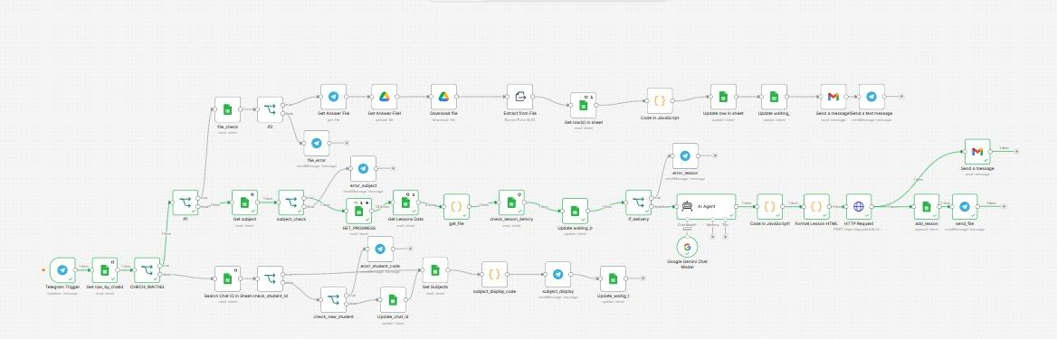
N8N CANVAS
Live workflow ADAPTIVE_11 (44 nodes)
Three message types only: student ID · subject code · answers Excel file
https://github.com/ahmedhamedali82/AdaptiveEdu
9

Slide 10
TOOLS
What each tool does
Telegram
n8n
Google Sheets ×3
Student screen. Bot link on cover.
Orchestrates all paths.
Students, lessons, progress.
Gemini AI Agent
HTML → PDF
Gmail + Drive
Writes lesson + model answers.
Lesson file for the student.
Email result + store files.
https://github.com/ahmedhamedali82/AdaptiveEdu
10

Slide 11
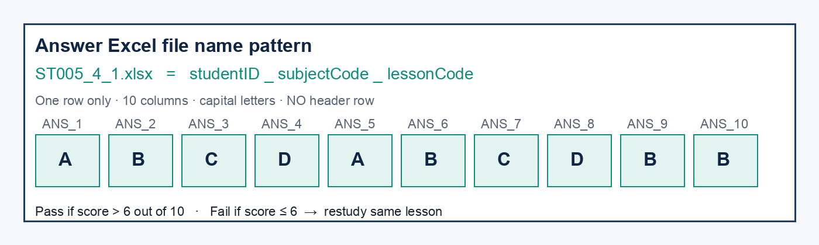
QUIZ FILE
Exact Excel style the bot accepts
Example for Ahmed (ST005), Philosophy (4), lesson 1 → file name ST005_4_1.xlsx
https://github.com/ahmedhamedali82/AdaptiveEdu
11

Slide 12
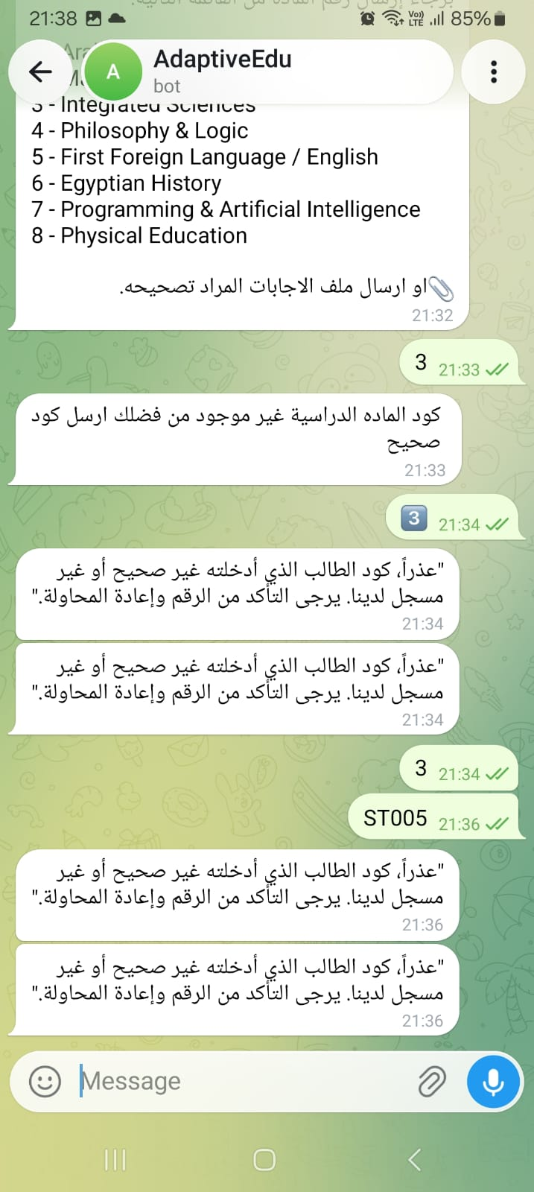
LIVE DEMO · TELEGRAM
Bot messages (subjects + validation)
What you should see
After a valid ID, the bot lists subjects 1–8 and offers to upload an answers file.
Send a subject number (example: 4) to open the next lesson.
Validation messages
Wrong subject → “كود المادة غير موجود…”
Wrong / unknown student ID → “كود الطالب غير صحيح…”
These prove the Sheets checks are live.
https://github.com/ahmedhamedali82/AdaptiveEdu
12

Slide 13
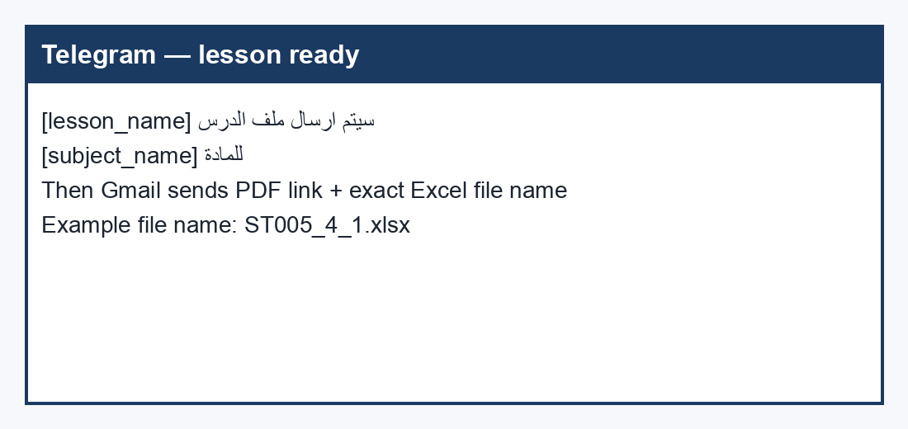
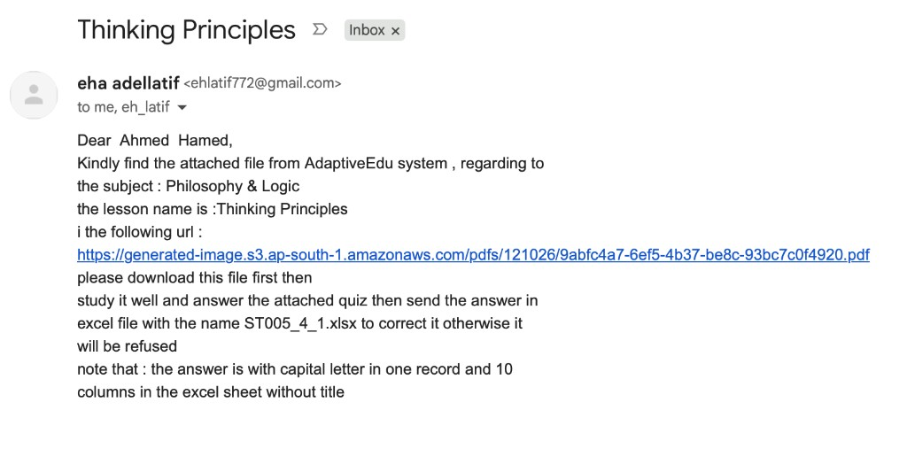
LIVE DEMO · LESSON DELIVERY
Telegram notice + Gmail with PDF
Real email example: Philosophy & Logic → Thinking Principles → download PDF → reply with ST005_4_1.xlsx
https://github.com/ahmedhamedali82/AdaptiveEdu
13

Slide 14
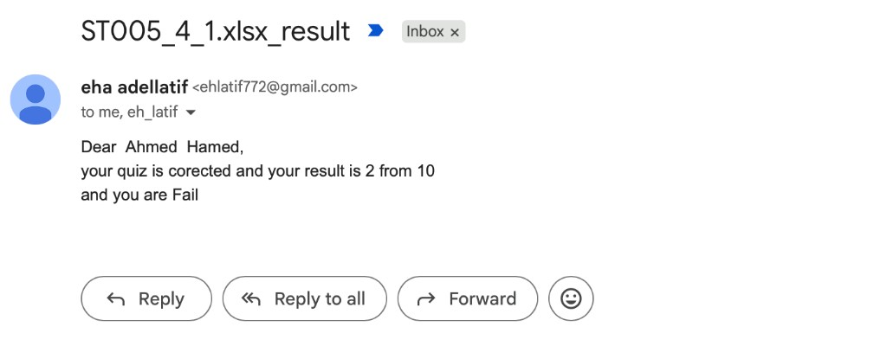
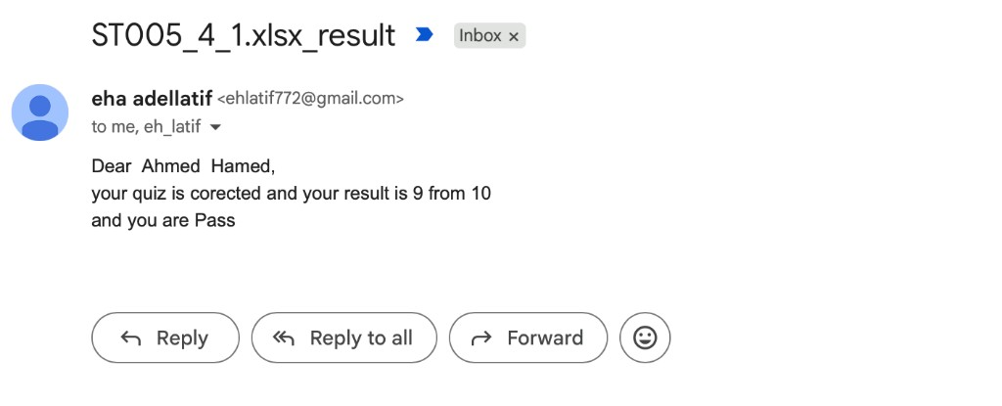
LIVE DEMO · RESULTS
Same student — Fail then Pass emails
Fail example: 2 / 10
Pass example: 9 / 10
Rule in n8n: Pass if grade > 6. Fail → restudy same lesson and upload again. Pass → next lesson_code opens.
https://github.com/ahmedhamedali82/AdaptiveEdu
14

Slide 15
RULE
Pass, fail, and what happens next
Pass · more than 6 / 10
Fail · 6 or less / 10
student_progress: succeed = 1
grade saved with ANS_1…ANS_10
Email: “you are Pass”
Telegram: grading done.
Next subject request opens lesson_code + 1.
student_progress: succeed = 0
Email: “you are Fail”
Telegram: restudy and resend answers.
Same lesson stays open until Pass.
Wrong file name is refused.
https://github.com/ahmedhamedali82/AdaptiveEdu
15

Slide 16
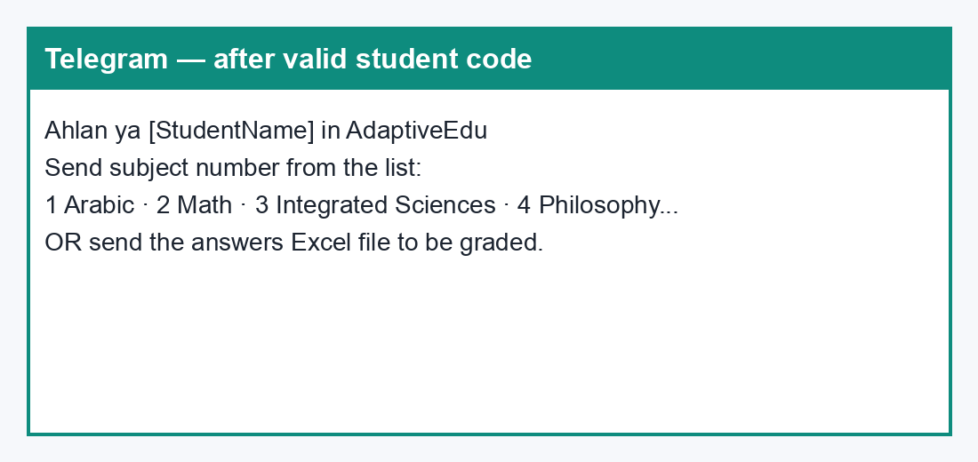
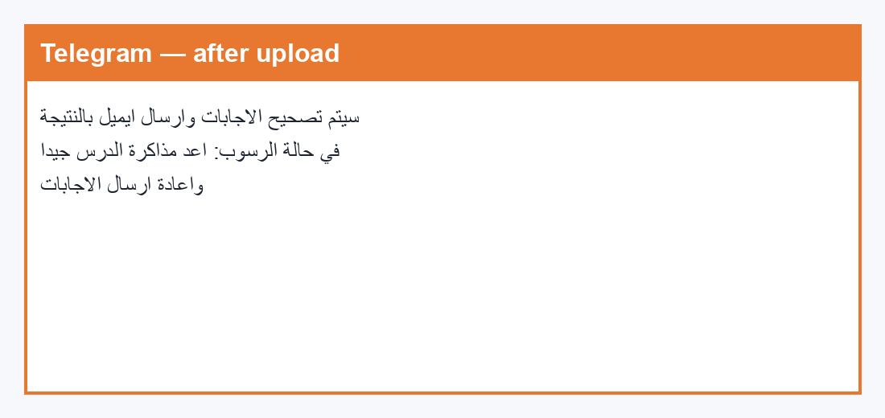
BOT + EMAIL TEXT
Key messages the panel can read aloud
Left: welcome + subject list after register. Right: after Excel upload (before the result email).
https://github.com/ahmedhamedali82/AdaptiveEdu
16

Slide 17
SUBMIT
What the panel should see
Working bot
n8n JSON
3 Sheets
t.me/AdaptiveEdubot
AdaptiveEdu.json (ADAPTIVE_11)
Students · Lessons · Progress
This PPT
Docs + video
GitHub
Journey + n8n steps + live shots
Full write-up + 2–5 min demo
github.com/ahmedhamedali82/AdaptiveEdu
https://github.com/ahmedhamedali82/AdaptiveEdu
17

Slide 18
LIVE DEMO SCRIPT
Say this. Do this. ~3 minutes.
1
Open Telegram bot
Send ST005
2
Show subject list
Send 4 (Philosophy)
3
Open Gmail
PDF link + file name ST005_4_1.xlsx
4
Show Excel row
10 capital letters, no header
5
Upload file on Telegram
Bot confirms grading
6
Show Pass or Fail email
Then open student_progress row
https://github.com/ahmedhamedali82/AdaptiveEdu
18

