Slide 1
DEPI GRADUATION PROJECT
1 Problem
AdaptiveEdu
2 n8n workflow
3 Tools & outcomes
Personal lessons with LLM + n8n.
Not one fixed book for every student.
4 4-week milestones
5 Deliverables
4-week plan · Proposal → Design → Build → Deliver
6 Do this week
1

Slide 2
WHY + WHAT
Problem and solution
Problem
Solution — AdaptiveEdu
One fixed curriculum for all.
Same pace. Same examples.
Weak students fall behind.
Strong students get bored.
Teachers cannot rewrite every lesson by hand.
A personalized AI agent.
Student asks → agent builds content for that student.
Input: prompt + level + goal
Process: n8n + LLM + profile
Output: personal lesson + quiz
Learning fits the learner.
AdaptiveEdu · Project plan
2

Slide 3
OBJECTIVES
What we will achieve
1 Personalize
2 Automate
Generate content per student request and level.
Run the full flow in n8n with little manual work.
3 Track
4 Deliver
Save each request and output for teacher review.
ZIP, PPT, docs, GitHub, 2–5 min video.
AdaptiveEdu · Project plan
3

Slide 4
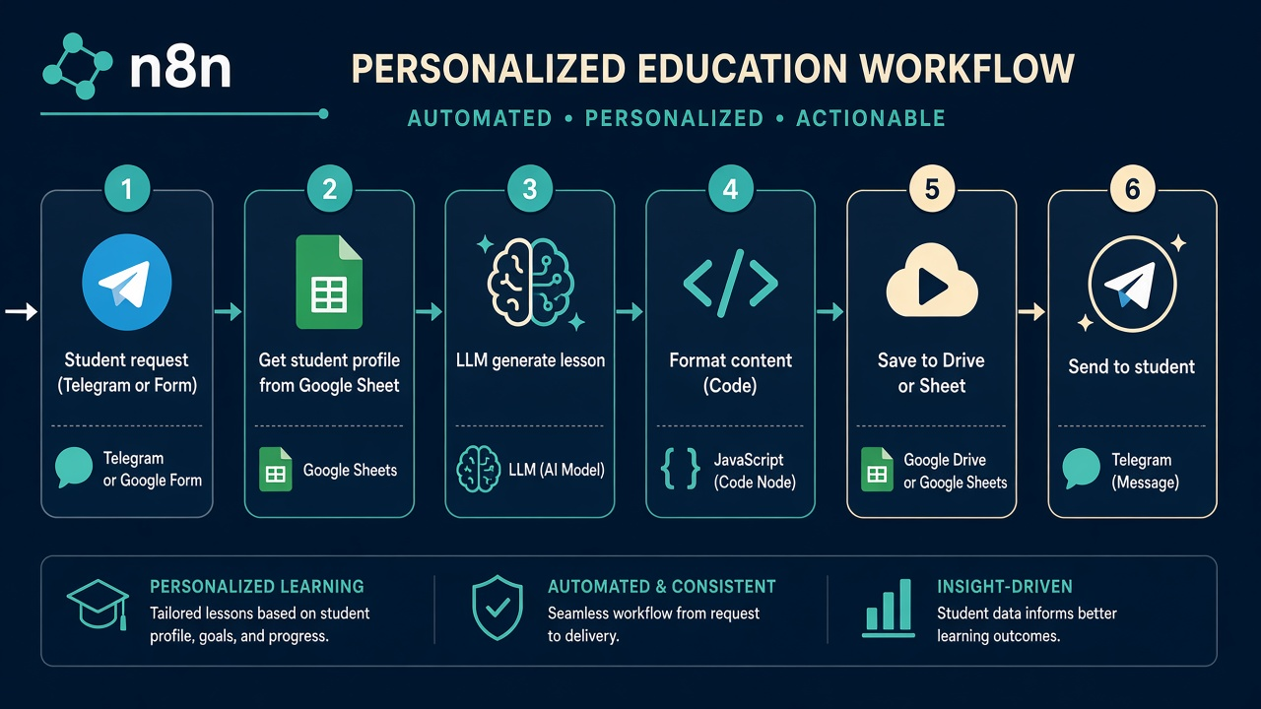
HOW IT WORKS
Student path + n8n nodes
1 Trigger
2 Profile
3 LLM
4 Format
5 Log
6 Send
Form / Telegram
Google Sheet
Generate lesson
Code / Set
Save run
Email / Telegram
AdaptiveEdu · Project plan
4

Slide 5
PROMPT TEMPLATE
Same structure. Different student data.
Role: You are a school tutor in Egypt.
Student: {{name}} · Level: {{level}} · Subject: {{subject}}
Request: {{student_prompt}}
Task: Create a short personal lesson.
Format:
1) Title
2) 5 key points (simple English)
3) One Egypt school example
4) 3 practice questions
5) One tip for next study session
Rules: No fake facts. If unsure, say so. Keep under 350 words.
AdaptiveEdu · Project plan
5

Slide 6
TOOLS & OUTCOMES
Stack + what success looks like
n8n
LLM
Sheets
Telegram / Gmail
Workflow: trigger → LLM → send
ChatGPT / Gemini / Groq
Profiles + activity log
Ask and deliver
Working agent
Workflow JSON
Teacher log
DEPI package
Ask → personal lesson arrives.
Importable n8n + AI node.
Sheet of requests/outputs.
ZIP, PPT, docs, GitHub, video.
AdaptiveEdu · Project plan
6

Slide 7
MILESTONES
4-week delivery
Week 1
Proposal + GitHub
Week 2
Design
Week 3
Build + test
Week 4
Docs + delivery
Problem, objectives, tools, outcomes.
Team roles. Fixed GitHub URL.
n8n canvas. Prompt templates.
Sheet columns. User flow.
Trigger → profile → LLM → send.
Test 3 student personas.
Docs, final PPT, 2–5 min video.
ZIP + defense prep.
AdaptiveEdu · Project plan
7

Slide 8
DELIVERABLES & ROLES
What we submit · who does what
Source ZIP
Final PPT
Full docs
n8n JSON + prompts
DEPI panel deck
Proposal + user guide
GitHub
Video 2–5 min
15-min defense
Create early. Never change URL.
Problem → demo → result
Each member’s role clear
Team roles (fill names later)
Leader: deadlines + GitHub · n8n: workflow · Prompts: templates · Docs/video: PPT + film · QA: tests + sheet log
AdaptiveEdu · Project plan
8

Slide 9
DO THIS WEEK
Then we write the proposal document
1
Confirm name
AdaptiveEdu
2
Register team
Form before deadline
3
Create GitHub
Empty repo. Link stays forever.
4
Draft proposal
Problem · objectives · tools · outcomes
5
Sketch n8n
6 nodes on paper. Build in Week 3.
AdaptiveEdu · Project plan
9

