Slide 1
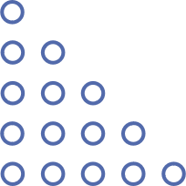

Software Design Patterns & Software Architecture Patterns
Ahmed El-Hendy El-Desokey

Slide 2
Members
-01-
Ahmed El-Hendy El-Desokey ( Software Design Patterns & Software Architecture Patterns )
-02-
Soliman Mostafa ( TDD )
-03-
Mahmoud Taha ( SOLID Principles )

Slide 3
Part 01
Design Patterns OUTLINE
-01-
-02-
Design Patterns Definition
Design Patterns Classification
-03-
-04-
Factory Pattern
CODE
-05-
-06-
Adapter Pattern
CODE
-07-
-08-
Real-World Analogy
Strategy Pattern
-09-
-10-
Advantages
CODE

Slide 4
01 Design Patterns Definition
In Software engineering, design pattern is a general solution to a commonly occurring problem in software design.
A design pattern isn’t a finished design that can be transformed directly into code.
It’s a description or template for how to solve a problem that can be used in many different situations.

Slide 5
02 Design Patterns Classification
Design Patterns can be classified into three categories :-
1.Creational
2.Structural
3.Behavioral

Slide 6
02 Design Patterns Classification
Design Patterns can be classified into three categories :-
01 Creational Design Patterns :-
In software engineering, creational design patterns are design patterns that deal with object creation mechanisms.
Trying to create objects in a manner suitable to the situation.
The basic form of object creation could result in design problems or added complexity to the design.

Slide 7
02 Design Patterns Classification
Design Patterns can be classified into three categories :-
01 Creational Design Patterns :-
Creational Design Patterns
Factory Method
Singleton
Prototype
Abstract Factory
Builder
Object Pool

Slide 8
03 Factory Pattern
Factory Pattern is a Creational Design Pattern that allows class to create an object but lets subclasses decide which class to instantiate.
Using the Factory method, we have the best ways to create an object ( objects are created without exposing the logic to the client, and for creating the new type of object, the client uses the same common interface )

Slide 9
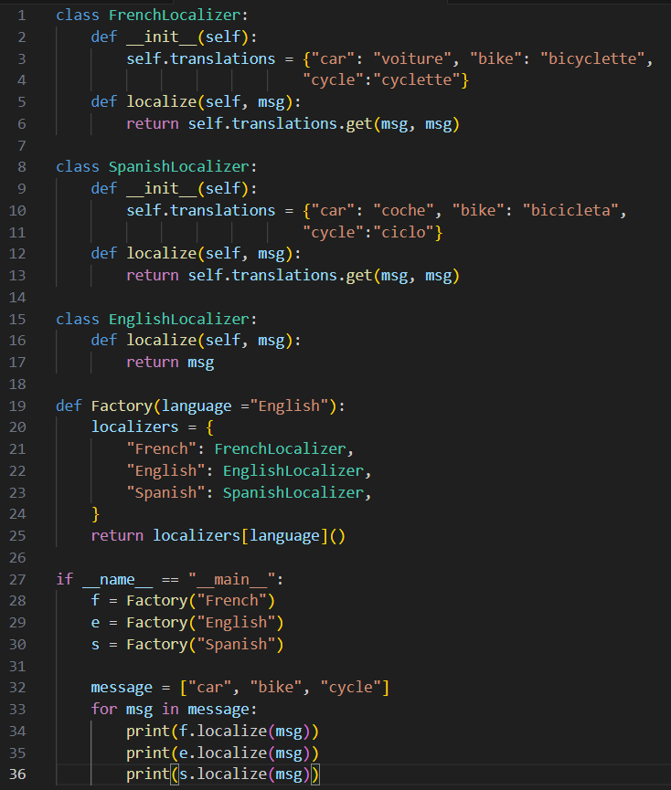
04 CODE

Slide 10
02 Design Patterns Classification
Design Patterns can be classified into three categories :-
02 Structural Design Patterns :-
Structural design patterns in software engineering provide ways to create relationships between different entities in a design.
This ease the design by identifying a simple way to realize relationships between entities.

Slide 11
02 Design Patterns Classification
Design Patterns can be classified into three categories :-
02 Structural Design Patterns :-
Structural Design Patterns
Adapter
Composite
Decorator
Proxy
Bridge
Flyweight

Slide 12
05 Adapter Pattern
Adapter is a structural design pattern that allows objects with incompatible interfaces to interact.
The Adapter Design Pattern acts as a bridge between two incompatible interfaces, allowing them to work together.

Slide 13
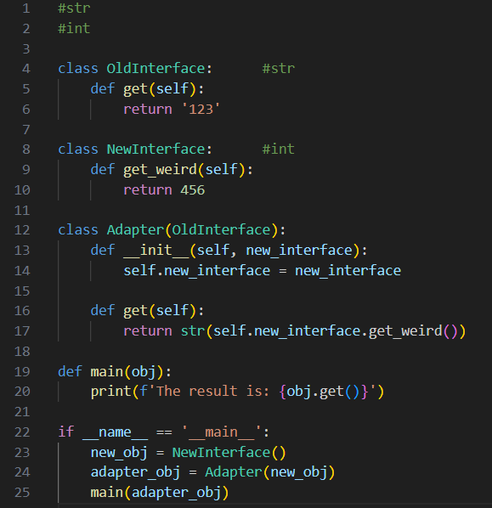
06 Code

Slide 14
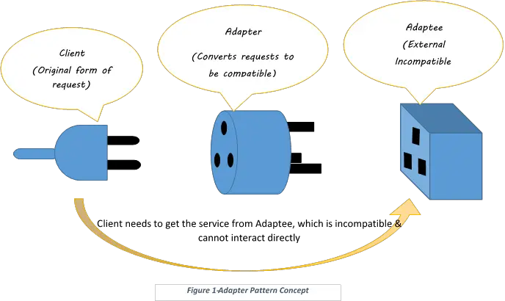
07
Real-World Analogy
real-world adapter is used to connect two different pieces of equipment that cannot be connected directly.

Slide 15
02 Design Patterns Classification
Design Patterns can be classified into three categories :-
03 Behavioral Design Patterns :-
Behavioral design patterns in software engineering focus on improving communication and interaction between objects in a system.
These design patterns promote flexibility, scalability, and maintainability in software development.

Slide 16
02 Design Patterns Classification
Design Patterns can be classified into three categories :-
03 Behavioral Design Patterns :-
Behavioral Design Patterns
CoR
Interpreter
Strategy
Null Object
Command
Visitor

Slide 17
08 Strategy Pattern
Strategy is a behavioral design pattern that turns a set of behaviors into objects and makes them interchangeable inside interfaces.
09 Advantages
Open/Closed Principle: It's always easy to introduce new strategies without needing to modify the client’s existing code.
Isolation: The specific implementation details of algorithms can be isolated from the client’s code.
Run-time Switching: The application can dynamically switch between strategies at runtime.

Slide 18
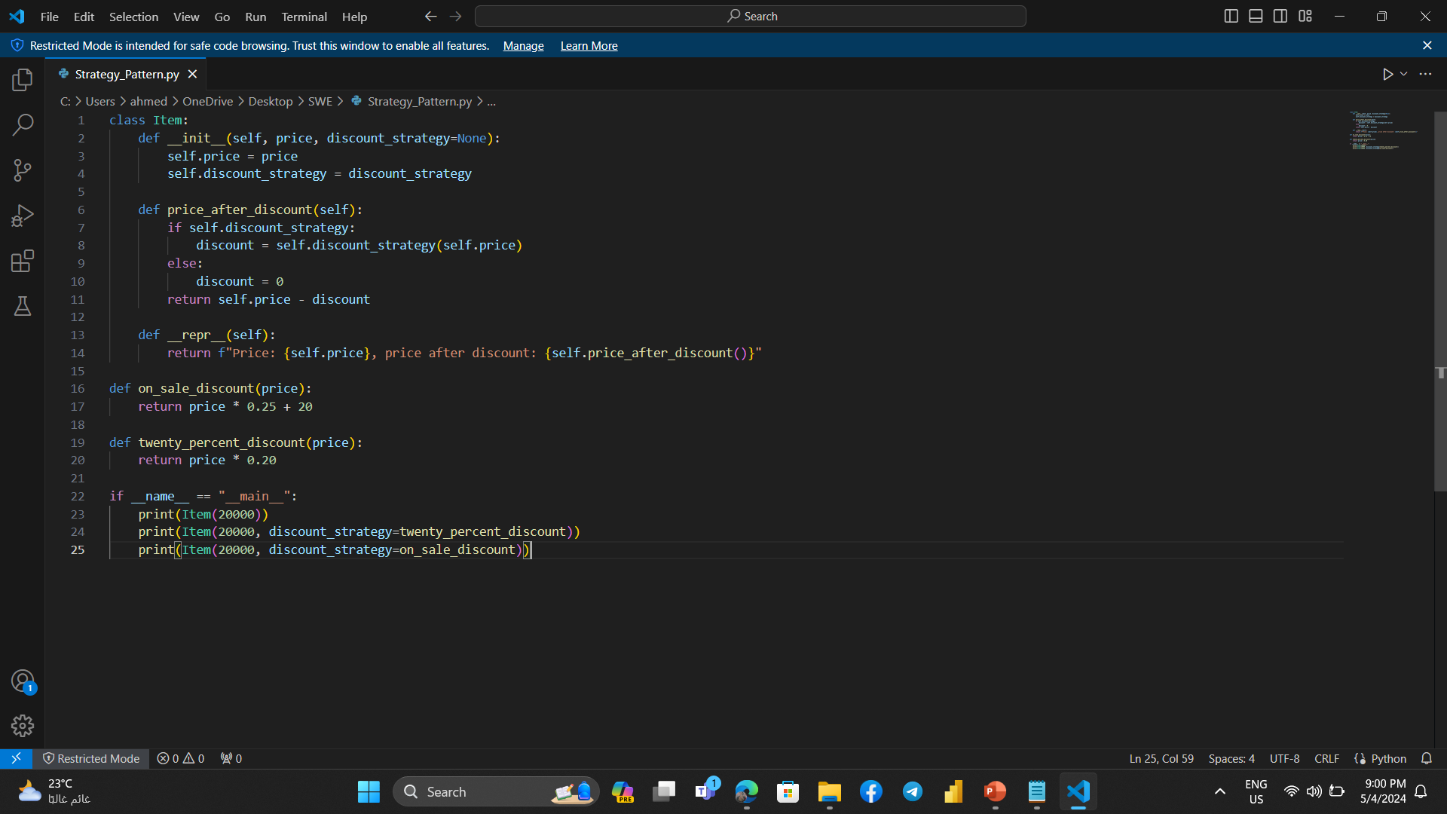
10
CODE

Slide 19
Part 02
Architecture Patterns OUTLINE
-01-
-02-
Architecture Patterns Definition
Why Use It?!
-03-
Types Of Architecture Patterns
-04-
Layered Architecture
-05-
-06-
Open/Closed Layers
When We Use Layered architecture?
-07-
-08-
Example Of Layered Architecture
Pattern Analysis

Slide 20
01 Architecture Patterns Definition
An architectural pattern is a general, reusable resolution to a commonly occurring problem in software architecture.
These patterns address various issues in software engineering, such as computer hardware performance limitations, high availability, and minimizing business risks.
It serves a variety of purposes, making presentations powerful tools for convincing and teaching. It serves a variety of purposes, making presentations

Slide 21
02 Why We Use Architecture Patterns ?!
1. Proven Construct.
2. Easy to communicate.
3. Keep things in order.
03 Types Of Architecture Patterns
1. Layered Architecture.
2. Event-Driven Architecture.
3. Microkernel Architecture.
It serves a variety of purposes, making presentations powerful tools for convincing and teaching. It serves a variety of purposes, making presentations
4. Microservices Architecture.

Slide 22
04 Layered Architecture
It is one of the most common types of architecture in software engineering.
Organizes software into horizontal layers, each responsible for distinct functionalities like presentation, business logic, and data storage.
Title here
Title here
Title here
Title here

Slide 23
04 Layered Architecture
Request
Presentation Layer(UI)
Component
Component
Component
Closed
Business/authorization Layer
Component
Component
Component
Closed
Persistence Layer
Component
Component
Component
Closed
Database Layer
Title here
Title here
Title here
Title here
Closed
Service

Slide 24
04 Layered Architecture
responsible for handling user interface components and user interactions. It may include components like UI controllers, views, and presentation logic.
Title here
Title here
Title here
Title here
Presentation Layer(UI)
Component
Component
Component
Closed

Slide 25
04 Layered Architecture
responsible for encapsulate the domain model and business rules, representing concepts and behavior relevant to the problem domain.
Title here
Title here
Title here
Title here
Business/authorization Layer
Component
Component
Component
Closed

Slide 26
04 Layered Architecture
responsible for managing the storage and retrieval of data in a software application
Title here
Title here
Title here
Title here
Persistence Layer
Component
Component
Component
Closed

Slide 27
04 Layered Architecture
responsible for organize and manage data within the database.
Title here
Title here
Title here
Title here
Database Layer
Component
Component
Component
Closed

Slide 28
05 Open/Closed Layers
Request
Presentation Layer(UI)
Component
Component
Component
Closed
Business/authorization Layer
Component
Component
Component
Closed
Services Layer
Component
Component
Component
Open
Title here
Title here
Title here
Title here
Persistence Layer
Component
Component
Component
Closed
Database Layer
Closed
Service

Slide 29
06 When We Use Layered architecture?
Layered architecture is widely used for numerous reasons.
You can consider it under the following scenarios/requirements:
When you aim to design an application quickly with fewer developers.
Applications that primarily require maintainability and separation of concerns as their pillars of architecture.
Title here
Title here
Title here
Title here
Enterprise applications that need to adopt traditional IT structures and processes.

Slide 30
07 Example Of Layered Architecture
Presentation Layer
Customer Screen
Customer Delegate
Business Layer
Component
Persistence Layer
Title here
Customer Screen
Customer Delegate
Title here
Title here
Title here
Database Layer

Slide 31
08 Pattern Analysis
1. Overall Agility ➔ Low.
2. Ease of Deployment ➔ Low.
3. Testability ➔ High.
4. Performance ➔ Low.
5. Scalability ➔ Low.
Title here
Title here
Title here
6. Ease of Development ➔ High.

Slide 32
Part 03
Test driven development (TDD) OUTLINE
-01-
-02-
TDD Definition
Stages of TDD
-03-
Architecture of TDD
-04-
Benefits of TDD
-05-
Example Of TDD

Slide 33
01 TDD Definition
Test-driven development (TDD) is an approach to program development in which you inter-leave testing and code development.
Tests are written before code and 'passing' the tests is the critical driver of development.
You develop code incrementally, along with a test for that increment. You don't move on to the next increment until the code that you have developed passes its test.
It serves a variety of purposes, making presentations powerful tools for convincing and teaching. It serves a variety of purposes, making presentations
TDD was introduced as part of agile methods such as Extreme Programming. However, it can also be used in plan-driven development processes.

Slide 34
02 Stages Of TDD
01 Write test code for the feature you want to add to the system.
Title here
Title here
02 The test fails and produces a red light because there is no executable code.
Making presentations powerful tools
Making presentations powerful tools
03 production code.
04 Writing executive code production code, The test succeeds and a green light is produced indicating the test is successful.
Making presentations powerful tools
05 Improve the code.

Slide 35
03 Architecture Of TDD
Identify New Functionality
Pass
Write Test
Run Test
Implement Functionality And Refactor
Fail

Slide 36
04 Benefits Of TDD
01 It is considered a complete documentation of the system and all system features.
Title here
Title here
02 Makes the code easier to read.
Making presentations powerful tools
Making presentations powerful tools
03 It gives high flexibility to rebuild the code, improve it, or add to it.
04 It gives the ability to add new features without causing problems.
Making presentations powerful tools
05 Complete understanding and control of the system.

Slide 37
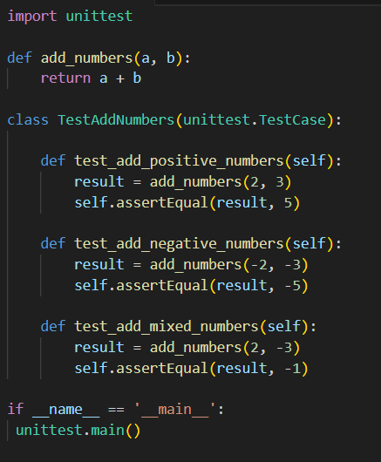
05
Example
Of TDD

Slide 38
Part 04
SOLID Principles
-01-
-02-
SOLID Definition
Single Responsibility Principle
-03-
Open-Closed Principle
-04-
Liskov Substitution Principle
-05-
-06-
Interface Segregation Principle
Dependency Inversion Principle

Slide 39
01 SOLID Definition
SOLID is a popular set of design principles that are used in object-oriented software development.
SOLID is an acronym that stands for five key design principles.
Single Responsibility Principle (SRP)
Open-Closed Principle (OCP)
Liskov Substitution Principle (LSP)
Interface Segregation Principle (ISP)
Dependency Inversion Principle (DIP)
All five are commonly used by software engineers and provide some important benefits for developers.
Title here
Title here
Making presentations powerful tools
Making presentations powerful tools
S
O
L
I
D
Making presentations powerful tools

Slide 40
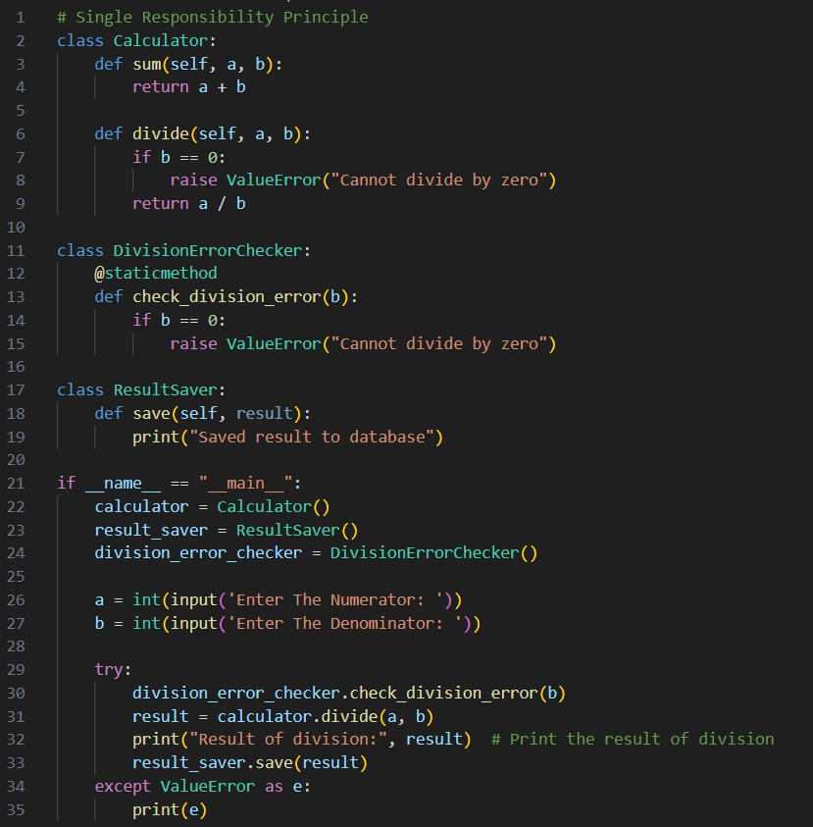
02 Single Responsibility
Principle
Title here
Title here
The class should solve one problem, it should have a single reason to change.
Making presentations powerful tools
Making presentations powerful tools
Making presentations powerful tools

Slide 41
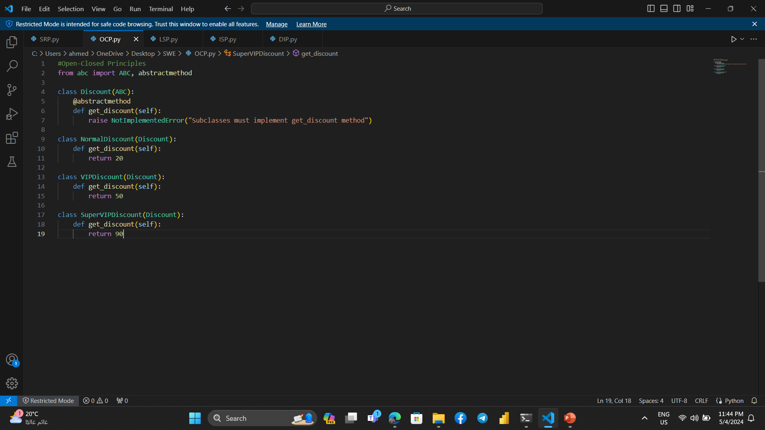
03 Open-Closed
Principle
The class should be open for extension, closed for modification.
Title here
Title here
You should be able to extend the behaviour of module, without modifying it.
Making presentations powerful tools
Making presentations powerful tools

Slide 42
04 Liskov Substitution
Principle
If you substitute any type with one of its subtypes, the behavior should not change
This means that, given that class B is a subclass of class A, we should be able to pass an object of class B to any method that expects an object of class A and the method should not give any weird output in that case.
Liskov's principle is easy to understand but hard to detect in code.
This principles confirms that our abstraction is correct and helps us get a code that is easy reusable, and class hierarchies that are easily understood.
Title here
Title here
Making presentations powerful tools
Making presentations powerful tools
Making presentations powerful tools

Slide 43
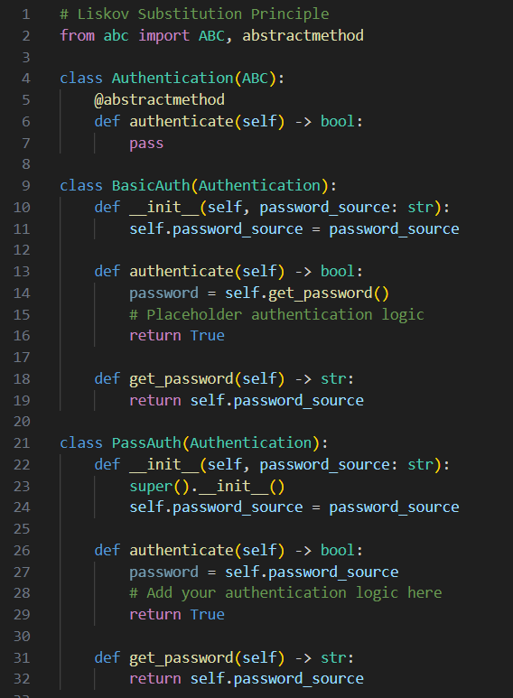
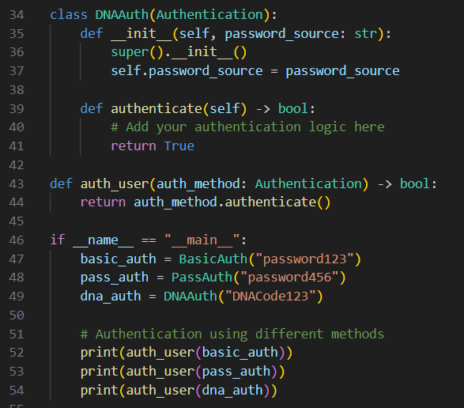
04
Liskov
Substitution
Principle

Slide 44
05 Interface Segregation
Principle
Avoid making general interface contains all methods.
Segregation means keeping things separated, and the Interface Segregation Principle is about separating the interfaces.
Clients should not be forced to implement a function they do no need.
The interface of a program should be split in a way that the user/client would only have access to the necessary methods related to their needs.
Title here
Title here
Making presentations powerful tools
Making presentations powerful tools
Making presentations powerful tools

Slide 45
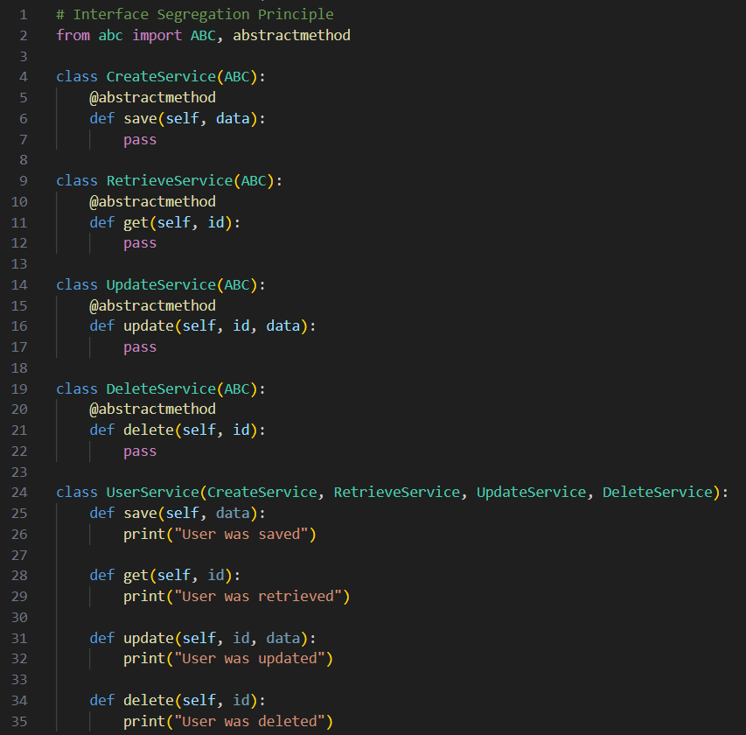
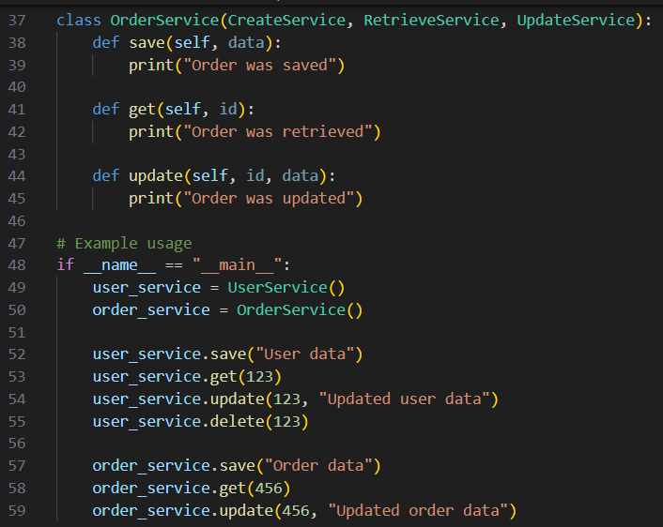
05
Interface Segregation
Principle

Slide 46
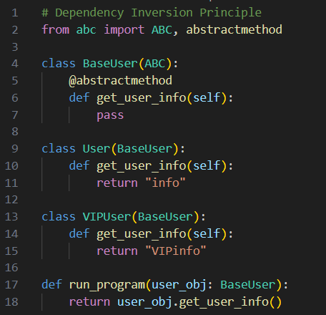
06 Dependency Inversion
Principle
High-level modules should not depend on low-level modules.
Both should depend on abstractions, Abstractions should not depend upon details.
Title here
Making presentations powerful tools
Making presentations powerful tools
Details should depend upon abstractions

Slide 47
THANKS
Ahmed El-Hendy El-Desokey

