Slide 1
Face Mask Detection

Slide 2
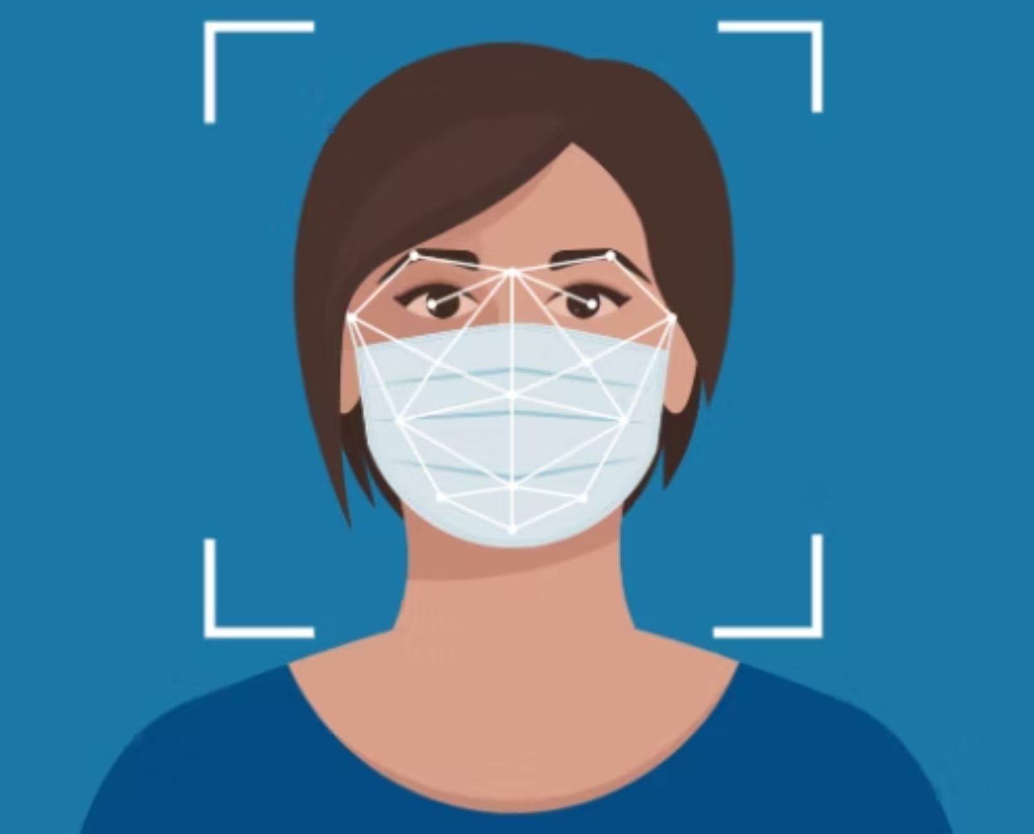
Face Mask Detection
Using ResNet50

Slide 3
Overview
Goal : Classify whether a person is wearing a mask or not.
Importance : Public safety during pandemics.
Tools : Python, TensorFlow, Keras, Google Colab.

Slide 4
Dataset
1
Dataset Source
2
Classes
Face Mask Detection Dataset (Face Mask 12k Images Dataset)
With Mask
Without Mask
Sourced from Kaggle
3
Dataset Details
4
Preprocessing Steps
Total images: ~12,000+
Resized all images to 224×224 (for ResNet50 compatibility)
Split into:
Training: 80%
Normalized pixel values to [0, 1]
Validation: 20%
Applied data augmentation:
Rotation, flipping, zoom, brightness changes
To reduce overfitting and handle class imbalance

Slide 5
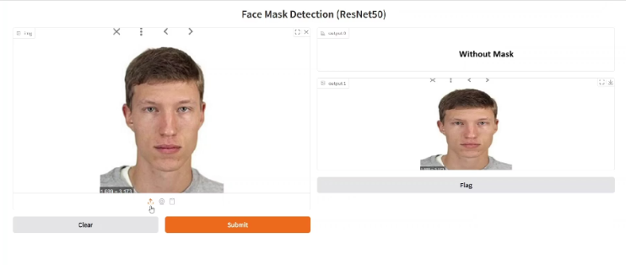
Initial Model & Issues
Initial Approach
In our initial implementation, we used MobileNetV2, a lightweight CNN architecture known for its speed and performance on mobile and edge devices.
Model Highlights
Pretrained on ImageNet
GlobalAveragePooling2D → Dense(128, relu) → Dropout → Dense(1, sigmoid)
Binary classification (With Mask / Without Mask)
Optimized with Adam, binary_crossentropy, and a learning rate of 1e-5
Used ImageDataGenerator for preprocessing and augmentation
Applied class weights to handle imbalance
Observed Issues
Poor Generalization: Failed on real-world photos (different lighting, angles, backgrounds)
Underfitting: Base model frozen with no fine-tuning → limited learning capacity
Misclassified Obvious Images: Clear “Without Mask” faces predicted as “With Mask”
Label Mapping Bugs: Gradio predictions were inverted due to incorrect class-to-index logic
Preprocessing Mismatch: Inconsistent image scaling between training and testing pipelines
Shallow Architecture: MobileNetV2 lacked depth to capture subtle facial differences

Slide 6
Challenges Faced
1. Class Imbalance
The dataset had more images of people with masks than without masks or worn incorrectly
This led to biased predictions toward the dominant class
2.Overfitting
The initial CNN model overfitted the training data
Required data augmentation and early stopping to stabilize learning

Slide 7
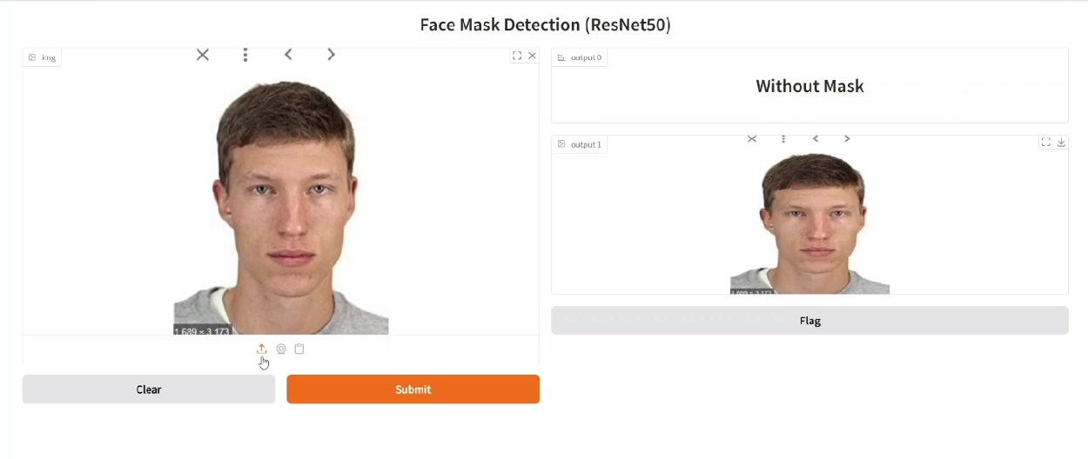
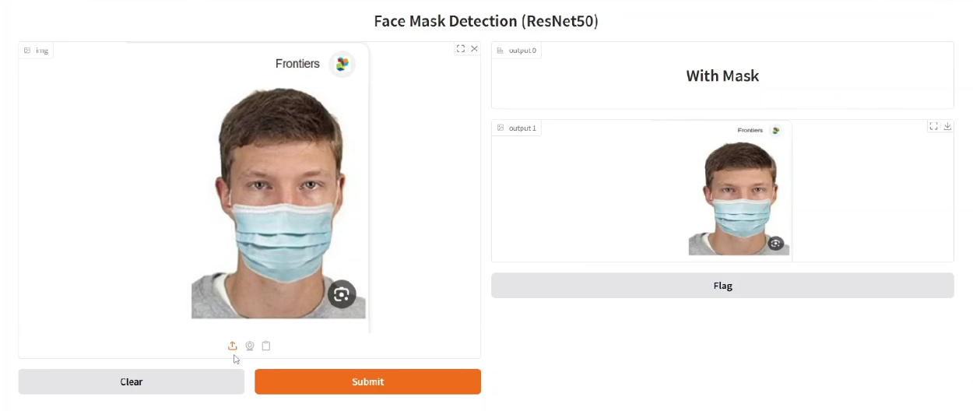
Model Improvement – ResNet50
Why ResNet50?
Chose ResNet50 for its deep architecture and residual connections, which help prevent vanishing gradients.
Model Highlights
Based on ResNet50 pretrained on ImageNet for deep feature extraction
Used 2-phase training:→ Phase 1: Frozen base→ Phase 2: Fine-tuned last 80 layers
Applied preprocess_input() for ResNet compatibility
Added Dropout (0.5 & 0.3) and Dense(256) for regularization
Compiled with Adam optimizer and categorical_crossentropy
Output layer: 2 neurons (softmax) for binary classification
Included OpenCV face detection to focus on face regions only
Built with an interactive Gradio web interface
Used preprocess_input() for compatibility with ResNet50
Tuned Dense(256) + Dropout(0.5/0.3) layers to reduce overfitting
Unfroze deeper ResNet50 layers for fine-tuning
Applied ReduceLROnPlateau to auto-adjust learning rate
Plotted training & validation accuracy/loss curves for diagnostics
Key Improvements Over Initial Version
Replaced MobileNetV2 with deeper ResNet50 for better accuracy
Applied class weighting to solve prediction bias
Fixed label mismatch bugs using dynamic class index mapping
Enhanced data augmentation (rotation, zoom, shift, flip)
Added EarlyStopping & ReduceLROnPlateau for stable training
Introduced confusion matrix + F1-score evaluation
Achieved 98%+ accuracy with strong real-world generalization

Slide 8
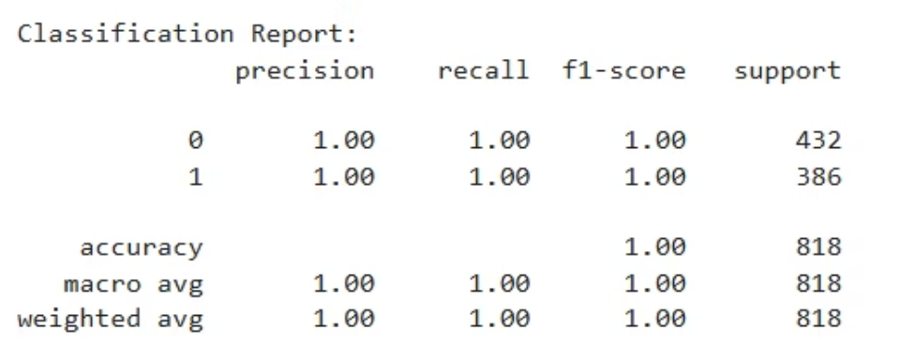
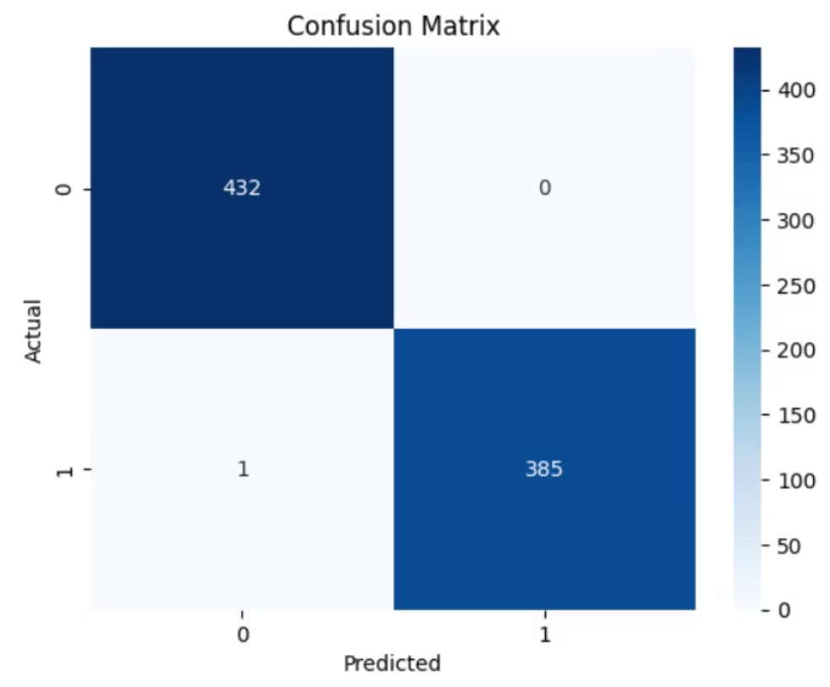
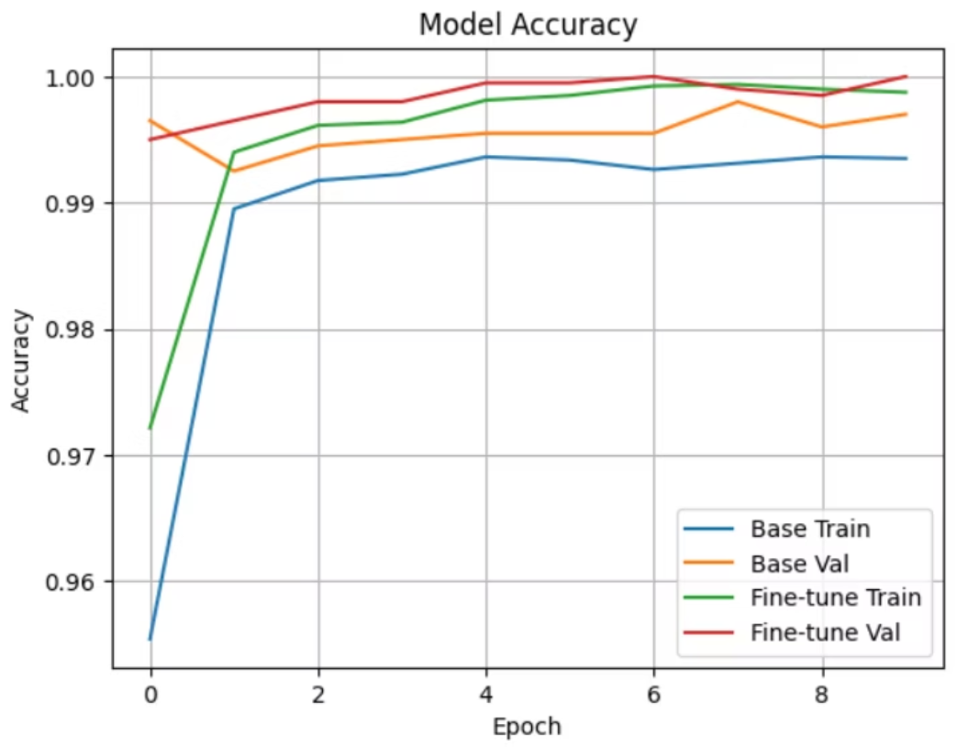
Model Performance
1. Accuracy Scores 2. Confusion Matrix
3. Training Curves

Slide 9
Future Work
1. Real-Time Deployment
Integrate the model with OpenCV for live webcam detection
Optimize detection speed for low-latency environments
2. Model Optimization
Convert model to TensorFlow Lite or ONNX for mobile or edge deployment
Reduce model size while keeping accuracy using quantization or pruning
3. Better Face Detection
Use advanced face detectors (e.g., MTCNN, YOLO)
Improve accuracy in crowded scenes or side profiles
4. Expand Dataset
Collect or generate more images, especially for:
Mask worn incorrectly class
Diverse lighting, ethnicities, and angles

Slide 10
Conclusion
Summary of the Project
Developed a machine learning model to detect face masks, using deep learning
Started with a simple CNN, but later switched to ResNet50 for better performance
Key Achievements
Achieved over 98% test accuracy
Successfully addressed class imbalance, overfitting, and data quality issues
Applied transfer learning, augmentation, and early stopping techniques
Lessons Learned
Importance of data preprocessing and model selection
How transfer learning can drastically improve results
Real-world problems often require iterative experimentation and tuning
Impact
The model can help in automated health safety monitoring, especially in public spaces

