Slide 1
The Cake
Batch: 2101a
Team Members:
Shazim Rajput
Ahmed Hamza
Shams ul Hasan
Sarim

Slide 2
WELCOME
TO OUR TODAY’S PRESENTATION
Designed By The Cake Team
To order an online cake at any time, choose The Cake.

Slide 3

The Cake
The cake shop was founded in 2021 to provide delicious cakes and other types of pastry for a variety of events including weddings, birthdays, and parties. We are glad to provide the cake you’ll love.

Slide 4




Our
Team Members
Shazim Rajput
Ahmed Hamza
Founder/CEO
Co-Founder/COO
Shamsul Hasan
Sarim
CMO
CFO

Slide 5
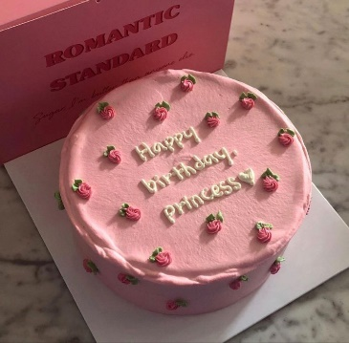
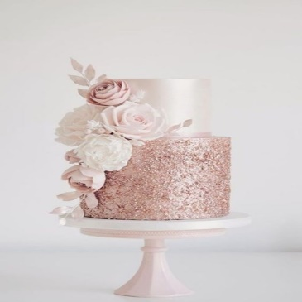
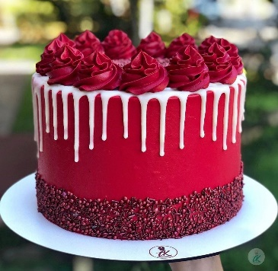
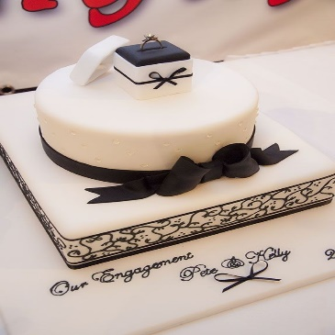

What we offer?
Birthday Cakes
Wedding Cakes
Anniversary Cakes
Engagement Cakes
Custom Cakes

Slide 6
THANKS
FOR LISTENING WITH PATIENCE
Designed By The Cake Team

