Slide 1

Bachelor of Science in Computer Science and Engineering
Smart Task & Quality Management System
TASKFLOW
An Offline-First Cross-Platform Desktop Application with AI-Powered Assistance
Ahmed Hassan Abdelbarr
Supervised by: Assoc. Prof. Wael Zakaria Abdallah
German University in Cairo • Faculty of Engineering and Materials Science • 2025

Slide 2
Agenda
Presentation Overview
01
Problem Statement
This presentation covers the design, implementation, and evaluation of TaskFlow — a cross-platform desktop task management system built on an offline-first architecture with dual-database synchronisation, multi-modal AI integration, and a rich collaborative feature set. Duration: ~15 minutes | 15 slides | Live demo included
02
Objectives
03
Background & Related Work
04
System Architecture & Design
05
Key Innovations
06
Results & Evaluation
07
Contributions
08
Future Work
09
Live Demo
10
Q&A
Smart Task & Quality Management System (TaskFlow) | Ahmed Hassan Abdelbarr

Slide 3
01
Problem Statement
Why existing task management tools fall short
Cloud-Centric Fragility
Fragmented Toolchains
Shallow AI Integration
Tools like Trello, Asana, Jira, and Notion assume always-on connectivity
Users juggle separate apps for tasks, code, calendar, chat, and notifications
AI features in existing tools are limited to basic text generation
When offline, operations are silently lost or error out
No single cohesive desktop application integrates all of these
No conversational assistant aware of the user's own project data
Unusable on trains, planes, rural areas, or during network outages
Context-switching reduces productivity and increases cognitive load
No support for code generation, document OCR, or multimodal input
No graceful degradation — full functionality requires internet
Task assignments buried in social media / messaging apps with no structure
Missed opportunity for AI to truly augment project management
Smart Task & Quality Management System (TaskFlow) | Ahmed Hassan Abdelbarr

Slide 4
02
Objectives
Six design goals that guided the development of TaskFlow
1
Offline-First Operation
2
Reliable Synchronisation
3
Multi-Mode AI Assistant
Every core feature works fully without internet connectivity. SQLite for local persistence.
Transactional outbox pattern for at-least-once delivery. User-visible sync progress.
Mistral API: chat, code gen (Codestral), and document OCR. SSE streaming for responsiveness.
4
Five Task Visualisations
5
Cross-Platform Desktop App
6
Full Collaboration
Default, Kanban, Table, Gantt, and Calendar views — each optimised for different workflows.
Self-contained ~35MB installer via Tauri v2. Embedded .NET backend + React frontend.
Teams, DMs, group chats, file attachments, real-time SignalR notifications, calendar events.
Smart Task & Quality Management System (TaskFlow) | Ahmed Hassan Abdelbarr

Slide 5
03
Background & Related Work
Survey of existing tools and technologies
Feature | Trello | Asana | Jira | Notion | TaskFlow
Offline Operation | ✗ | ✗ | ✗ | Partial | ✓ Full
Local Persistence | ✗ | ✗ | ✗ | ✗ | ✓ SQLite
Transparent Sync | ✗ | ✗ | ✗ | ✗ | ✓ Outbox Pattern
AI Assistant | ✗ | ✗ | ✗ | Basic | ✓ Multi-Mode (Mistral)
Desktop Installer | ✗ | ✗ | ✗ | ✓ | ✓ Tauri (~35MB)
Kanban View | ✓ | ✓ | ✓ | ✓ | ✓
Gantt View | ✗ | ✓ | ✓ | ✗ | ✓
Calendar View | ✗ | ✓ | ✗ | ✓ | ✓
Team Messaging | ✗ | ✓ | ✗ | ✓ | ✓ SignalR
Key Insight: TaskFlow is the only tool combining offline-first architecture, local SQLite persistence, transparent synchronisation, multi-modal AI, and a self-contained desktop installer — all in a single cohesive application.
Smart Task & Quality Management System (TaskFlow) | Ahmed Hassan Abdelbarr

Slide 6
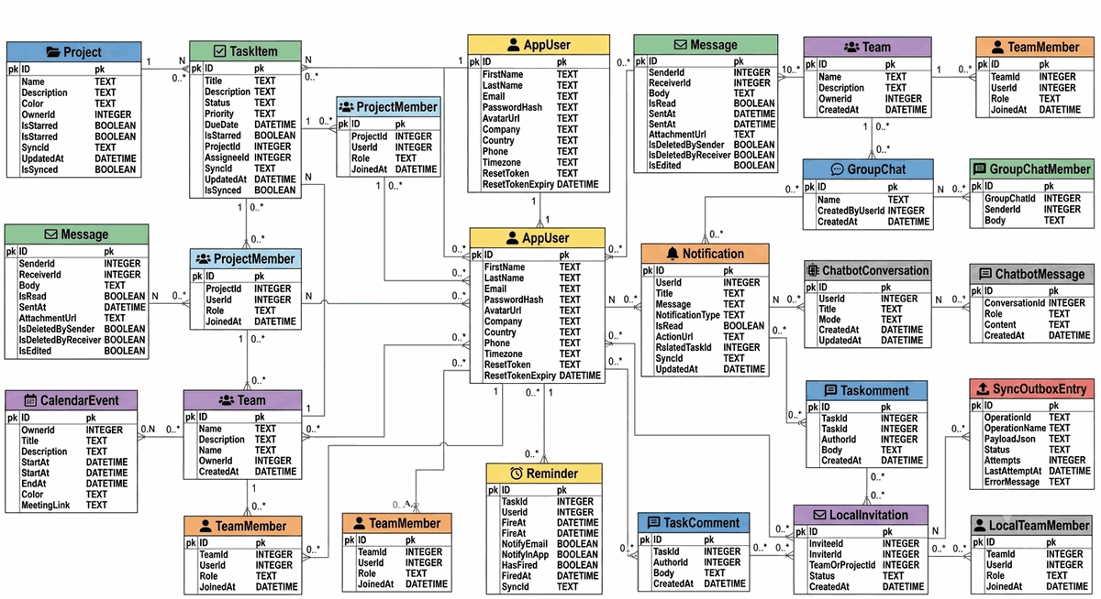
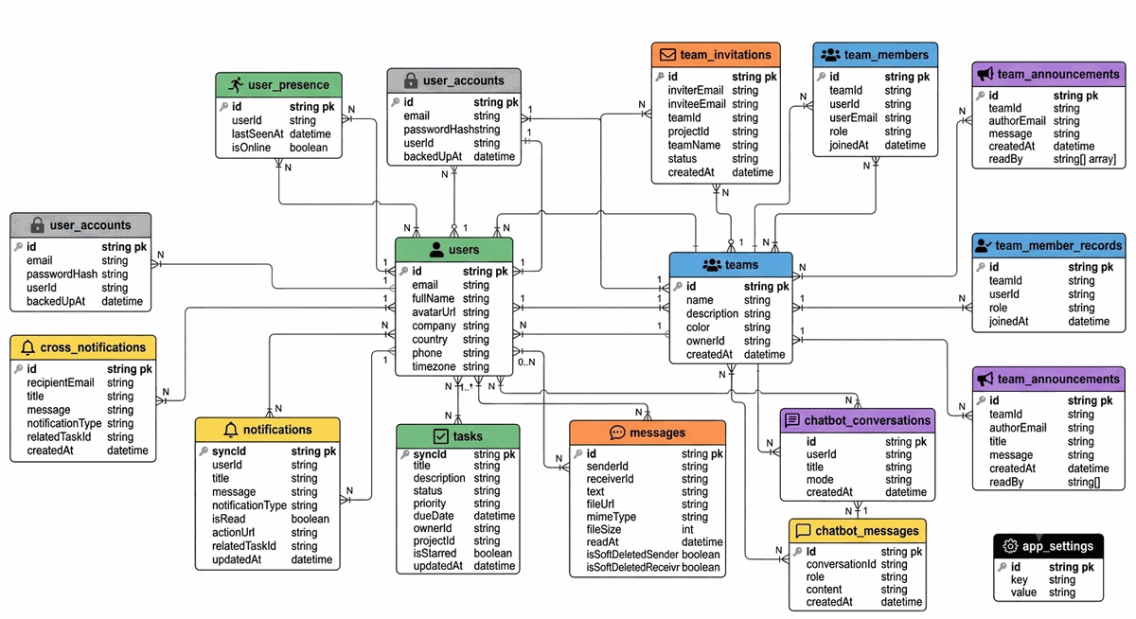
04
System Architecture
Three-tier desktop application with dual-database strategy
PRESENTATION LAYER
DESKTOP SHELL
React 19 + TypeScript SPA REST HTTP + SignalR WebSocket
Tauri v2 (Rust) • OS-native WebView2 • Sidecar .NET backend • Stdout port negotiation • Splashscreen → Main window lifecycle • 9 IPC commands • CSP security policy • NSIS / MSI installer (~35 MB self-contained)
▼
APPLICATION LOGIC LAYER
ASP.NET Core (.NET 10) • C# Controllers → Services → Repositories
Offline Sync
SignalR Hub
AI Gateway
Auth
Notification
▼
DATA LAYER
Data Model — Entity Relationship Diagrams:
SQLite • 18 Entities • ACID Compliant Primary local store — zero network dependency
◄── Sync ──►
MongoDB • 15 Collections • Document Store Cloud relay — cross-device synchronisation
Smart Task & Quality Management System (TaskFlow) | Ahmed Hassan Abdelbarr

Slide 7
05
Key Innovation: Offline-First Synchronisation
Transactional Outbox Pattern adapted for desktop .NET
1. LOCAL SQLITE TRANSACTION
2. OFFLINESYNCSERVICE
3. MONGODB RELAY
Within a single atomic transaction: ├── Write entity changes │ (TaskItem, Message, etc.) │ └── Write SyncOutboxEntry { EntityType, SyncId, Operation, Payload, Status: Pending } ✓ ACID guarantee — both or neither
Background worker polls every few seconds: ├── Reads Pending outbox │ entries (FIFO order) │ ├── Marks → Processing │ └── Uses ConnectivityService as circuit breaker ↻ Retries Failed entries
HTTP PUT to MongoDB: ├── Idempotent upsert │ (SyncId as _id) │ ├── On success → Synced │ └── On failure → Failed (retry with backoff) State machine: Pending → Processing → Synced
▶
▶
Connectivity States:
Online
Normal operation Outbox replayed immediately
Manually Offline
User-toggled Operations queued locally
Disconnected
No connection Queue grows; auto-replay on reconnect
UI: ConnectivityBar shows real-time status • Pending operation count • Colour-coded indicators • Animated sync progress
Smart Task & Quality Management System (TaskFlow) | Ahmed Hassan Abdelbarr

Slide 8
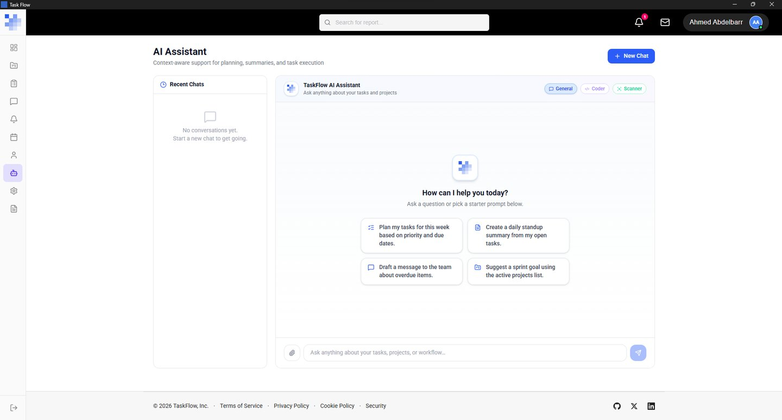
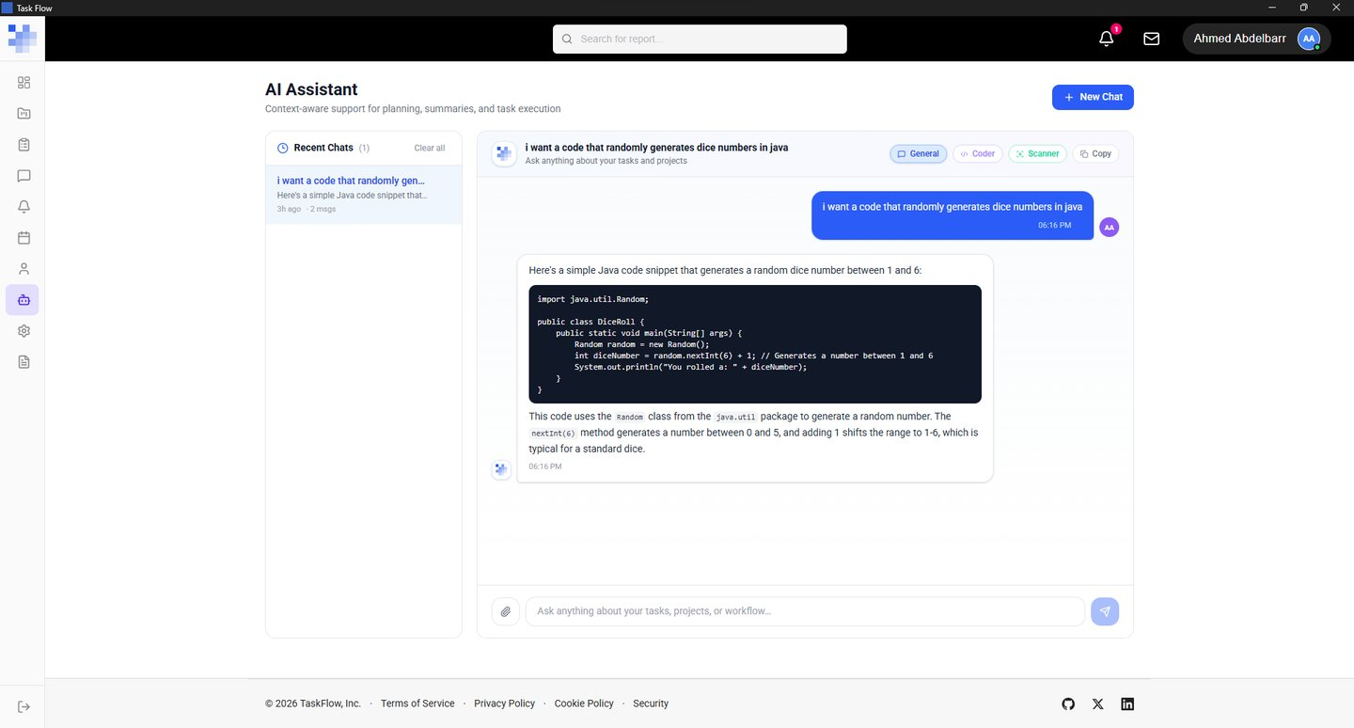
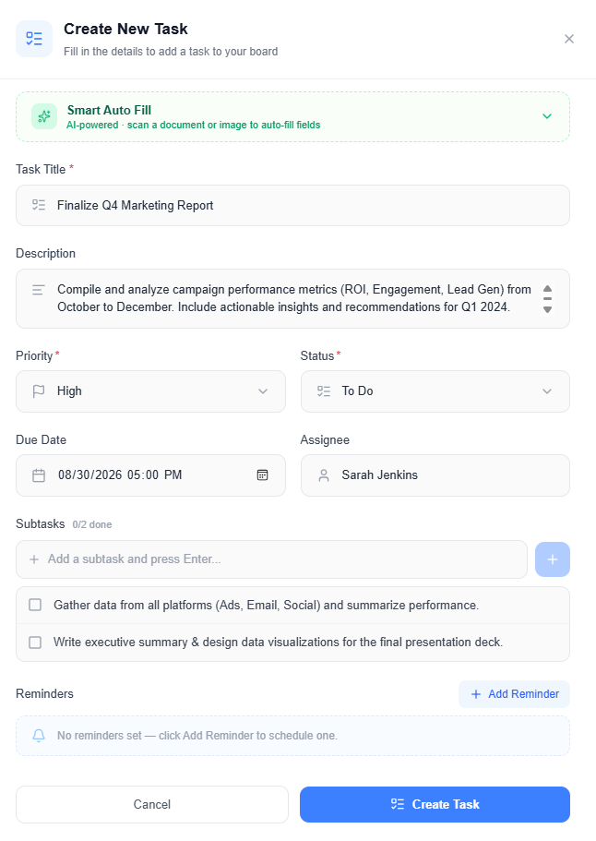
05
Key Innovation: Multi-Modal AI Assistant
Mistral API integration with three specialised modes
💬 General Chat
💻 Code Generation
📄 Document OCR
Model: mistral-small-latest
Model: codestral-latest
Model: mistral-ocr-latest
Conversational Q&A Brainstorming ideas Help & guidance Project advice
Generate code snippets Explain code logic Refactor existing code Debug assistance
Extract text from images Analyse documents Process uploaded files Multimodal understanding
Technical: SSE (Server-Sent Events) streaming from React → ASP.NET Core → Mistral API • Sliding window context (last 20 messages) • AI-generated conversation titles • Persisted conversation history in SQLite
Smart Task & Quality Management System (TaskFlow) | Ahmed Hassan Abdelbarr

Slide 9
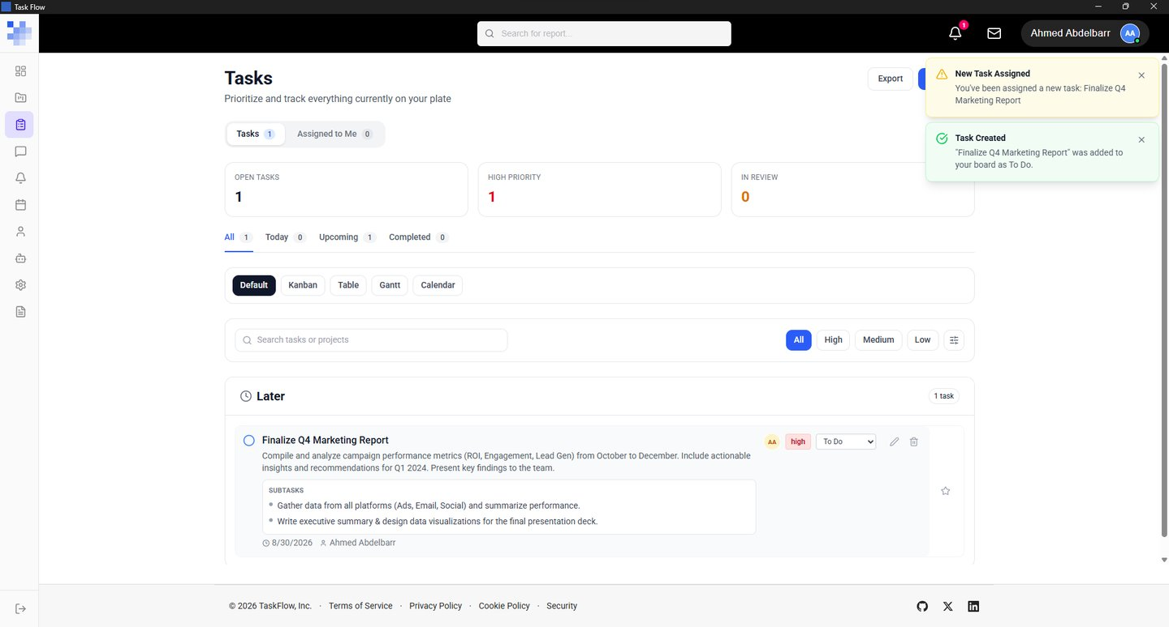
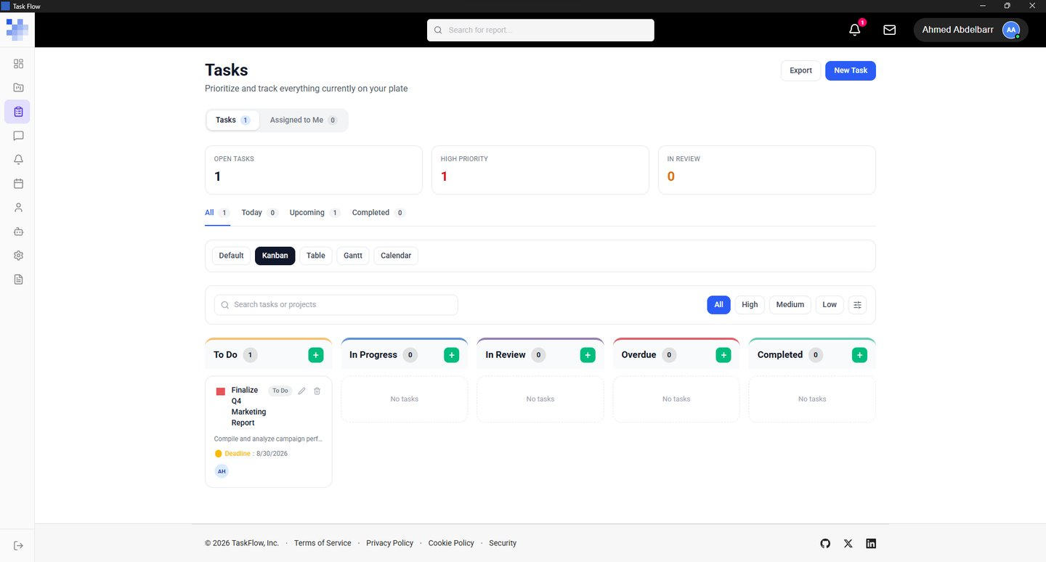
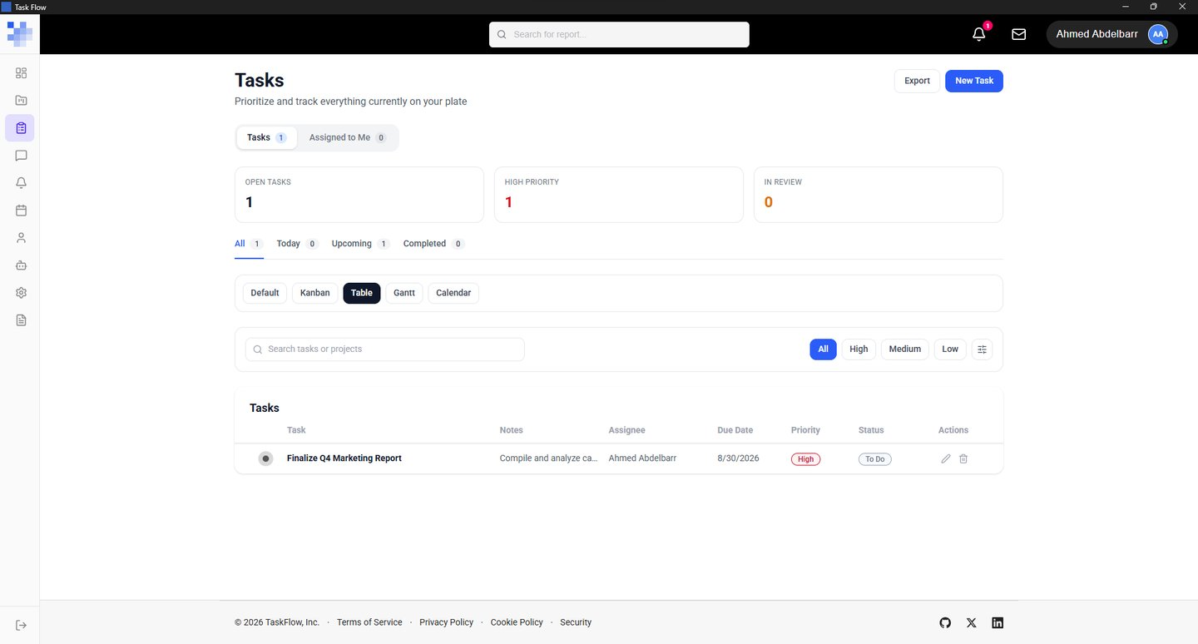
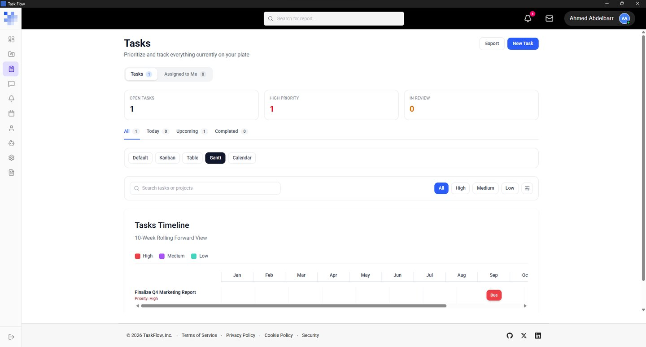
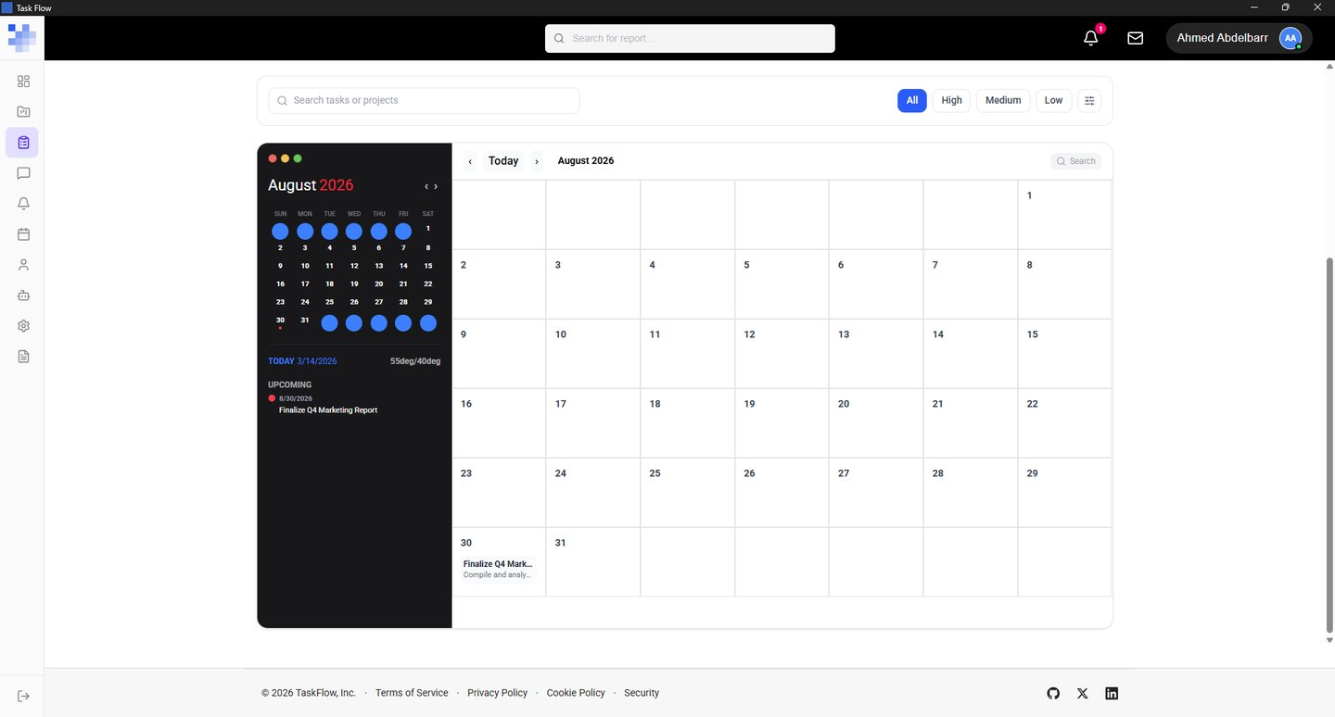
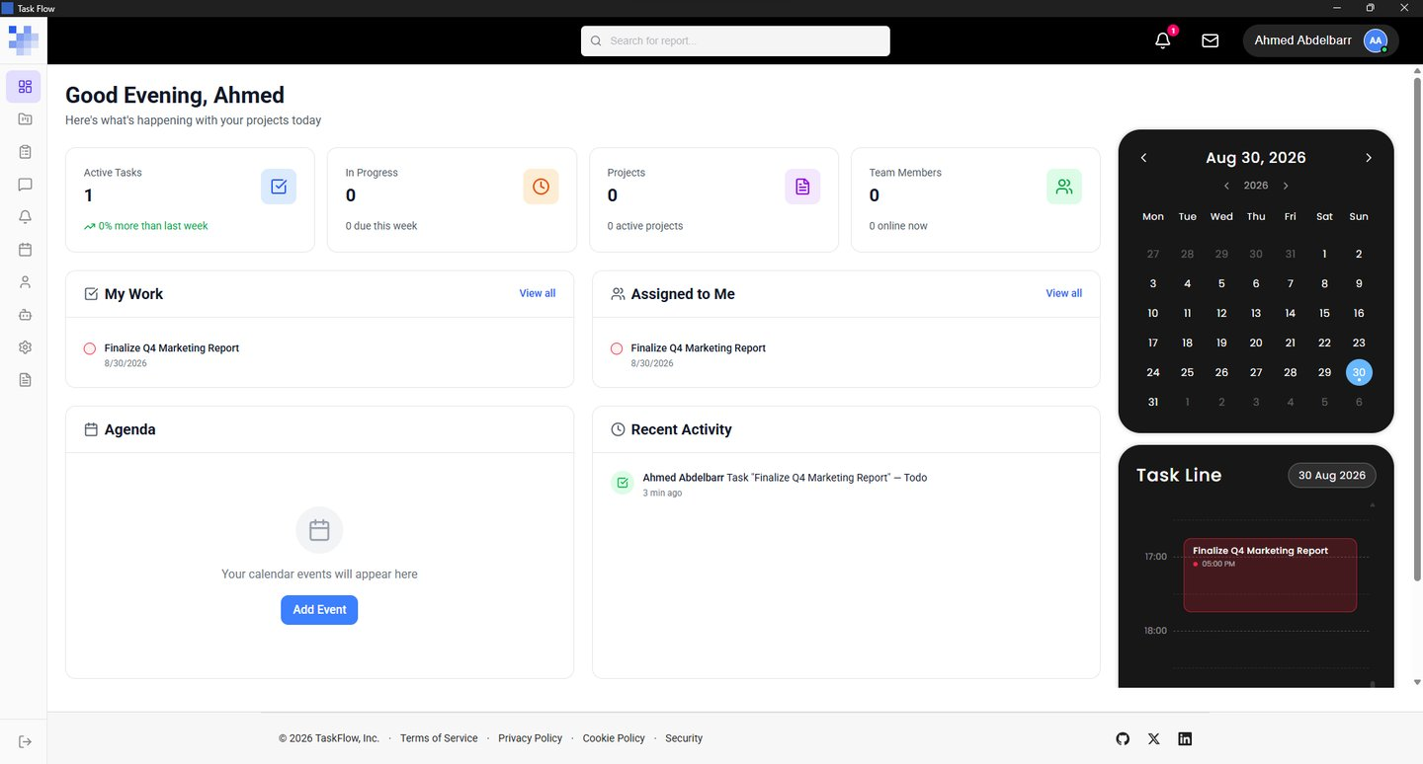
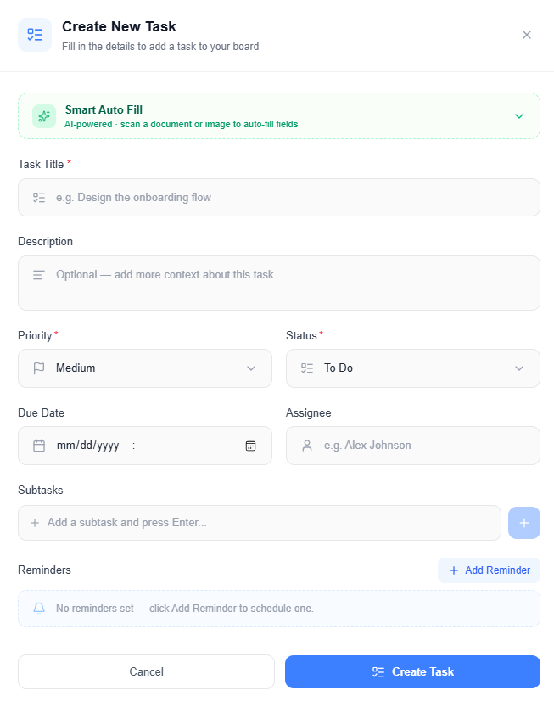
05
Key Innovation: Five Task Visualisation Modes
Multiple perspectives on project data, each optimised for different workflows
1. Default
2. Kanban
3. Table
4. Gantt
5. Calendar
Smart temporal grouping (Overdue, Today, This Week, Next Week, Future, No Date)
Drag-and-drop columns (To Do, In Progress, Review, Completed, Overdue)
Sortable, filterable grid with inline editing and column customisation
Timeline-based view for project scheduling and dependency tracking
Weekly time-grid with drag-to-schedule and event overlays
Additional Interface Screenshots:
Dashboard
Task Editor
Smart Task & Quality Management System (TaskFlow) | Ahmed Hassan Abdelbarr

Slide 10
06
Results: Requirements Fulfilment
All 11 functional and 5 non-functional requirements fully met
# | Functional Requirement | Status
FR-01 | User Authentication (register, login, password reset) | ✓ Fully Met
FR-02 | Task Management (CRUD, priorities, statuses, starring, assignment) | ✓ Fully Met
FR-03 | Multiple Task Views (Default, Kanban, Table, Gantt, Calendar) | ✓ Fully Met
FR-04 | Projects & Teams (membership, MongoDB-relayed invitations) | ✓ Fully Met
FR-05 | Messaging (DMs, group chats, file attachments up to 20 MB) | ✓ Fully Met
FR-06 | Notifications (SignalR real-time, email reminders, 17 types) | ✓ Fully Met
FR-07 | Calendar Events (CRUD, colour, meeting links, weekly grid) | ✓ Fully Met
FR-08 | AI Chatbot (3 modes, SSE streaming, persisted history) | ✓ Fully Met
FR-09 | Offline Operation (outbox queue, auto-replay, BulkSync) | ✓ Fully Met
FR-10 | Dashboard (stats, task trend, due this week, recent activity) | ✓ Fully Met
FR-11 | Settings (profile, password, notification preferences) | ✓ Fully Met
NON-FUNCTIONAL REQ.
NFR-01: Offline-first architecture ✓
NFR-02: Cross-platform (Windows) ✓
NFR-03: Real-time collaboration ✓
NFR-04: Performance (<200ms ops) ✓
NFR-05: Security (bcrypt, CSP) ✓
✓ ALL 11 FUNCTIONAL AND 5 NON-FUNCTIONAL REQUIREMENTS SUCCESSFULLY IMPLEMENTED ✓
Smart Task & Quality Management System (TaskFlow) | Ahmed Hassan Abdelbarr

Slide 11
06
Results: Performance Benchmarks
Measured on Windows 11, Intel Core i7, 16GB RAM, NVMe SSD
Operation | Measured Time | Threshold | Result
Application cold start (to UI ready) | ~1,500 ms | — | ✓ Acceptable
Login (local identity + MongoDB pull) | <500 ms | 2,000 ms | ✓ Pass
Task list load (100 tasks, SQLite) | <100 ms | 200 ms | ✓ Pass
Task create (SQLite write + SignalR) | <80 ms | 200 ms | ✓ Pass
First AI token rendered (General) | ~400 ms | 2,000 ms | ✓ Pass
Offline-to-online sync replay (20 entries) | ~1,800 ms | — | ✓ Acceptable
Direct message delivery (sender → recipient) | <150 ms | 200 ms | ✓ Pass
Dashboard load | <200 ms | 200 ms | ✓ Pass
Kanban drag-and-drop update | <100 ms | 200 ms | ✓ Pass
All interactive operations satisfy the 200ms responsiveness threshold (NFR-04). Cold start and AI first-token are dominated by process initialisation and network round-trip respectively.
Smart Task & Quality Management System (TaskFlow) | Ahmed Hassan Abdelbarr

Slide 12
06
Results: Offline Synchronisation Verification
End-to-end test of the outbox pattern
TEST PROCEDURE
VERIFICATION RESULTS
1. User toggles to Manual Offline mode
20/20
Outbox entries created
2. User performs 20 task operations (create, update, delete)
20/20
Entries replayed successfully
3. All 20 SyncOutboxEntry rows created with Pending status
4. No data reaches MongoDB during offline period
0
Entries stuck in Pending state
5. User reconnects to network
~2s
Startup BulkSync completion
6. OfflineSyncService replays entries in FIFO order
LWW
Conflict resolution (last-write-wins)
7. All 20 entries transition: Pending → Processing → Synced
8. Tasks visible in MongoDB and on other devices via BulkSync
100%
Data integrity maintained
The transactional outbox pattern provides reliable, at-least-once delivery semantics with zero data loss.
Smart Task & Quality Management System (TaskFlow) | Ahmed Hassan Abdelbarr

Slide 13
07
Contributions & Lessons Learned
Five technical contributions and key insights from the project
TECHNICAL CONTRIBUTIONS
LESSONS LEARNED
1
Outbox-Pattern Offline Sync Engine
Offline-first requires deliberate UI design — ConnectivityBar with pending count, colour-coded states, animated progress bar
Adapted the distributed-systems transactional outbox pattern to a single-user SQLite-backed desktop context. Lightweight, zero external dependencies, <1ms overhead per write.
Choosing conflict resolution early (last-write-wins) shaped entity interfaces and prevented late-stage rework
2
Dual-Database Architecture
SQLite (primary) + MongoDB (relay) with ISyncableEntity interface exposing ToMongoDocument(). Keeping transformation logic on entities simplified adding new syncable types.
SignalR group-per-user (Groups.AddToGroupAsync) is a reliable notification pattern that handles reconnection transparently
3
SSE-Streamed Multi-Modal AI Chatbot
Integrated streaming HTTP responses inside a Tauri-hosted application without WebView buffering issues. SSE request issued directly from React renderer to local ASP.NET Core server.
Clean architectural boundaries enable shell-layer substitution — Rust Tauri shell entirely decoupled from React frontend and .NET backend
4
Self-Contained Desktop Packaging
Bundled ASP.NET Core server, React frontend, and Tauri shell into a single ~35 MB installer. Stdout-signal protocol decouples frontend load from backend start time.
ACKNOWLEDGED LIMITATIONS
• Last-write-wins: no merge dialogue for concurrent edits
5
Tauri Sidecar + Splashscreen Lifecycle
• Sub-task backend not implemented (UI scaffold only)
Two-window lifecycle with Rust backend management. 9 IPC commands bridge shell and web renderer. Neither frontend nor backend required modification for desktop shell integration.
• Mistral API key hardcoded (not via environment variable)
• No automated test suite (manual testing only)
Smart Task & Quality Management System (TaskFlow) | Ahmed Hassan Abdelbarr
• macOS not notarised (Gatekeeper override required)

Slide 14
08
Future Work
Short-term improvements and long-term vision
SHORT-TERM (IMMEDIATE NEXT STEPS)
LONG-TERM VISION
1
Sub-task Backend
1
Mobile Companion App
Complete the backend support for hierarchical task breakdown
Native mobile clients with offline-first sync to the same backend
2
API Key Security
2
AI Natural-Language Task Creation
Move Mistral API key to environment variable / secure config
Create tasks by simply describing them in natural language
3
Automated Test Suite
3
CRDT-Based Sync
Add unit and integration tests (xUnit, Moq, Testcontainers)
Replace LWW with Conflict-Free Replicated Data Types for true real-time collaboration
4
Analytics Dashboard
4
Per-Field Conflict Resolution
Advanced visualisations: burndown charts, velocity metrics, cycle time analysis
Replace last-write-wins with field-level merge
5
Third-Party Plugin System
5
Cross-Platform Builds
Extend via plugins for Git integration, Slack, Teams, Jira import, etc.
Extend installer pipeline to macOS (.dmg) and Linux (.AppImage)
6
Cloud-Hosted Multi-Tenant SaaS
Offer TaskFlow as a hosted service with team management and billing
Smart Task & Quality Management System (TaskFlow) | Ahmed Hassan Abdelbarr

Slide 15
Live Demonstration
Three demo scenarios:
Scenario 1 — Offline-First Sync
1. Create tasks while online → Observe SQLite + MongoDB sync 2. Toggle Manual Offline mode → ConnectivityBar turns amber 3. Create more tasks → They persist locally in SQLite 4. Reconnect → Watch Outbox replay in real-time → All tasks appear in MongoDB
Scenario 2 — AI Assistant
1. Open AI Chatbot → Ask a general question (General mode) 2. Switch to Coder mode → Ask to generate a sorting algorithm 3. Observe SSE streaming: tokens appear one by one 4. Upload a document/ image → Switch to OCR mode → Extract text
Scenario 3 — Task Visualisations
1. Open Default view → See temporally grouped tasks 2. Switch to Kanban → Drag a task between status columns 3. Switch to Gantt → See timeline view 4. Open Calendar → See tasks on the weekly grid

Slide 16
Thank You
Questions & Discussion
Ahmed Hassan Abdelbarr Supervised by: Assoc. Prof. Wael Zakaria Abdallah German University in Cairo Faculty of Engineering and Materials Science Department of Computer Science and Engineering 2025

