Slide 1


Cairo University
Faculty of Graduate Studies for Statistical Research
Department Of Computer Science
Interna
A Project presented for fulfillment
for Diploma project in Computer Science
Submitted by
Hazem Tarek Abd El-Azeem
Ahmed Ragab Ahmed
Ahmed Muhammed Abd El-Moneim
Abdallah Muhammed Rashad
Ahmed Hassan Hashem Sarah Yasser Ahmed
Supervised by
Dr. Mustafa Ezzat
June 2023

Slide 2
Introduction
In today's highly competitive job market, college students and fresh graduates often find it challenging to land a job that aligns with their skills and interests. While traditional Job posting platforms have become increasingly popular in recent years, with many employers now using them as their primary tool for hiring new talent. For college students and fresh graduates, these platforms are inefficient for students or fresh graduates because of insufficient experience and lack of skills.
One of the primary benefits of student employment platform is the ease and convenience they offer. It allows students and graduates to browse job postings at any time, from anywhere. they can search for jobs while on the go, during breaks from class or studying, or even while at their part-time job.
it also provides students and graduates with the opportunity to apply for jobs directly through the platform. This eliminates the need to navigate through multiple company websites and fill out numerous application forms. Instead, job seekers can create a profile on the platform, upload their resume, and apply for jobs with just a few clicks. Some platforms even allow users to save their application materials, making it easier to apply for multiple jobs.
In conclusion, student employment platforms offer many benefits to college students and fresh graduates. These platforms provide ease and convenience, access to a vast pool of job opportunities, the ability to apply for jobs directly through the platform, additional resources, the opportunity to build a professional network, and the ability to save time and money. With these advantages, these platforms are an excellent tool for college students and fresh graduates who are looking to start their careers.

Slide 3
Scope
The system provides the members with jobs information, online applying for jobs and many other facilities.
The basic scope of the project is given as under
Maintain Job seekers and Employee record.
Maintain uploaded resumes.
Provide customized job posting.
Maintain job posting details and generate various reports

Slide 4
Purpose
The Employment System that is to be developed provides the members with jobs information, online applying for jobs and many other facilities. This system provides a service to the job applicants to search for working opportunities.
The employment portal will allow job provider to establish one to one relationships with candidates. This Portal will primarily focus on the posting and management of job vacancies. This system is designed such that ultimately all vacancies will be posted online and would offer employers the facilities to post their vacancies online. It helps to review and manage the resulting applications efficiently through the web. Employer can also find the resume according to key skill in very less amount of time.
The platform can keep the jobs catalogue updated all the time so that the job seekers get the updated information all the time.

Slide 5
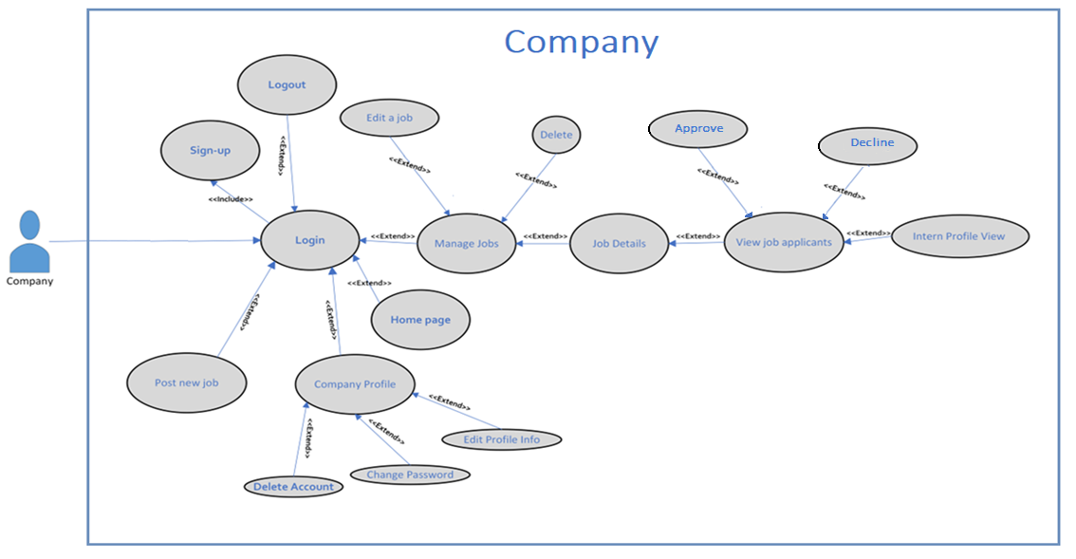
Use-Case Diagram

Slide 6
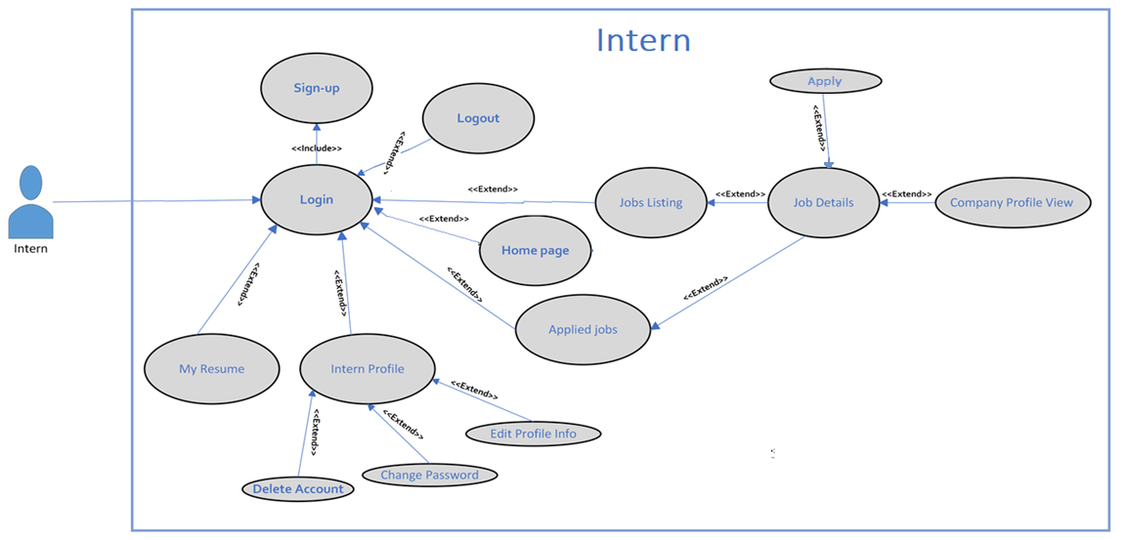
Use-Case Diagram

Slide 7
Actor Description
Actor | Actor’s Goal | Use case name
User | Create a new user | Signup
User | Receive email confirmation | Verify account
User | Login to the site | Login
User | Logout of the site | Logout
User | Subscribe to newsletter | Newsletter
User | Change forgotten password | Reset password
User | Change profile’s information | Edit profile
User | Ability to change password | Change password
User | Delete profile’s data from the system | Delete account
Intern | See recent posted jobs | Jobs Listing
Intern | Filter posted jobs | Filter Jobs
Intern | Sorting posted jobs | Sorting Jobs
Intern | Apply for a job | Apply
Intern | Edit and Download resume | Resume
Intern | View applied jobs | Applied jobs
Company | Post a new job | Post a job
Company | View open vacancies by the company | Posted Jobs
Company | View a posted vacancy | View job
Company | Edit a posted vacancy | Edit job
Company | Delete a posted vacancy | Delete job

Slide 8
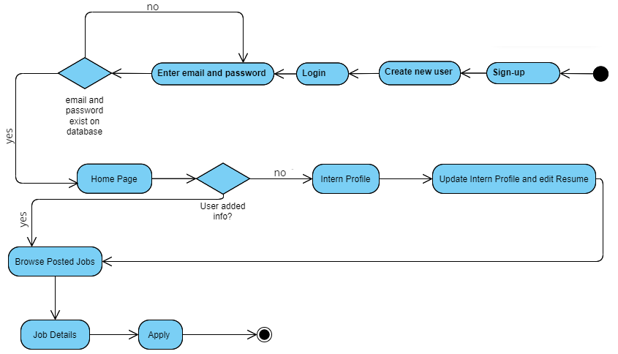
Activity Diagram Intern

Slide 9
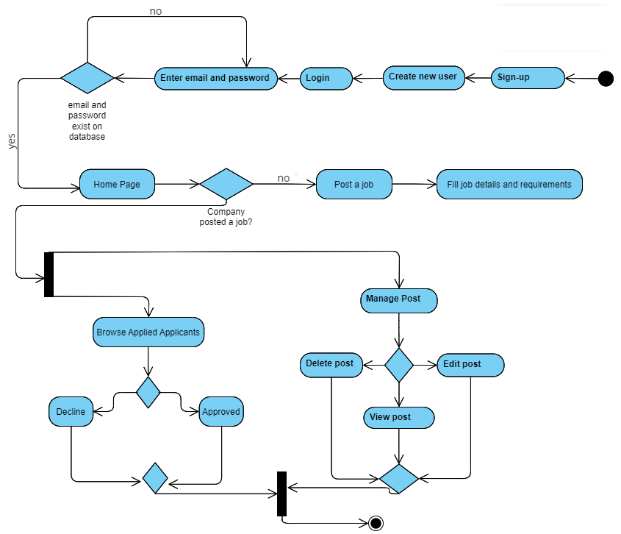
Activity Diagram Company

Slide 10
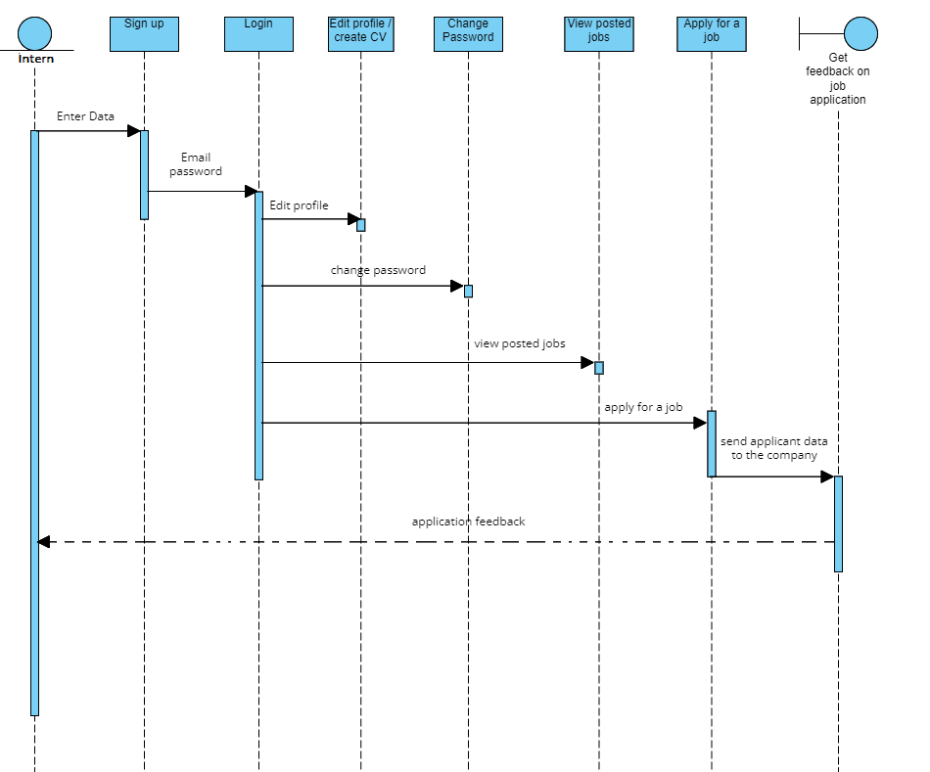
Sequence Diagram Intern

Slide 11
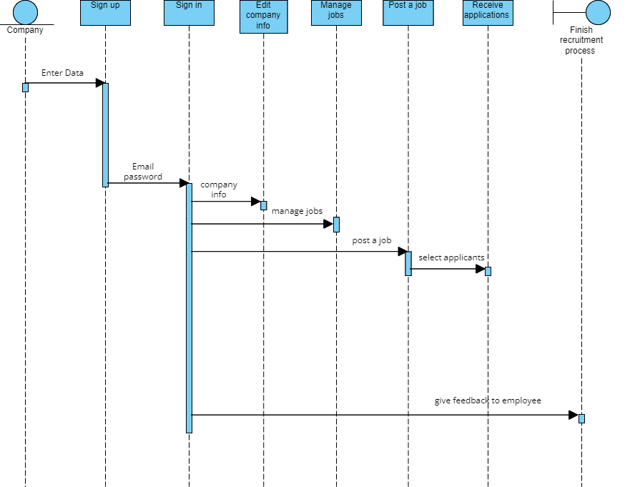
Sequence Diagram Company

Slide 12
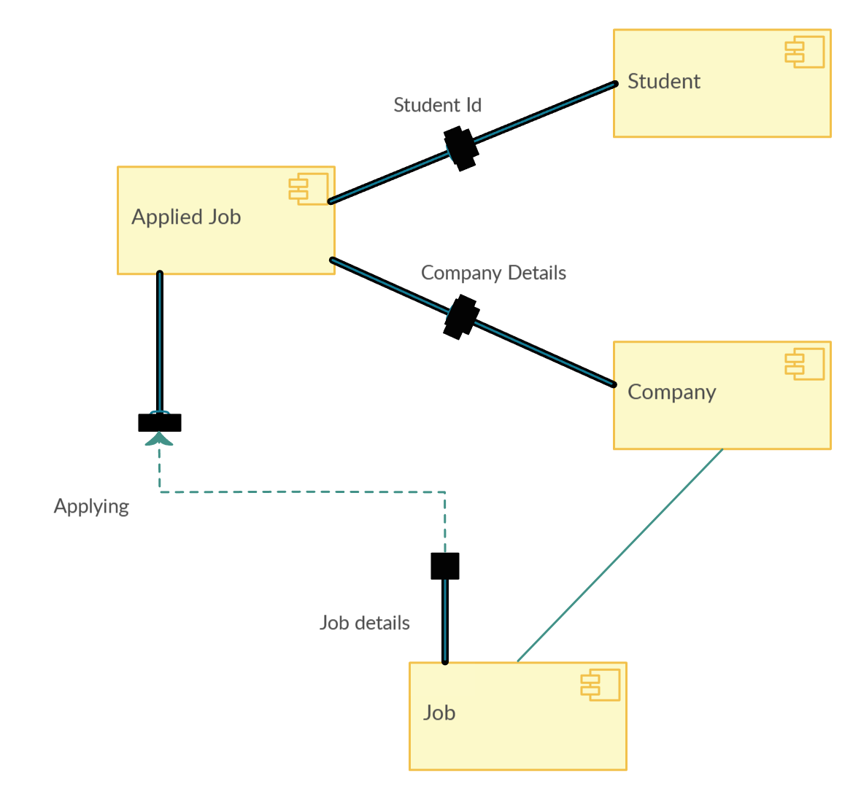
Component Diagram System

Slide 13
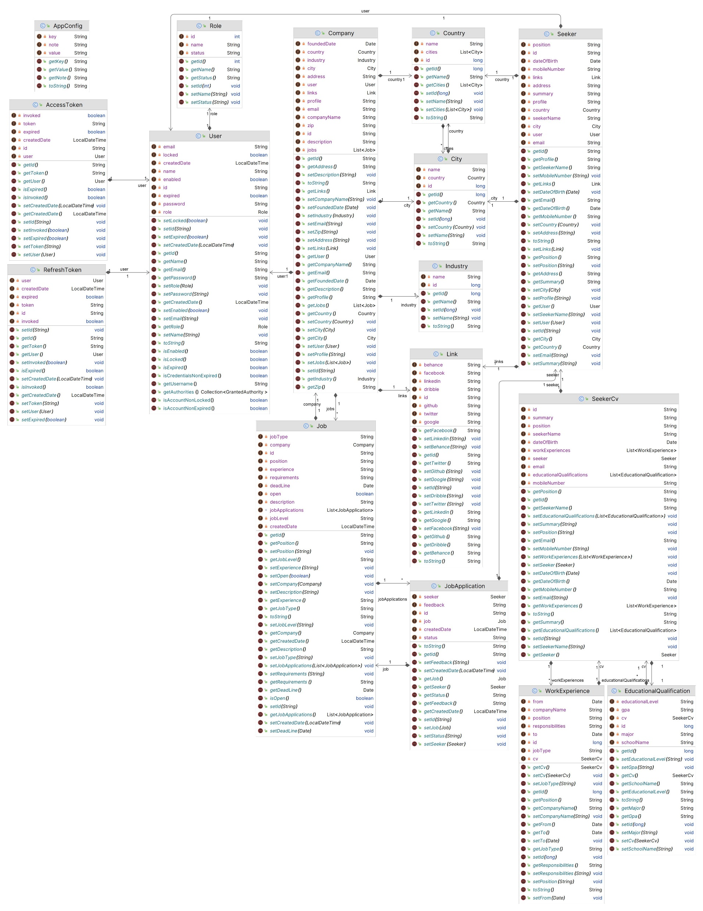
Class Diagram System

Slide 14
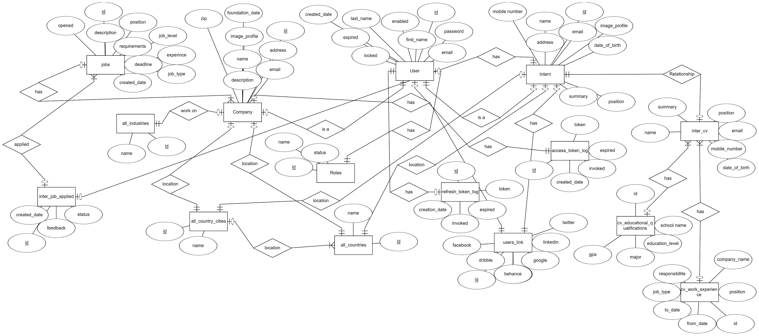
Entity Relationship Diagram System

Slide 15
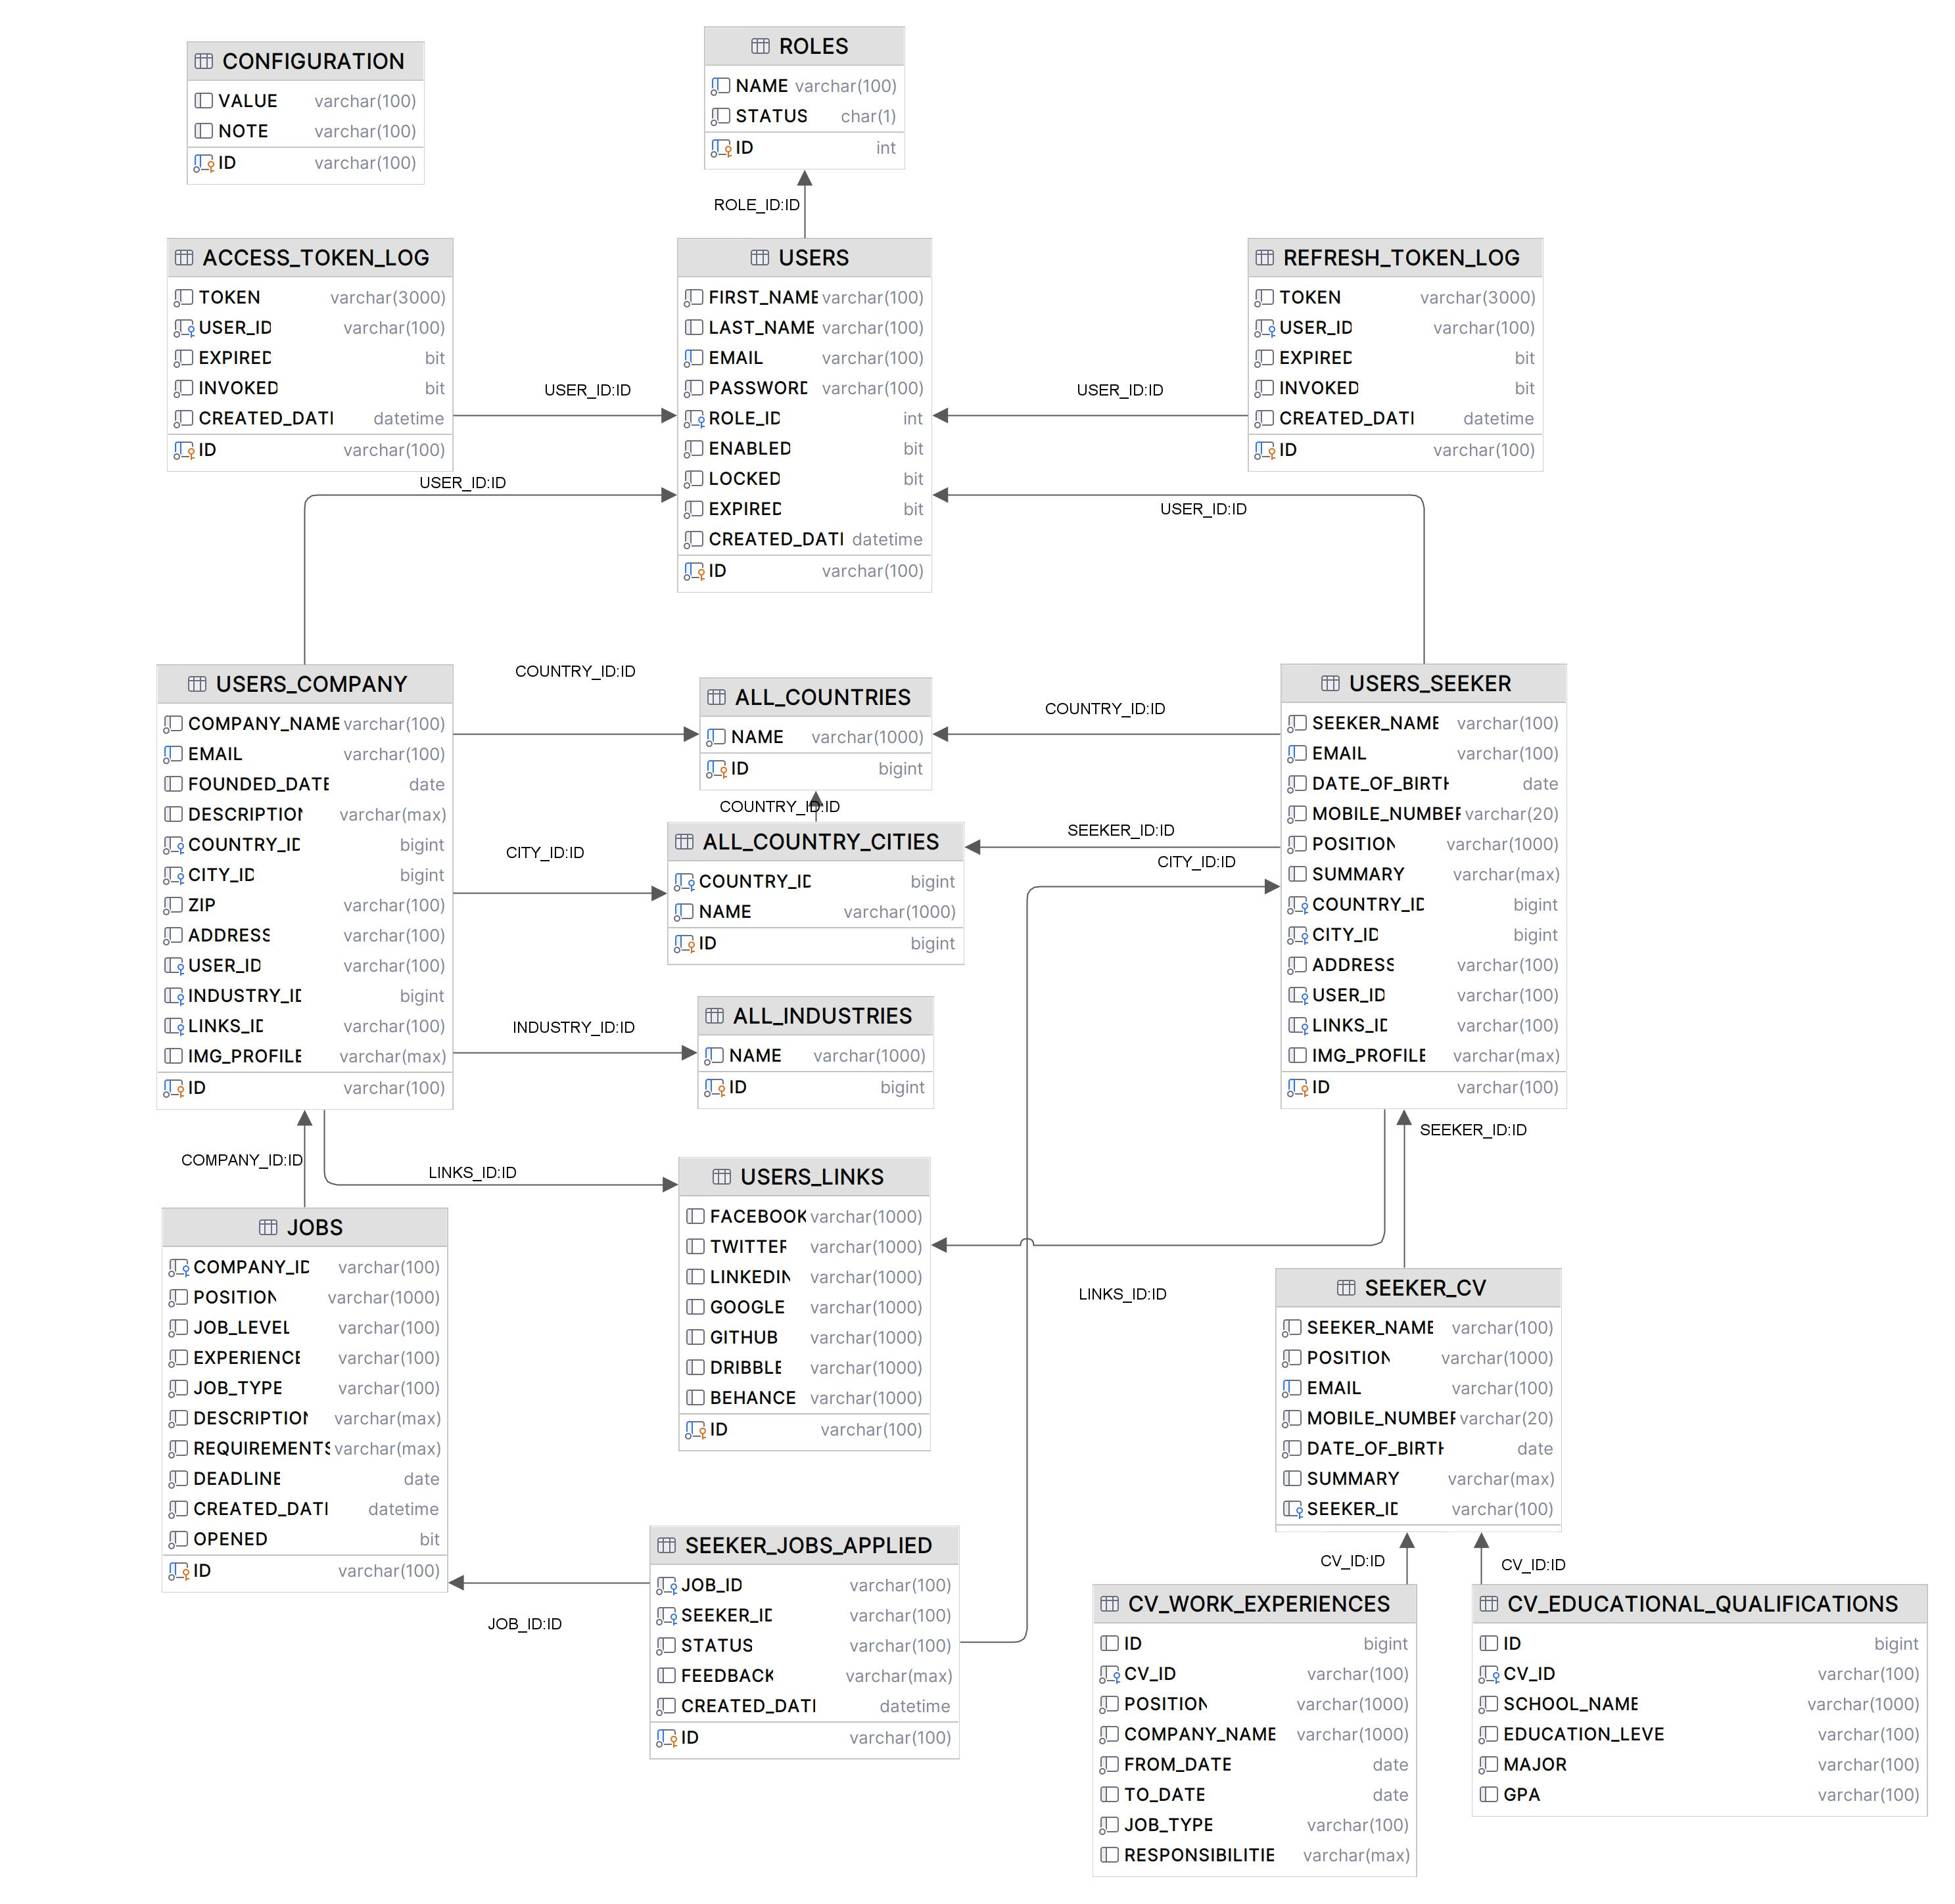
Entity Relationship Mapping System

