Slide 1
DP-100 Coverage Exam

Slide 2
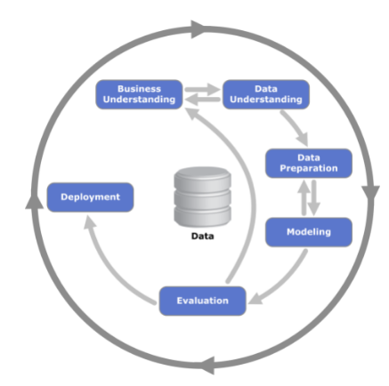
Development Cycle
Data scientists follow an iterative workflow that keeps their work closely aligned to both business problems and their data.
This cycle begins with a thorough understanding of the business problem and the data itself, a process called exploratory data analysis. Once the motivating business question and data are understood, the next step is preparing the data for modeling.
This includes removing or imputing missing values and outliers as well as creating features to train the model on. The majority of a data scientist's work is spent in these earlier steps.
After preparing the features in a way that the model can benefit from, the modeling stage uses those features to determine the best way to represent the data.
The various models are then evaluated and this whole process is repeated until the best solution is developed and deployed into production.

Slide 3
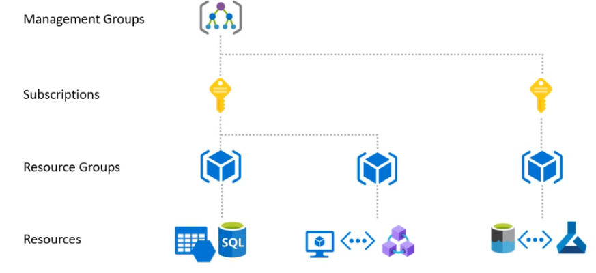
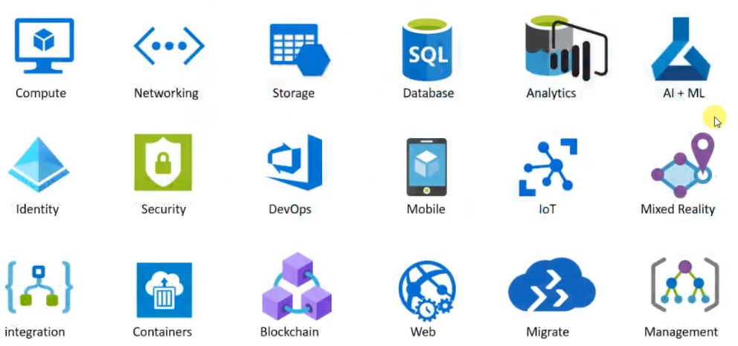

Slide 4
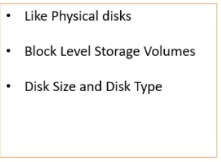
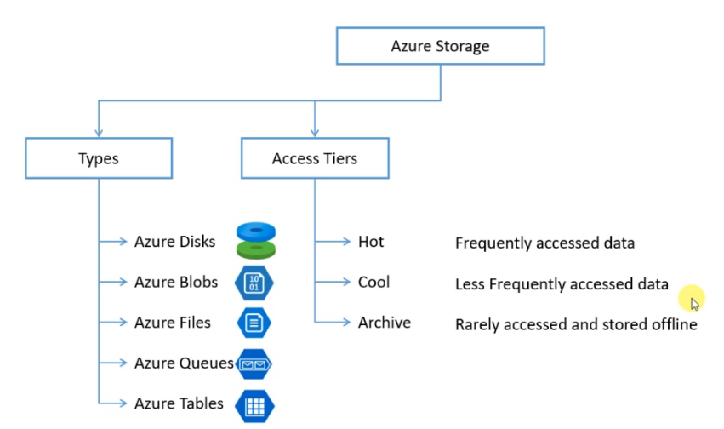
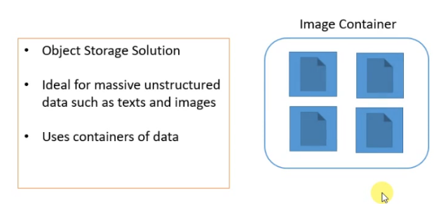
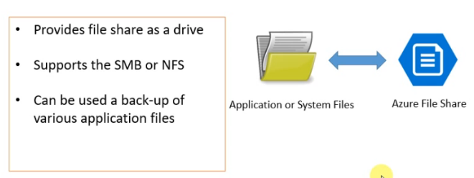
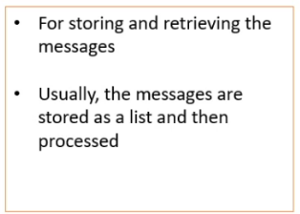

Slide 5
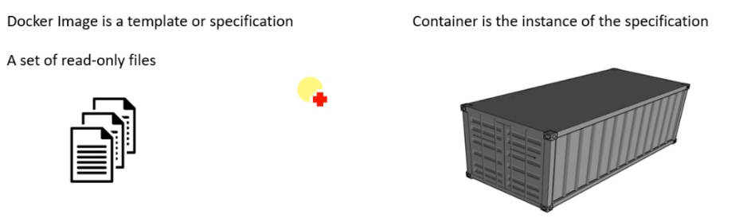
Docker image is nothing but a specification or a wishlist of various packages and libraries.
Docker image can be considered a class and the container is an instance of that class
We can create multiple set of containers using one Image

Slide 6
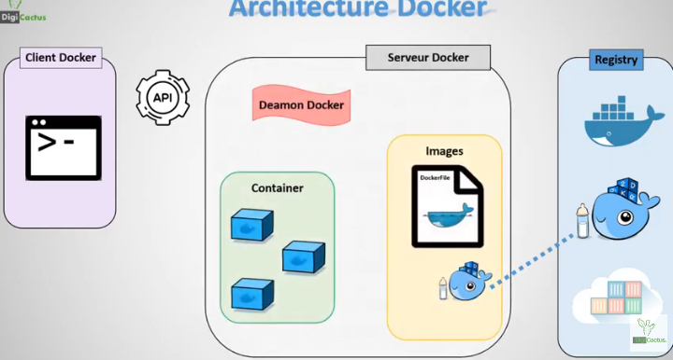
Docker container
Client docker
Fonctionne avec des instructions pour faire construire des images et manager des conteneurs avec des fonctions comme: Build, Pull &Push et Run
Docker Server
Communique avec le client docker via une REST-API et démarre le Docker Daemon & Docker registry
Docker Daemon
Processus qui s’occupe de construire des images et de manager des conteneurs
Image
L’image Docker est un template prêt à l’emploi sous forme de fichier docker file avec une liste d’instructions procédurale pour créer et démarrer le conteneur
Conteneur
Un conteneur docker est une petite boite qui contient notre application et ces dépendances exécuté par notre daemon sur notre machine à partir d’une image construite ou chargé a partir de notre registry

Slide 7
Register Data
Cosmos DB data
We can transfer data from cosmos DB to a blob storage via Azure Data Factory .
Cosmos DB is not a Datastore or a Dataset or an SQL Data Storage
You can use RENAME TABLE and ADD COLUMN statements with the ALTER TABLE command, but other clauses are not supported, including DROP COLUMN, ALTER COLUMN, and ADD CONSTRAINT.
You can create a VIEW within SQLite, but thereafter views are read-only. You cannot execute a DELETE, INSERT, or UPDATE statement on a view. However, you can create a trigger that fires on an attempt to DELETE, INSERT, or UPDATE on a view and perform other operations in the body of the trigger.
Using Azure Data factory with Cosmos DB

Slide 8
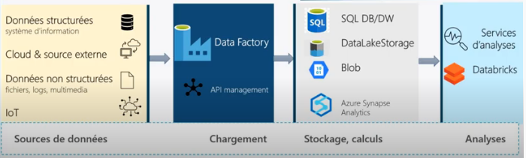
Azure Data Factory
Azure Data Factory Orchestre les pipeline de data, le workflow et le scheduling

Slide 9

Azure ML Designer
Import data module can cope with tabular data typically CSV, Not suitable for unstructed sources
managed identities are the best way to access to Key Vaults.

Slide 10
SQL Transformation
SQLite uses dynamic typing for values, rather than assigning a type to a column as in most relational database systems. It is weakly typed, and allows implicit type conversion.
LEFT OUTER JOIN is implemented, but not RIGHT OUTER JOIN or FULL OUTER JOIN.
You can use RENAME TABLE and ADD COLUMN statements with the ALTER TABLE command, but other clauses are not supported, including DROP COLUMN, ALTER COLUMN, and ADD CONSTRAINT.
You can create a VIEW within SQLite, but thereafter views are read-only. You cannot execute a DELETE, INSERT, or UPDATE statement on a view. However, you can create a trigger that fires on an attempt to DELETE, INSERT, or UPDATE on a view and perform other operations in the body of the trigger.
Si le jeu de données d’entrée n’a pas de noms de colonnes, les noms de colonnes de la table sont créés automatiquement à l’aide de la Convention d’affectation de noms suivante : T1COL1, T1COL2, T1COL3, etc., où les nombres indiquent l’index de chaque colonne dans le jeu de données d’entrée
Exceptions
Erreur 0001 | Une exception se produit si une ou plusieurs colonnes spécifiées du jeu de données sont introuvables.
Erreur 0003 | Une exception se produit si un ou plusieurs jeux de données d'entrée ont la valeur Null ou sont vides.
Erreur 0069 | Erreur de logique SQL ou base de données manquante

Slide 11
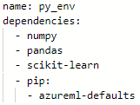
Environment
Conda.yml
Creating an environment from a specification file
from azureml.core import Environment env = Environment.from_conda_specification(name='training_environment',
file_path='./conda.yml')
myenv = Environment.from_pip_requirements(name = "myenv", file_path = "path-to-pip-requirements-file")
Creating an environment from an existing Conda environment
from azureml.core import Environment env = Environment.from_existing_conda_environment(name='training_environment',
conda_environment_name='py_env')
Creating an environment by specifying packages
from azureml.core import Environment
from azureml.core.conda_dependencies import CondaDependencies env = Environment('training_environment')
deps = CondaDependencies.create(conda_packages=['scikit-learn','pandas','numpy'],
pip_packages=['azureml-defaults'])
env.python.conda_dependencies = deps
Pre-built Curated environment
AzureML-pytorch-1.10-ubuntu18.04-py38-cuda11-gpu
AzureML-sklearn-0.24-ubuntu18.04-py37-cuda11-gpu
AzureML-lightgbm-3.2-ubuntu18.04-py37-cpu

Slide 12
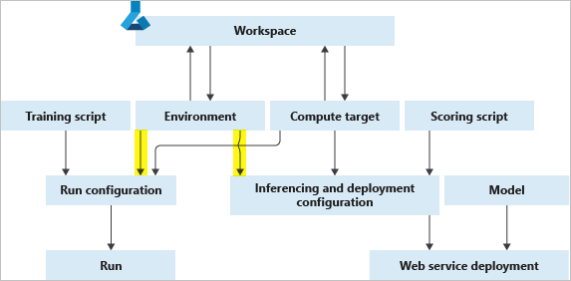
Work with Dataset: tabular
Experiment
Script
Create the evironnment
Call the dataset
Call the compute target
Call the ScriptRunconfig with the following arguments:
Call parser
Set the required arguments
Build the model
Log metrics
Save the trained model
Evironnment created
Script training file
Script.py
Arguments
Compute target
Workspace
Prepare the dataset
Create the compute target
Work with Dataset: file

Slide 13
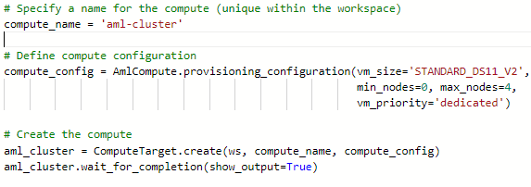
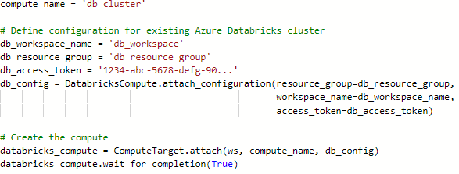
Work with Compute
Creating a managed compute target with the SDK
Creating unmanaged compute target with the SDK

Slide 14
Pipeline Input/Output
To use a OutputFileDatasetConfig object to pass data between steps, you must:
Define a named OutputFileDatasetConfig object that references a location in a datastore. If no explicit datastore is specified, the default datastore is used.
2. Pass the OutputFileDatasetConfig object as a script argument in steps that run scripts.
3.Include code in those scripts to write to the OutputFileDatasetConfig argument as an output or read it as an input.
Managing step output reuse
To control reuse for an individual step, you can set the allow_reuse parameter in the step configuration
Forcing all steps to run
pipeline_run = experiment.submit(train_pipeline, regenerate_outputs=True)

Slide 15
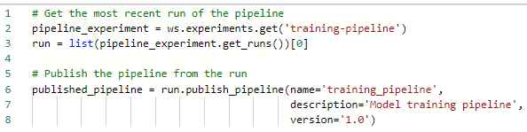

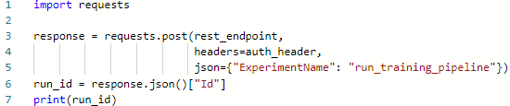
Publish Pipeline
Call the publish method on a successful run of the pipeline
Getting the endpoint
Using a published pipeline
To initiate a published endpoint, you make an HTTP request to its REST endpoint

Slide 16
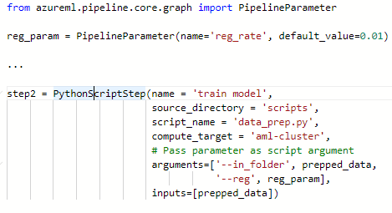

Pipeline Parameters
Defining parameters
create a PipelineParameter object for each parameter, and specify each parameter in at least one step
Allow reuse:
We need to set it to false so that the steps wont use previous outputs
You must define parameters for a pipeline before publishing it!!!
response = requests.post(rest_endpoint,headers=auth_header,
json={"ExperimentName": "run_training_pipeline",
"ParameterAssignments": {"reg_rate": 0.1}})
Running a pipeline with a parameter

Slide 17
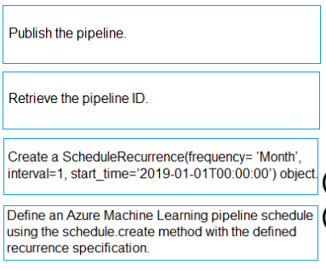
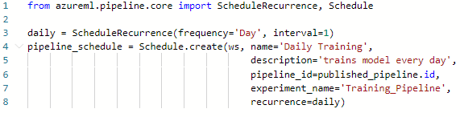
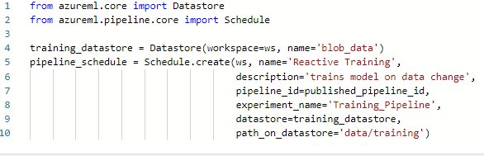
Schedule pipelines
Scheduling a pipeline for periodic intervals
define a ScheduleRecurrence that determines the run frequency
use it to create a Schedule
Triggering a pipeline run on data changes
To schedule a pipeline to run whenever data changes, you must create a Schedule that monitors a specified path on a datastore

Slide 18

Run experiments
Retrieve metric logs
Triggering a pipeline run on data changes

Slide 19
Manage Azure ressources for ML
Azure compute instance
A single VM which doesn’t scale down when idle and doesn’t scale up for high demand (managed manually) (need to be deleted for charges)
Can be used for AutoML and running pipelines but not supported in the ML Designer
You cannot share your computer instance for developpment
Remote VM
Not managed by Azure, scale up/down must be seperatly managed
Azure HDInsight
Capable of running pipelines
Not suitable for AutoMl and MLDesigner
Apache spark based big-data plateform. Used as an attached compute for training and not for inference
Compute clusters
Flexible and cost effective environments for training experiments
Suitable for AutoML runs
Multi-node can scale up for training and scale down to 0 in idle
You can share your compute cluster for training
AKS rescaling technique
Azure Container Instance
Deploy the model as a Web Service on Azure Container Instance

Slide 20



Manage Azure ressources for ML
Role Based access control (RBAC)
A tool to manage and control the scope granted to an identity over a ressource. Helps you manage which user has access to the ressource and what can they do with it. Can be coupled with the authentification methods like Interactive, service principale or Managed identity
Managed Identity
Authentification method supported with the Azure SDK with Virtual Machine
managed identities are the best way to access to Key Vaults.
System –assigned identity: linked directly to a single ressource and not accessing multiple ressources
User-assigned identity: provides reusability with the least administration, needs to be created seperatly in the azure AD and then attached to the compute
Service Principal
Preferred authentification method to the ML Workspace without users interaction as an automated process
Useful to connect to other Azure ressources such as the DataLake Storage or the Azure SQL
Authentification to a Blob storage container
Shared access Keys
Create access for co-workers to the workspace

Slide 21
Manage Azure ressources for ML
Recommanded way of accessing data from Workspace
For a structured data: Register as a tabular Dataset and access it by mounting
For unstructered data like images: Register as file Dataset and access it by mounting
For Large ammount of Data use the As mount instead of As Downlaod
Azure Data Lake storage
Capability of managing hierarchical namespaces
Azure Storage account
A flat non hierarchical storage
Azure application insight
Store monitoring data related to the models

Slide 22
Manage Azure ressources for ML
Predifined roles inside the workspace
General
Owner: Grants full access to manage all resources, including the ability to assign roles in Azure RBAC.
Contributor: Grants full access to manage all resources, but does not allow you to assign roles in Azure RBAC, manage assignments in Azure Blueprints, or share image galleries.
Reader: View all resources, but does not allow you to make any changes.
User access administrator: Lets you manage user access to Azure resources.
Management
Managed Application Contributor Role: Allows for creating managed application resources.
Managed Application Operator Role: Lets you read and perform actions on Managed Application resources
Managed Applications Reader: Lets you read resources in a managed app and request JIT access.
Resource Policy Contributor: Users with rights to create/modify resource policy, create support ticket and read resources/hierarchy.
Monitor
Monitoring Contributor: Can read all monitoring data and update monitoring settings.
Monitoring metric publisher : Enables publishing metrics against Azure resources
Monitoring Reader: Can read all monitoring data .
Analytics
Log analytics Contributor: Log Analytics Contributor can read all monitoring data and edit monitoring settings. Editing monitoring settings includes adding the VM extension to VMs; reading storage account keys to be able to configure collection of logs from Azure Storage; adding solutions; and configuring Azure diagnostics on all Azure resources.
Log analytics Reader : Log Analytics Reader can view and search all monitoring data as well as and view monitoring settings, including viewing the configuration of Azure diagnostics on all Azure resources.

Slide 23



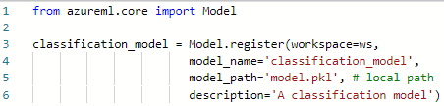

Implement responsible ML
Deploy models
Note !!!
Azure
uses containers as a deployment mechanism, packaging the model and the code to use it as an image that can be deployed to a container in your chosen compute target.
Compute targets
1
- local compute
Azure Machine Learning compute instance
Azure Container Instance (ACI)
Azure Kubernetes Service (AKS) cluster
Azure Function
Internet of Things (IoT) module
2
1. Register the trained model (Not mandatory)
3
1.1 Register from a local file
Previous models will not be overwritten
A new version of the model will be added
1.2 Register from a reference to the run

Slide 24
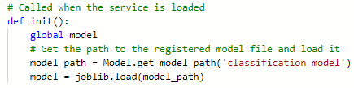
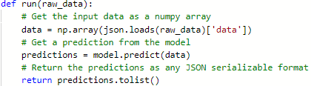
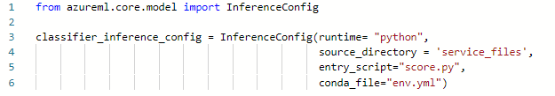
Deploy model as real time service
2. Define an inference config
2.1 entry script
init(): Called when the service is initialized.
run(raw_data): Called when new data is submitted to the service.
2.2 Create an environment
An easy way to create this file is to use a CondaDependencies class to create a default environment (which includes the azureml-defaults package and commonly-used packages like numpy and pandas), add any other required packages, and then serialize the environment to a string and save it
2.3 Combine the script and environment in an InferenceConfig

Slide 25
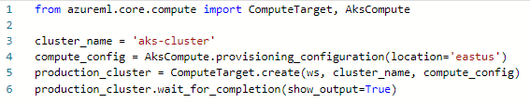

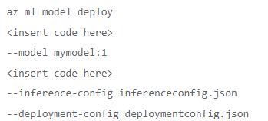

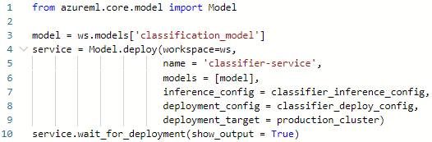


Deploy model as real time service
Note !!!
3. Define a deployment configuration
The code to configure an ACI deployment is similar, except that you do not need to explicitly create an ACI compute target, and you must use the deploy_configuration class from
the azureml.core.webservice.AciWebservice namespace
Similarly, you can use the azureml.core.webservice.LocalWebservice namespace to configure a local Docker-based service.
3.1 configure the compute
3.2 define the deployment configuration
Deploy Via Azure CLI
4. Deploy the model
looking for endpoint !!!

Slide 26
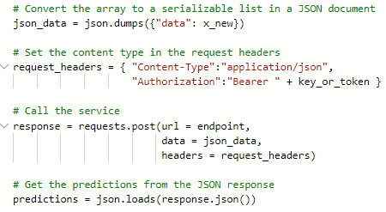
Consume a real-time inferencing service
Authentication
Key: Requests are authenticated by specifying the key associated with the service.
Token: Requests are authenticated by providing a JSON Web Token (JWT).
By default, authentication is disabled for ACI services, and set to key-based authentication for AKS services. You can optionally configure an AKS service to use token-based authentication (which is not supported for ACI services).
For token-based authentication, your client application needs to use service-principal authentication to verify its identity through Azure Active Directory (Azure AD) and call the get_token method of the service to retrieve a time-limited token.

Slide 27
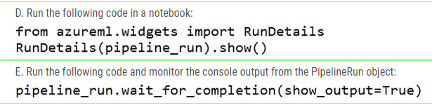
Creating a batch inference pipeline
Create a pipeline with a ParallelRunStep
Azure Machine Learning provides a type of pipeline step specifically for performing parallel batch inferencing.
Using the ParallelRunStep class, you can read batches of files from a File dataset and write the processing output to a OutputFileDatasetConfig.
Additionally, you can set the output_action setting for the step to "append_row", which will ensure that all instances of the step being run in parallel will collate their results to a single output file named parallel_run_step.txt
Run the pipeline and retrieve the step output
After your pipeline has been defined, you can run it and wait for it to complete. Then you can retrieve the parallel_run_step.txt file from the output of the step to view the results
Monitor the execution of pipeline

Slide 28
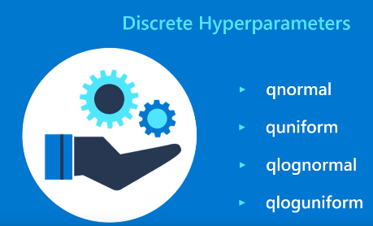
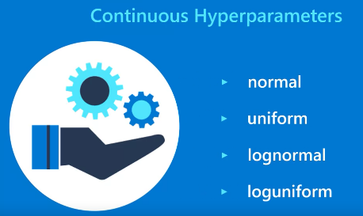
Tune hyper-parameter with Azure ML
Discrete Hyper-parameters
Continuous Hyper-parameter

Slide 29
Tune hyper-parameter with Azure ML
Grid Sampling
Grid sampling can only be employed when all hyperparameters are discrete, and is used to try every possible combination of parameters in the search space.
Random Sampling
Random sampling is used to randomly select a value for each hyperparameter, which can be a mix of discrete and continuous values
Bayesian Sampling
Supports discrete as well as Continous Hyper-parameters
Select the combination by learning from the previous run
it applies the Bayesian Optimization for getting the best combination
Does not supports early termination
Can’t use normal distribution but only Choicen, uniform and qUniform

Slide 30
Tune hyper-parameter with Azure ML
MedianStoppingPolicy
- ce calculate the running average for each epoch
- Next we take the median running average as our threshhold
- if the next epoch metric is less than the average we break
Bandit Policy
* delay eval: apply the policy after delay_eval intervals(epochs)
* eval_interval: frequency of appliance
*slack_ammount: During the first 10 epochs, if epoch 5 provides the best accuracy of 0.9 then if any epoch after 10 th one , reports accuracy less than (0.9- slack (0.1)= 0.8) the run will be terminated
* slack amount: During the first 10 epochs, if epoch 5 provides the best accuracyof 0.9. Then if the epoch 11 reports an accuracy of 0.8, it will compare (0.8 + 0.8* slack_factor(0.1)= 0.88) . As 0.9 is greater than 0.88 the run will be terminated/stopped
Truncation cancels a percentage of lowest performing runs at each evaluation interval
Bandit policy compares the value (Y + Y * slack_factor) to AUC value, and if smaller, cancels the run.

Slide 31


Running automated ML Experiments
Specify data for training
When using the SDK to run an automated machine learning experiment, you can submit the data in the following ways:
Specify a dataset or dataframe of training data that includes features and the label to be predicted.
Optionally, specify a second validation data dataset or dataframe that will be used to validate the trained model. if this is not provided, Azure Machine Learning will apply cross-validation using the training data.
Retrieve the best run and its model
Explore preprocessing steps
Troubleshoot a failed experiment

Slide 32
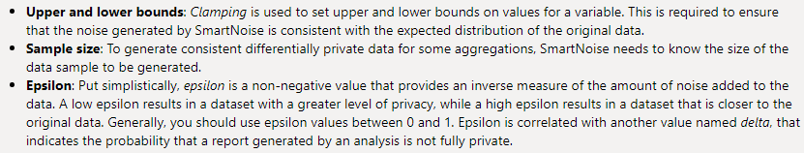
Explore differential privacy
Specify data for training
Look for the mean
with sn.Analysis() as analysis:
# load data
data = sn.Dataset(path=data_path, column_names=cols)
# Convert Age to float
age_dt = sn.to_float(data['Age'])
# get mean of age
age_mean = sn.dp_mean(data = age_dt,privacy_usage = {'epsilon': .50},
data_lower = age_range[0],data_upper = age_range[1],
data_rows = samples
)
analysis.release()

Slide 33




Use model explainers
Same architecture as your trained model!!
Mimic explainer
MimicExplainer is an explainer that creates a global surrogate model that approximates your trained model, and can be used to generate explanations. This explainable model must have the same kind of architecture as you're trained model
Global explainer
Local explainer
Global means: Understand the relative importance of features. We look for the features with highest global importance for the predictions
Local means: Understand how each feature contribute for a specific prediction
Tab Explainer
TabularExplainer is an explainer that acts as a wrapper around various sharp explainer algorithms.
Automatically choosing the one that is most appropriate for your model architecture

Slide 34
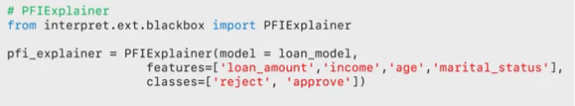

Use model explainers
Provide features to shuffle!!
PFI Explainer
Global explainer
The PFIExplainer requires the actual labels that correspond to the test features
The PFIExplainer doesn't support local feature importance explanations!!!

Slide 35
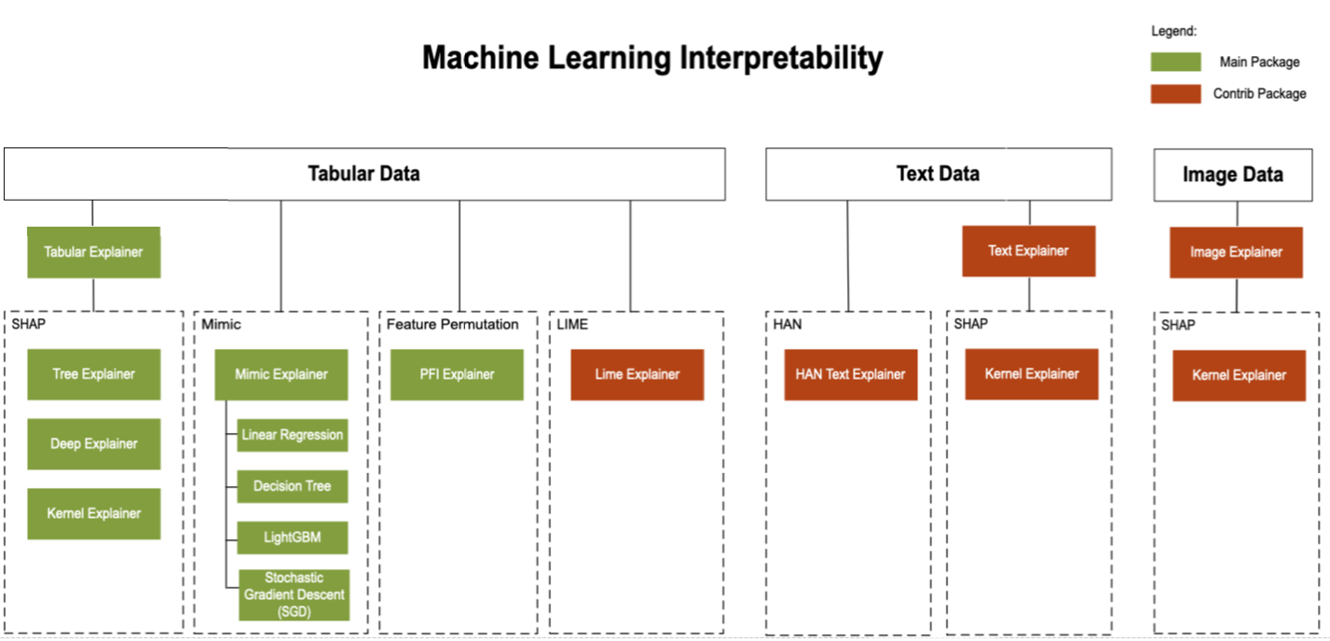
Use model explainers
https://medium.com/microsoftazure/automated-and-interpretable-machine-learning-d07975741298

Slide 36
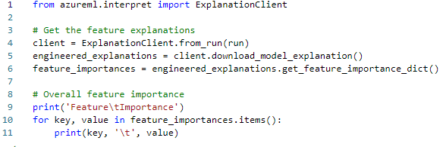

Use model explainers
Tab Explainer for an experiment

Slide 37
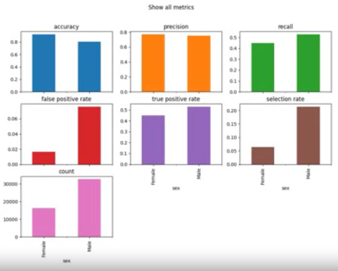
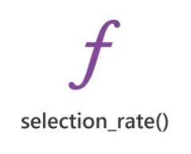
Detect and mitigate unfairness
Analyse unfairness with Fairlearn
Fairlearn is a Python package that you can use to analyze models and evaluate disparity between predictions and prediction performance for one or more sensitive features
For a binary classification model, you might start by comparing the selection rate, the number of positive predictions for each group by using the selection rate function.
This function returns the overall selection rate for the test data set

Slide 38
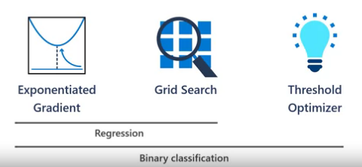
Detect and mitigate unfairness
Mitigating unfairness in models
Exponentiated gradient, which is a reduction technique that applies a cost minimization approach to learning the optimal trade off of overall predictive performance and fairness disparity.
Grid search, which is a simplified version of the exponentiated gradient algorithm that works efficiently with small numbers of constraints.
Threshold optimizer, which is a post processing technique that applies a constraint to an existing classifier, transforming the prediction as appropriate
Note:
It is important to note that all three techniques support binary classification and regression.
While threshold optimizer only supports the binary classification model

Slide 39
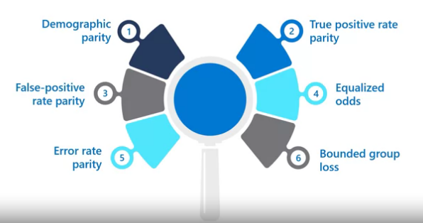
Detect and mitigate unfairness
Mitigating unfairness: types of parity constraints
minimize disparity in true positive rate across sensitive
feature groups
minimize disparity in the selection rate across sensitive feature groups
minimize disparity in combined true positive rate and false positive rate across sensitive feature groups
minimize disparity in false positive rate across sensitive
feature groups
Use the error rate parity constraint with any of the reduction based mitigation algorithms exponentiated gradient and grid search to ensure that the error for each sensitive feature group does not deviate from the overall error rate by more than a specified amount
use the bounded group loss constraint with any of the reduction based mitigation algorithms to restrict the loss for each sensitive feature group in a regression model

Slide 40
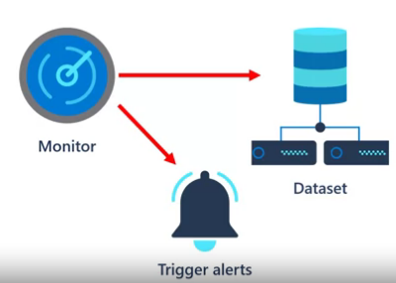
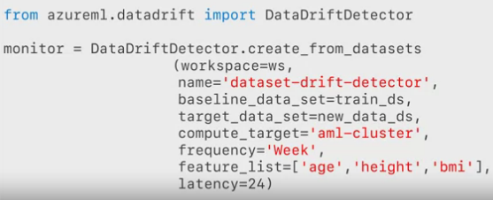
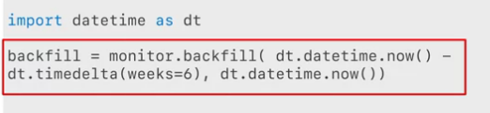
Monitor drift in dataset
Creating a data drift Model
We need to register two datasets: A baseline dataset, which is usually the original training data, and a target dataset that will be compared to the baseline based on time intervals.
Create dataset Monitor
compare the baseline dataset to existing data in the target dataset, which backfills the monitor based on weekly changes in data for the previous six weeks
define a dataset monitor to detect
data drift and trigger alerts if the rate of
drift exceeds a specified threshold

Slide 41
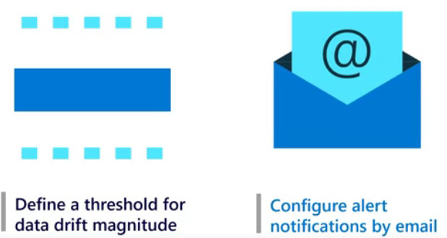
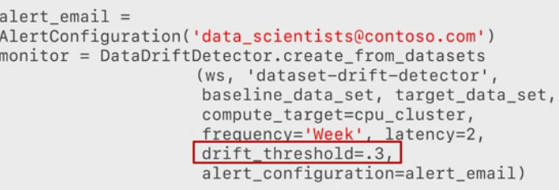
Monitor drift in dataset
Example
using Python code, you can schedule a data drift monitor to run every week and send an alert if the drift magnitude is greater than 0.3
you can specify a threshold for the rate of data drift and an operator email address for notifications if this threshold is exceeded

Slide 42
Pyspark with azure Databricks
Parquet Files
View file on the DBFS:
Efficient data compression
Open source
Splittable file format
Column oriented datastore
csv: %fs ls /mnt/training/wikipedia/pageviews/
Json: %fs ls dbfs:/mnt/training/wikipedia/edits/snapshot-2016-05-26.json
Parquet:
Table:
Infer schema:
csv: CSVSchema = StructType([,,,,,,]) → .schema(jsonSchema)
Json: jsonSchema = StructType([,,,,,,]) → .schema(jsonSchema)
Parquet: Schema already exists in the meta data but we could do the same as JSON
Cache data into the memory
(pagecountsEnAllDF
.cache() # Mark the DataFrame as cached
.count() # Materialize the cache
)

Slide 43
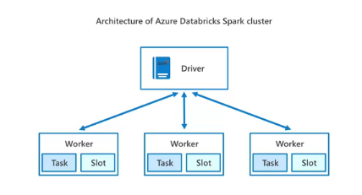
les composants d'un cluster Azure Databricks Spark.
Slot: Le travail envoyé par les nœuds pilotes aux nœuds
Worker est affecté à des créneaux, leur ordonnant d'extraire des données d'une source de données spécifiée.
Driver : Les clusters Spark, ou ensembles de données, sont également appelés Driver .
Task: tâche est envoyée du nœud pilote aux nœuds ouvriers.PiloteDans un cluster Apache Spark, le pilote est l'interface de l'ordinateur portable. Il contient la boucle principale du programme et crée des ensembles de données distribuées sur le cluster.Traduit avec)

Slide 44
Pyspark with azure Databricks
Delta Lakes:
Schema evolution: make changes to a table schema that can be applied automatically, without the need for DDL modifications.
Time Travel: provides snapshots of data enabling developers to access and revert to earlier versions of data for audits, rollbacks or to reproduce experiments
DESCRIBE DETAIL tableName: Display MetaData
OPTIMIZE Customers ZORDER BY City: Ensures that all data backing, for example, City=’London’ is colocated, then rewrites the sorted data into new Parquet files.
The Catalyst Optimizer: can optimize sql built-in functions
write, register and invoke UDFS right
register and invoke vectorized UDFs
articulate performance advantages of vectorized UDFs

Slide 45
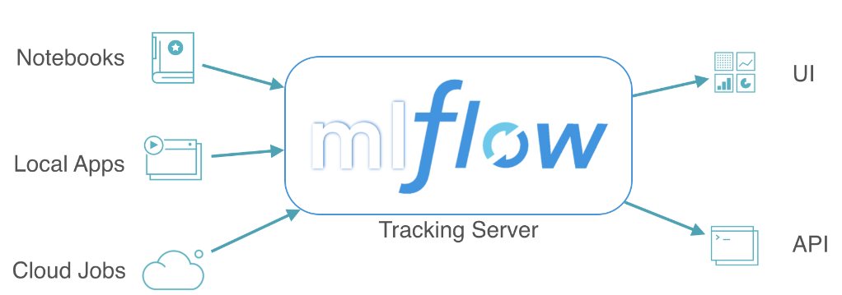
MLFlow
MLflow Tracking is a logging API specific for machine learning.
Runs are aggregated into experiments where many runs can be a part of a given experiment and an MLflow server can host many experiments.
MLflow tracking also serves as a model registry so tracked models can easily be stored and, as necessary, deployed into production.
Experiments can be tracked using libraries in Python, R, and Java as well as by using the CLI and REST calls.
MLFlow
In the past, when examining a problem, you would have to manually keep track of the many models you created, as well as their associated parameters and metrics. This can quickly become tedious and take up valuable time, which is where MLflow comes in
managing the machine learning workflow is challenging because of difficulty in tracking various experiments.
Ensuring that experiments are reproductible, and providing a standard way to package and deploy trained models
log metrics, and compare runs
Logs and artfacts are stored in both Azure ML and Azure Databricks workspace

Slide 46

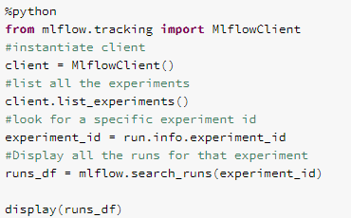


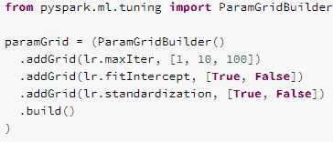
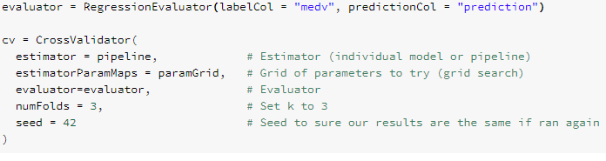
MLFlow
Querying Past Runs
Model selection

Slide 47



MLFlow
MLFlow logging target
Set tracking uri is required for MLFlow to point to the URI of a ML Workspace
Get_mlflow_tracking_uri(): required to achieve a unique tracking URI to the workspace
Configure experiment

Slide 48


MLFlow
Serving Models with Microsoft Azure ML
Build an Azure Container Image for model deployment
Deploy to the model's image to the specified AKS cluster
build container images that can be deployed as a scoring web service to either ACI for development and test,
and then subsequently to AKS to support production applications

Slide 49
Horovod: Deep Learning
Azure Databricks and run long running distributed deep learning training jobs on Spark, and use Petastorm to enable training and evaluation of deep learning models from data sets in Apache Parquet format

