Slide 1
AutoWorth AI
Used Car Price & Deal Advisor
Final Machine Learning Project · Individual · Your name here
Notes:
Introduce the project: predict the fair market price of a used UK car and tell the buyer if the seller's price is a good deal.

Slide 2
The question
“What is the expected market price of this car, and is the seller offering a good deal?”
99,187
97,709
13
listings, 9 UK manufacturers (Kaggle)
rows after cleaning
features incl. 5 engineered
Regression task
Smart Deal Advisor
Target: price (£). Inputs: make, model, year, mileage, transmission, fuel type, engine size, MPG, tax.
Compare the predicted market price with the seller's price → 🟢 Great / 🟢 Good / 🟡 Fair / 🟠 Slightly overpriced / 🔴 Overpriced.

Slide 3
Cleaning: investigate first, then decide
Every decision was checked against the data before rows were touched
Duplicates
Invalid years
Engine size = 0
1,475 identical rows removed — same advert scraped twice; would leak between train and test.
2060 (impossible) and two 1970 rows (models did not exist) dropped — 3 rows only.
265 petrol/diesel/hybrid cars → set to missing, imputed with the TRAIN median + flag feature. EVs keep 0.
MPG outliers
Price & mileage
Categories
Plug-in hybrids / EVs report up to 470 mpg. Rows kept, values clipped to [10, 150].
£450 bangers and £160k G-Classes are real market extremes → kept.
Leading spaces in model names fixed; Hyundai's “tax(£)” column renamed before combining.

Slide 4
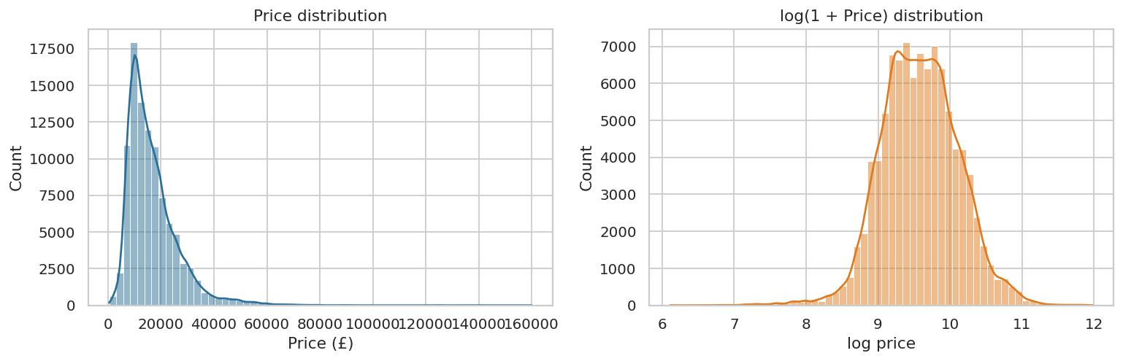
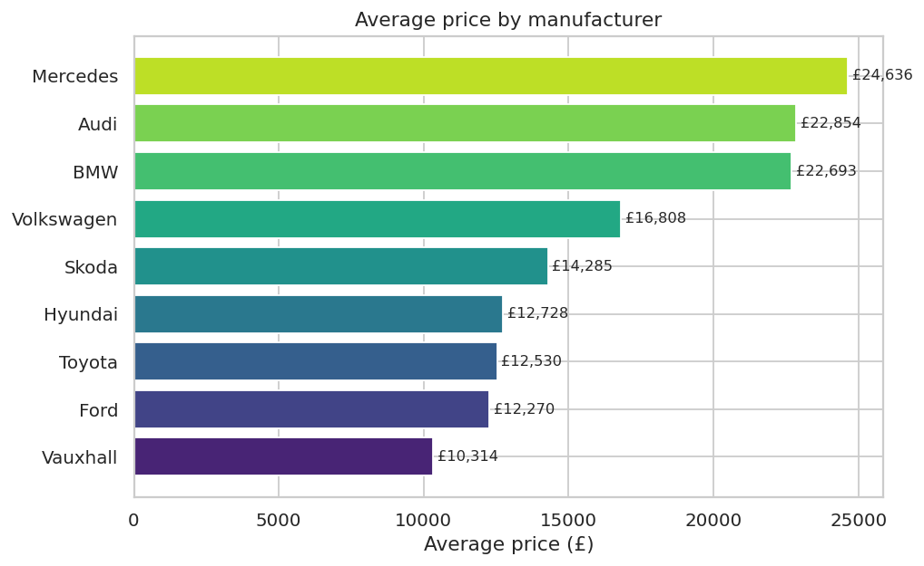
EDA: price is skewed, brand matters
Prices are right-skewed → models learn log(price)
Mean £16,774 vs median £14,470 (skew 2.36 → −0.08 after log). Mercedes, Audi and BMW average ~£23–25k; Vauxhall ~£10k.

Slide 5
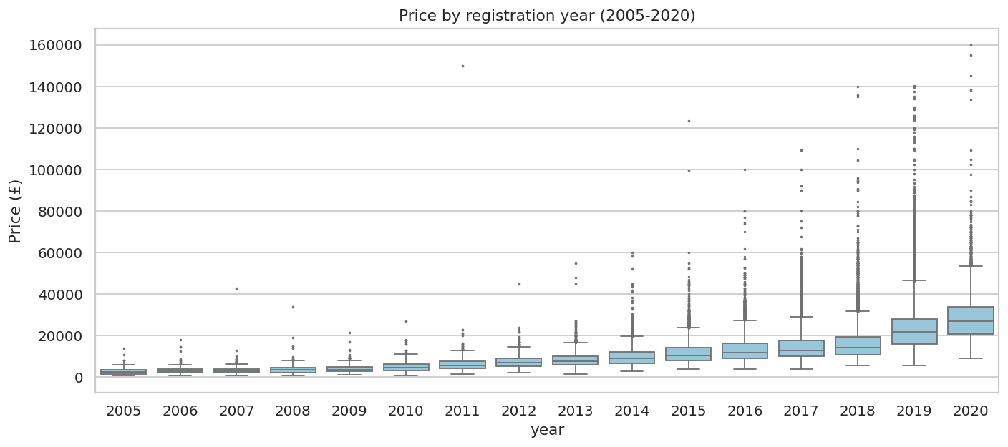
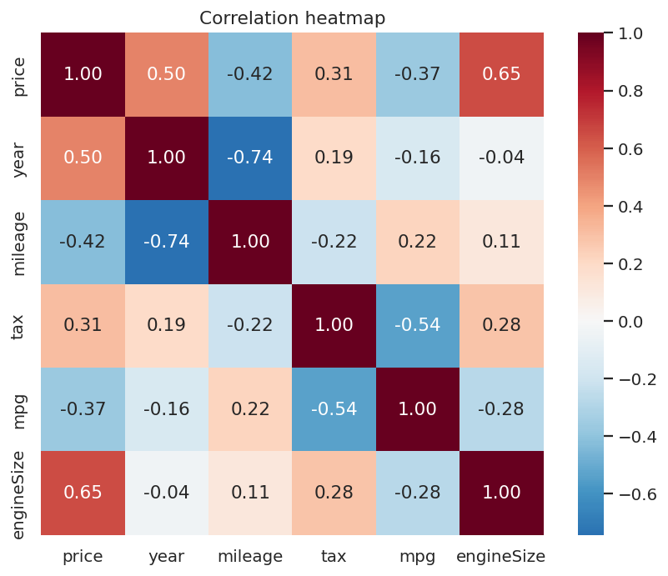
EDA: age, mileage and engine drive price
Correlation with price: engine size 0.65 · year 0.50 · mileage −0.42 · mpg −0.37
Median price: £2.5k (2005) → £10.5k (2015) → £27k (2020). Manual cars £11k vs Automatic £19k; petrol £12k vs diesel £17k.

Slide 6
Feature engineering: 5 new features
Row-wise formulas — nothing learned from data, so no leakage
car_age
mileage_per_year
is_premium_brand
2020 − year. Reference year 2020 = scrape year.
mileage / max(age,1). Separates heavy vs light use; safe for age 0.
Audi, BMW, Mercedes = 1. Premium makes cost ~2× more.
engine_mpg_ratio
engine_missing
Result
engineSize / mpg. Power-vs-economy proxy.
Flags the 265 imputed engine sizes.
engine_mpg_ratio and car_age are among the top features.
engine_mpg_ratio and car_age are among the top features.

Slide 7
No data leakage by design
Split first — every fitted step sees the training set only
Split
70/15/15
Fit imputer +
scaler + encoder
on TRAIN
Transform
validation
Select model
on validation
Test set
used ONCE
→
→
→
→
Train 68,396 · Validation 14,656 · Test 14,657 rows
Tuning uses cross-validation inside a Pipeline, so preprocessing is re-fitted in every fold.
Duplicates removed first so identical cars cannot sit in both train and test.

Slide 8
Five models compared (validation set)
Ensembles win; the log-target linear model is a strong baseline
Model | R² | MAE | RMSE
Linear Regression | 0.924 | £1,599 | £2,740
Decision Tree | 0.920 | £1,472 | £2,799
Random Forest | 0.957 | £1,139 | £2,046
Gradient Boosting | 0.937 | £1,489 | £2,484
XGBoost-style Boosting | 0.958 | £1,149 | £2,025
All five models pass the R² > 0.90 target; Random Forest and boosting cut the MAE by ~30% vs linear.

Slide 9
Overfitting check: train vs validation R²
Decision Tree memorises; boosting generalises
0.079
Decision Tree gap (0.9996 vs 0.920) → overfit
0.011
Boosting gap → generalises well

Slide 10
Hyperparameter tuning
RandomizedSearchCV: 8 combinations × 3-fold CV on the training set
Before
After
0.958
£1,149
0.962
£1,096
R²
MAE
R²
MAE
Did it help?
Yes, modestly: R² +0.004, MAE −£53, RMSE £2,025 → £1,928. The default model was already strong, so the room for improvement was small; the train–validation gap stays small.

Slide 11
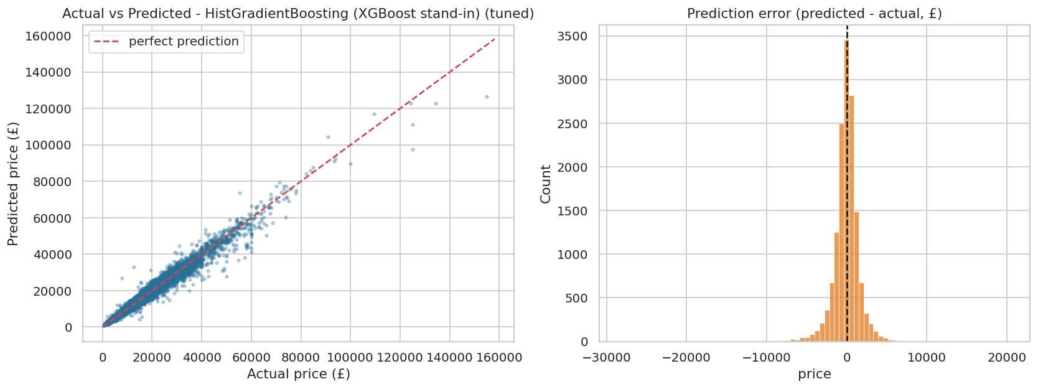
Final model: evaluated once on the test set
HistGradientBoosting (XGBoost stand-in) (tuned)
0.968
Test R²
£1,094
Test MAE
£1,773
Median error £713 · 90% of predictions within £2,379
Test RMSE

Slide 12
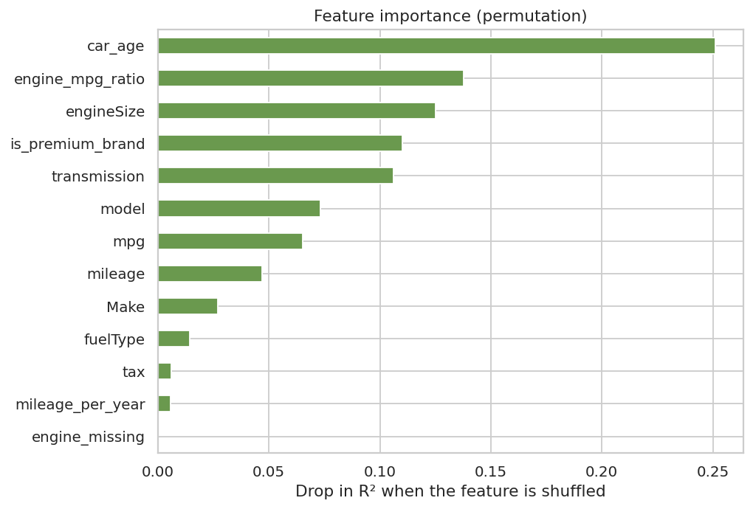
What drives the price?
Permutation importance on the validation set
1. Vehicle age
The strongest driver — steep early depreciation.
2. Engine & brand
Engine size, power-vs-economy ratio, premium makes.
3. Transmission, mileage
Automatics cost more; mileage matters but overlaps with age.

Slide 13
Where does the model make large errors?
Largest £ errors: rare, expensive cars
Relative error is stable
Median error ≈ 5% in every price band.
Big misses
G-Class, Audi R8, Mustang, GLE — few similar cars; trim and options are not in the data.
Suspicious listings
Some +160% to +240% cases look like mis-priced or damaged cars.

Slide 14
Smart Deal Advisor
Rating = how far the seller's price is from the predicted market price
🟢 Great Deal
>10% cheaper
9% of test listings
🟢 Good Deal
5–10% cheaper
16% of test listings
🟡 Fair Price
within ±5%
49% of test listings
🟠 Slightly Overpriced
5–10% dearer
14% of test listings
🔴 Overpriced
>10% dearer
12% of test listings
Example (from the brief)
Estimated market price £18,500 · Seller price £17,000 · Difference £1,500 cheaper (8.1%) · 🟢 GOOD DEAL. On real test listings the advisor rates about half as fair and the rest roughly symmetric — as expected for a calibrated model. Ratings close to a boundary should be read as “roughly fair”, because the typical error is ~5%.

Slide 15
Streamlit application
Enter 8 fields → price, difference and rating
Inputs
Output
Make · Model · Year · Mileage
Transmission · Fuel type · Engine size
Seller price (£)
Tax and MPG are filled automatically with typical values for that make / model / engine (optional manual override).
💰 Estimated Market Price
🏷️ Seller Price
💵 Difference (e.g. “£1,409 cheaper”)
🚦 Deal Rating (e.g. 🟢 GOOD DEAL)
Run: streamlit run app.py

Slide 16
Conclusions
Test R² 0.968, MAE £1,094 — above the 0.90 target, error ≈ 5% of price
Age first, then engine, brand/model and transmission drive price
No leakage: split first, fit on train only, test set used once
Deal Advisor turns a price estimate into a clear decision
Limits: 2020 data, 9 makes, no trim / condition / options
Next: price intervals, fresh data, CatBoost / stacking

