Slide 1
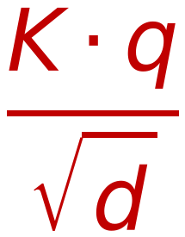
Encoder-Decoder Attention Mechanism (In Decoder)
55
(Self Attention of word Z₂ w.r.t All words in Sentence ( Y₁, Y₂, Y₃, Y₄ )
O
Similarity
Probabilities
Weighted SUM
From Encoder
Output
Dot
Product
K.q
$$\frac{K⋅q}{\sqrt{d}}$$
Σ
From Encoder
Output
Y₄
W_{k}^{(r)}
K₄
×
V₄
W_{v}^{(r)}
Y₄
Y₃
W_{k}^{(r)}
K₃
Soft max
×
V₃
W_{v}^{(r)}
Y₃
Scaling by √d
ς
Y₂
W_{k}^{(r)}
K₂
×
V₂
W_{v}^{(r)}
Y₂
Y₁
W_{k}^{(r)}
K₁
×
V₁
W_{v}^{(r)}
Y₁
q₂
W_{q}^{(r)}
W
Z₁
Z₂
Z₃
Z₄
From Decoder
Self Attention Layer
1×d
=
1×d
d×d
d: Embedding Length

