Slide 1

1
Linear Regression &
Classification
CSAI 253 - Spring 2024
Prepared By
Dr. Khaled Mostafa ElSayed
kmelsayed@zewailcity.edu.eg
Instructors:
Dr. Khaled Mostafa ElSayed
kmelsayed@zewailcity.edu.eg
Dr. Mohamed Maher Ata
momaher@zewailcity.edu.eg

Slide 2
2
Linear Regression

Slide 3
Regression – One Dimensional Case
3
Length and Weight of different samples of Steel Bars
Weight
Length

Slide 4
Regression – One Dimensional Case
4
Length and Weight of different samples of Steel Bars
Weight
Model
I/P: Length
O/P: Weight
?
?
?
Length

Slide 5









Regression – One Dimensional Case
5
Length and Weight of different samples of Steel Bars
Weight
Model
I/P: Length
O/P: Weight
Model
( Line )
$$y$$
$$=$$
$$a$$
$$x$$
$$+$$
$$b$$
$$Weight$$
$$=$$
$$a$$
$$∗$$
$$Length$$
$$+$$
$$b$$
Model Parameters :
a
,
b
Length

Slide 6












Regression – Two Dimensional Case
6
Length, Radius, and Weight of different samples of Steel Bars
Weight
Model
I/P: Length, Radius
O/P: Weight
Model ( Plane)
$$z=$$
$$a$$
$$x$$
$$+$$
$$b$$
$$y$$
$$+$$
$$c$$
?
$$Weight$$
$$=$$
$$a$$
$$∗$$
$$Length$$
$$+$$
$$b$$
$$∗$$
$$Radius$$
$$+$$
$$c$$
Model Parameters : a , b , c
Length
Radius

Slide 7
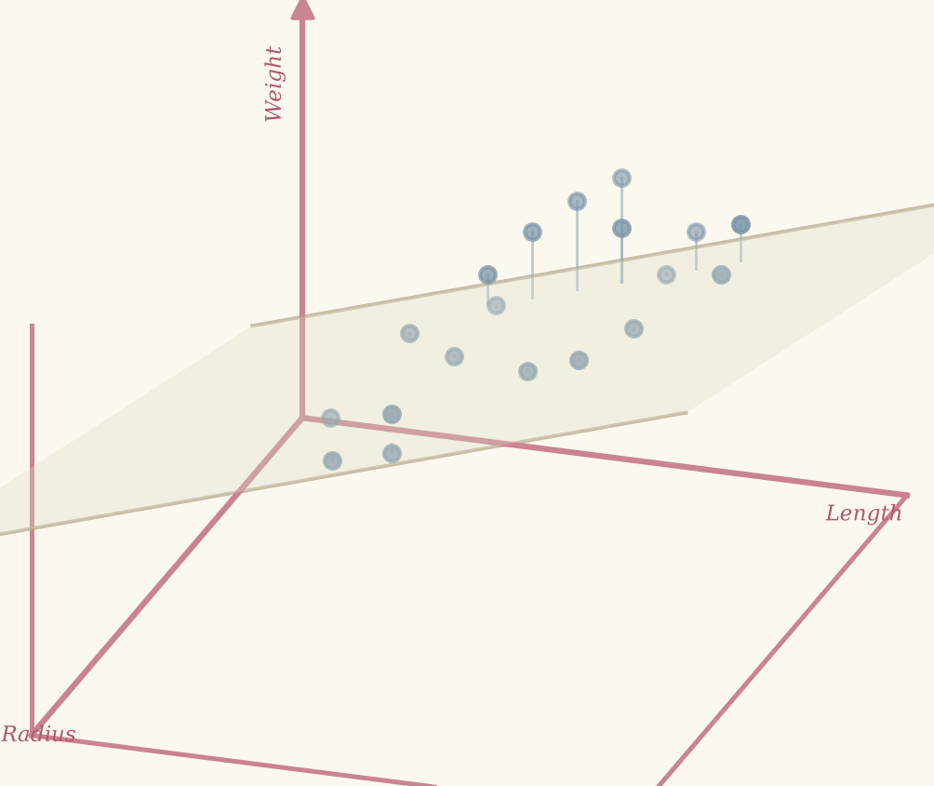
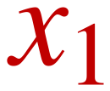
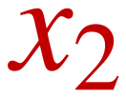
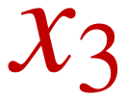

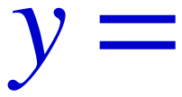



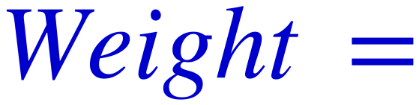








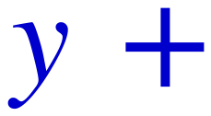

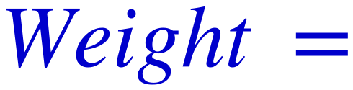







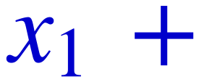

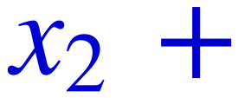

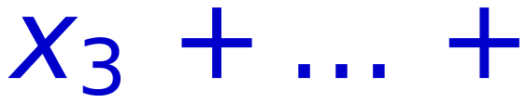

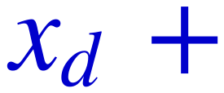
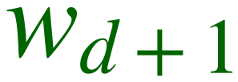







7
Input Vector: 1-D
Input Vector: 2-D
Input Vector: d-D
General Case
Weight
$$x_{1}$$
$$x_{2}$$
?
Input:
$$x_{3}$$
Output: (y)
$$x_{d}$$
Length
Model
Model
Model
I/P:
Length
[x]
I/P:
I/P:
[X₁, X₂, X₃, .... X_{d}]
Length,
Radius
[x,y]
O/P:
Weight
[y]
O/P:
Weight
[z]
O/P:
[Y]
Model ( Line )
Model ( Plane )
Model ( Hyperplane )
$$y=$$
$$a$$
$$x+$$
$$b$$
$$z=$$
$$a$$
$$x+$$
$$b$$
$$y+$$
$$c$$
$$y=$$
$$w_{1}$$
$$x_{1}+$$
$$w_{2}$$
$$x_{2}+$$
$$w_{3}$$
$$x_{3}+…+$$
$$w_{d}$$
$$x_{d}+$$
$$w_{d+1}$$
$$Weight=$$
$$a$$
$$∗$$
$$Length+$$
$$b$$
$$Weight=$$
$$a$$
$$∗Length+$$
$$b$$
$$∗Radius+$$
$$c$$
$$ModelParameters:$$
$$w_{1}$$
$$,$$
$$w_{2}$$
$$,$$
$$w_{3}$$
$$, . . . . ,$$
$$w_{d+1}$$
Model Parameters : a , b
Model Parameters : a , b , c

Slide 8
8
Linear Classification

Slide 9
Classification – Two Dimensional Case
9
Weight
Length and Weight of different
samples of Steel and wood Bars
Steel
Steel
Wood
Model
I/P: Length, Weight
O/P: Class Type
Wood
Length

Slide 10
Classification – Two Dimensional Case
10
Weight
Length and Weight of different
samples of Steel and wood Bars
Steel
Steel
Wood
Model
I/P: Length, Weight
O/P: Class Type
Wood
Data is linearly separable
Linear Classifier is sufficient
Length

Slide 11
Classification – Two Dimensional Case
11
Weight
Length and Weight of different
samples of Steel and wood Bars
?
Steel
Wood
?
Belongs to
Which Class ??
?
Model
I/P: Length, Weight
O/P: Class Type
?
Length

Slide 12
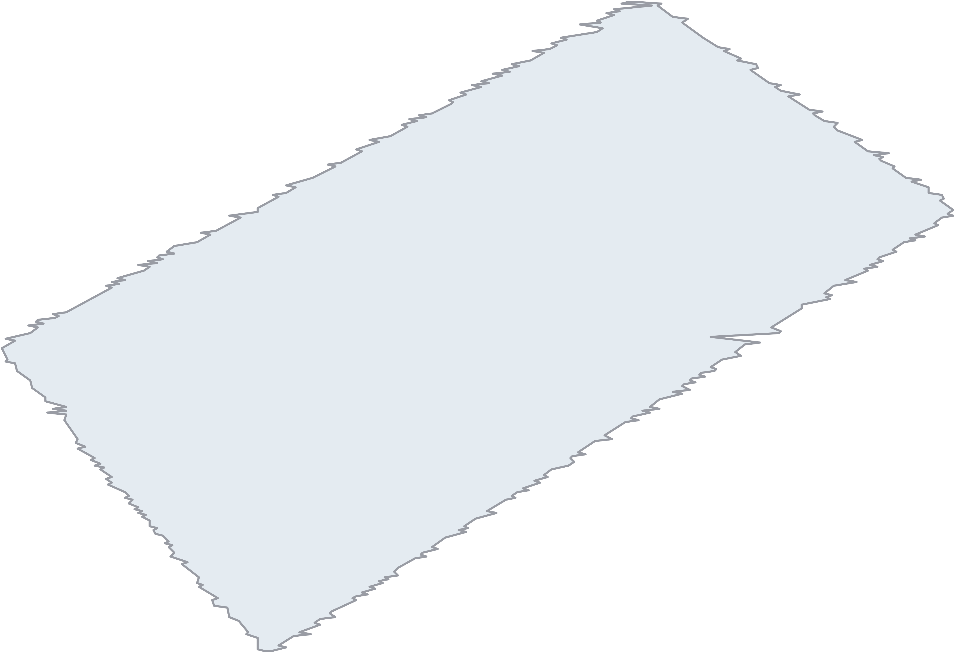












Classification – Two Dimensional Case
12
Weight
Length and Weight of different
samples of Steel and wood Bars
Steel
?
Steel
Wood
?
Model
I/P: Length, Weight
Wood
O/P: Class Type
Model ( Plane )
$$z$$
$$=$$
$$a$$
$$x$$
$$+$$
$$b$$
$$y$$
$$+$$
$$c$$
?
$$Class$$
$$=$$
$$a$$
$$∗$$
$$Length$$
$$+$$
$$b$$
$$∗$$
$$Weight$$
$$+$$
$$c$$
Class > 0 Steel
Class < 0 Wood
Class = 0 Undefined
Model Parameters : a , b , c
Length

Slide 13
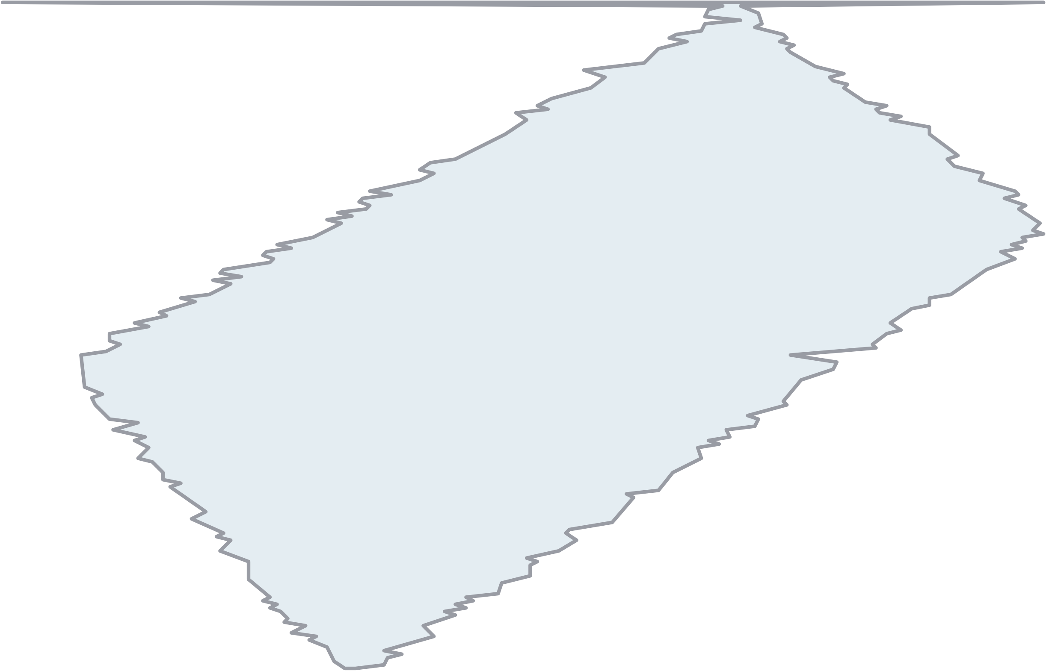







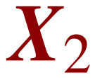
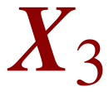
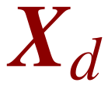

















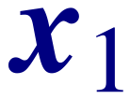


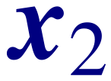

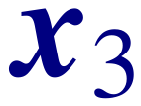


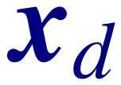
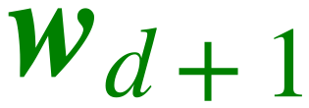











Input Vector: 2-D
Input Vector: d-D
13
Weight
Steel
General Case
?
?
Wood
?
Input:
Output:
( y )
Length
Model
I/P: Length, Weight
Model
O/P: Class Type
I/P:
Model ( Plane )
O/P:
Model ( Hyperplane )
Class > 0 Steel Class < 0 Wood
Class = 0 Undefined
Model Parameters :
Model Parameters : a , b , c

Slide 14
















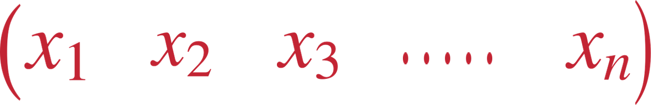


Same Equation for Linear Regression and Classification
14
Model
I/P:
$$(x_{1} x_{2} x_{3} ..... x_{n})$$
O/P:
$$( y )$$
General Case - Regression
Model
$$y=w_{1}x_{1}+w_{2}x_{2}+w_{2}x_{2}+…+w_{d}x_{d}+b$$
Model Parameters :
Input:
$$w_{1},w_{2},w_{3},...,w_{d},b$$
Output:
b is called "bias" term as it is independent of x
General Case - Classification
Model
$$y=w_{1}x_{1}+w_{2}x_{2}+w_{2}x_{2}+…+w_{d}x_{d}+b$$
y > 0
Class 1
y < 0
Class 2
y = 0
Undefined
Model Parameters :
$$w_{1},w_{2},w_{3},...,w_{d},b$$

Slide 15
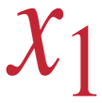
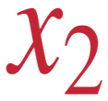
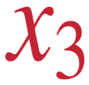






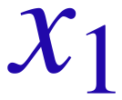


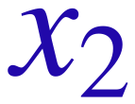




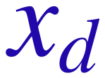













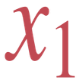
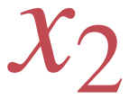

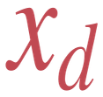


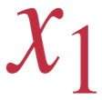



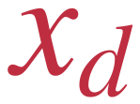






Vector Notation for Linear Regression and Classification (One Sample)
15
Model
I/P:
O/P:
$$x_{1}$$
$$x_{2}$$
$$x_{3}$$
$$…$$
$$x_{n}$$
$$y$$
$$x_{1}$$
$$w_{1}$$
$$x_{2}$$
$$w_{2}$$
X =
w =
Model
Input:
Output:
$$x_{3}$$
$$w_{3}$$
$$y$$
$$y$$
$$w_{1}$$
$$x_{1}$$
$$+$$
$$w_{2}$$
$$x_{2}$$
$$+$$
$$w_{2}$$
$$x_{2}$$
$$+$$
$$+$$
$$w_{d}$$
$$x_{d}$$
$$+$$
$$b$$
$$…$$
$$…$$
$$=$$
$$…$$
$$…$$
$$…$$
$$w_{d}$$
$$W^{T}$$
$$X$$
$$+$$
$$b$$
$$x_{d}$$
$$y$$
$$=$$
$$w_{1}$$
$$w_{2}$$
$$…$$
$$w_{d}$$
$$x_{1}$$
$$y$$
$$=$$
$$x_{2}$$
$$+$$
$$b$$
$$…$$
$$x_{d}$$

Slide 16


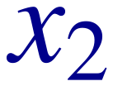
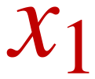
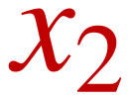
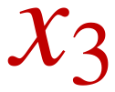
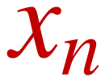



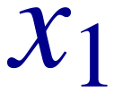

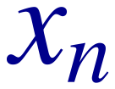

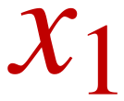

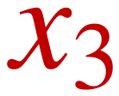

















Vector Notation for Linear Regression and Classification (One Sample)
16
Model
I/P:
(
$$x_{1}$$
$$x_{2}$$
$$x_{3}$$
$$x_{n}$$
)
O/P:
( y )
$$x_{1}$$
$$w_{1}$$
$$.....$$
$$x_{2}$$
$$w_{2}$$
X =
W =
$$w_{3}$$
( y )
Model
Input:
$$x_{3}$$
Output:
$$y$$
$$=$$
$$w_{1}$$
$$x_{1}$$
$$+$$
$$w_{2}$$
$$x_{2}$$
$$w_{n}$$
$$x_{n}$$
$$b$$
$$…$$
$$…$$
$$…$$
W
T
X
b
$$x_{d}$$
$$w_{d}$$
y
=
+
$$w_{1}$$
$$w_{2}$$
$$w_{n}$$
$$b$$
$$1$$
$$....$$
$$w_{1}$$
$$w_{2}$$
$$....$$
$$w_{d}$$
y =
$$x_{1}$$
$$+$$
$$b$$
$$x_{1}$$
W
T
y =
y =
X
$$…$$
$$x_{2}$$
$$x_{n}$$
$$…$$
$$x_{d}$$
Note:
“b” may be added at begin of the vector
W
T
X
y =
or at end of the vector
Where X is Augmented vector
Same for “1” added to input vector
W
is
Model Parameter is
W
d+1 dimension

Slide 17
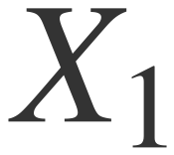
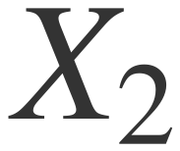
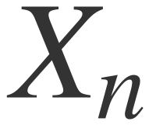


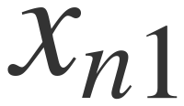


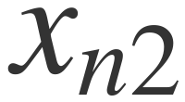





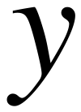

































Matrix Notation for Linear Regression and Classification (N- Samples)
17
Remember
N Training Samples
In General:
N
>>>
d
Where:
is a matrix
is labels vector

Slide 18















Calculation of Model Parameter “W”
18
$$Y$$
$$=$$
$$X$$
$$W$$
$$X$$
Where:
is a matrix
Given
$$⇒$$
$$X$$
$$-1$$
$$N×d+1$$
$$W$$
$$=$$
$$Y$$
$$Y$$
is labels vector
Given
$$⇒$$
$$N×1$$
is Model Parameter
Required
$$W$$
$$⇒$$

Slide 19











Calculation of Model Parameter “W”
19
Where:
is a matrix
Given
is labels vector
Given
is Model Parameter
Required
$$($$
$$X$$
$$)$$
$$-1$$
$$W$$
$$=$$
$$Y$$
$$N×d$$
X
is non-square matrix
There is NO Inverse

Slide 20

20
How to obtain the BEST model parameters (W)
Training Sample with Label
X
$$\hat{y}$$
y
Classification Model
(with Model
Parameters)
Error
Training
Sample
Predicted
Output
(Label)
True Label
of the Sample
Try to obtain model parameters by minimizing the Error (Loss Function)
Note:
There are three terms that are commonly used interchangeably (though there is a difference)
Loss function , Error function, and Objective function
(to be discussed later)
Cost

Slide 21





Concept of LOSS Function
21
Let Y =
Original Labels
Predicted Labels
Let Ŷ =
from Training Samples
from Model Ŷ = X W
Objective is Ŷ=Y
If Ŷ ≠ Y ⇒ There is an Error (Loss)
Remember
Define Loss function as squared distance between Ŷ and Y
$$‖a‖_{2}=a^{T}a$$
$$Loss$$
$$=‖Y-\hat{Y}‖_{2} = (Y-\hat{Y})^{T} (Y-\hat{Y})$$

Slide 22



Monotonic Functions
22
O/P
O/P
O/P
I/P
I/P
I/P
Monotonically
Increase
Monotonically
Decrease
Not
Monotonic
For Monotonically increase function: When Input increases → Output increases
For Monotonically decrease function: When Input increases → Output decreases

Slide 23





23
Some Monotonically increase Functions
6
y
5
4
$$y=\log_{2}(x)$$
$$f(x)=ln(x)$$
$$y=\frac{1}{2}x$$
3
2
2
1
-1
1
2
3
4
5
6
7
8
9
10
x
-1
11
2
4
6
8
10
12
14
-2
-3
-2
-4
-5
-6

Slide 24





24
Some Monotonically increase Functions
6
y
5
4
3
2
2
1
-1
1
2
3
4
5
6
7
8
9
10
x
-1
11
2
4
6
8
10
12
14
-2
-3
-2
-4
-5
-6
Apply monotonically increase function
on Loss function
$$Φ$$
$$L(x)$$
$$⇒$$
$$Φ$$
$$(L(x))$$
when
is minimized
$$L(x)$$
$$⇒$$
$$Φ$$
$$(L(x))$$
is minimized
Conclusion:
instead of using
Loss
function
during training ,
one can use
$$L(x)$$
$$Φ$$
$$(L(x))$$
where
$$Φ$$
is any monotonically increase function
$$\frac{1}{2}$$
We will use
instead of
during minimization
$$L(x)$$
$$L(x)$$
(to Simplify Math operations)

Slide 25








Minimization of Loss function to obtain BEST model parameters
25
$$\frac{1}{2}$$
$$(Y-\hat{Y})^{T} (Y-\hat{Y})$$
$$\frac{1}{2}$$
$$Loss$$
$$=$$
$$(Y-X W)^{T} (Y-X W)$$
Remember
X is a matrix, W is a vector,
X W is a vector
$$[ Y^{T} Y + (X W)^{T} (X W) - Y^{T} (X W) - (X W)^{T} Y ]$$
$$Y^{T} (X W) = (X W)^{T} Y$$
$$[ Y^{T} Y + (X W)^{T} (X W) - 2 (X W)^{T} Y ]$$
$$\frac{∂ Loss}{∂ W} = 0$$
Get Best W that minimizes the loss

Slide 26









Minimization of Loss function to obtain BEST model parameters
26
$$\frac{1}{2}$$
$$(Y-\hat{Y})^{T} (Y-\hat{Y})$$
$$\frac{1}{2}$$
$$Loss$$
$$=$$
$$=$$
$$(Y-X W)^{T} (Y-X W)$$
Remember
X is a matrix, W is a vector,
$$\frac{1}{2}$$
X W is a vector
$$Loss$$
$$=$$
$$[ Y^{T} Y + (X W)^{T} (X W) - Y^{T} (X W) - (X W)^{T} Y ]$$
$$Y^{T} (X W) = (X W)^{T} Y$$
$$\frac{1}{2}$$
$$Loss$$
$$=$$
$$[ Y^{T} Y + (X W)^{T} (X W) - 2 (X W)^{T} Y ]$$
$$\frac{∂ Loss}{∂ W} = 0$$
Get Best W that minimizes the loss
Remember
$$\frac{∂ Loss}{∂ W}$$
$$\frac{1}{2}$$
$$=$$
$$0$$
$$=$$
$$[ (X W)^{T} (X) + (X)^{T} (X W) - 2 (X)^{T} Y ]$$
$$X^{T} (X W) = (X W)^{T} X$$
$$\frac{∂ Loss}{∂ W}$$
$$\frac{1}{2}$$
$$=$$
$$0$$
$$=$$
$$[ 2 X^{T} X W - 2 X^{T} Y ]$$
$$(X^{T} X) W = X^{T} Y$$
$$W = (X^{T} X)^{-1} X^{T} Y$$

Slide 27

























27
Minimum Sum Squared Error (MSSE) Technique
(Least Squares)
$$(X_{N×d})^{-1}$$
$$W$$
$$=$$
$$Y$$
Pseudo Inverse of Non-Square Matrix
$$X_{N×d}$$
is non-square matrix
There is NO Inverse
$$(X_{N×d})^{-1}$$
$$(X^{T}X)$$
$$^{-1}$$
$$X^{T}$$
$$=$$
$$W$$
$$(X^{T}X)^{-1} X^{T}$$
$$Y$$
Remember
$$=$$
$$(X_{d×N}^{T} X_{N×d})$$
$$^{-1}$$
$$=$$
$$^{-1}$$
$$d$$
$$×$$
$$d$$
In General:
<<<
$$d$$
$$N$$

Slide 28




































Regression Example
28
$$x$$
$$⇒$$
$$1$$
$$2$$
$$2$$
$$1$$
Predict
$$7$$
$$T$$
$$^{-1}$$
$$X^{T}$$
$$1$$
$$X_{1}$$
$$=$$
$$X_{2}$$
$$=$$
$$X_{3}$$
$$=$$
$$X_{4}$$
$$=$$
$$X$$
$$=$$
$$W$$
$$=$$
$$X$$
$$X$$
$$Y$$
$$x$$
$$⇒$$
$$1$$
$$2$$
$$1$$
$$2$$
$$3$$
$$2$$
$$y_{1}$$
$$=$$
$$10$$
$$y_{2}$$
$$=$$
$$15$$
$$y_{3}$$
$$=$$
$$13$$
$$y_{4}$$
$$=$$
$$12$$
$$y=???$$
$$y=$$
$$W^{T}$$
$$X$$

Slide 29










































Regression Example
29
$$x$$
$$⇒$$
$$1$$
$$2$$
$$2$$
$$1$$
Predict
$$7$$
$$T$$
$$^{-1}$$
$$X^{T}$$
$$1$$
$$X_{1}$$
$$=$$
$$X_{2}$$
$$=$$
$$X_{3}$$
$$=$$
$$X_{4}$$
$$=$$
$$X$$
$$=$$
$$W$$
$$=$$
$$X$$
$$X$$
$$Y$$
$$x$$
$$⇒$$
$$1$$
$$2$$
$$1$$
$$2$$
$$3$$
$$2$$
$$y_{1}$$
$$=$$
$$10$$
$$y_{2}$$
$$=$$
$$15$$
$$y_{3}$$
$$=$$
$$13$$
$$y_{4}$$
$$=$$
$$12$$
$$y=???$$
$$y=$$
$$W^{T}$$
$$X$$
$$1$$
$$⇒$$
$$1$$
$$1$$
$$1$$
$$1$$
$$x$$
$$⇒$$
$$X_{1}$$
$$=$$
$$1$$
$$X_{2}$$
$$=$$
$$2$$
$$X_{3}$$
$$=$$
$$2$$
$$X_{4}$$
$$=$$
$$1$$
Augmented Vectors
$$1$$
Always
$$x$$
$$⇒$$
$$1$$
$$2$$
$$1$$
$$2$$
Symmetric
$$2$$
(and its inverse)
$$y_{1}$$
$$=$$
$$10$$
$$y_{2}$$
$$=$$
$$15$$
$$y_{3}$$
$$=$$
$$13$$
$$y_{4}$$
$$=$$
$$12$$
$$10$$
$$1$$
$$1$$
$$1$$
$$X^{T}$$
$$1$$
$$1$$
$$1$$
$$1$$
$$4$$
$$6$$
$$6$$
$$15$$
$$X$$
$$1$$
$$2$$
$$2$$
$$X$$
$$T$$
$$X$$
$$y$$
$$y=$$
$$=$$
$$=$$
$$1$$
$$2$$
$$2$$
$$1$$
$$=$$
$$6$$
$$10$$
$$9$$
$$13$$
$$1$$
$$2$$
$$1$$
$$1$$
$$2$$
$$1$$
$$2$$
$$6$$
$$9$$
$$10$$
$$12$$
$$1$$
$$1$$
$$2$$
$$4.75$$
$$-1.5$$
$$-1.5$$
$$5$$
$$X$$
$$T$$
$$X$$
$$^{-1}$$
$$W$$
$$X$$
$$T$$
$$X$$
$$^{-1}$$
$$X$$
$$T$$
$$Y$$
$$W$$
$$=$$
$$-1.5$$
$$1$$
$$0$$
$$=$$
$$⇒$$
$$=$$
$$3$$
$$-1.5$$
$$0$$
$$1$$
$$y$$
$$=$$
$$3$$
$$x_{1}$$
$$+$$
$$2$$
$$x_{2}$$
$$+$$
$$5$$
$$2$$

Slide 30






















































Regression Example
30
30
Linear Equation
Check y for training data
Perfect Fit

Slide 31


































Classification Example
31
$$x_{1}$$
$$⇒$$
$$1$$
$$2$$
$$2$$
$$1$$
$$X_{1}$$
$$=$$
$$X_{2}$$
$$=$$
$$X_{3}$$
$$=$$
$$X_{4}$$
$$=$$
$$y$$
$$⇒$$
$$1$$
$$2$$
$$1$$
$$2$$
$$x_{2}$$
$$y_{1}=C_{1}$$
$$y_{2}=C_{2}$$
$$y_{3}=C_{1}$$
$$y_{4}=C_{2}$$
Classify
$$7$$
$$X$$
$$=$$
$$3$$
$$y=$$
$$C_{1}$$
$$or$$
$$C_{2}$$
Required to obtain W that satisfies
-ve ( < 0 )
+ve ( > 0 )
$$x_{1}$$
$$⇒$$
$$1$$
$$1$$
$$1$$
$$x_{2}$$
$$⇒$$
$$1$$
$$2$$
$$2$$
$$1$$
$$2$$
$$1$$
$$2$$
$$1$$
$$W$$
$$=$$
$$x_{2}$$
$$x_{3}$$
$$⇒$$
$$1$$
$$1$$
$$1$$
$$2$$
$$2$$
$$x_{4}$$
$$⇒$$
How to deal “Mathematically” with “<” and “>” ???
$$x_{1}$$

Slide 32
Classification Example
32
$$x_{1}$$
$$⇒$$
$$1$$
$$2$$
$$2$$
$$1$$
$$X_{1}$$
$$=$$
$$X_{2}$$
$$=$$
$$X_{3}$$
$$=$$
$$X_{4}$$
$$=$$
$$y$$
$$⇒$$
$$1$$
$$2$$
$$1$$
$$2$$
$$x_{2}$$
$$y_{1}=C_{1}$$
$$y_{2}=C_{2}$$
$$y_{3}=C_{1}$$
$$y_{4}=C_{2}$$
Classify
$$7$$
$$X$$
$$=$$
$$3$$
$$y=$$
$$C_{1}$$
$$or$$
$$C_{2}$$
Required to obtain W that satisfies
-ve ( < 0 )
+ve ( > 0 )
$$x_{1}$$
$$⇒$$
$$1$$
$$1$$
$$1$$
$$x_{2}$$
$$⇒$$
$$1$$
$$2$$
$$2$$
$$1$$
$$2$$
$$1$$
$$2$$
$$1$$
$$W$$
$$=$$
$$x_{2}$$
$$x_{3}$$
$$⇒$$
$$1$$
$$1$$
$$1$$
$$2$$
$$2$$
$$x_{4}$$
$$⇒$$
How to deal “Mathematically” with “<” and “>” ???
$$x_{1}$$

Slide 33













Classification Example
33
Rearrange vecotrs (group vectors in same class)
Substitute > 0 with 1 (may use any small positive value)
Multiply vectors belong to -ve class with -1
The equation is in the form:

Slide 34














Classification Example
34
Check Classes of training data
Perfect Classification

Slide 35































35
Check Class of Test Vector
Class C2
-ve ( < 0 )
+ve ( > 0 )
Class C1
?

Slide 36
36
Assignment #2: Part 1 - Prediction
[1] Define any linear equation of one variable (e.g. y = 3x+2)
[2] Select 5 different values for x (x1, x2,… x10) and calculate corresponding y values
[3] Use x and y values as training data , apply MSSE technique to obtain the equation of the line
that best fit on the training data (compare to your defined equation)
[4] Repeat 1,2, and 3 after adding random noise term to the equation (e.g. y = 3x+2 + random(0..1)
y
y
x
x

Slide 37
37
Assignment #2: Part 2 - Classification
[1] Use IRIS dataset, group samples of class 2 and class 3 together to form new class (Class II)
[2] Split Class I samples into 40 samples for train and 10 samples for test
[3] Split Class II samples into 80 samples for train and 20 samples for test
[4] Train your linear classifier model using Least Squares Technique (MSSE). Let your model
output be Positive for Class I and Negative for Others. This model is suitable to classify the input
sample as Class I or “Other classes”
[5] Use your trained model to classify test samples (into either Class I or Class II)
[6] Optional: train two other models to classify IRIS class 2 and IRIS class 3. This approach is
called “One vs All”

Slide 38

38
Setosa
Versicolor
Virginica

Slide 39

39
One vs All (for Multi Class Classification)
Classification Model
(of Class “1”)
+ve if Class “1”
-ve for other classes
Training
Sample
Classification Model
(of Class “2”)
+ve if Class “1”
-ve for other classes
Decision
Classification Model
(of Class “3”)
+ve if Class “1”
-ve for other classes
Decision Rules
Number of Positive output (Only One)
→
Input is properly Classified
Number of Positive output (More than One)
→
can NOT define the class
NO Positive output
→
Not one of the classes (new class)

