Slide 1

1
Deep Learning
DSAI 308
Prepared By
Dr. Khaled Mostafa ElSayed
kmelsayed@zewailcity.edu.eg
Instructors:
Dr. Khaled Mostafa ElSayed
kmelsayed@zewailcity.edu.eg
Dr. Mohamed Maher Ata
momaher@zewailcity.edu.eg

Slide 2
2
Agenda
Quick revision of Machine Learning
Deep Learning vs Machine Learning
Quick revision of Neural Network
Introduction to Convolutional Neural Network

Slide 3
3
[1] Revision of
Machine Learning

Slide 4
4
Artificial Intelligence
Rule Based
Data Based
(Expert Systems)
(Machine Learning)

Slide 5
5
What is Machine Learning?
Machine Learning:
Designing algorithms that can learn patterns from data (and
exploit them)
Approach: human supplies training examples, the machine
learns
Example: Show the machine a bunch of spam and legitimate
emails and let it learn to predict if a new email is spam or not

Slide 6
6
Machine Learning in the real-world
Broadly applicable in many domains (e.g., finance, robotics,
bioinformatics, vision, natural language, etc.). Some applications:
Spam filtering
Machine Translation (e.g., Google Translate)
Speech/handwriting recognition
Object detection/recognition
Weather prediction
Classifying DNA sequences
Stock market analysis
Automatic vehicle navigation
Search engines (e.g., Google)
Credit-card fraud detection
Webpage clustering (e.g., Google News)
.. and many more

Slide 7
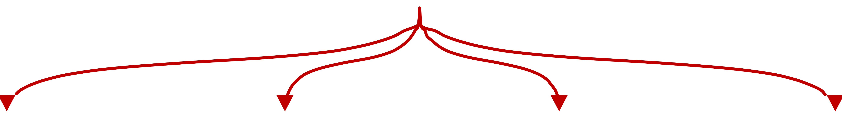
7
Major Domains
of
Machine/Deep Learning
Time Series
Computer
Vision
Speech
Natural
Language
Processing

Slide 8
Programming Languages, Platforms,
and Libraries
8
Popular Languages for ML/DL
Python
R
Matlab
Popular Platforms for ML/DL
Tensor Flow
Pytorch
Popular Libraries (for python)
SciKit Learn
SciPy
NLTK
Spacy
Gensim
OpenCV

Slide 9


The Complete ML Classification Process
9
Training
Data
Pre
processing
Feature
Extraction
Feature
Selection
Classification
Post
processing
Cleaned
Data
Feature
Vectors
Final
Features
Predicted
Class
Final
Result

Slide 10
10
Pre processing
Preprocessing is Problem dependent and data dependent
It may include:
Gap filling
Thinning
Contour
Binarization
Noise Removal
Color to Gray
Opening touched points
Resizing
Normalization
.......

Slide 11
11
Feature Extraction
Features Types are is Problem dependent
Features may include:
Center of Gravity location,
Aspect Ratio,
Length and Width,
Number of intersections,
Moments,
Geometrical Features ,
Colors,
Transformations
………

Slide 12
12
Feature Invariants
Features Invariants are is Problem dependent
Rotation Invariant
Scaling Invariant
Translation invariant
Mirroring Invariant

Slide 13
13
Classification
Examples of Commonly used classifiers:
Linear Regression
Logistic Regression
Neural Network
Support Vector Machine
Hidden Markov Model
Decision Trees

Slide 14
14
How Training Takes Place to learn the model ?
Classification
Model
(with Model Parameters)
Training Sample
Predicted
Class
(Label)
True Label
of the
Sample
Error
Try to update model parameters (Iteratively) to minimize error (Loss Function)

Slide 15
15
[2] Machine Learning
vs
Deep Learning

Slide 16

The Complete ML Classification Process
16
Training
Data
Pre
processing
Feature
Extraction
Feature
Selection
Classification
Classifier
Output
Based on your inspection
You select the techniques
Your decision
And using which
approach
Apply
Model
Handcrafted features
(by You)

Slide 17
The Complete ML Classification Process
17
Training
Data
Pre
processing
Feature
Extraction
Feature
Selection
Classification
Classifier
Output
Apply Model
Based on
Trained Model!
Based on your inspection
You select the techniques
Your decision
And using which
approach
Based on
Human Experience
Handcrafted features
(by You)

Slide 18
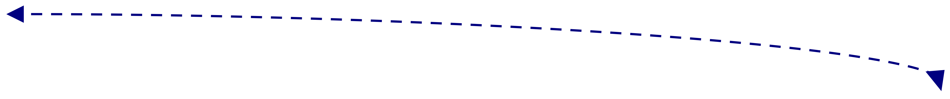

The Complete Deep Learning Model
18
Training
Data
End-To-End model
Pre
processing
Feature
Extraction
Feature
Selection
Classification
Classifier Output
Deeeeeeep Model
Based on Training Data
(Model Choice)
Model choose Best
feature for given
training data
Model Reduces
the features
(if required)
Based on
Trained Model
Classify using
Trained Model
No Interaction from Human
It is Based on Training Data

Slide 19
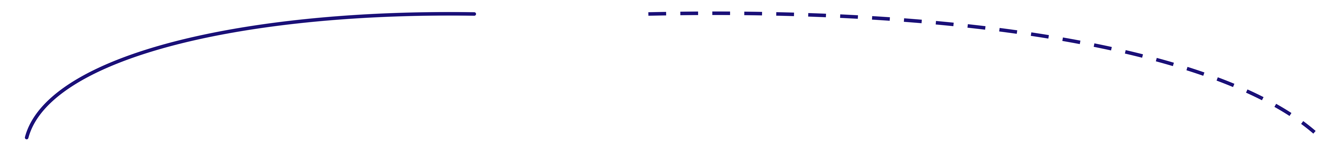
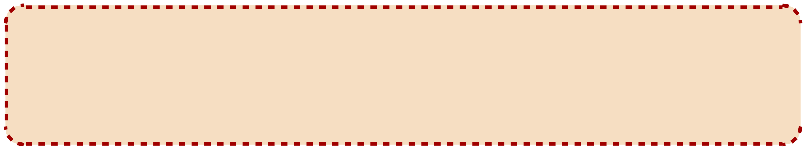
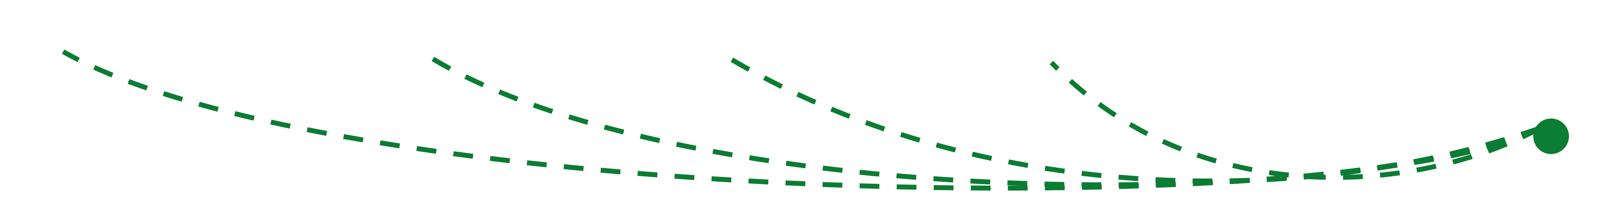
The Complete Deep Learning Model
19
Training
Data
Input
Samples
Pre
processing
Feature
Extraction
Feature
Selection
Classification
Predicted
Labels
Prediction Error
Samples
Labels
(Loss Function)
Update Model Parameters in order to MINIMIZE error
(difference between model prediction and Actual labels

Slide 20
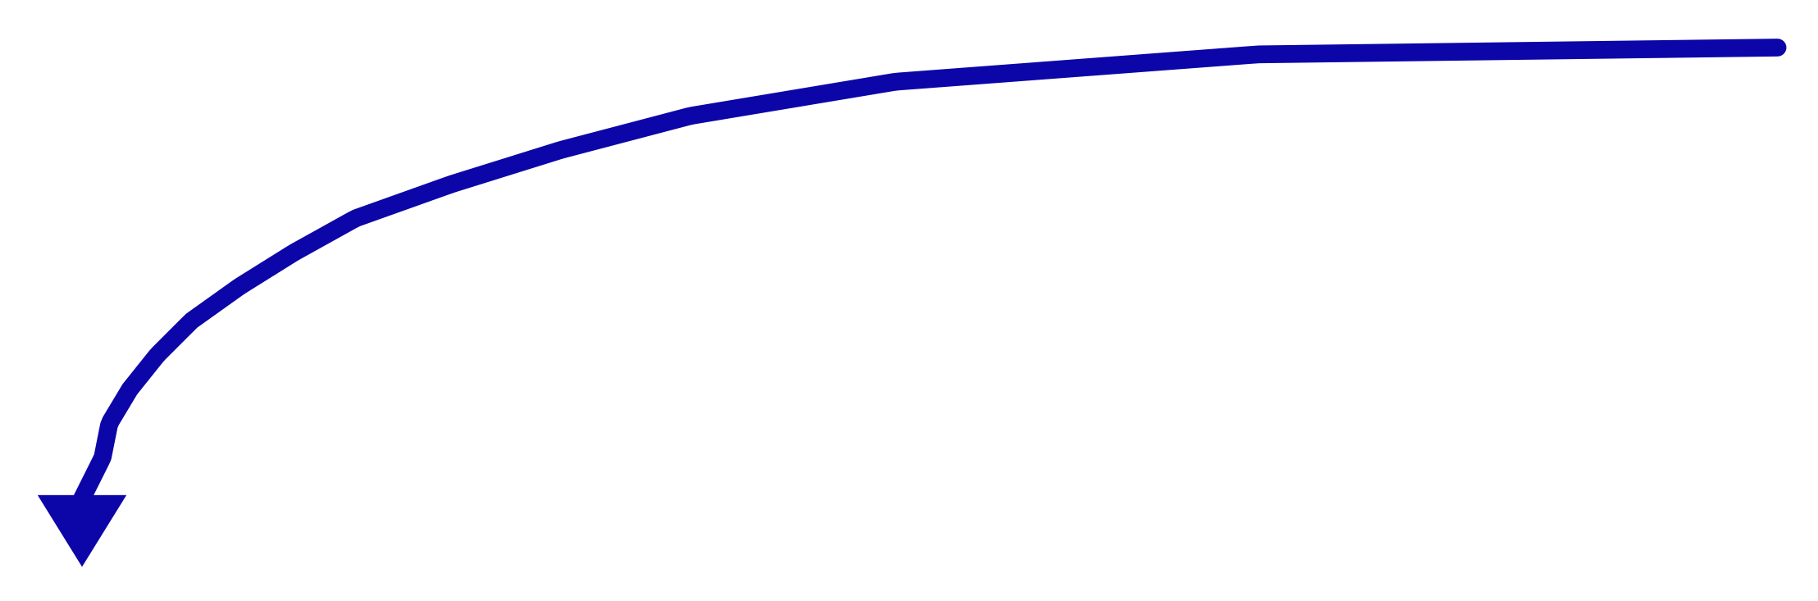
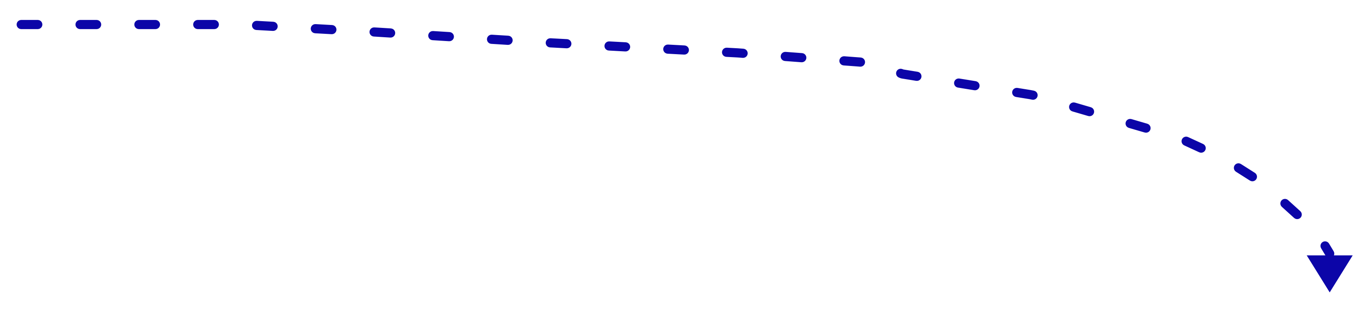
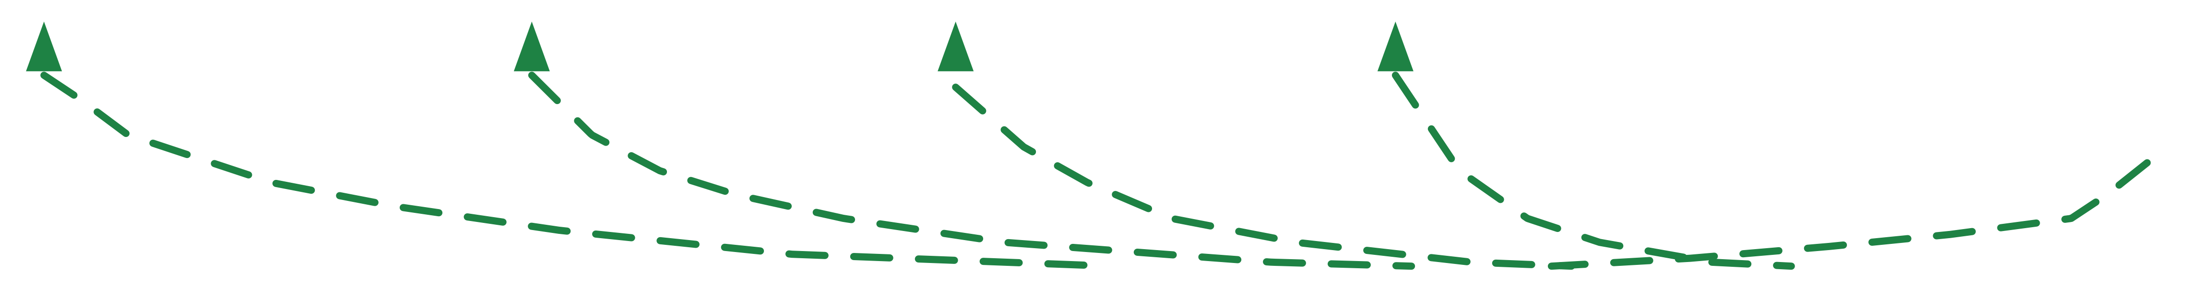
The Complete Deep Learning Model
20
Training
Data
Prediction Error
(Loss Function)
Input
Samples
Pre
processing
Feature
Extraction
Feature
Selection
Classification
Predicted
Labels
Samples
Labels
Update Model Parameters in order to MINIMIZE error
(difference between model prediction and Actual labels
The BIG
challenge

Slide 21
21
[3] Quick revision of
Neural Netwok (NN)

Slide 22





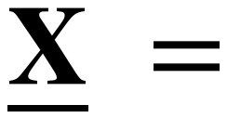








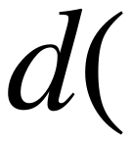






















Visualization of Single Perceptron
22
Ugmented Vector
Model Weights
O/P
Binary Classification
(2 Classes)

Slide 23
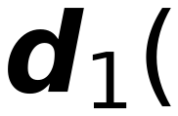


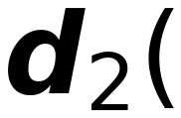
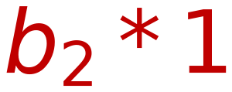
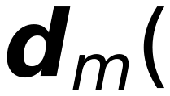

Visualization of Single Layer Perceptron
23
Σ
>0 Class I
<0 Not Class
I
w₁₁
x₁
w₁₂
x₂
w₁₃
w₂₁
w₂₂
Σ
>0 Class II
<0 Not Class
II
x₃
w₂₃
...
w_{1n}
w_{2n}
Multi-Class
b₂
...
Classification
x_{n}
b₁
w_{m1}
w_{m2}
1
w_{m3}
w_{mn}
b_{m}
Σ
>0 Class m
<0 Not Class
m

Slide 24

Neural Network Model
24
Input
Samples
Sample
Label
Net_{i}
Net_{j}
Net_{k}
O_{i}
w_{ji}
O_{j}
w_{kj}
O_{k}
Σ
Σ
Σ
Σ
Σ
Output 1
Error
Class 1
w_{ji}
w_{kj}
O_{i}
w_{ji}
O_{j}
w_{kj}
O_{k}
Σ
Σ
Σ
Σ
Σ
Output 2
Error
Class 2
O_{i}
O_{j}
O_{k}
Σ
Σ
Σ
Σ
Σ
Output m
Error
Class m
i
j
k
Previous Layer
Layer (i)
Current Layer
(You are here)
Next Layer
Layer (K)

Slide 25
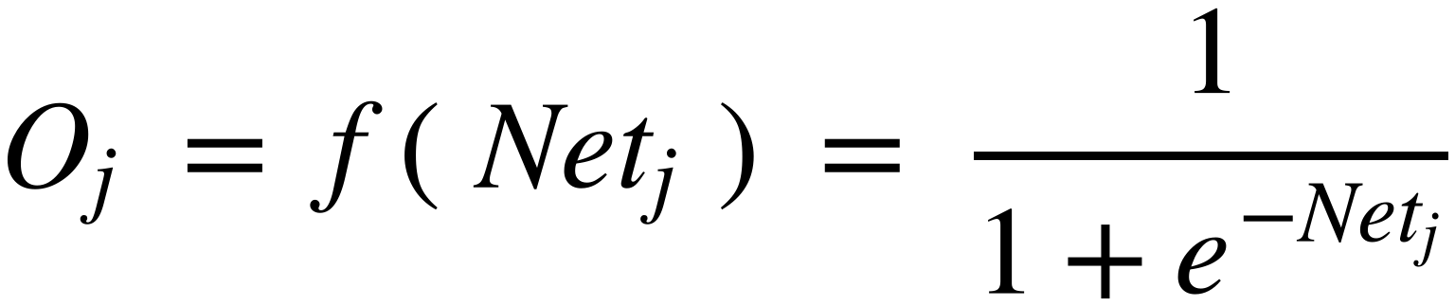
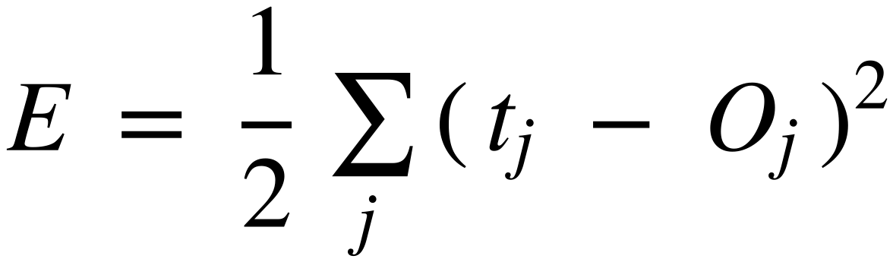
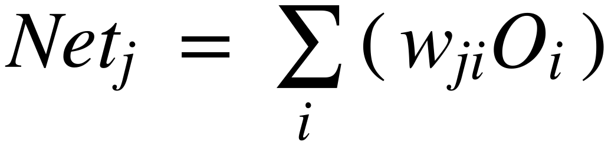
Neural Network Model
25
Input
Samples
Sample
Label
Net_{i}
Net_{j}
O_{i}
w_{ji}
O_{j}
Σ
Σ
Σ
Output 1
Error
Class 1
w_{ji}
O_{i}
w_{ji}
O_{j}
Σ
Σ
Σ
Output 2
Error
Class 2
O_{i}
O_{j}
Σ
Σ
Σ
Output m
Error
Class m
i
j
Previous Layer
Layer (i)
Current Layer
(You are here)

Slide 26
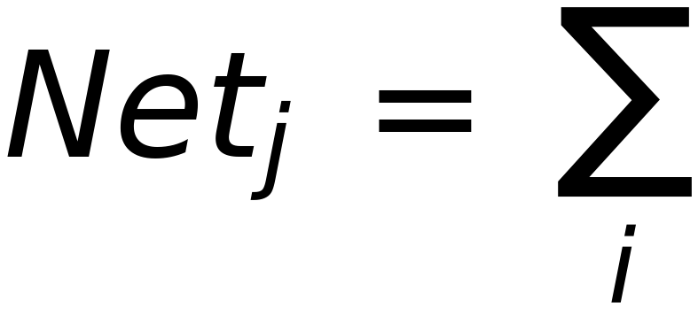
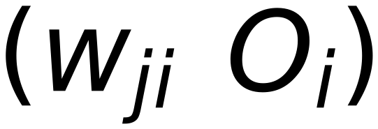
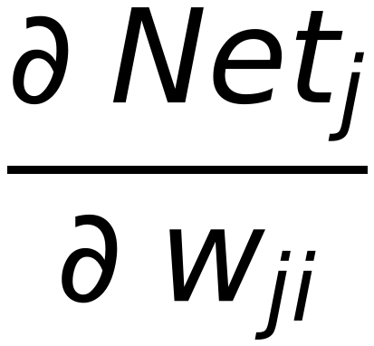

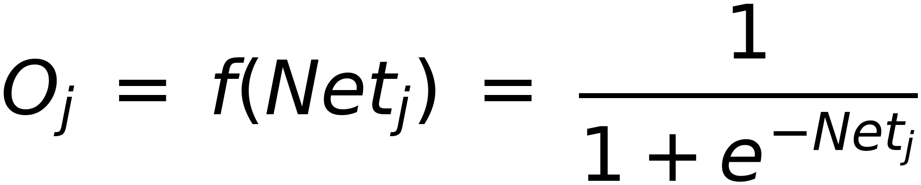


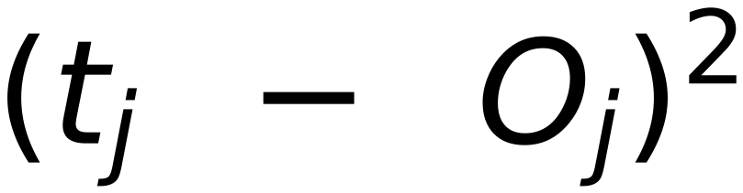


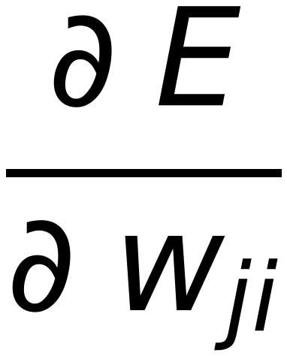
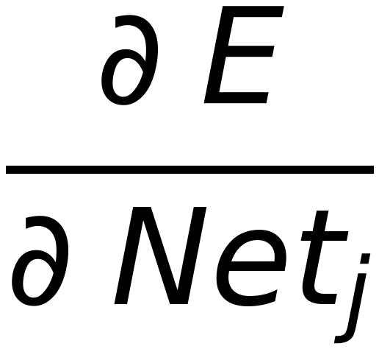
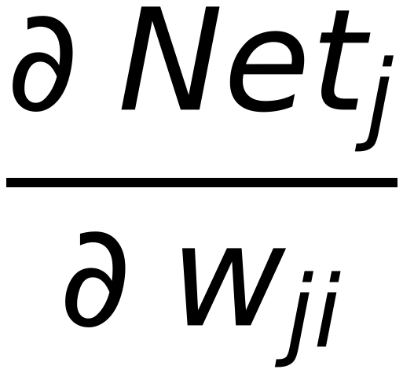
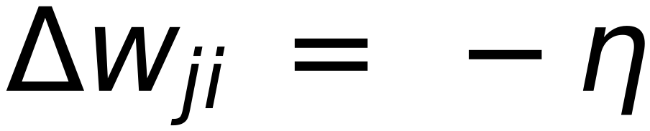














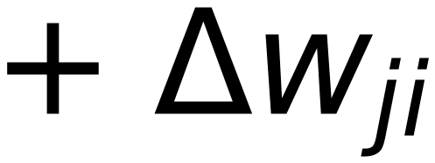
Update the weights by moving in the negative direction of the
26
Gradient of the Loss function with respect to model weights
(For Sigmoid Function)
(Error at Output layer ONLY)
Let
then

Slide 27
27
[4] Introduction to
Deep Learning
and
CNN

Slide 28
28
Introduction to
Convolutional Neural Network
(CNN)
Some of Slides are picked from
UVA Deep Learning Course EFSTRATIOS GAVVES

Slide 29
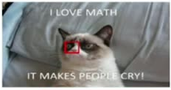
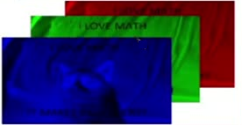

29
Spatial Structure of Image
Images are 2-D
k-D if you also count the extra channels
RGB, hyperspectral, etc.
What does a 2-D input really mean?
Neighboring variables are locally correlated

Slide 30
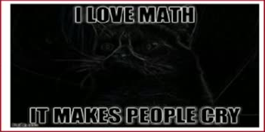
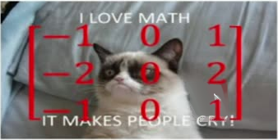
30
Apply filter on 2-D gray image (K=1 Channel)
e.g. Sobel 2-D filter

Slide 31

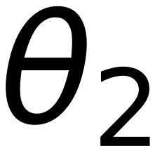
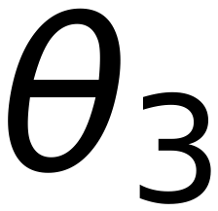
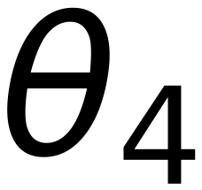

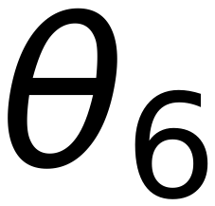
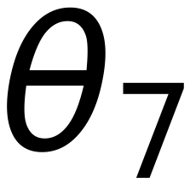
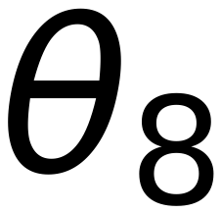
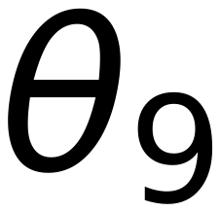
31
Where to Get Filters for Recognition
There are Several, handcrafted filters in computer vision
For example:
Canny, Sobel, Gaussian blur, smoothing, low- level segmentation,
morphological filters, Gabor filters,...
Are they optimal for recognition?
Can we learn them from our data?
Filter Parameters

Slide 32

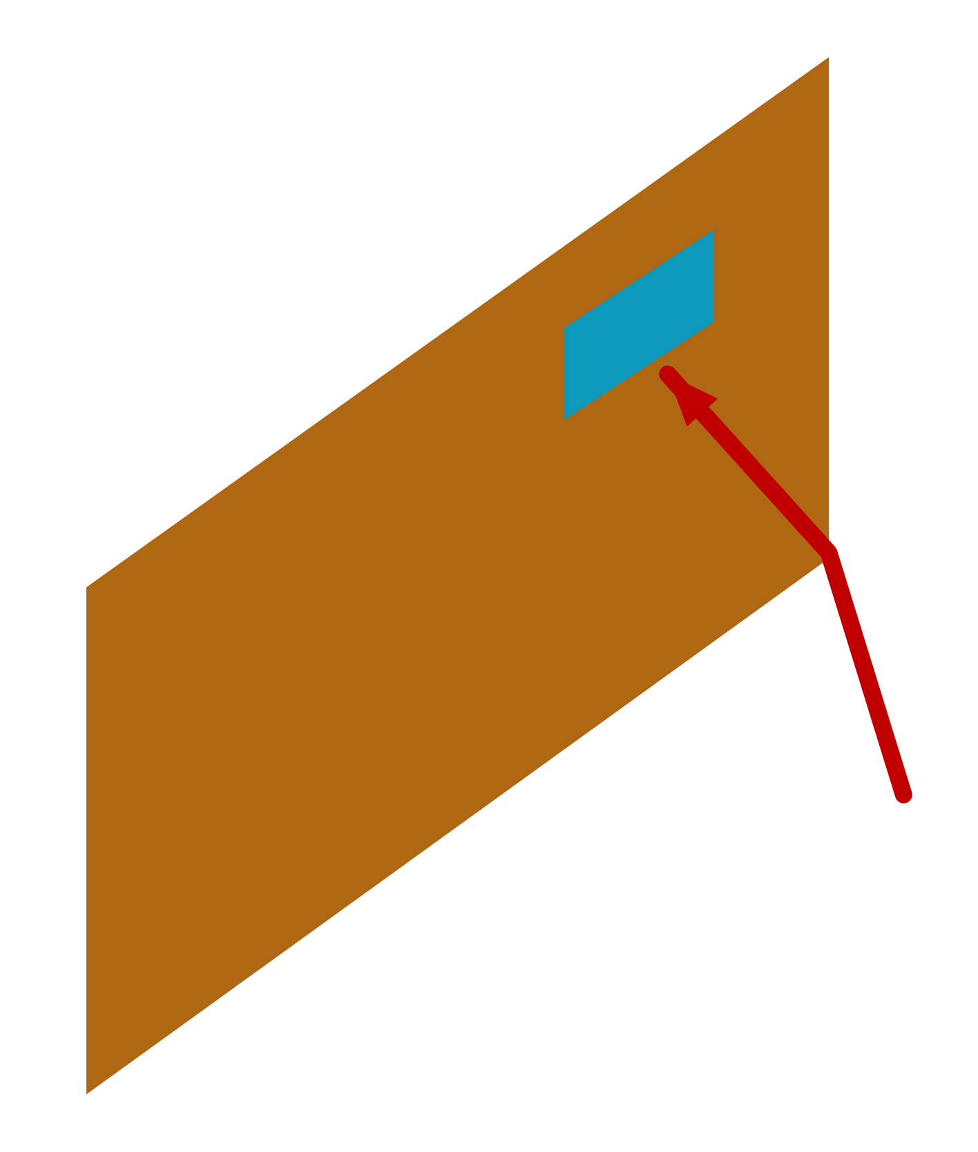

32
Where to Get Filters for Recognition
If images are 2-D,
parameters should also be organized in 2-D
That way they can learn the local
2-D Image
correlations between input variables
That way they can “exploit” the spatial
nature of images

Slide 33
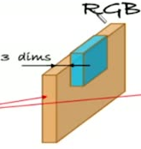

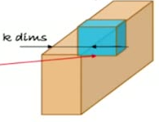

33
Where to Get Filters for Recognition
Similarly, if images are k-D, parameters should also be k-D
For K=3 (RGB), use K-D filter (third dim >> K=3)
For K=9 (Satellite images) use 9-D filter (3
dim = 9)
...etc

Slide 34
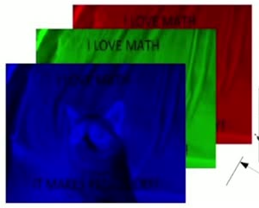
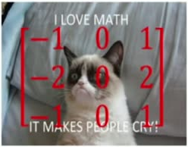
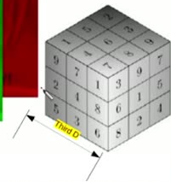
34
What would a k-D filter looks like?
e.g. Sobel 2-D filter
3-D Filter

Slide 35
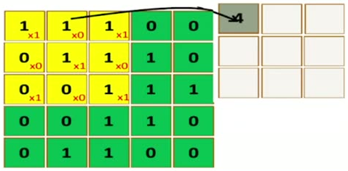
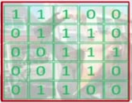
How to Apply Filter on image
35
Image
Filter
1 | 0 | 1
0 | 1 | 0
1 | 0 | 1
Apply Filter on Image is a Dot product between image values and filter values
(can be modeled by PERCEPTRON )

Slide 36

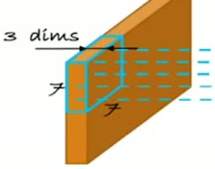
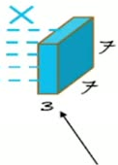

36
How many Parameters are in the RGB
Image filter ( K=3 )
How many weights for this neuron?

Slide 37
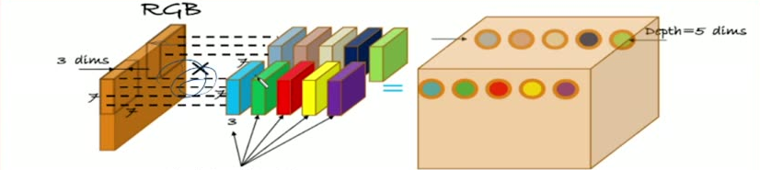
37
How many filter can we apply on the image
We can Apply multiple filters on the same location (e.g. 5 different filters on
the same location. For Example:
[ one to detect edges, one to detect lines, one to detect curves, ...etc)
How many weights for these 5 neurons?

Slide 38


Filters parameters
38
Number of parameters for different filters applied to same location in the image
= Filter size (2-D) * Number of channels (K) * number of different filters
= 7*7 * 3 * 5 =735
RGB
3 dims
X
7
7
7
7
7
3
735 weights

Slide 39
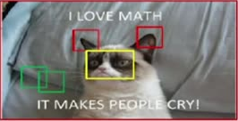

How many filters we should apply
39
Hypothesis
Natural images are stationary
Visual features are common for different parts of one or multiple image
Conclusion
It is not required to use different filters for different spatial locations in the image
(in other words, apply same filter for ALL positions in the image)
Apply Red filter to detect ears in the whole image (not necessarily in the middle of the image)
Apply Yellow filter to detect nose in the whole image
Apply Green filter to detect edges in the whole image

Slide 40



40
How many filters we should apply
Example: 30 different filters
Each filter can detect different information from the image
Apply those 30 filters on the image (each one should be
applied on the whole locations on the image)

Slide 41





41
The Convolution Process
Original image
Convolutional filter 1
1 | 0 | 1
0 | 1 | 0
1 | 0 | 1
a=1,
b=1
$$I(x,y)∗h=\sum_{i=-a}^{a}{ \sum_{j=-b}^{b}{I(x-i, y-j)⋅h(i,j)}}$$
Image: I (x,y)
Filter: h (-a:a , -b:b) (odd dimension)
Scan the original image using the 3x3 filter
Move the filter ONE pixel (Right, Left, Up, Down) and Re-Calculate

Slide 42

























42
Output dimensions of Convolution?
h
hight
w
Width
d
Depth
f
Filter
n
Filters Count
S
Stride

Slide 43
Problem: Image will vanish if applying more filters in cascade
43
Our images get smaller and smaller
Not too deep architectures
Details are lost
Image
After conv 1
After conv 2
1
1
1
0
0
x1
x0
x1
0
1
1
1
0
4
3
4
x0
x1
x0
0
0
1
1
1
2
4
3
18
x1
x0
x1
0
0
1
1
0
2
3
4
0
1
1
0
0
Original 5x5
After apply one filter of size 3x3, output will be3x3
After applying second filter on the output (cascaded filters)
Output will be 1x1

Slide 44




44
Solution? Zero-padding! , Others !!
For
surround
the
image
with
and
layers
of
0
0
0
0
0
0
0
0
0
1
1
1
0
0
0
1
1
2
0
0
0
0
1
1
1
0
0
0
1
1
1
0
0
0
1
0
0
0
1
1
1
0
0
1
1
0
0
1
2
1
0
0
0
1
1
0
0
1
1
1
1
0
2
1
0
0
0
1
1
0
0
0
0
1
1
3
0
0
0
0
0
0
0
0
Original 5x5
After padding ONE pixel (surrounding the image) it will be 7x7
After apply one filter of size 3x3 , output will be 5x5 again
Do the same for next applied filter

Slide 45




























Apply Convolution as a NEW MODULE
45
Important
Important
Important
Important
Important
Important
Important
Important
Important
Important
Important
Important
Important
Important
Important
Important
Important
Since Convolution is a DOT product (between filter values and corresponding image values),
It can be applied as if it is a NN Layer
Input: image values, Weights : filter values, Activation: Linear, Bias:0
Remember: for training, it is required to have the gradient of Output w.r.t both Input and
weights
Activation function
θ_{ij}
⇒ Filter weights
Weights: filter values
r, c
⇒ row, column
Essentially a dot product, similar to linear layer
a_{rc}
⇒ Activation value = Σ
θ
⇒ Vevtor of all weights
Gradient w.r.t. the parameters
Input: pixel values

Slide 46


46
POOLING
Aggregate multiple values into a single value
Invariance to small transformations
Reduces the size of the layer output/input to next layer → Faster computations
Keeps most important information for the next layer
Max pooling
Average pooling
a
b
Pool
z
(
)
==
c
d
Size is reduced

Slide 47



47
AVERAGE POOLING Layer (Take Average Value)
It is a new Module (Average-POOLING module)
Output = 1/r c * Summation (each_input_pixel * 1)
Required to define its input, its output, and Gradient of Output w.r.t input
Run a sliding window of size [h_{f} , w_{f} ]
At each location keep the average value
Activation function:
Gradient w.r.t. input
Where:
r
Row
1
4
1
6
c
Column
2
3
0
9
5
8
f
filter
⇒
h
Height
1
2
7
1
4
5
w
width
4
1
0
2

Slide 48



Standard Neural Network (NN) vs Convolutional
48
Neural Network (ConvNet/CNN)
Neural Network
Flatten
(1-D)
FC
FC
FC
FC
O/P
Layer 1
Layer 2
Layer 3
Layer 4
Layer 5
Loss
Convolutional Neural Network
FC
O/P
Layer 5
Layer 6
Loss
Deep Learning (too Many Layers)

Slide 49
49
Convnets in practice
Several convolutional layers ( 5 or more)
After the convolutional layers non-linearities are added (The most
popular one is the ReLU)
After the ReLU usually some pooling ( Most often max pooling)
After 5 rounds of cascading:
Vectorize the last convolutional layer (Flatten)
Use as Input to the first fully connected layer (FC)
Proceed as in a traditional classification neural network

