Slide 1

1
Deep Learning
DSAI 308
+
Prepared By
Dr. Khaled Mostafa ElSayed
kmelsayed@zewailcity.edu.eg
Instructors:
Dr. Khaled Mostafa ElSayed
kmelsayed@zewailcity.edu.eg
Dr. Mohamed Maher Ata
momaher@zewailcity.edu.eg

Slide 2
2
Transformers
Part I
Aug. 2020

Slide 3
Transformers – Part I
3
Processing Sequential Data
Transformer Building Blocks
Self Attention Mechanism
Multi-Head Attention

Slide 4
4
Processing Sequential Data
1-D Convolutional Neural Network (1-D CNN)
Recurrent Neural Network (RNN)

Slide 5
1-D Convolutional Neural Network
5
Can be Computed In Parallel
Convolutional
Kernel
Words
Vectors
1st Feature
Map
2nd Feature
Map
3rd Feature
Map
4th Feature
Map
Non Linearity
Non Linearity
Non Linearity
Non Linearity
Sequence Length
*** Not Practical for Very Long Sequences***
As Word Sequence Length Increases, we need to stack many convolution Layers.

Slide 6
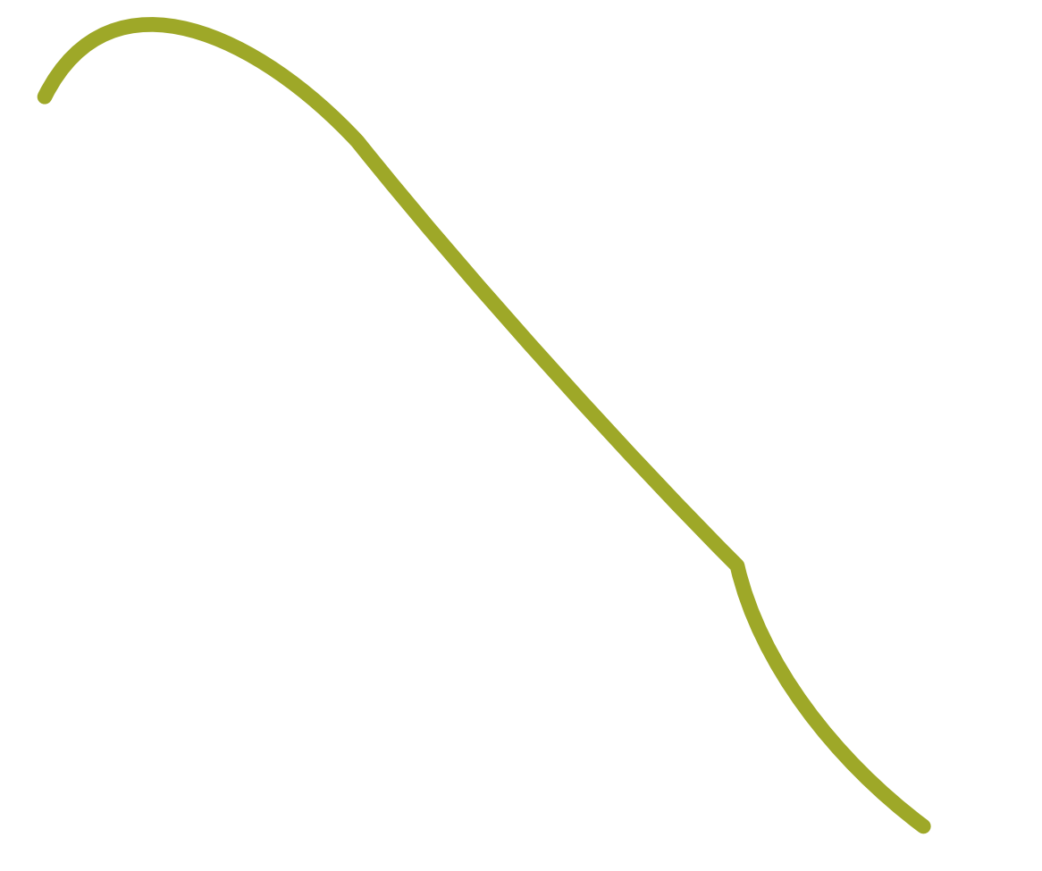

Traditional RNN Seq2Seq model
6
Decoder (RNN)
o₁
o₂
o₃
softmax
softmax
softmax
s₁
s₂
s₃
h₁
h₂
embedding x₁
embedding x₂
embedding x₃
Context Vector (of Whole Inputs)
x₁
x₂
x₃
Encoder (RNN)

Slide 7
Traditional RNN Seq2Seq model
7
(Challenges)
Decoder (RNN)
o₁
o₂
o₃
[1] Bottleneck
The meaning of the entire input sequence is
Expected to be captured by a single context vector
with fixed dimensionality
softmax
softmax
softmax
s₁
s₂
s₃
h₁
h₂
embedding x₁
embedding x₂
embedding x₃
Context Vector (of Whole Inputs)
x₁
x₂
x₃
Encoder (RNN)

Slide 8
Traditional RNN Seq2Seq model
8
(Challenges)
Decoder (RNN)
o₁
o₂
o₃
[2] Sequential Processing
softmax
softmax
softmax
Can NOT do processing in Parallel
Wait
Till Processing X₁
Wait
Till Processing X₂
s₁
s₂
s₃
h₁
h₂
embedding x₁
embedding x₂
embedding x₃
Context Vector (of Whole Inputs)
x₁
x₂
x₃
Encoder (RNN)

Slide 9
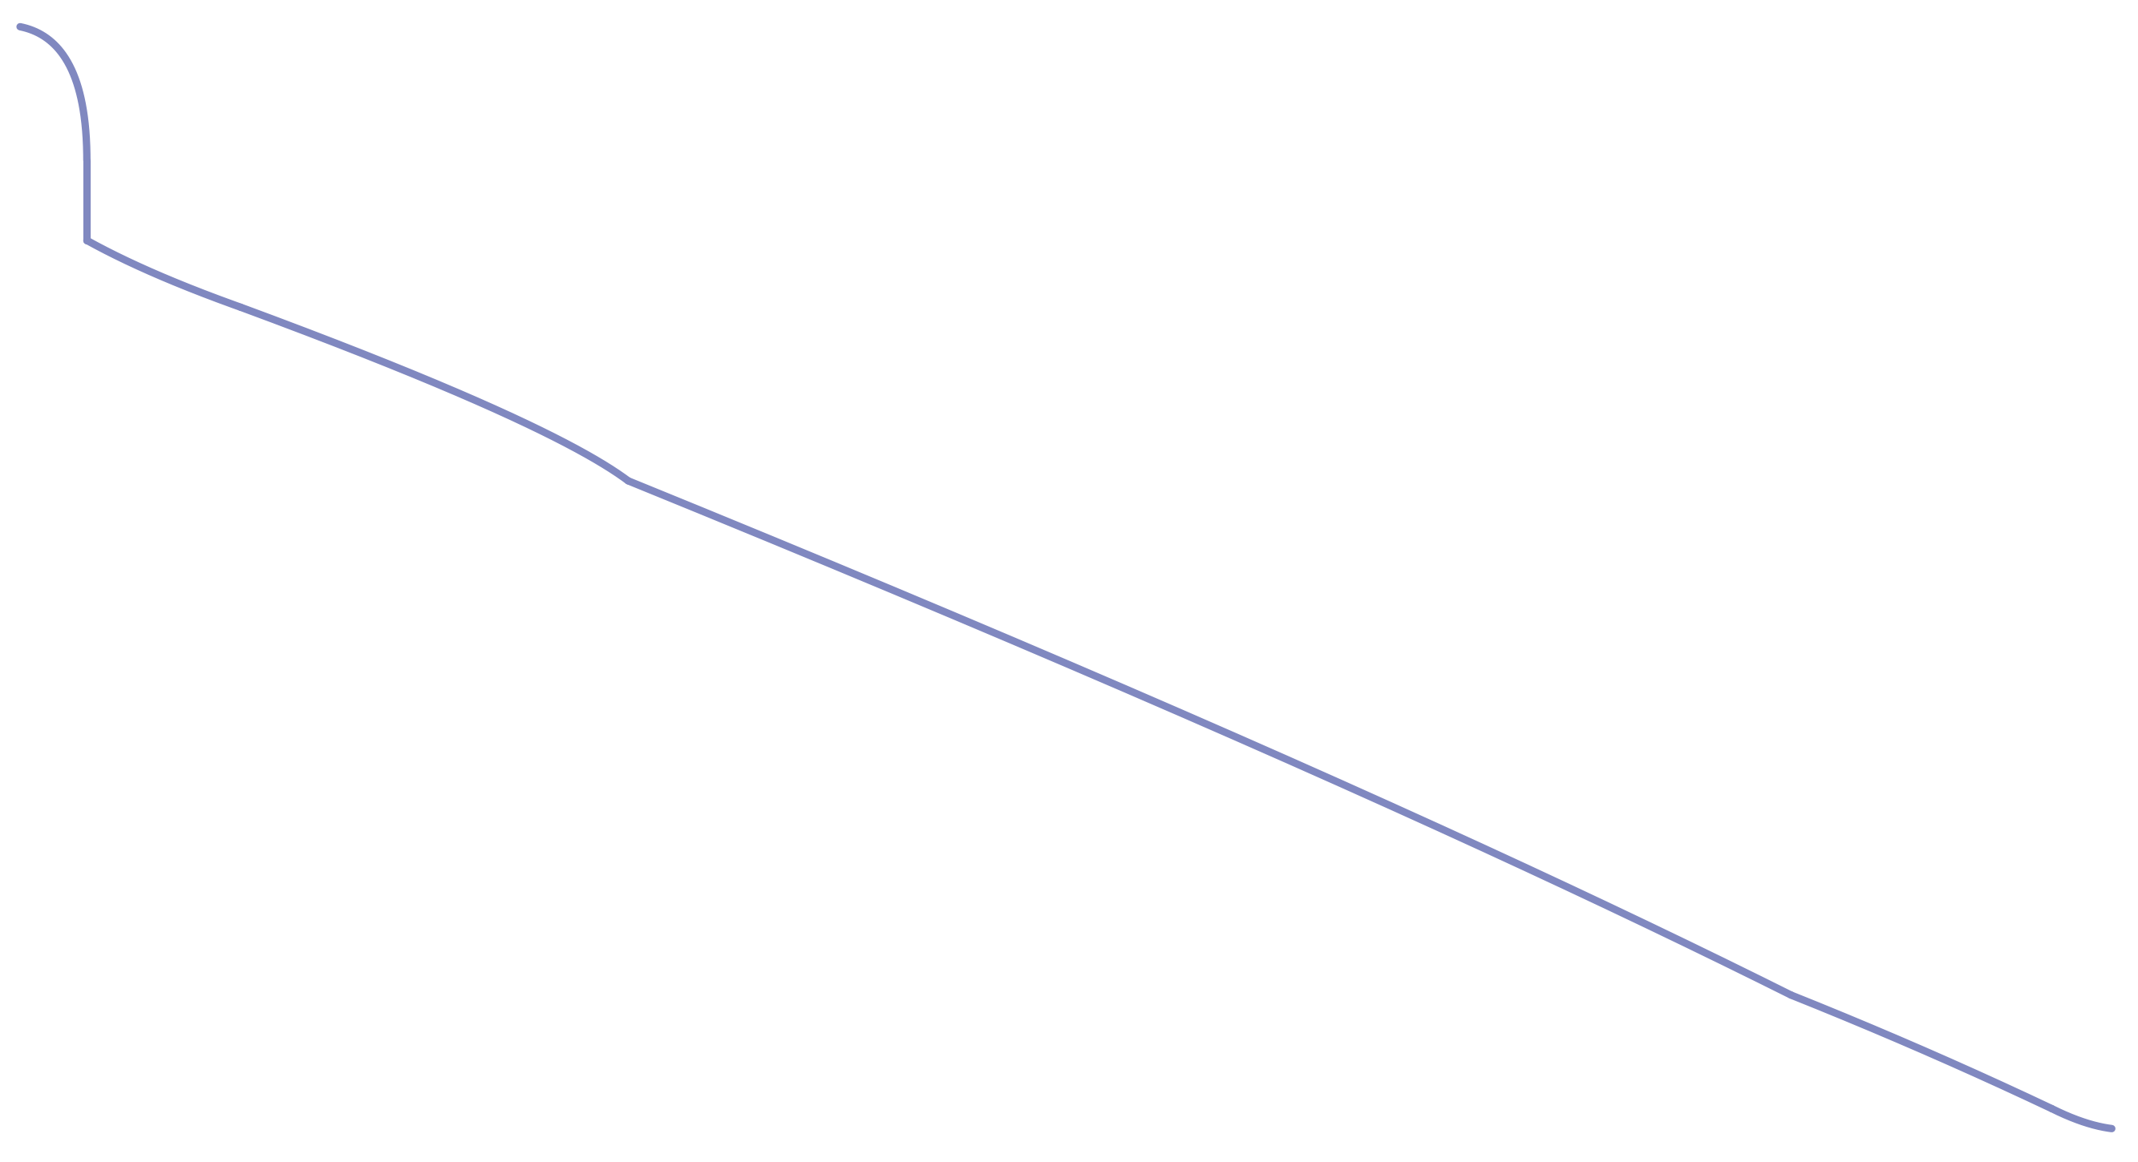
Traditional RNN Seq2Seq model
9
(Challenges)
Decoder (RNN)
[3] Very Long Sequence
Vanishing Gradient
o₁
o₂
o₃
softmax
softmax
softmax
Short Sequence: RNN
Long Sequence: LSTM, GRU
Very Long Sequence: FAIL
s₁
s₂
s₃
h₁
h₂
Back Propagation
embedding x₁
embedding x₂
embedding x₃
x₁
x₂
x₃
x₀
x₁
x₂
x₃
x₄
x₅
x₆
x₇
x₈
x₉
x₁₀
Encoder (RNN)

Slide 10
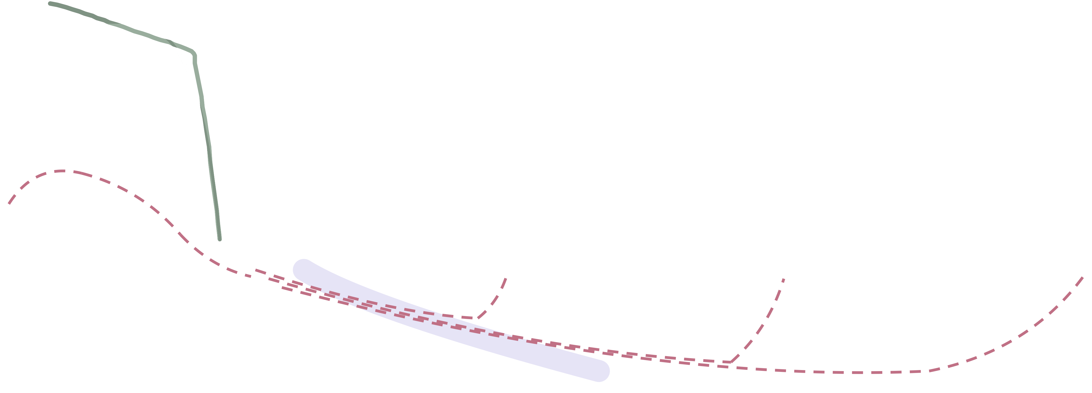
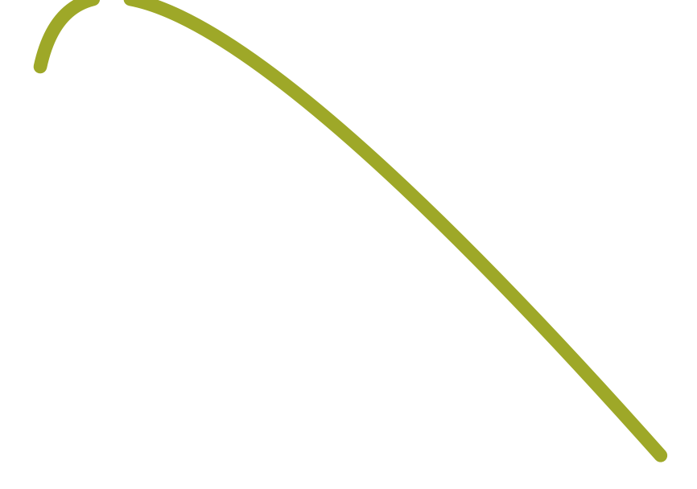
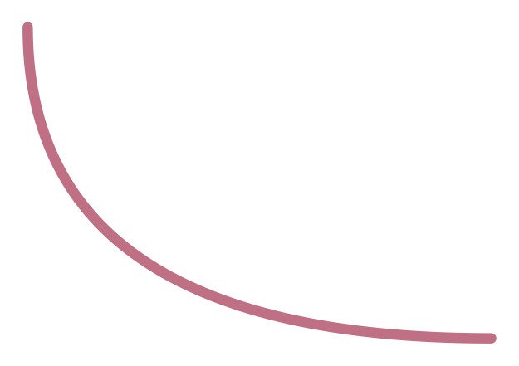
RNN Seq2Seq model [with Attention]
10
[ To overcome Bottleneck challenge]
Decoder
o₁
o₂
o₃
weighted sum of the hidden states
softmax
softmax
softmax
Attention
attention
s₁
s₂
s₃
h₁
h₂
Attention
embedding x₁
embedding x₂
embedding x₃
Context Vector (of Whole Inputs)
Decoder Utilizes:
Context Vector
x₁
x₂
x₃
Weighted sum of hidden states
Encoder

Slide 11


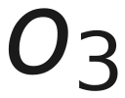
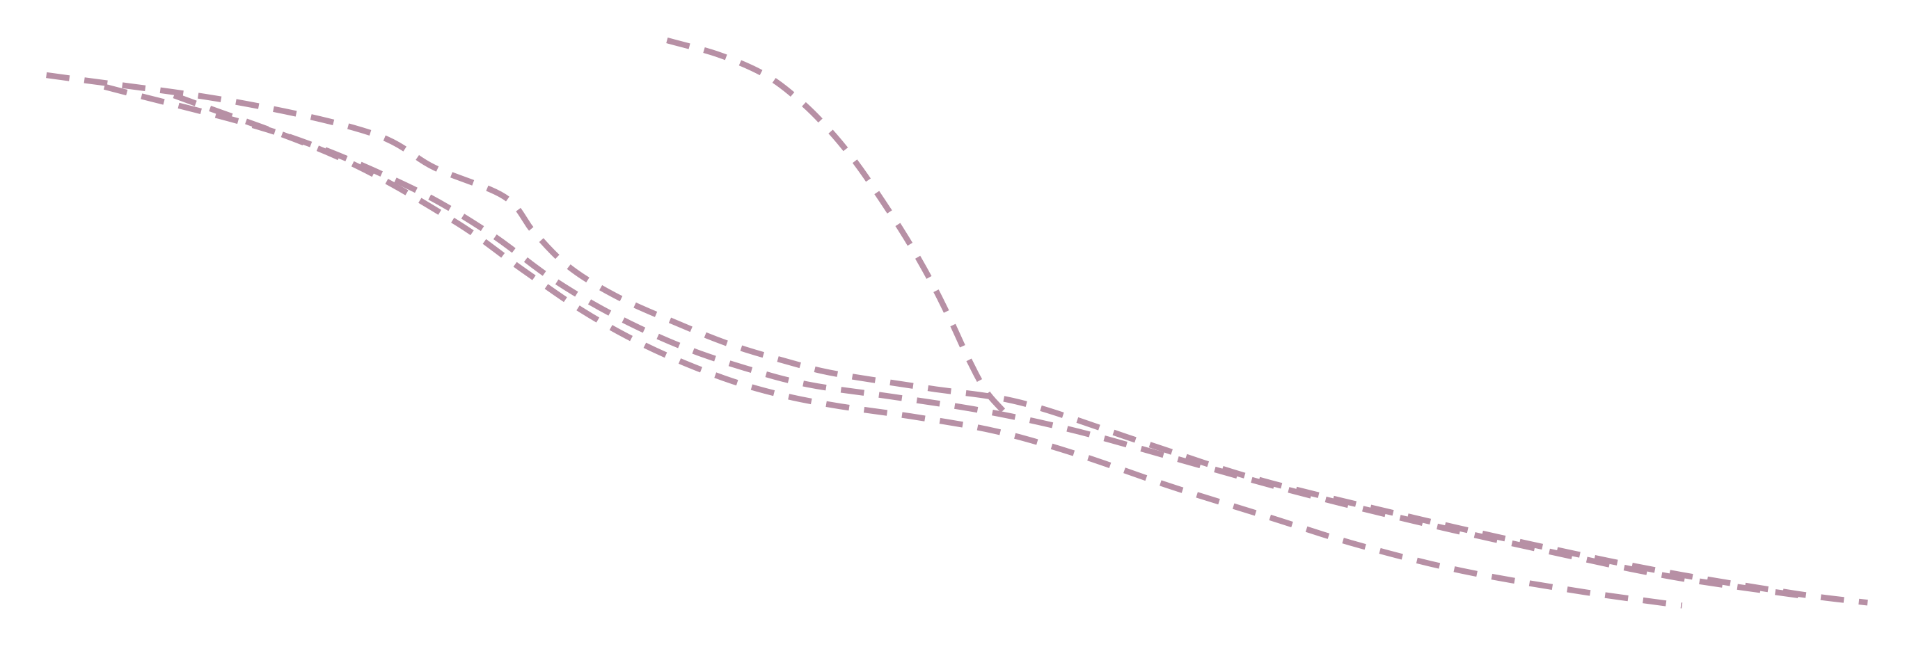
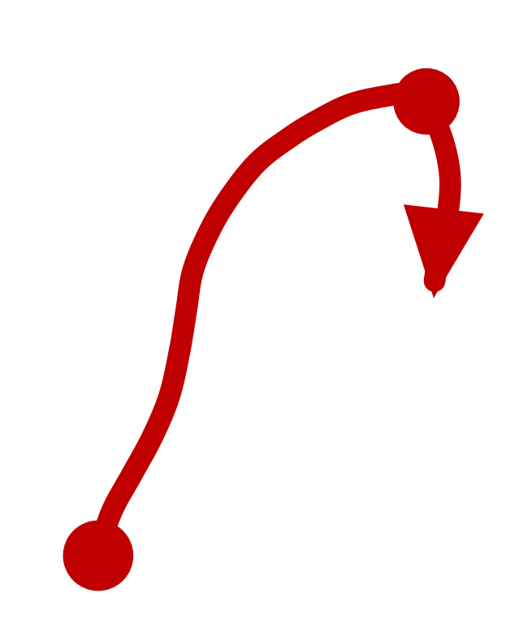




Transformer
11
Attention is All You Need
Decoder
Encoder-Decoder Attention
Multi Head Self Attention Blocks
attention
Encoder-Decoder Attention
Multi Head Self Attention Blocks
Attention Mechanism supports:
• Parallelization of Encoder ,
• Parallelization of Decoder ( Training Mode Only)
Encoder
• Very Long Sequence length

Slide 12
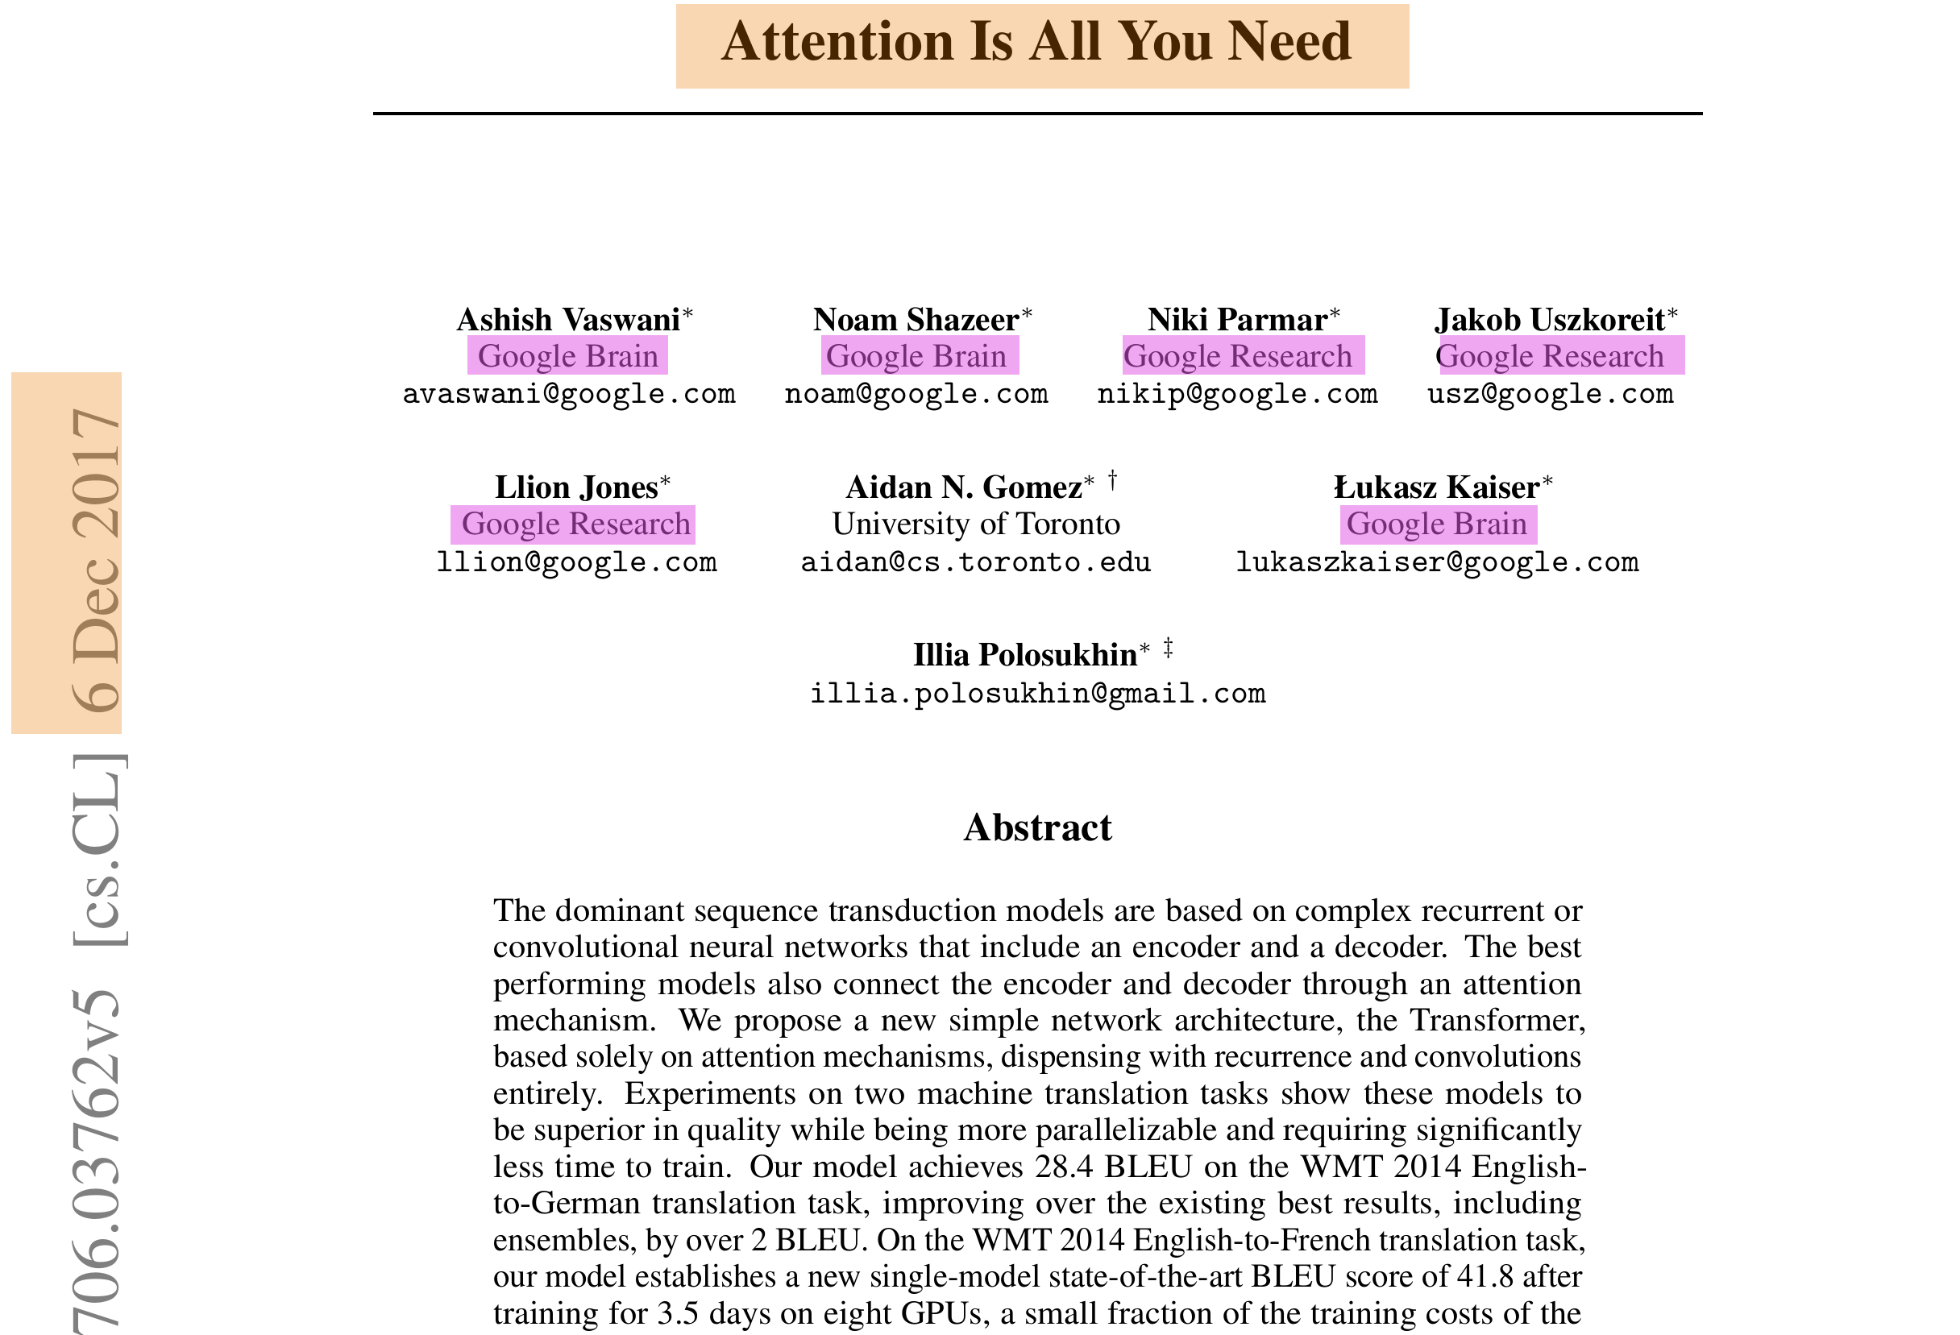
12

Slide 13
13
Transformer Building Blocks

Slide 14

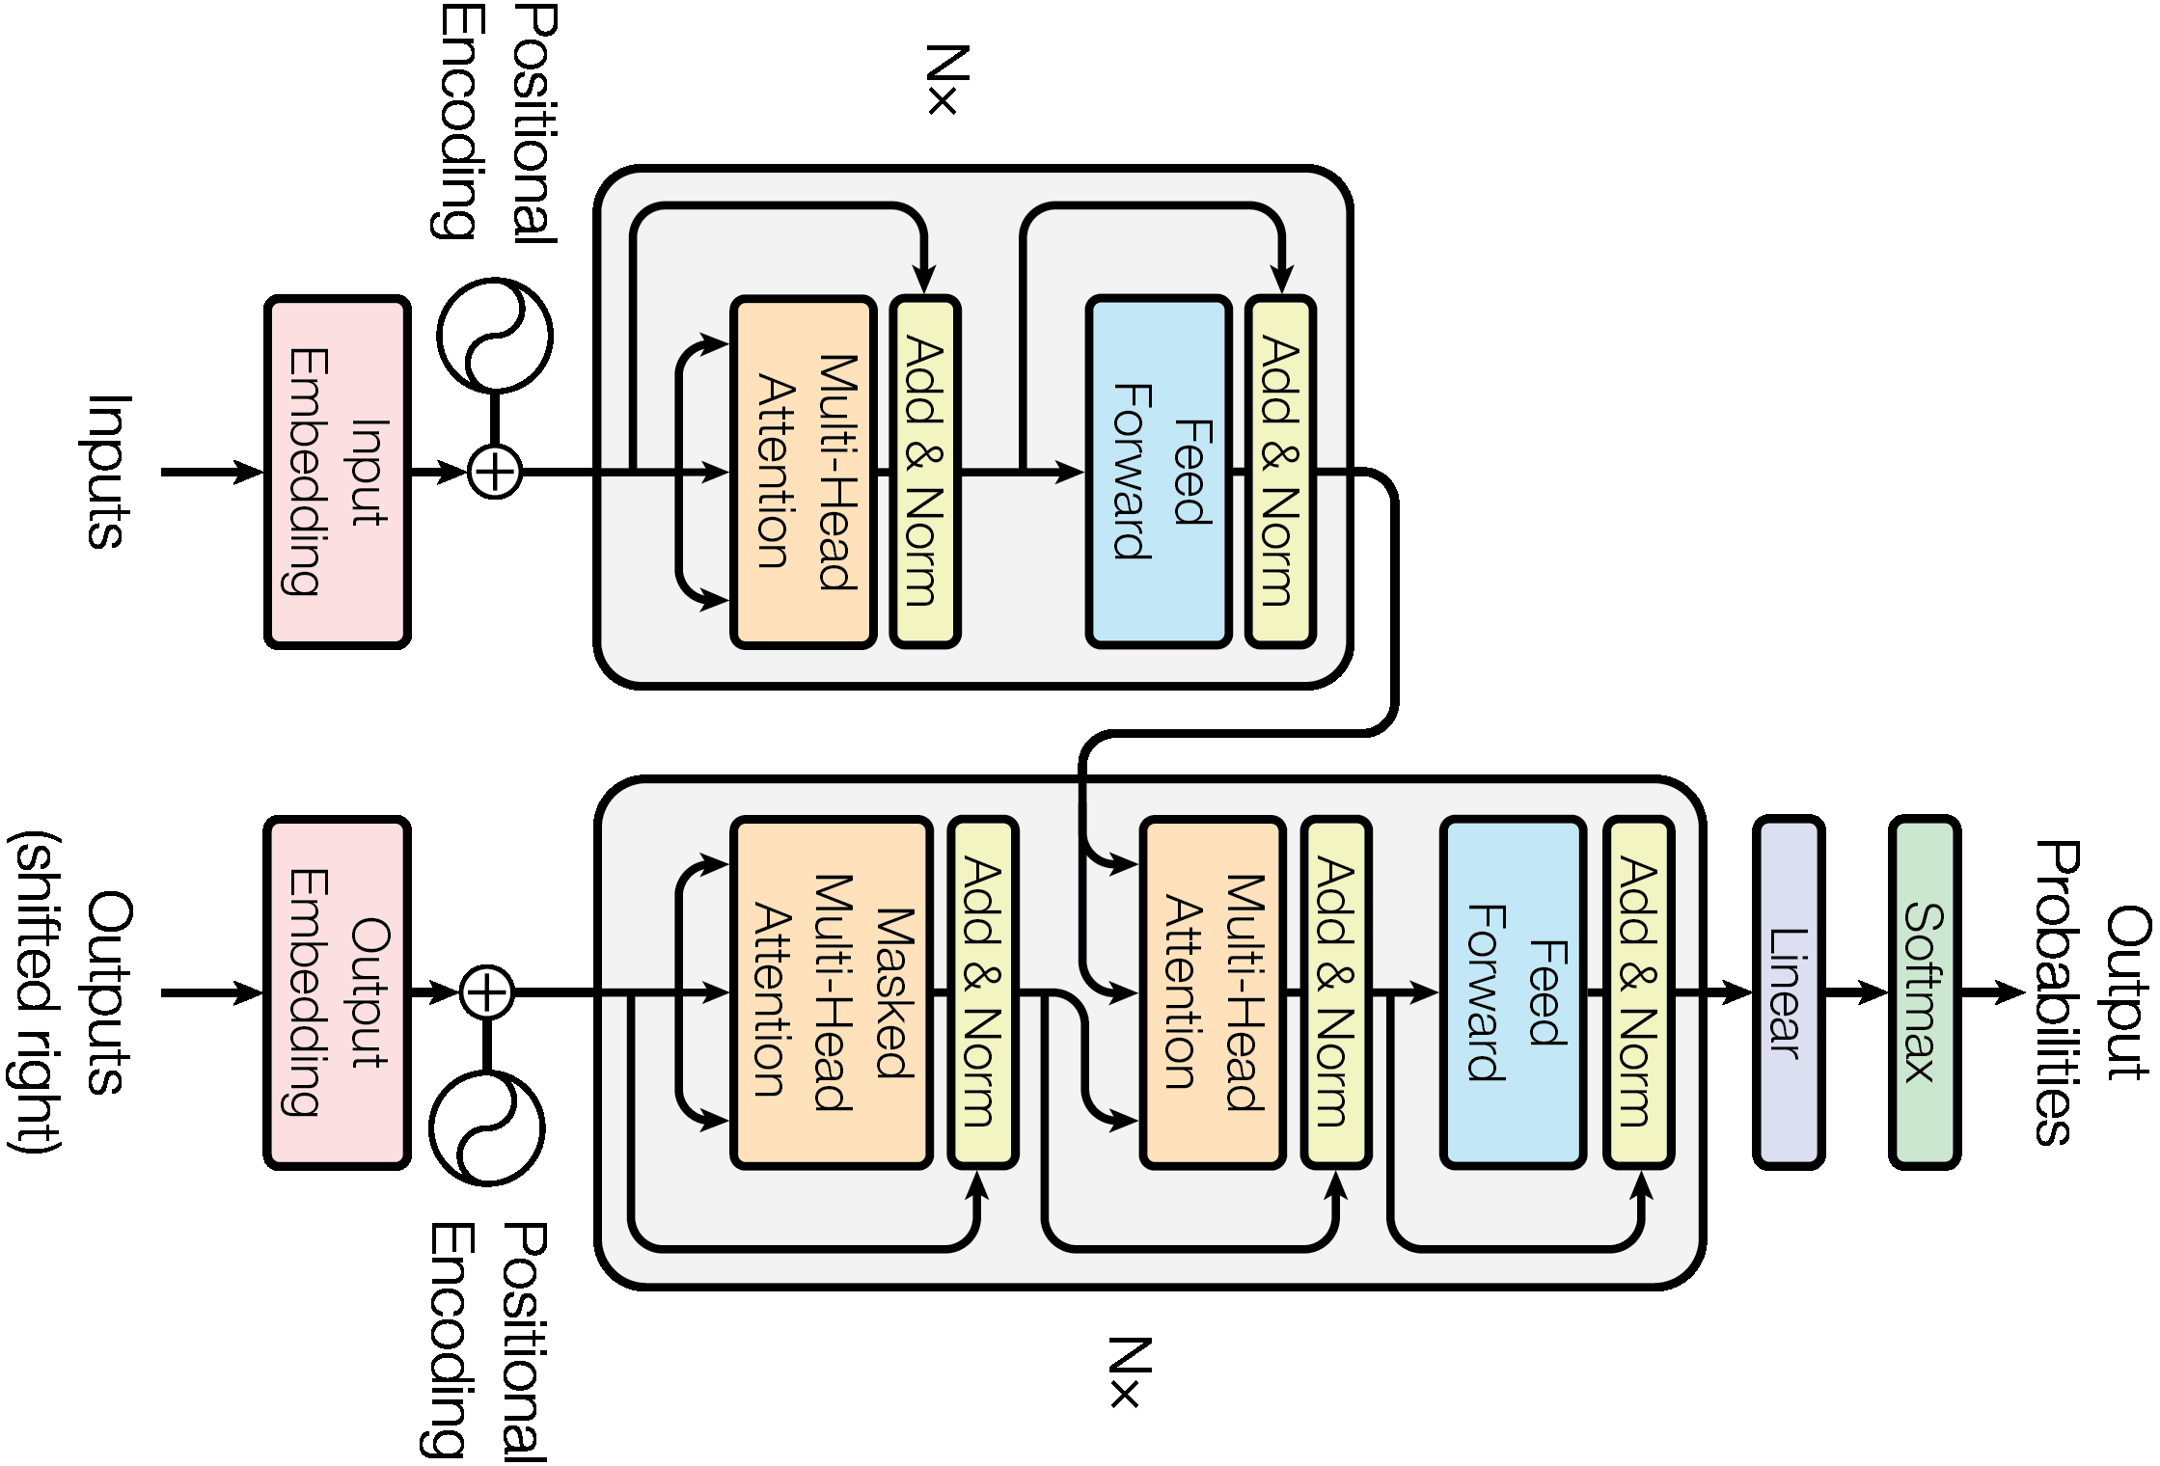

Encoder – Decoder Transformer
14
Orientation is not the Issue
Let us focus on the Building blocks

Slide 15




Encoder – Decoder Transformer
15
Encoder
Decoder

Slide 16
Encoder – Decoder Transformer
16
Decoder Block
Decoder
Encoder
Output
Probabilities
Encoder Block
Softmax
Linear
N Cascaded Blocks
In Both Encoder and Decoder
Add & Norm
Feed
Forward
Add & Norm
Multi-Head
Attention
Add & Norm
Encoder Decoder Attention
From Last Encoder Block
To ALL Decoder Cascaded Blocks
Feed
Forward
Nx
V
K
Q
Nx
Add & Norm
Add & Norm
Masked
Multi-Head
Attention
Multi-Head
Attention
V
K
Q
V
K
Q
Inputs to Encoder Block (V,K,Q)
All are from Previous Block
Positional
Encoding
Positional
Encoding
Input
Embedding
Output
Embedding
Inputs to Decoder Block (V,K,Q)
(V,K) from Attention, (Q) from Previous Block
Inputs
Outputs
(shifted right)

Slide 17
Encoder – Decoder Transformer
17
Decoder Output (at step “t-1”)
Is supplied as Decoder Input (at step “t”)
Encoder
Output
Decoder
Probabilities
Softmax
Linear
First Decoder Block
No Input from Encoder Attention
Add & Norm
Feed
Forward
Add & Norm
Add & Norm
Multi-Head
Attention
Feed
Forward
V
N x
K
Q
Input Positional Encoder
(Position of Input Word within the Input Sequence)
N x
Add & Norm
Add & Norm
Multi-Head
Attention
Masked
Multi-Head
Attention
V
V
K
Q
K
Q
Positional
Encoding
Positional
Encoding
Input
Embedding
Output
Embedding
Output Positional Encoder
(Position of Output Word within the Output Sequence)
Inputs
Outputs
(shifted right)

Slide 18
Encoder – Decoder Transformer
18
Both Encoder and Decoder Blocks Contain
“Multi-Head Self Attention” block
Encoder
Output
Decoder
Probabilities
“h” Heads
Outputs of Heads are concatenated
Softmax
Linear
Multi-Head Attention
Add & Norm
Scaled Dot-Product
Attention
Feed
Forward
Add & Norm
Linear
Add & Norm
Multi-Head
Attention
Multi-Head
Attention
MatMul
Feed
Forward
V
N x
Concat
K
Q
SoftMax
N x
Add & Norm
Add & Norm
Multi-Head
Attention
Masked
Multi-Head
Attention
Mask (opt.)
Scaled Dot-Product
Attention
h
Multi-Head
Attention
V
V
K
Q
Scale
Linear
Linear
Linear
K
Q
Positional
Encoding
Positional
Encoding
MatMul
Input
Embedding
Output
Embedding
Q
K
V
V
K
Q
Inputs
Outputs
(shifted right)

Slide 19
Encoder – Decoder Transformer
19
Normalization Layer
Encoder
Output
Decoder
Probabilities
Feed Forward Layer
Softmax
Residual Connections
Linear
Add & Norm
Multi-Head Attention
Add & Norm
Feed
Forward
Scaled Dot-Product
Attention
Feed
Forward
Add & Norm
Add & Norm
Linear
Add & Norm
Multi-Head
Attention
Add & Norm
Multi-Head
Attention
Feed
Forward
MatMul
Feed
Forward
V
N x
Concat
K
Q
SoftMax
N x
Add & Norm
Add & Norm
Add & Norm
Add & Norm
Masked
Multi-Head
Attention
Multi-Head
Attention
Mask (opt.)
Scaled Dot-Product
Attention
h
Multi-Head
Attention
V
V
K
Q
Scale
Linear
Linear
Linear
V
K
Q
Positional
Encoding
Positional
Encoding
MatMul
Input
Embedding
Output
Embedding
Q
K
V
V
K
Q
Inputs
Outputs
(shifted right)

Slide 20
20
Self Attention Mechanism

Slide 21
Word Embedding
21
Continuous bag-of-words (CBOW) vs Skip-Gram Models
Continuous bag-of-words model:
predicts the middle word based on surrounding context words. The context consists of a
few words before and after the current (middle) word. This architecture is called a bag-of-
words model as the order of words in the context is not important.
Continuous skip-gram model:
predicts words within a certain range before and after the current word in the same
sentence.
a bag-of-words model predicts a word given the neighboring context, a skip-gram model
predicts the context (or neighbors) of a word, given the word itself.

Slide 22
22
Continuous bag-of-words (CBOW) vs Skip-Gram Models
INPUT
PROJECTION
OUTPUT
INPUT
PROJECTION
OUTPUT
w(t-2)
w(t-2)
w(t-1)
w(t-1)
SUM
w(t)
w(t)
w(t+1)
w(t+1)
w(t+2)
w(t+2)
CBOW
Skip-gram

Slide 23
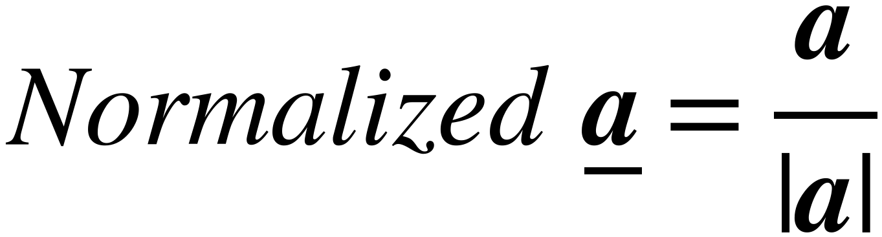
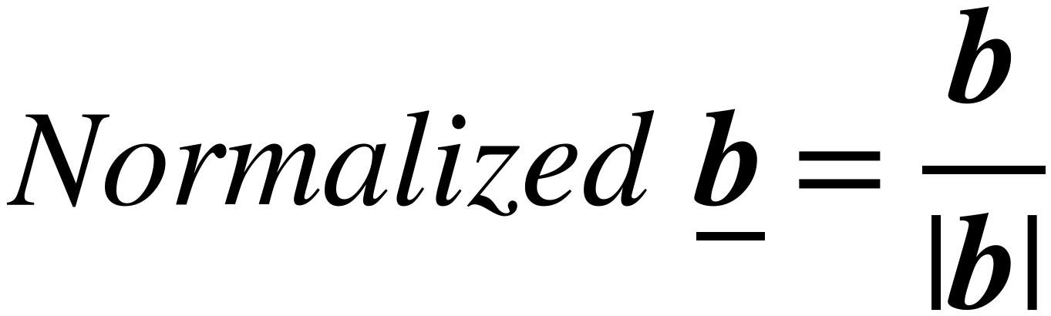

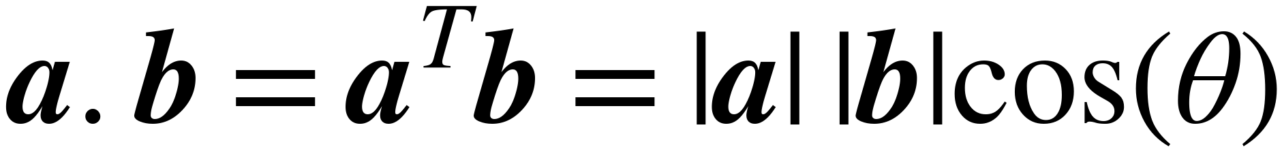
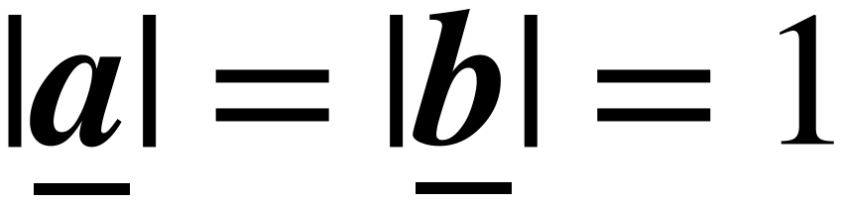
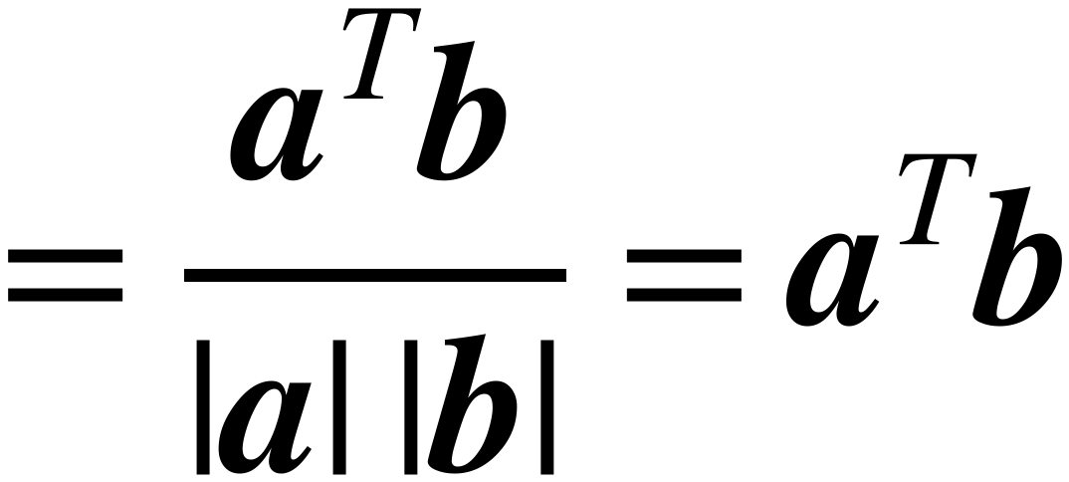

Review: Cosine Similarity
23
Vectors must be normalized
before calculate similarity
Their Lengths = 1
b
b
a
a
Normalize
After Normalization
Cosine Similarity is between -1 , +1
It is a dot product between two Normalized vectors a and b
Maximize [Similarity] = Minimize -[Similarity]
Loss = -[Similarity]

Slide 24
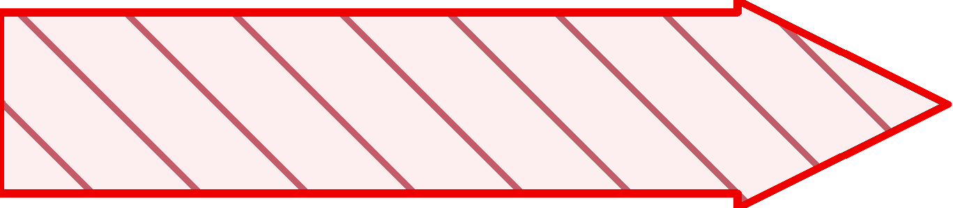
Objective of Self attention
24
in
The boy climbs the tree in the garden
garden
the
Boy
Boy
tree
climbs
Boy

Slide 25
Encoder – Decoder Transformer
25
Encoder
Output
Decoder
WE
ARE
HERE
Probabilities
Softmax
Linear
Multi-Head Attention
Add & Norm
Scaled Dot-Product
Attention
Feed
Forward
Add & Norm
Linear
Multi-Head
Attention
Add & Norm
MatMul
Feed
Forward
Nx
Concat
V
K
Q
SoftMax
Nx
Add & Norm
Add & Norm
Masked
Multi-Head
Attention
Mask (opt.)
Scaled Dot-Product
Attention
h
Multi-Head
Attention
Scale
V
K
Q
V
K
Q
Linear
Linear
Linear
Positional
Encoding
Positional
Encoding
MatMul
Input
Embedding
Output
Embedding
Q
K
V
V
K
q
Inputs
Outputs
(shifted right)

Slide 26
Self Attention Mechanism (Fundamental Operation)
26
(Self Attention of word X₂ w.r.t All words in Sentence ( X₁, X₂, X₃, X₄ )
Y
Similarity
Probabilities
Weighted SUM
Dot
Product
Σ
W₂₁
X₁
X₁
W₂₂
X₂
Soft max
X₂
W₂₃
X₃
X₃
W₂₄
X₄
X₄
X₁
X₂
X₃
X₄

Slide 27
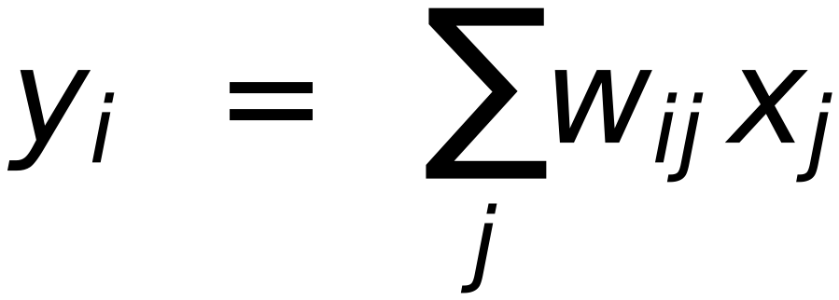
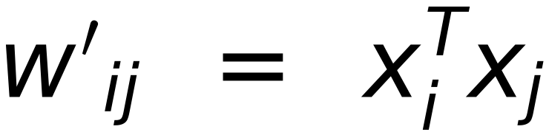
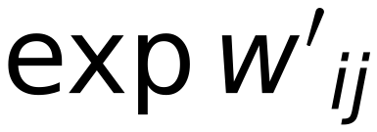
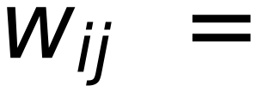
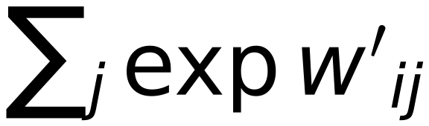
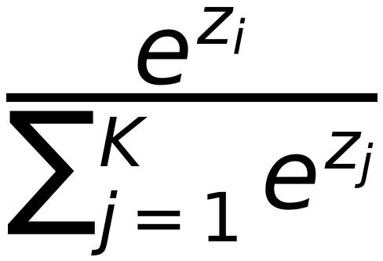
Self Attention Mechanism (Fundamental Operation)
27
(Self Attention of word X₂ w.r.t All words in Sentence ( X₁, X₂, X₃, X₄ )
Y
Similarity
Probabilities
Weighted SUM
X_{ℓ}
Dot
Product
Σ
W₂₁
X₁
X₁
W₂₂
X₂
Soft max
X₂
W₂₃
X₃
X₃
W₂₄
X₄
X₄
Output
layer
Softmax
activation function
Probabilities
X_{i} = X₂
1.3
5.1
2.2
0.7
1.1
0.02
0.90
0.05
0.01
0.02
X₁
X₂
X₃
X₄
Remember

Slide 28
Self Attention Mechanism (Not Sensitive to Words Order)
28
(Self Attention of word X₂ w.r.t All words in Sentence ( X₄, X₂, X₁, X₃ )
Y
Similarity
Probabilities
Weighted SUM
Dot
Product
Σ
W₂₁
X₁
X₁
W₂₂
X₂
Soft max
X₂
W₂₃
X₃
X₃
W₂₄
X₄
X₄
Sequential nature of the input is IGNORED
Mitigated Later with
Positional Encoder
X₄
X₂
X₁
X₃

Slide 29
Self Attention Mechanism (as Query and {Key-Value} Dictionary)
29
(Query using X₂ All Keys in Dictionary and retrieve Corresponding Values
Y
Matched KEYS with
Relevance Percentage
Retrieve VALUES
Weighted by their Relevance
KEYs
Dot
Product
Σ
Values
W₂₁
X₁
X₁
W₂₂
X₂
Soft max
X₂
W₂₃
X₃
K
X₃
V
W₂₄
X₄
X₄
Query
ALL Keys with X₂
Q
Values of Matched Keys
are returned
when Running Query
X₁
X₂
X₃
X₄

Slide 30
Self Attention Mechanism (Input Word plays Different Roles)
30
(Query using X₂ All Keys in Dictionary and retrieve Corresponding Values
Y
Matched KEYS with
Relevance Percentage
Retrieve VALUES
Weighted by their Relevance
KEYs
Dot
Product
Σ
Values
W₂₁
X₁
X₁
X₂ is used as
Key
W₂₂
X₂ is used as
Value
X₂
Soft max
X₂
W₂₃
X₃
K
X₃
V
W₂₄
X₄
X₄
Query
ALL Keys with X₂
X₂ is used as
Query
Q
Should we use SAME X₂ Vector
for the three Roles ?
X₁
X₂
X₃
X₄

Slide 31
Self Attention Mechanism (Linear Transformation of Inputs)
31
(Query using X₂ All Keys in Dictionary and retrieve Corresponding Values
W₁₁
W₂₁
W₃₁
W₄₁
X_{Q21}
W₁₁
W₂₁
W₃₁
W₄₁
X_{V21}
[
x₂₁
x₂₂
x₂₃
x₂₄
]
[
x₂₁
x₂₂
x₂₃
x₂₄
]
1xd
W₁₂
W₂₂
W₃₂
W₄₂
X_{Q22}
1xd
W₁₂
W₂₂
W₃₂
W₄₂
X_{V22}
X₂
X₂
=
=
W₁₃
W₂₃
W₃₃
W₄₃
X_{Q23}
W₁₃
W₂₃
W₃₃
W₄₃
X_{V23}
W_{Q}
W_{V}
W₁₄
W₂₄
W₃₄
W₄₄
X_{Q24}
W₁₄
W₂₄
W₃₄
W₄₄
X_{V24}
dxd
X₂ variant to QUERY with
dxd
X₂ variant used as Value
W₁₁
W₂₁
W₃₁
W₄₁
X_{K21}
X₂ variant used as KEY
[
x₂₁
x₂₂
x₂₃
x₂₄
]
1xd
W₁₂
W₂₂
W₃₂
W₄₂
X_{K22}
Generate Three Variants
of X₂ (Based on its Role)
X₂
=
W₁₃
W₂₃
W₃₃
W₄₃
X_{K23}
W_{K}
W_{Q} W_{K} W_{V} are controllable parameters
(Trainable), allows to modify the incoming
vectors to suit the three roles they must play
W₁₄
W₂₄
W₃₄
W₄₄
X_{K24}
dxd

Slide 32
32
[
]
W₁₁
W₂₁
W₃₁
W₄₁
X_{Q21}
X₂₁
X₂₂
X₂₃
X₂₄
Linear Transformation
1xd
W₁₂
W₂₂
W₃₂
W₄₂
X_{Q22}
(= Fully connected Layer)
X₂
=
W₁₃
W₂₃
W₃₃
W₄₃
X_{Q23}
W_{Q}
W₁₄
W₂₄
W₃₄
W₄₄
X_{Q24}
dxd
X_{Q21}
X_{Q22}
X_{Q23}
X_{Q24}
W₁₁
W₂₁
W₄₁
W₁₂
W₂₁
W₁₃
W₄₂
W₂₁
W₄₃
W_{Q}
W₁₄
W₂₁
W₄₄
X₂₁
X₂₂
X₂₃
X₂₄

Slide 33
Self Attention Mechanism (Linear Transformation of Inputs)
33
(Self Attention of word X₂ w.r.t All words in Sentence ( X₁, X₂, X₃, X₄ )
Y
2
Similarity
Probabilities
Weighted SUM
Dot
Product
K.q
Σ
X₄
W_{k}^{(r)}
K₄
V₄
W_{v}^{(r)}
X₄
X₃
W_{k}^{(r)}
K₃
V₃
W_{v}^{(r)}
X₃
Soft max
X₂
W_{k}^{(r)}
K₂
V₂
W_{v}^{(r)}
X₂
X₁
W_{k}^{(r)}
K₁
V₁
W_{v}^{(r)}
X₁
q₂
W_{q}^{(r)}
X₁
X₂
X₃
X₄
W
=
1*d
d*d
1*d
d: Embedding Length

Slide 34
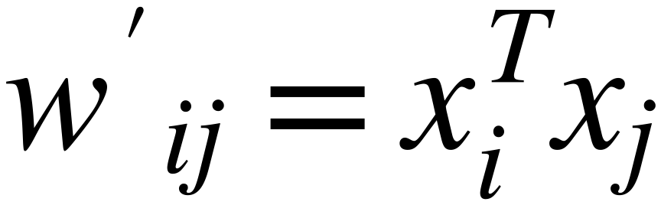




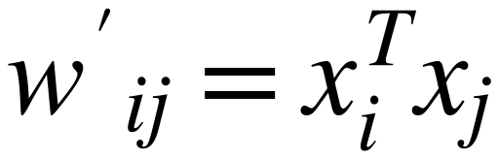



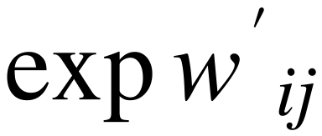
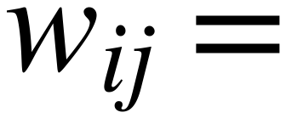
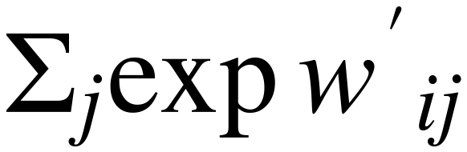
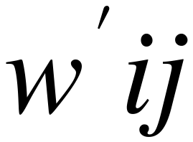
Self Attention Mechanism
34
(Embedding Vector Dimension and Softmax Sensitivity)
1×d
d
As Dimension of Embedding "d" Increases
the Calculated weight value "w" increases
High Weight Values kill the gradient, and slow down learning
SoftMax
1×d
d
d
d
1
0.0321
5
0.0000
10
0.0000
2
SoftMax
0.0871
10
SoftMax
0.0000
20
SoftMax
0.0000
3
0.2369
15
0.0067
30
0.0000
4
0.6439
20
0.9933
40
1.0000
For small "d"
For medium "d"
For large "d"

Slide 35
Self Attention Mechanism
35
(Embedding Vector Dimension and Softmax Sensitivity)
Scale down "Weights" Values
1×d
before applying SoftMax
d
Scaling Factor should be related to
As Dimension of Embedding "d" Increases
Embedding Dimension "d"
the Calculated weight value "w" increases
High Weight Values kill the gradient, and slow down learning
SoftMax
1×d
d
d
d
1
0.0321
5
0.0000
10
0.0000
2
SoftMax
0.0871
10
SoftMax
0.0000
20
SoftMax
0.0000
3
0.2369
15
0.0067
30
0.0000
4
0.6439
20
0.9933
40
1.0000
For small "d"
For medium "d"
For large "d"

Slide 36
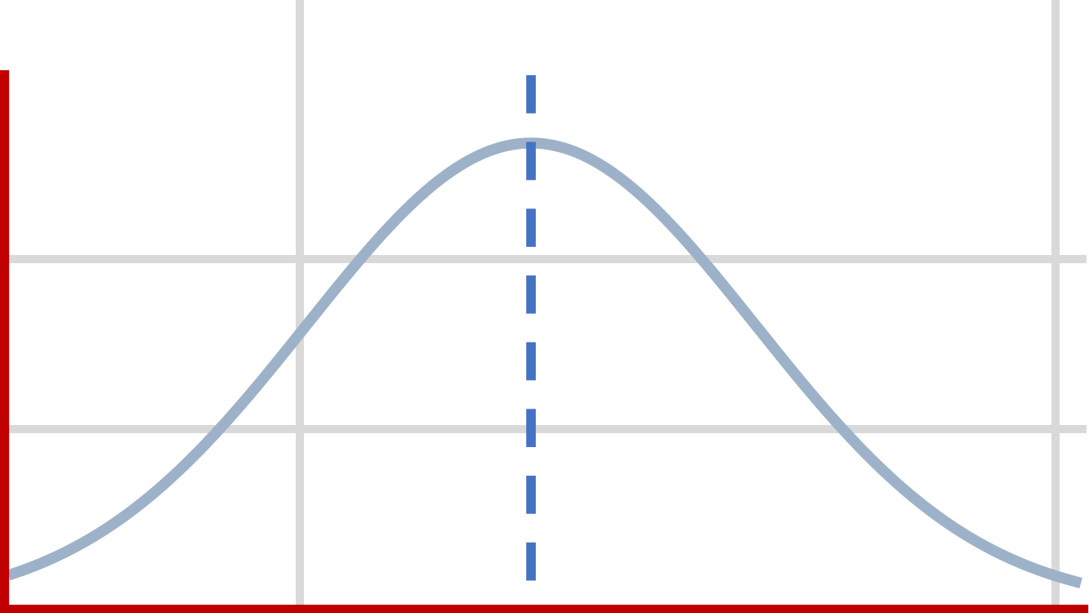


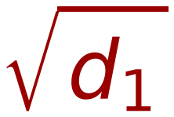
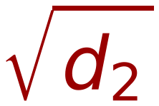
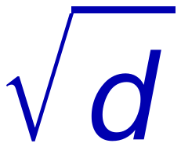
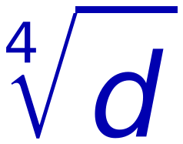


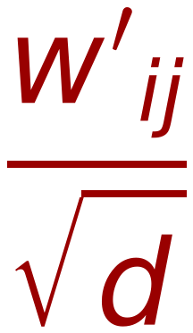

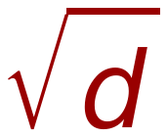
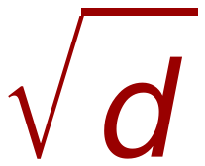
36
Self Attention Mechanism
(Scaling based on Square Root of Embedding Vector Dimension)
V₁
V₂
V₁
V₂
Let Average Values of elements of V₁ = M
X₁
X₁
M
M
Let Average Values of elements of V₂ = M
X₂
X₂
M
M
Vector Length of V₁ (all Ms) = V₁^{T} V₁ = M
X₃
X₃
M
M
X₄
X₄
M
M
Vector Length of V₂ (all Ms) = V₂^{T} V₂ = M
X₅
1xd₂
M
1xd₂
M
X₆
M
X₇
M
is a good choice for scaling
Some times is used
X₈
M
X₉
M
X₁₀
M
X₁₁
M
X₁₂
M
SoftMax
SoftMax
d=100,
=10
1xd₁
1xd₁
Remember:
10
0.0000
10
1
0.0321
"d" is
Dimension of Embedding
20
SoftMax
0.0000
20
/
Scaled
2
SoftMax
0.0871
Not
30
0.0000
30
3
0.2369
length of input Sequence
40
1.0000
40
4
0.6439

Slide 37
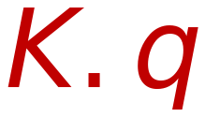
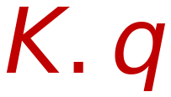



Self Attention Mechanism (Adding Scaling)
37
(Self Attention of word X₂ w.r.t All words in Sentence ( X₁, X₂, X₃, X₄ )
Y₂
Similarity
Probabilities
Weighted SUM
Scaling by √d
Dot
Product
Soft max
Σ
X₄
W_{k}⁽¹⁾
K₄
V₄
W_{v}⁽¹⁾
X₄
X₃
W_{k}⁽¹⁾
K₃
V₃
W_{v}⁽¹⁾
X₃
X₂
W_{k}⁽¹⁾
K₂
V₂
W_{v}⁽¹⁾
X₂
X₁
W_{k}⁽¹⁾
K₁
V₁
W_{v}⁽¹⁾
X₁
q₂
W_{q}⁽¹⁾
W
=
X₁
X₂
X₃
X₄
d: Embedding Length

Slide 38
Self Attention Mechanism (Adding Scaling)
38
(Self Attention of word X₂ w.r.t All words in Sentence ( X₁, X₂, X₃, X₄ )
Y₂
MatMul
Similarity
Probabilities
Weighted SUM
SoftMax
Dot
Product
Soft max
Σ
Mask (opt.)
W_{k}⁽¹⁾
K₄
V₄
W_{v}⁽¹⁾
Scale
X₄
X₄
MatMul
X₃
W_{k}⁽¹⁾
K₃
V₃
W_{v}⁽¹⁾
X₃
Scaling by √d
Q
K
V
X₂
W_{k}⁽¹⁾
K₂
V₂
W_{v}⁽¹⁾
X₂
X₁
W_{k}⁽¹⁾
K₁
V₁
W_{v}⁽¹⁾
X₁
q₂
W_{q}⁽¹⁾
W
=
X₁
X₂
X₃
X₄
d: Embedding Length

Slide 39
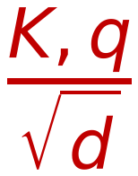
Parallel Processing
39
Transform Sequence Elements in Parallel
[Calculation of Self Attention of words ( X₁, X₂, X₃, X₄)]
Y₄
Y₃
Y
Y
Y
Y
Y₂
Y₁
Y
Y
Y
Y
Similarity
Probabilities
Weighted SUM
Y
Y
Y
Y
Similarity
Dot
Product
K,q
Σ
Y
Y
Y
Y
Probabilities
Weighted SUM
W_{k}⁽¹⁾
K,q
V₁
W_{v}⁽¹⁾
X₄
Dot
Product
K₄
Σ
X₄
Similarity
Probabilities
Weighted SUM
W_{k}⁽¹⁾
K,q
V₁
W_{v}⁽¹⁾
V₂
W_{v}⁽¹⁾
X₄
Dot
Product
K₄
W_{k}⁽¹⁾
K₃
Σ
X₄
X₃
Similarity
X₃
Probabilities
Weighted SUM
Soft max
Scaling by √d
W_{k}⁽¹⁾
K,q
V₁
W_{v}⁽¹⁾
V₂
W_{v}⁽¹⁾
V₃
W_{v}⁽¹⁾
X₄
Dot
Product
K₄
W_{k}⁽¹⁾
K₃
W_{k}⁽¹⁾
Σ
X₄
X₃
X₃
X₂
K₂
Soft max
X₂
Scaling by √d
X₄
W_{k}⁽¹⁾
X₃
K₄
W_{k}⁽¹⁾
X₂
K₃
W_{k}⁽¹⁾
X₁
K₂
W_{k}⁽¹⁾
K₁
V₁
W_{v}⁽¹⁾
V₂
X₄
W_{v}⁽¹⁾
V₃
X₃
W_{v}⁽¹⁾
V₄
X₂
W_{v}⁽¹⁾
X₁
Soft max
Scaling by √d
X₃
W_{k}⁽¹⁾
X₂
K₃
W_{k}⁽¹⁾
X₁
K₂
W_{k}⁽¹⁾
K₁
V₂
W_{v}⁽¹⁾
V₃
X₃
W_{v}⁽¹⁾
V₄
X₂
W_{v}⁽¹⁾
X₁
Soft max
Scaling by √d
q₁
X₂
W_{k}⁽¹⁾
X₁
K₂
W_{k}⁽¹⁾
K₁
W_{q}⁽¹⁾
V₃
W_{v}⁽¹⁾
V₄
X₂
W_{v}⁽¹⁾
X₁
q₁
X₁
W_{k}⁽¹⁾
K₁
W_{q}⁽¹⁾
V₄
X₂
W_{v}⁽¹⁾
X₃
X₁
X₄
q₁
X₁
W_{q}⁽¹⁾
X₂
X₃
X₄
q₁
X₁
W_{q}⁽¹⁾
X₂
X₃
X₄
X₁
X₁
X₂
X₃
X₄
*** Run In Parallel ***
X₁
X₂
X₃
X₄

Slide 40
40
Multi-Head Attention
Wide Architecture
Narrow Architecture

Slide 41
Encoder – Decoder Transformer
41
Encoder
Output
Probabilities
WE ARE
HERE
Decoder
Softmax
Linear
Scaled Dot-Product
Attention
Multi-Head Attention
Add & Norm
Feed
Forward
Linear
Add & Norm
Add & Norm
Multi-Head
Attention
MatMul
N×
Feed
Forward
Concat
N×
SoftMax
Add & Norm
Scaled Dot-Product
Attention
Add & Norm
Masked
Multi-Head
Attention
Mask (opt.)
× h
Multi-Head
Attention
Scale
V
K
V
K
Q
Q
Positional
Encoding
Linear
Linear
Linear
Positional
Encoding
MatMul
Input Embedding
Output
Embedding
Q
K
V
V
K
q
Inputs
Outputs
(shifted right)

Slide 42
42
Multi-Head Self Attention
Combining several self attention mechanisms give the self attention greater
power of discrimination
Each Head is indexed with “r”
Each head has its own matrices W^{r}_{q} , W^{r}_{k} , W^{r}_{v} .
For input X each attention head produces a different output vector Y^{r}.
All Output vectors are concatenated , and pass through a linear
transformation to reduce the dimension back to original X dimension.

Slide 43
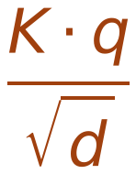




Multi Head Self Attention of Word X₂
Y₂
1*d
43
“Wide” Architecture
Linear Transformation [ T ] _{dH*d}
Concatenated Vector
Y₁^{(t)}
Y₂^{(t)}
Y₃^{(t)}
Y₄^{(t)}
Y₅^{(t)}
1*dH
Y₅
Similarity
Y₅
Weighted SUM
h=5
Similarity
Y₄
Weighted SUM
h=4
Similarity
Y₃
Weighted SUM
h=3
Similarity
Probabilities
Weighted SUM
h=2
Y₂
Similarity
Y₁
Weighted SUM
h=1
Σ
Dot
Product
K.q
X₄
W_{k}⁽¹⁾
K₄
W_{v}⁽¹⁾
×
V₁
X₁
K₃
W_{q}⁽⁵⁾
X₃
W_{k}⁽¹⁾
×
V₂
W_{v}⁽¹⁾
X₂
W_{q}⁽⁴⁾
X₂
W_{k}⁽¹⁾
K₂
W_{v}⁽¹⁾
X₃
W_{q}⁽³⁾
W_{k}⁽⁵⁾
×
V₃
X₁
W_{k}⁽¹⁾
K₁
W_{v}⁽¹⁾
X₄
W_{q}⁽²⁾
W_{k}⁽⁴⁾
*
V₄
W_{k}⁽³⁾
W_{v}⁽⁵⁾
W_{q}⁽¹⁾
“H” Heads
W_{q}⁽⁰⁾
W_{k}⁽²⁾
W_{v}⁽⁴⁾
q₂
W_{k}⁽¹⁾
W_{v}⁽³⁾
W_{v}⁽²⁾
W
=
X₁
X₂
X₃
X₄
W_{v}⁽¹⁾
1*d
1*d
d*d
d: Embedding Length

Slide 44
Y₂
Multi Head Self Attention of Word X₂
44
1*d
“Wide” Architecture
Linear Transformation [ T ] _{dH*d}
Linear
Concatenated Vector
Y₁^{(t)}
Y₂^{(t)}
Y₃^{(t)}
Y₄^{(t)}
Y₅^{(t)}
Concat
1*dH
Y₅
Scaled Dot-Product
Attention
h
Similarity
Y₅
Weighted SUM
h=5
Similarity
Y₄
Weighted SUM
h=4
Linear
Linear
Linear
Similarity
Y₃
Weighted SUM
h=3
Similarity
Probabilities
Weighted SUM
h=2
Y₂
Y₁
Similarity
Probabilities
Weighted SUM
h=1
V
K
Q
Σ
Dot
Product
K.q
X₄
W_{k}⁽¹⁾
K₄
W_{v}⁽¹⁾
×
V₁
X₁
K₃
W_{q}⁽⁵⁾
X₃
W_{k}⁽¹⁾
×
V₂
W_{v}⁽¹⁾
X₂
W_{q}⁽⁴⁾
X₂
W_{k}⁽¹⁾
K₂
W_{v}⁽¹⁾
X₃
W_{q}⁽³⁾
W_{k}⁽⁵⁾
×
V₃
X₁
W_{k}⁽¹⁾
K₁
W_{v}⁽¹⁾
X₄
W_{q}⁽²⁾
W_{k}⁽⁴⁾
*
V₄
W_{k}⁽³⁾
W_{v}⁽⁵⁾
W_{q}⁽¹⁾
“H” Heads
W_{q}⁽⁰⁾
W_{k}⁽²⁾
W_{v}⁽⁴⁾
q₂
W_{k}⁽¹⁾
W_{v}⁽³⁾
W_{v}⁽²⁾
W
=
X₁
X₂
X₃
X₄
W_{v}⁽¹⁾
1*d
1*d
d*d
d: Embedding Length

Slide 45
Multi Head Self Attention of Word X₂
Y₂
1*d
45
“Narrow” Architecture
Concatenated Vector
Y₁^{(t)}
Y₂^{(t)}
Y₃^{(t)}
Y₄^{(t)}
Y₅^{(t)}
1·d
W
=
Y₅
1×d/H
1×d/H
Y₄
1×d/H
d/H×d/H
1×d/H
Similarity
Y₃
Weighted SUM
h=5
d : Embedding Length
Similarity
Y₂
Weighted SUM
h=4
Similarity
Y₁
Weighted SUM
h=3
Similarity
Probabilities
Weighted SUM
h=2
Similarity
Weighted SUM
Σ
Weighted SUM
h=1
Dot
Product
K.q
Σ
X₄
W_{k}⁽¹⁾
K₄
W_{v}⁽¹⁾
×
V₁
X₁
K₃
W_{q}⁽⁵⁾
X₃
W_{k}⁽¹⁾
×
V₂
W_{v}⁽¹⁾
X₂
W_{q}⁽⁴⁾
X₂
W_{k}⁽¹⁾
K₂
W_{v}⁽¹⁾
X₃
W_{q}⁽³⁾
W_{k}⁽⁵⁾
×
V₃
Input
Sequence
X₁
W_{k}⁽¹⁾
K₁
W_{v}⁽¹⁾
X₄
W_{q}⁽²⁾
W_{k}⁽⁴⁾
*
V₄
W_{k}⁽³⁾
W_{v}⁽⁵⁾
W_{q}⁽¹⁾
“H” Heads
W_{k}⁽²⁾
W_{v}⁽⁴⁾
X₁
X₂
X₃
X₄
q₂
W_{q}⁽⁰⁾
Split vectors into “H” chunks
W_{q}⁽⁰⁾
W_{k}⁽¹⁾
W_{v}⁽³⁾
W_{v}⁽²⁾
X₁
X₂
X₃
X₄
To Head 5
X₁
X₂
X₃
X₄
W_{v}⁽¹⁾
X₁
X₂
X₃
X₄
To Head 4
X₁
X₂
X₃
X₄
To Head 3
X₁
X₂
X₃
X₄
To Head 2
X₁
X₂
X₃
X₄
To Head 1

