Slide 1
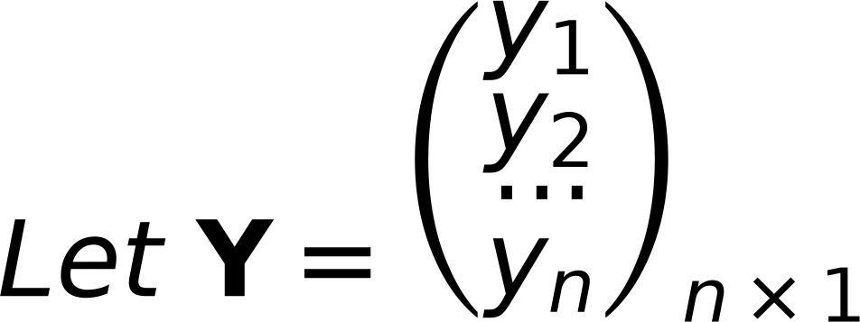
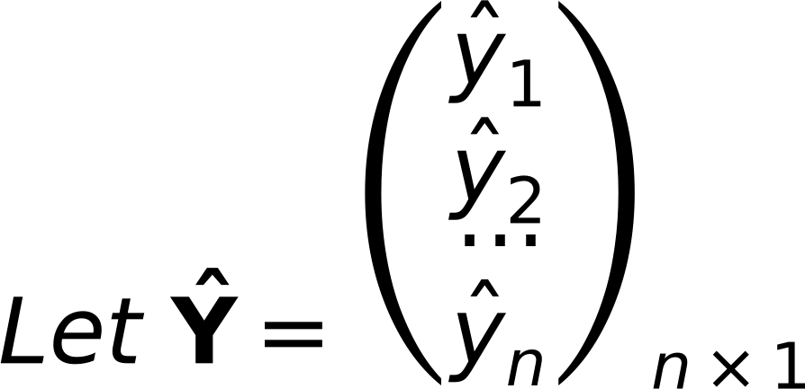

4
Concept of LOSS Function
Remember
Original Labels
Predicted Labels
from Training Samples
from Model Ŷ=XW
Objective is Ŷ=Y
Ŷ = XW Predicted
Where: X_{N×(d+1)} is a matrix ⇒ Given
If Ŷ≠Y ⇒ There is an Error (Loss)
Y_{N×1} is labels vector ⇒ Given
W is Model Parameter ⇒ Required
Define Loss function as squared distance between Ŷ and Y

