Slide 1




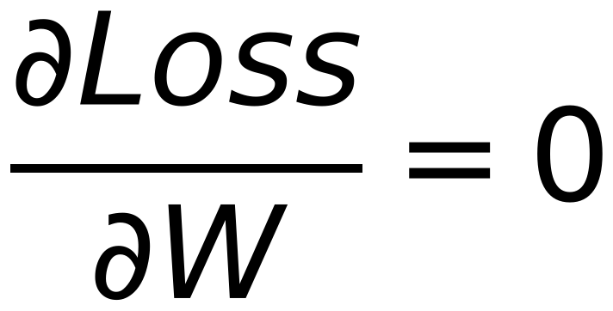




5
Minimization of Loss function to obtain BEST model parameters
Remember
X is a matrix, W is a vector,
XW is a vector
Get Best W that minimizes the loss
Remember

