Slide 1
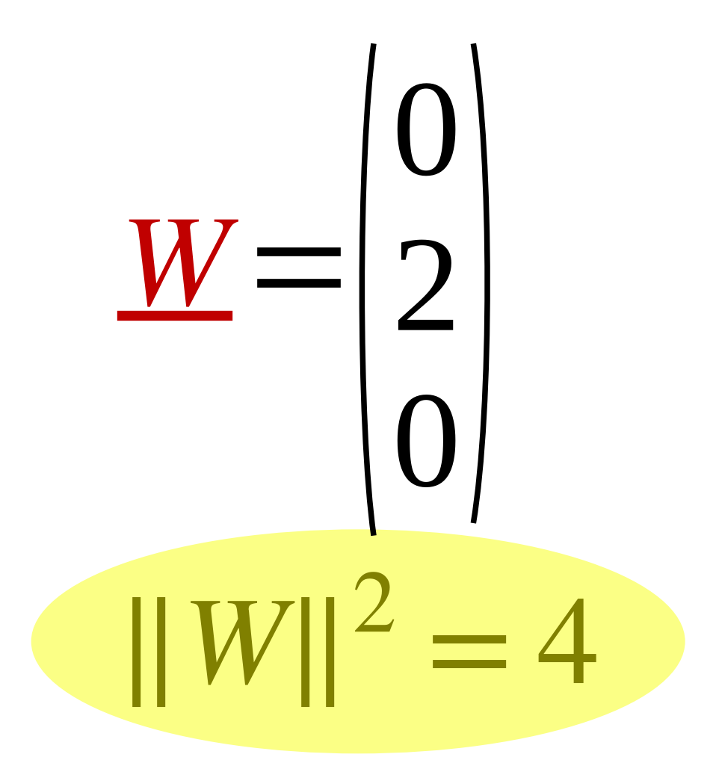
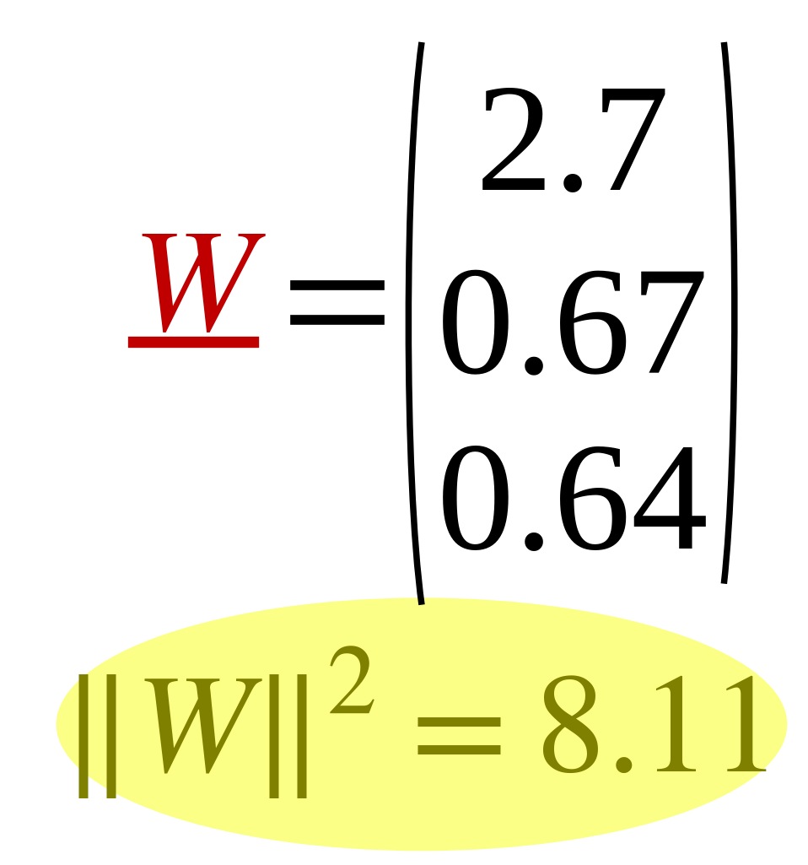
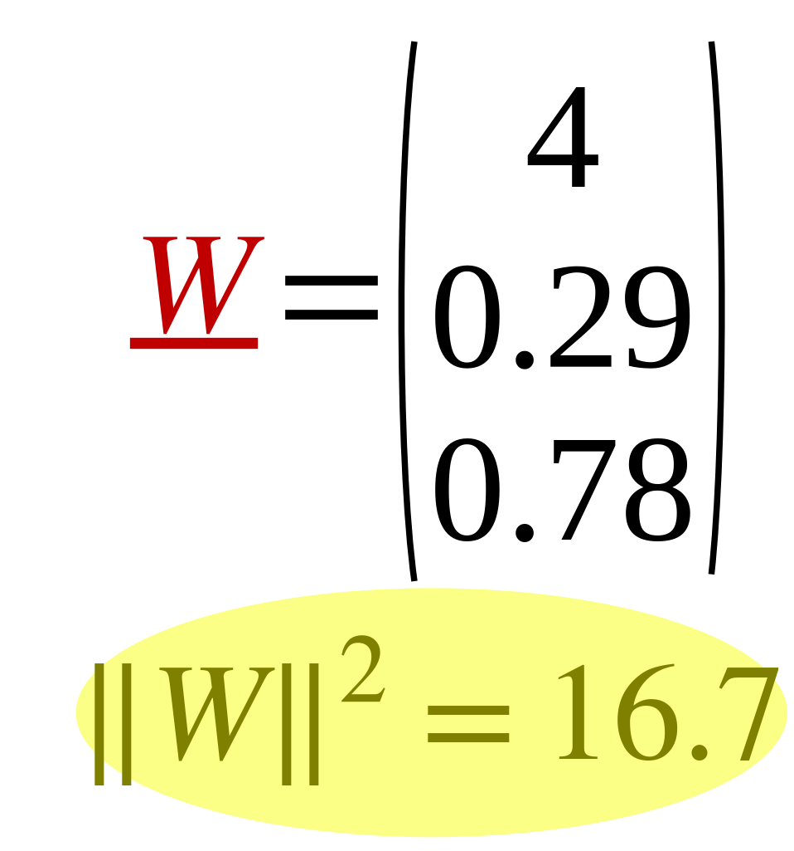
Effect of Overfitting on model parameter “W”
13
Train
Test
 | X1 | X2 | X3 | X4 | X5 | X6 | X7 | X8
X1 | 1 | 2 | 3 | 4 | 8 | 9 | 10 | 11
X2 | 1 | 3 | 5 | 6 | 16 | 7 | 5 | 3
y | 2 | 4 | 6 | 8 | 16 | 18 | 20 | 22
Test1 | Test2 | Test3
30 | 40 | 50
15 | 20 | 25
60 | 80 | 100
 | X1 | X2 | X3 | X4 | X5 | X6 | X7 | X8
X1 | 1 | 2 | 3 | 4 | 8 | 9 | 10 | 30
X2 | 1 | 3 | 5 | 6 | 16 | 7 | 5 | 3
y | 2 | 4 | 6 | 8 | 16 | 18 | 20 | 22
Test1 | Test2 | Test3
30 | 40 | 50
15 | 20 | 25
32.4 | 42.3 | 52.3
 | X1 | X2 | X3 | X4 | X5 | X6 | X7 | X8
X1 | 1 | 2 | 3 | 4 | 8 | 9 | 10 | 60
X2 | 1 | 3 | 5 | 6 | 16 | 7 | 5 | 3
y | 2 | 4 | 6 | 8 | 16 | 18 | 20 | 22
Test1 | Test2 | Test3
30 | 40 | 50
15 | 20 | 25
24.4 | 31.2 | 38

