Slide 1
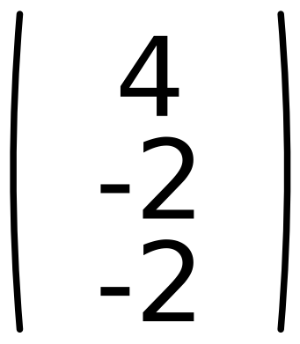
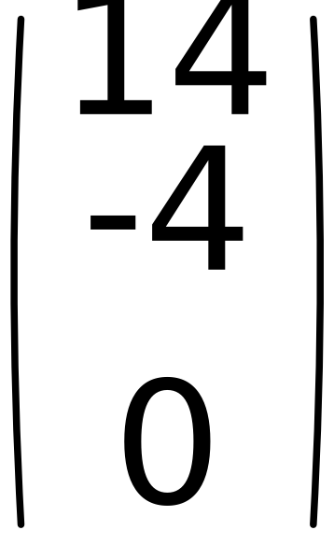
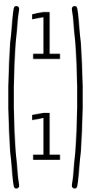
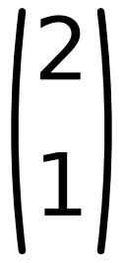
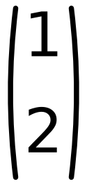
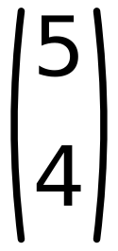
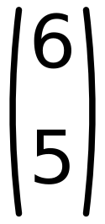
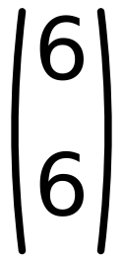
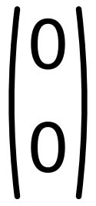
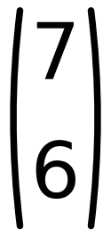
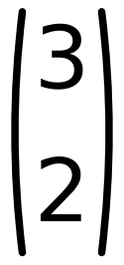






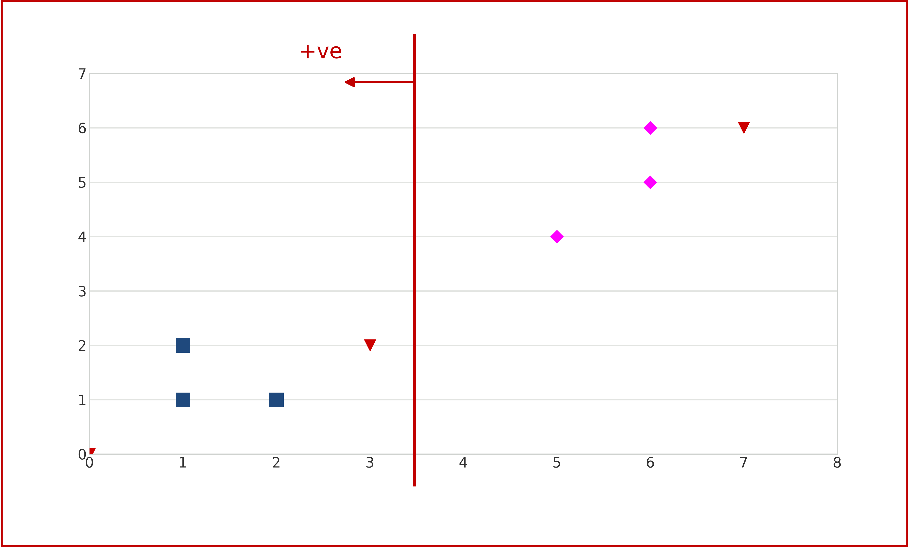
x₁
x₂
x₃
x₄
x₅
x₆
W =
Step η = 2
Z₁
Z₁
Z₁
46
Initial
Check classes of
W
=
C₁
C₁
C₁
C₂
C₂
C₂
C₁ positive C₂negative Zero is unaccepted
Ugmented Vectors ( from Top )
x₁
x₂
x₃
x₄
x₅
x₆
C₁
C₁
C₁
C₂
C₂
C₂
Iteration 4
No change in W
Stop Iterations

