Slide 1
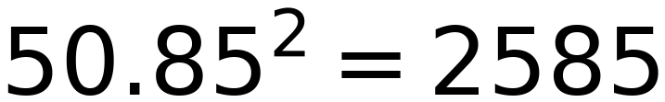
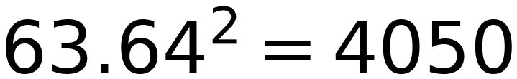
9
50.85 mm
63.64 mm
Overfit (try to minimize the residuals ONLY)
Generalized (Residuals are not minimized)
Fails to detect the Pattern
Successes to detect the Pattern

