Slide 1

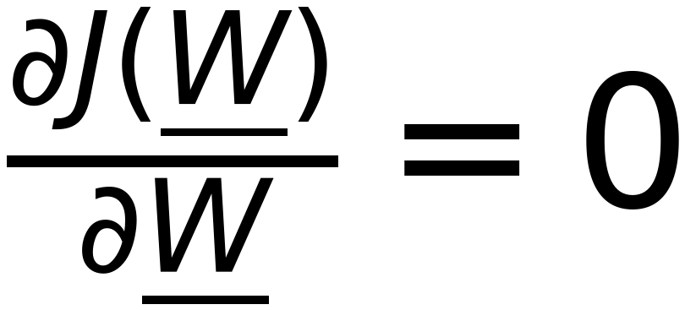




Minimization of Objective function to obtain BEST model parameters
15
Remember
Get Best W that minimizes the Objective Function J(W)

