Slide 1
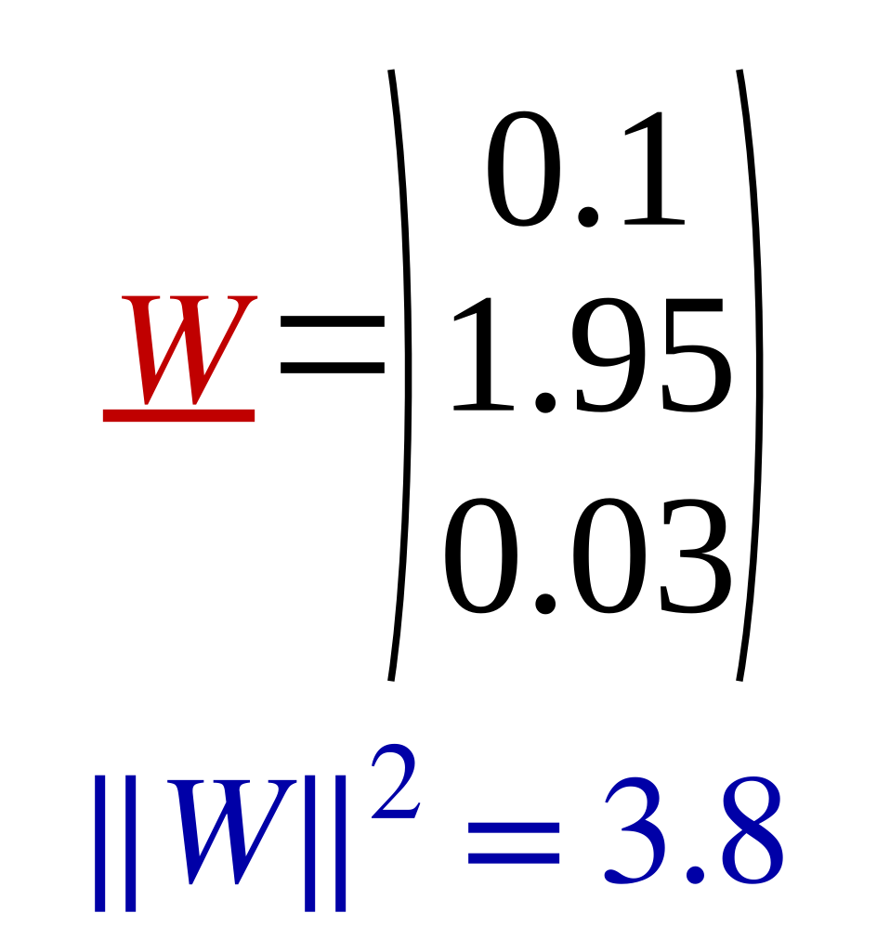
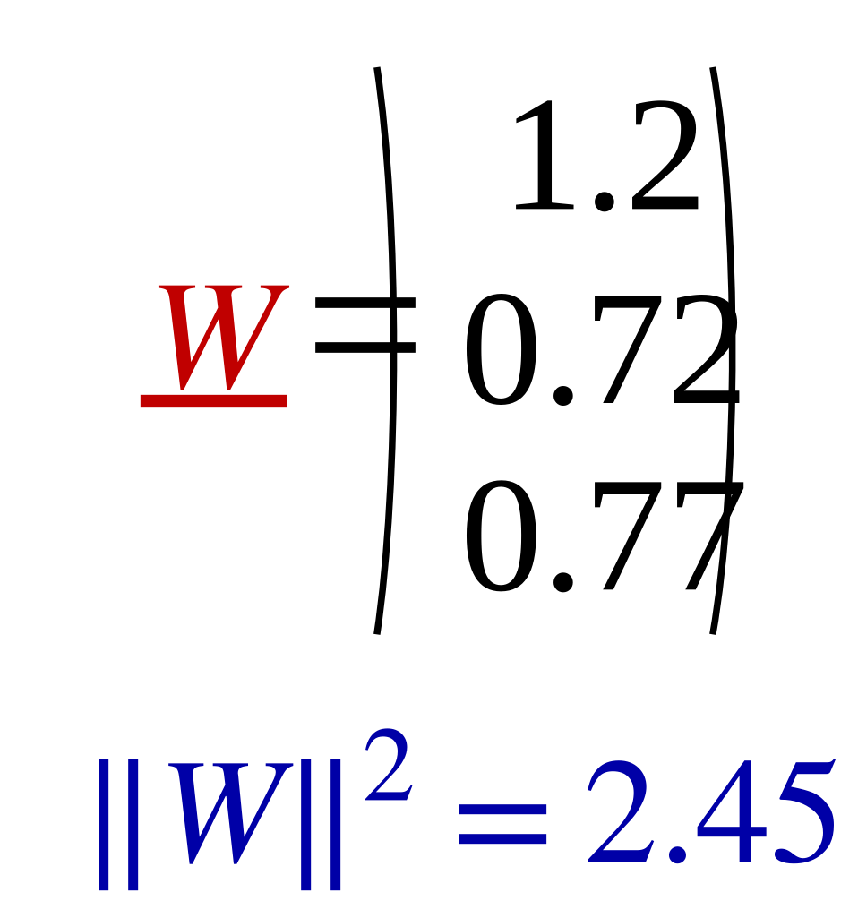
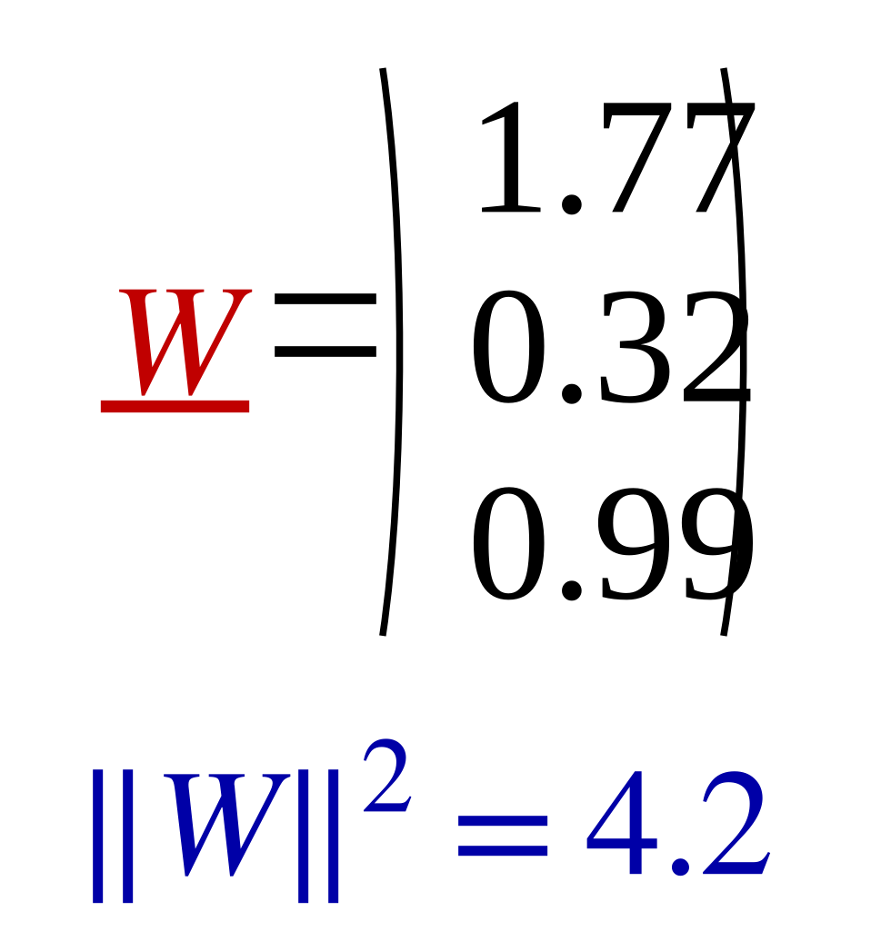
Adding Ridge Regularizer to the model λ=3
17
Train
Test
 | X1 | X2 | X3 | X4 | X5 | X6 | X7 | X8
X1 | 1 | 2 | 3 | 4 | 8 | 9 | 10 | 11
X2 | 1 | 3 | 5 | 6 | 16 | 7 | 5 | 3
y | 2 | 4 | 6 | 8 | 16 | 18 | 20 | 22
 | Test1 | Test2 | Test3
X1 | 30 | 40 | 50
X2 | 15 | 20 | 25
y | 59 | 78.7 | 98.4
 | X1 | X2 | X3 | X4 | X5 | X6 | X7 | X8
X1 | 1 | 2 | 3 | 4 | 8 | 9 | 10 | 30
X2 | 1 | 3 | 5 | 6 | 16 | 7 | 5 | 3
y | 2 | 4 | 6 | 8 | 16 | 18 | 20 | 22
 | Test1 | Test2 | Test3
X1 | 30 | 40 | 50
X2 | 15 | 20 | 25
y | 34.1 | 45.1 | 56.1
 | X1 | X2 | X3 | X4 | X5 | X6 | X7 | X8
X1 | 1 | 2 | 3 | 4 | 8 | 9 | 10 | 60
X2 | 1 | 3 | 5 | 6 | 16 | 7 | 5 | 3
y | 2 | 4 | 6 | 8 | 16 | 18 | 20 | 22
 | Test1 | Test2 | Test3
X1 | 30 | 40 | 50
X2 | 15 | 20 | 25
y | 26.2 | 34.4 | 42.5

