Slide 1

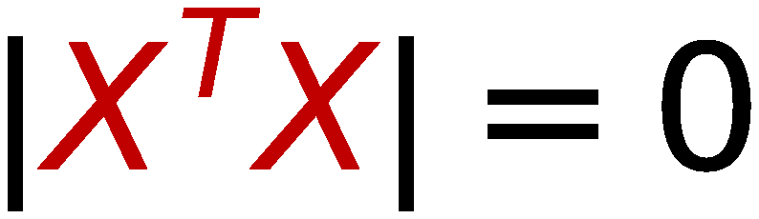
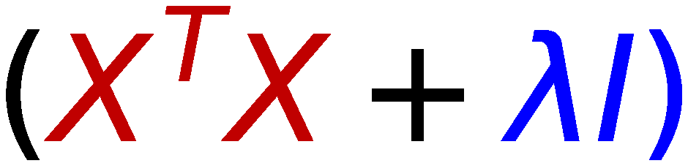

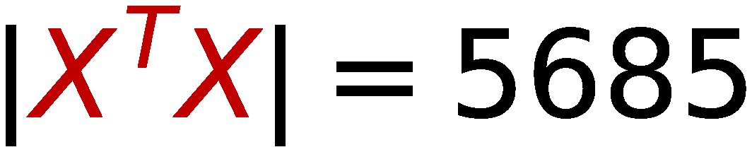
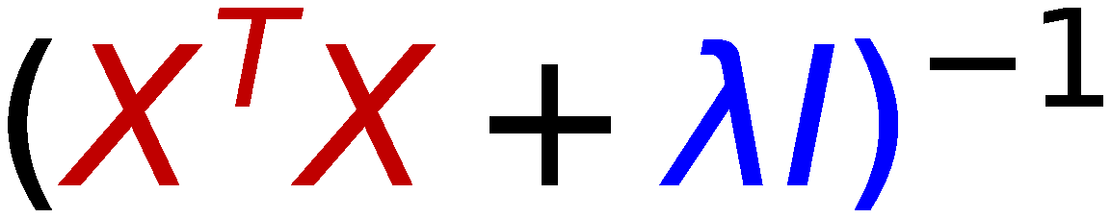
21
Inverse Problem of Singular Matrix
14 | 10 | 15
10 | 40 | 46
20 | 80 | 92
Singular Matrix
No Inverse
17 | 10 | 15
10 | 43 | 46
20 | 80 | 95
Non-Singular Matrix
Inverse Exists
0.07 | 0.04 | -0.03
-0.01 | 0.23 | -0.11
-0.01 | -0.2 | 0.11

