Slide 1
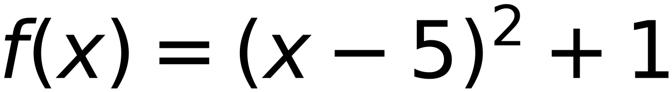

30
Convex Function, Learning Rate =0.2, Start at X=3
30
15
10
3
3
(2, 10)
(7, 7)
step | 0.2
initial X | 3
delta | 0.1
5
(5, 1)
f(x) Minimum value is 1.0
-5
0
5
10
15
Reach Minimum after 11 Steps
x | 3 | 3.2 | 3.4 | 3.6 | 3.8 | 4 | 4.2 | 4.4 | 4.6 | 4.8 | 5
f(x) | 5 | 4.24 | 3.56 | 2.96 | 2.44 | 2 | 1.64 | 1.36 | 1.16 | 1.04 | 1
x-delta | 2.9 | 3.1 | 3.3 | 3.5 | 3.7 | 3.9 | 4.1 | 4.3 | 4.5 | 4.7 | 4.9
f(x-delta) | 5.41 | 4.61 | 3.89 | 3.25 | 2.69 | 2.21 | 1.81 | 1.49 | 1.25 | 1.09 | 1.01
x+delta | 3.1 | 3.3 | 3.5 | 3.7 | 3.9 | 4.1 | 4.3 | 4.5 | 4.7 | 4.9 | 5.1
f(x+delta) | 4.61 | 3.89 | 3.25 | 2.69 | 2.21 | 1.81 | 1.49 | 1.25 | 1.09 | 1.01 | 1.01
slope | -8 | -7.2 | -6.4 | -5.6 | -4.8 | -4 | -3.2 | -2.4 | -1.6 | -0.8 | 0
next x | 3.2 | 3.4 | 3.6 | 3.8 | 4 | 4.2 | 4.4 | 4.6 | 4.8 | 5 | stop

