Slide 1

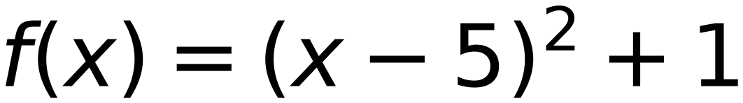
Convex Function, Learning Rate =0.4, Start at X=3
32
15
3
3
10
(2, 10)
(?, ?)
step
0.4
initial X
3
5
delta
0.1
X = 5
f(x) Minimum value is 1.0
(5, 1)
-5
0
5
10
15
Reach Minimum after 6 Steps
x
3
3.4
3.8
4.2
4.6
5
f(x)
5
3.56
2.44
1.64
1.16
1
x-delta
2.9
3.3
3.7
4.1
4.5
4.9
f(x-delta)
5.41
3.89
2.69
1.81
1.25
1.01
x+delta
3.1
3.5
3.9
4.3
4.7
5.1
f(x+delta)
4.61
3.25
2.21
1.49
1.09
1.01
slope
-8
-6.4
-4.8
-3.2
-1.6
0
next x
3.4
3.8
4.2
4.6
5
stop

