Slide 1
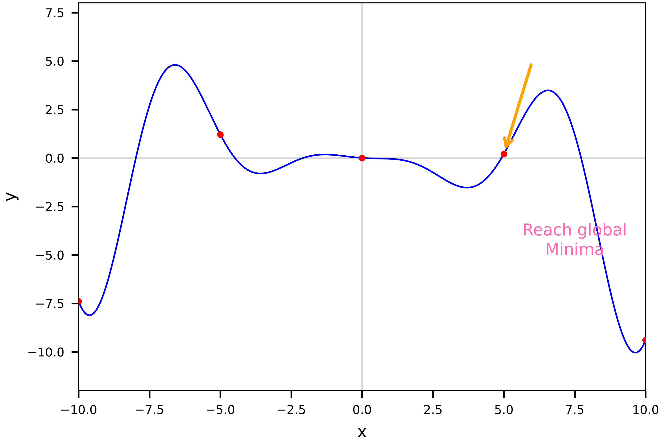
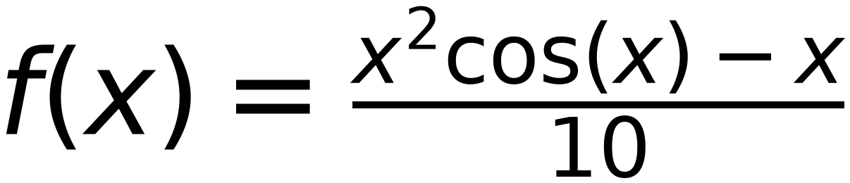
Non-Convex Function
34
May reach different minimum value based on:
initial point and learning rate
step | 0.2
initial X | 7
delta | 0.1
X is in between 9.6 and 9.8
f(x) is in between -10.03 and -9.92
x | 7 | 7.2 | 7.4 | 7.6 | 7.8 | 8 | 8.2 | 8.4 | 8.6 | 8.8 | 9 | 9.2 | 9.4 | 9.6 | 9.8 | 9.6 | 9.8 | 9.6
f(x) | 2.99 | 2.43 | 1.66 | 0.69 | -0.45 | -1.73 | -3.1 | -4.5 | -5.88 | -7.16 | -8.28 | -9.17 | -9.77 | -10.03 | -9.92 | -10.03 | -9.92 | -10.03
x-delta | 6.9 | 7.1 | 7.3 | 7.5 | 7.7 | 7.9 | 8.1 | 8.3 | 8.5 | 8.7 | 8.9 | 9.1 | 9.3 | 9.5 | 9.7 | 9.5 | 9.7 | 9.5
f(x-delta) | 3.19 | 2.74 | 2.07 | 1.2 | 0.14 | -1.08 | -2.41 | -3.8 | -5.2 | -6.54 | -7.75 | -8.76 | -9.51 | -9.95 | -10.02 | -9.95 | -10.02 | -9.95
x+delta | 7.1 | 7.3 | 7.5 | 7.7 | 7.9 | 8.1 | 8.3 | 8.5 | 8.7 | 8.9 | 9.1 | 9.3 | 9.5 | 9.7 | 9.9 | 9.7 | 9.9 | 9.7
f(x+delta) | 2.74 | 2.07 | 1.2 | 0.14 | -1.08 | -2.41 | -3.8 | -5.2 | -6.54 | -7.75 | -8.76 | -9.51 | -9.95 | -10.02 | -9.7 | -10.02 | -9.7 | -10.02
slope | -4.5 | -6.7 | -8.7 | -10.6 | -12.2 | -13.3 | -13.9 | -14 | -13.4 | -12.1 | -10.1 | -7.5 | -4.4 | -0.7 | 3.2 | -0.7 | 3.2 | -0.7
next x | 7.2 | 7.4 | 7.6 | 7.8 | 8 | 8.2 | 8.4 | 8.6 | 8.8 | 9 | 9.2 | 9.4 | 9.6 | 9.8 | 9.6 | 9.8 | 9.6 | 9.8

