Slide 1

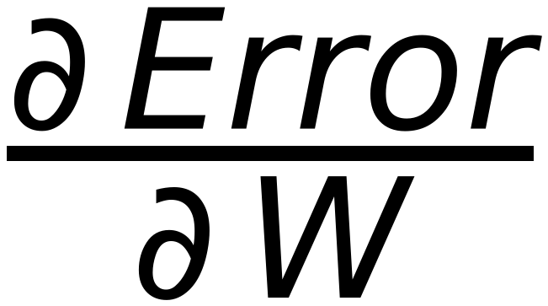
37
Problem Formulation
Define δ_{_i} as :
If X ∈ class I and misclassified as Class II then d(X) will be <0 ⇒ δ_{_i} = -1 ⇒ d(X)δ_{_i} > 0
If X ∈ class II and misclassified as Class I then d(X) will be >0 ⇒ δ_{_i} = +1 ⇒ d(X)δ_{_i} > 0
Redefine Error function as:
Error =
δ_{_i} W^{T} X_{_i}
⇒
(W^{T} X_{_i}) takes positive and negative values and δ_{_i} has the same sign
all misclassified vectors (i)
Summation is always positive
Minimize the Error using Gradient Descent with step η
W^{(updated)} = W^{old} - η
where
=
δ_{_i} X_{_i}
misclassified vectors
W^{(updated)} = W^{old} - η
δ_{_i} X_{_i}
misclassified vectors ONLY (i)

