Slide 1



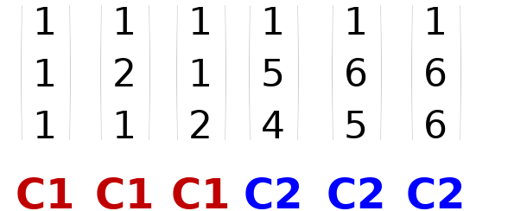
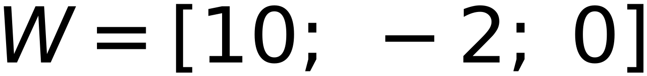
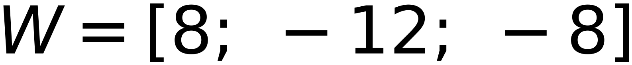
x1
x2
x3
x4
x5
x6
Step η = 2
Z1
Z1
Z1
43
(1)
(2)
(1)
(5)
(6)
(6)
Initial W =
4
Check classes of
(1)
(1)
(2)
(4)
(5)
(6)
-2
C1
C1
C1
C2
C2
C2
C1
positive,
C2
negative,
Zero
is unaccepted
Augmented Vectors (from Top)
x1
x2
x3
x4
x5
x6
Update Weight
Update Weight
Iteration 2
Update Weight
Keep same Weight
Keep same Weight
Keep same Weight

