Slide 1

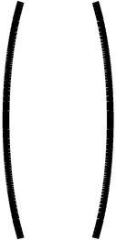
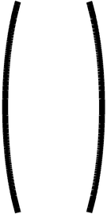
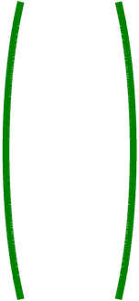
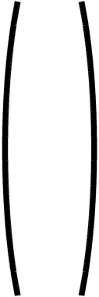
x₁
x₂
x₃
x₄
x₅
x₆
4
Step η = 2
Z₁
Z₁
Z₁
47
1
2
1
5
6
6
Initial W =
-2
Check classes of
0
7
3
1
1
2
4
5
6
-2
0
6
2
C₁
C₁
C₁
C₂
C₂
C₂
C₁ positive C₂negative Zero is unaccepted
Ugmented Vectors ( from Top )
(1 0 0)
14
x₁
x₂
x₃
x₄
x₅
x₆
d(Z₁) =
-4
= 14
⇒ Positive > 0
Class I
1
1
1
1
1
1
0
1
2
1
5
6
6
1
1
2
4
5
6
(1 7 6)
14
C₁
C₁
C₁
C₂
C₂
C₂
d(Z₂) =
-4
= -14
⇒ Negative < 0
Class II
0
Check Classes
(1 3 2)
14
d(Z₂) =
-4
= -2
⇒ Negative < 0
Class II
0

