Slide 1
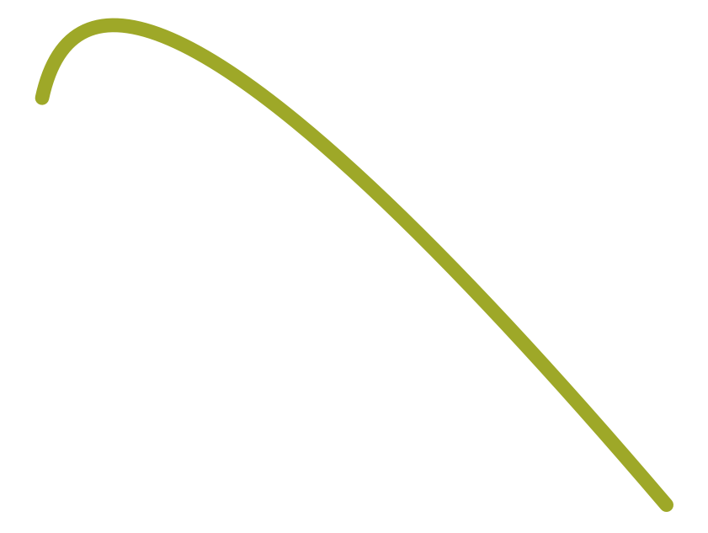

Traditional RNN Seq2Seq model
6
Decoder (RNN)
o₁
o₂
o₃
softmax
softmax
softmax
s₁
s₂
s₃
h₁
h₂
embedding x₁
embedding x₂
embedding x₃
Context Vector (of Whole Inputs)
x₁
x₂
x₃
Encoder (RNN)

